Slide 1
Tt
Pp
Ee
Nn

Slide 2
PET
NET
PEN
TEN
pet
pen
ten
net

Slide 3
Uu
Cc
Ss

Slide 4
UP up
CUP cup
NUT nut
SUN sun

Slide 5
Set | Pun
Ten | Pup
Sent | Punt
Pep | Cup
Net | Cut
Pen | Sup

Slide 6
Аа
Hh
Mm

Slide 7
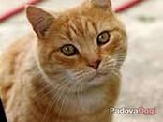

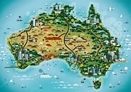

CAT cat
HAT hat
MAP map
ANT ant

Slide 8
Oo
Dd
Gg

Slide 9

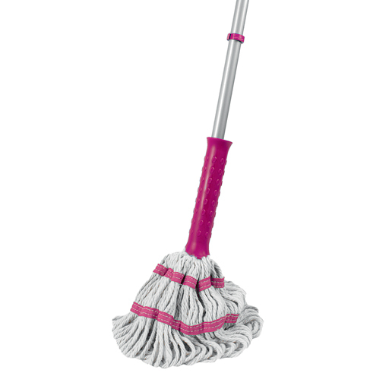
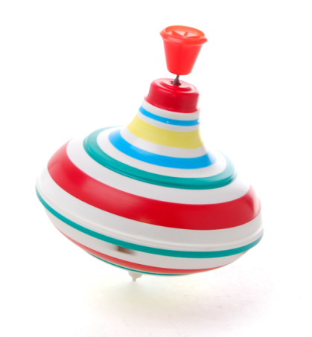

DOG dog
MOP mop
TOP top
POND pond

Slide 10
ton pod
hot got
not dot
cog get
hot dug
top sad

Slide 11
Ii
Bb
Kk
Xx

Slide 12
BIG big
BOX box
SIX six
KID kid

Slide 13
Rr

Slide 14

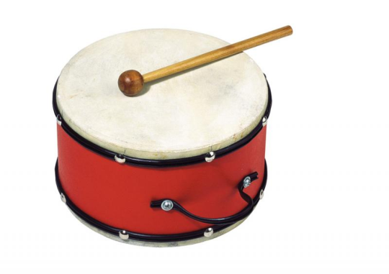

RED red
DRUM drum
DROP drop

Slide 15
Ff
Ll

Slide 16
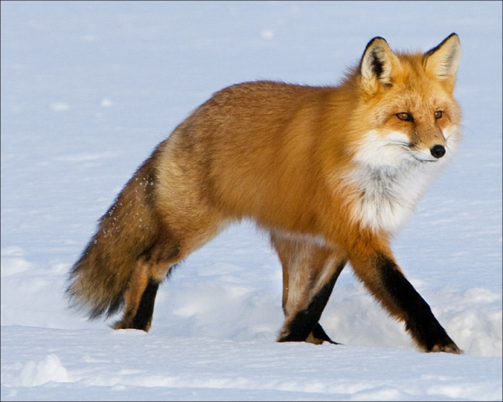


FOX fox
FROG frog
FLAG flag

Slide 17
Jj
Ww

Slide 18
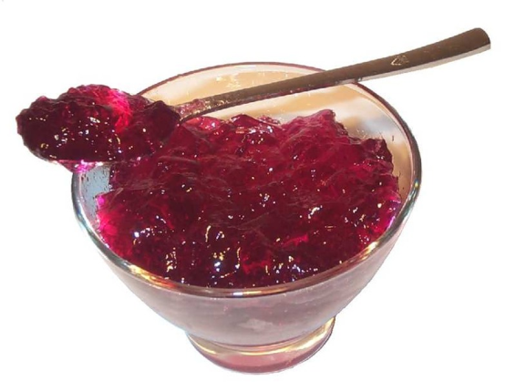



JAM jam
JUMP jump
WIND wind
SWIM swim

Slide 19
jag
brat
jet
web
job
jot
jug
jut
twin
twig

Slide 20
sh
ch

Slide 21
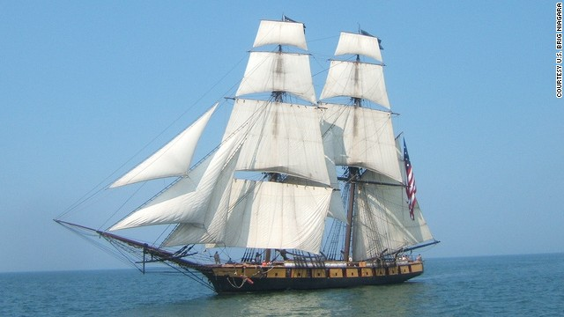
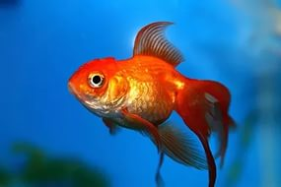
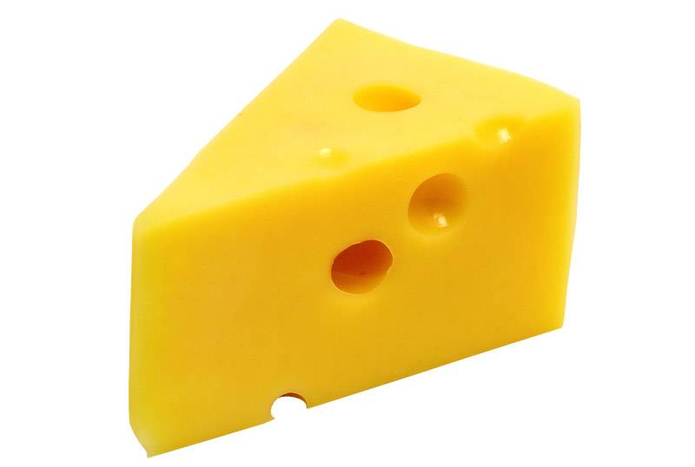
Ship
Fish
Cheese

Slide 22
Shall
Chat
Shop
Chop
Shed
Send
Chum
shun

