Slide 1
Human anatomy.
The noun. The plural forms of the noun.

Slide 2
Human anatomy
Vocabulary list
head- голова
trunk- туловище
limb- конечность
forehead- лоб
mouth- рот
tongue- язык
palate- нёбо
gums- десны
tooth- зуб
to breathe- дышать
stomach- желудок
liver- печень
spleen- селезенка
kidney- почка
gall-bladder- желчный пузырь

Slide 3
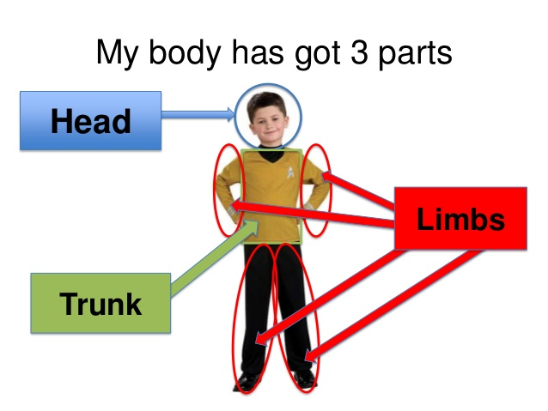
Human anatomy
The principle parts of the human body are the head, the trunk and the limbs (extremities).
We speak of the upper extremities (arms) and the lower extremities (legs).

Slide 4
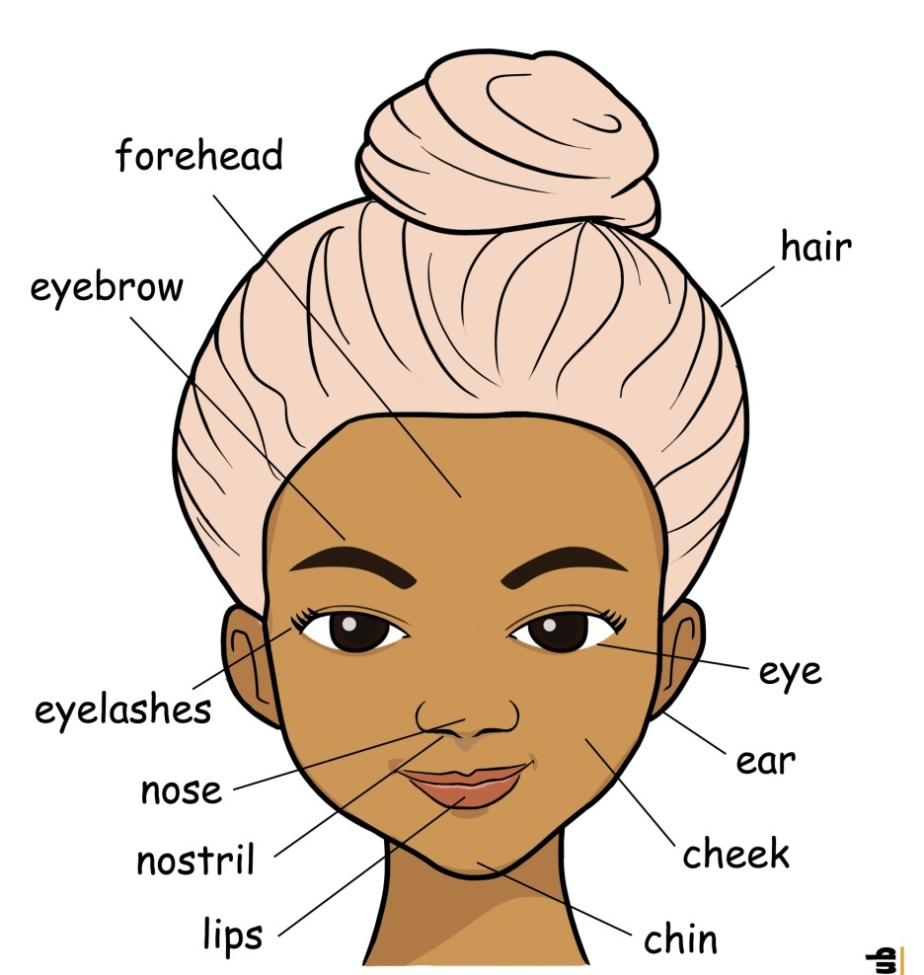
The head consists of two parts: the skull which contains the brain, and the face which consists of the forehead, the eyes, the nose, the mouth, the cheeks, the ears and the chin.

Slide 5
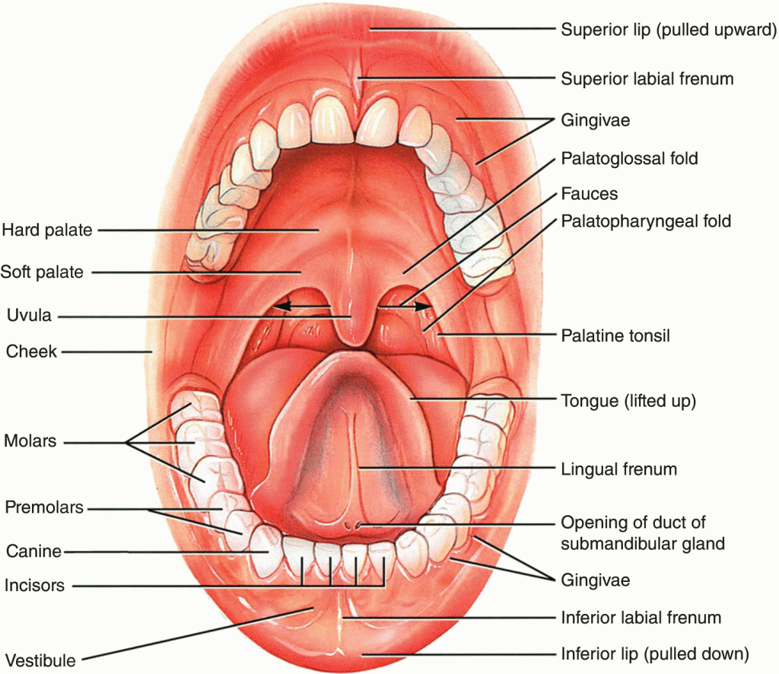
In the mouth there are gums with teeth, the tongue and the palate.

Slide 6
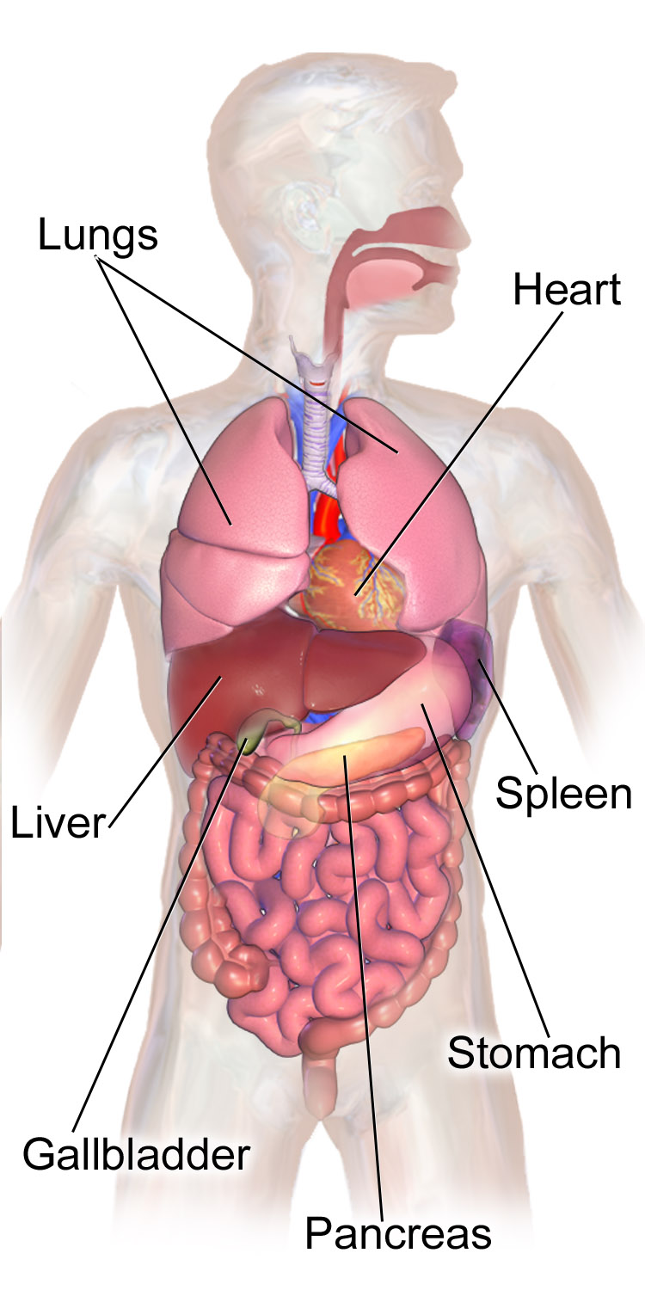
The head is connected with the trunk by the neck. The upper part of the trunk is the chest and the lower one is the abdomen. The principle organs in the chest are the lungs, the heart and the gullet (esophagus).

Slide 7
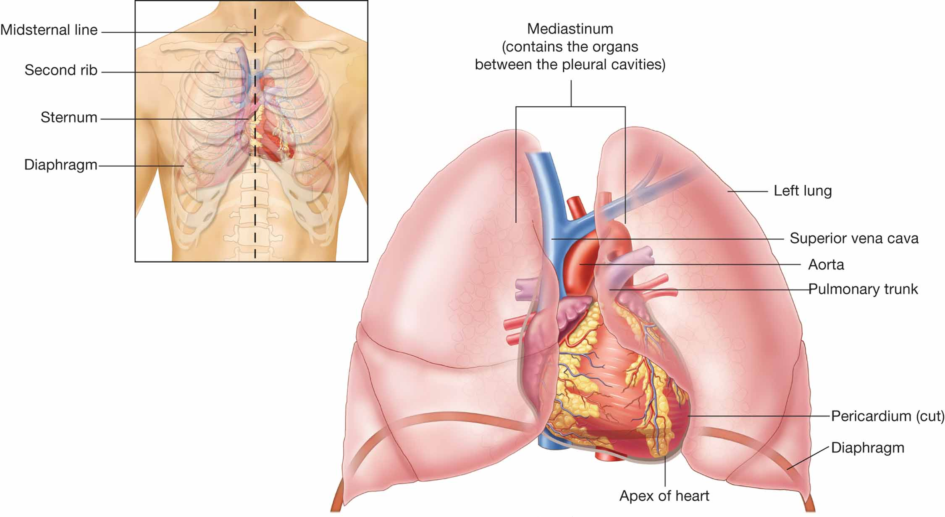
We breathe with the lungs. The heart contracts and makes 60-80 beats per minute.

Slide 8
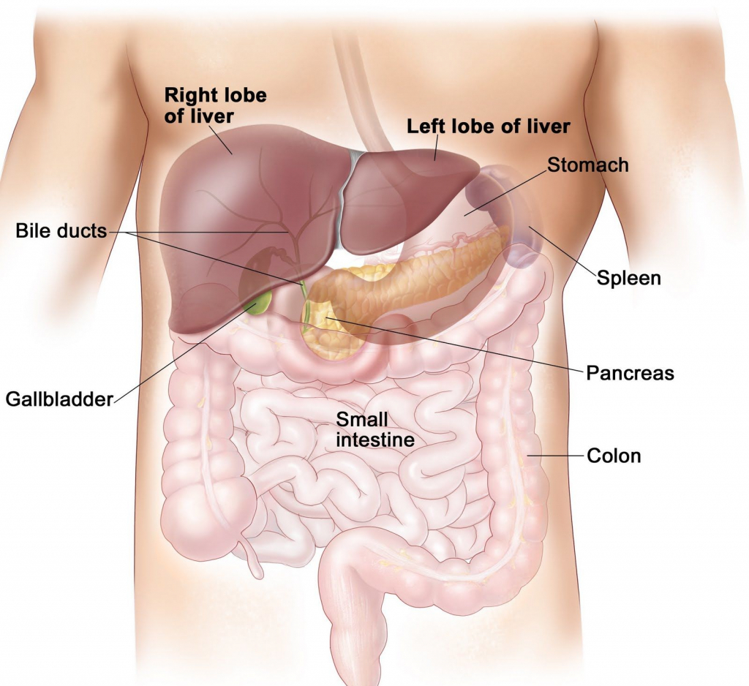
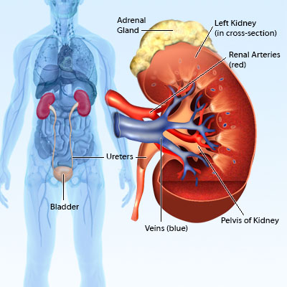
The principle organs in the abdominal cavity are the stomach, the liver, the spleen, the intestine, the kidneys, the gall-bladder and the bladder.

Slide 9
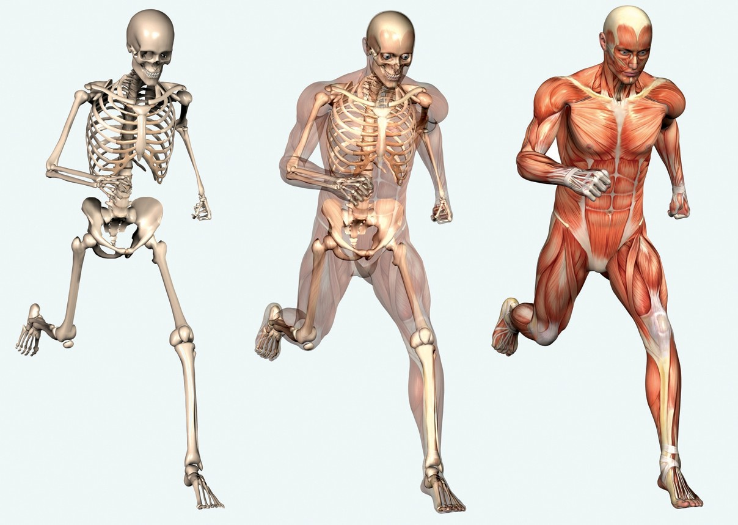
The framework of the bones is called the skeleton; it supports the soft parts and protects the organs form injury.
The bones are covered with muscles.

Slide 10
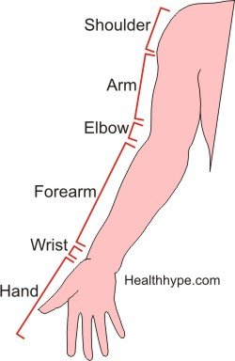
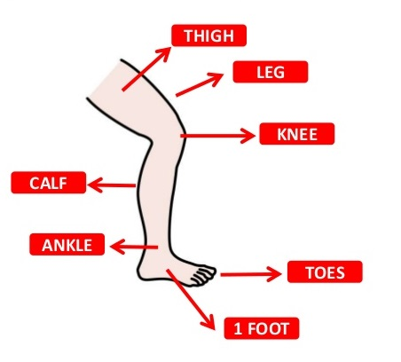
The upper extremity is connected with the chest by the shoulder. Each arm consists of the upper arm, forearm, elbow, wrist and hand. We have four fingers and a thumb on each hand.
The lower extremity (the leg) consists of the hip (the thigh), knee, calf, ankle and foot.
The body is covered by the skin.

Slide 11
Найдите в тексте эквиваленты следующих слов и словосочетаний.
- защищает органы от повреждений;
- верхняя часть туловища;
- верхние конечности – руки;
- нижние конечности – ноги;
- легкие, сердце, пищевод – основные органы в
грудной клетки;
- печень, селезенка, желудок, почки, желчный
пузырь, кишечник, мочевой пузырь – основные
органы в абдоминальной полости;
- голова состоит из двух частей - черепа, лица;
- головной мозг;
- лицо состоит изо лба, глаз, щек, ушей, носа, рта,
подбородка;
- десны, зубы, язык, нёбо находятся во рту;
- сердце совершает 60-80 ударов в минуту;
- кости покрыты мышцами.

Slide 12
Закончите предложения, заменив русские слова в скобках их английскими
эквивалентами.
1. A man has four (конечностей) ………………………
2. (Глаза) …………….. are under the (лоб) ………………
3. (Язык) …………………… is the organ for speech.
4. The heart is in the (грудная клетка) ……………………..
5. We breathe with the (легкие) ……………………..
6. The skull contains (головной мозг) ………………………
7. (Шея) connects the head with the (туловище) ………………..
8. The spleen is in the (брюшная полость) ………………………
9. (Плечо) ……………………. connects the upper extremity with the chest.
10. The leg consists of the hip, thigh, knee,
( голень) ……………………… ankle and the foot.

Slide 13
Найдите и переведите существительные,
соответствующие данным глаголам.
to smell speech
to hear touch
to taste taste
to touch hearing
to think thinking
to see sight
to speak smell

Slide 14
Вставьте соответствующие слова в пропуски.
1. The brain is the organ of …………..
2. The eye is the organ of ……………..
3. The nose is the organ of ……………
4. The tongue is the organ of …………
5. The ear is the organ of ……………..

Slide 15
The Noun. The plural form of the nouns-
Имя существительное.
Множественное число имен существительных
Именем существительным называется часть речи, которая обозначает предмет и отвечает на вопросы who is this?- кто это? и what is this?- что это?
Имена существительные имеют два числа: единственное и множественное.

Slide 16
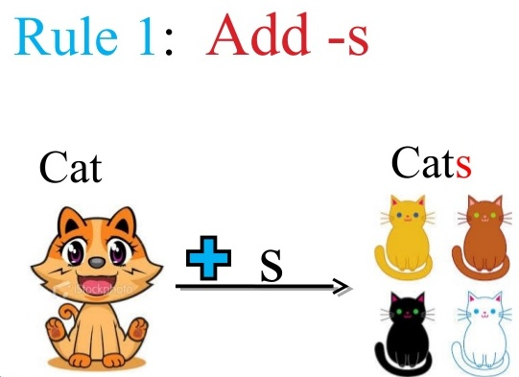
Имена существительные образуют множественное число путем прибавления к форме единственного числа окончания – s

Slide 17
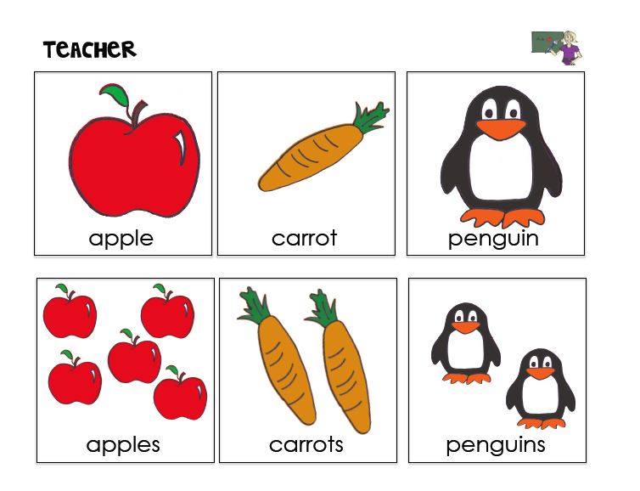

Slide 18
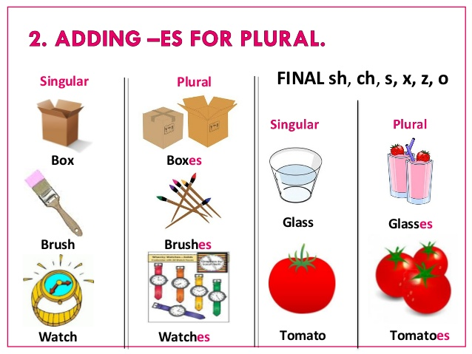

Slide 19
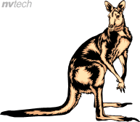
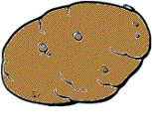
Some nouns that end in o change to es when made plural. Some change to s:
kangaroo
  kangaroos
potato
  potatoes

Slide 20


Add ies to make nouns plural that end with a consonant and a y:
lady
  ladies
fry
  fries

Slide 21
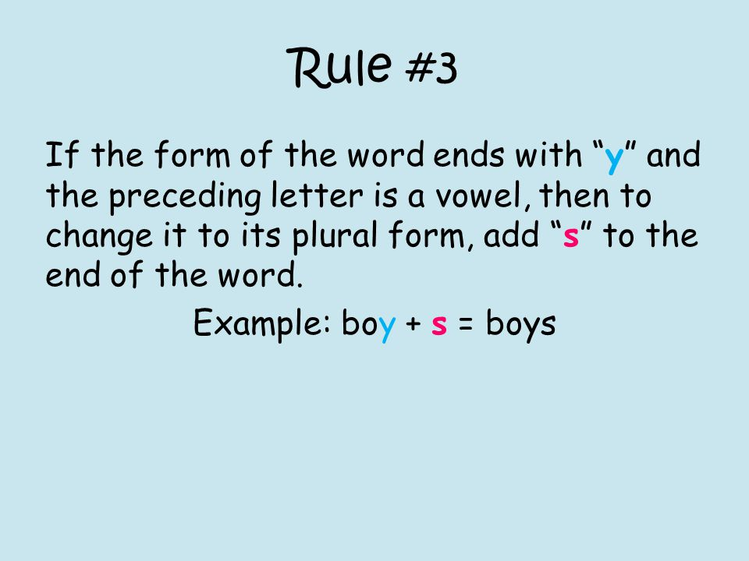

Slide 22
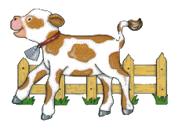
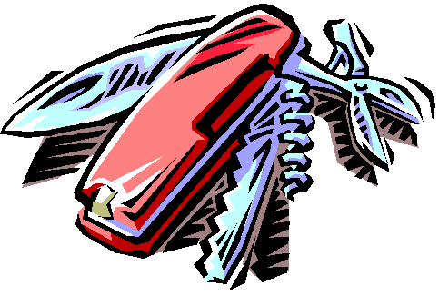
Some nouns that end in f or fe change to ves when made plural:
calf
  calves
knife
  knives

Slide 23
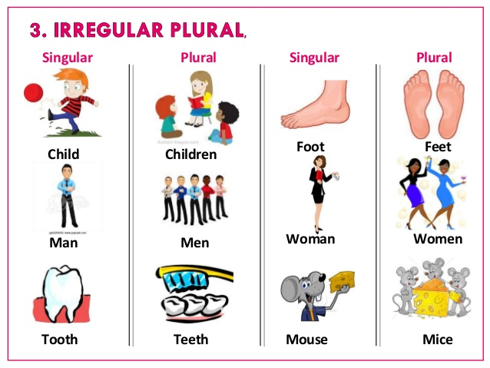

Slide 24
Singular form | Plural form

Slide 25
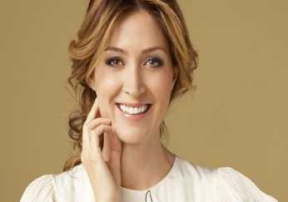
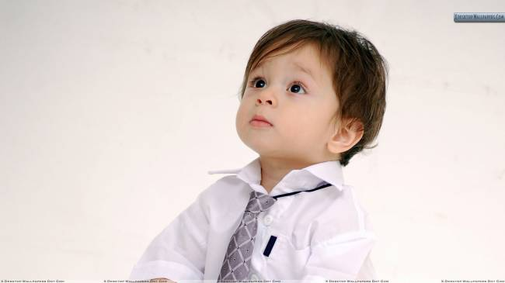
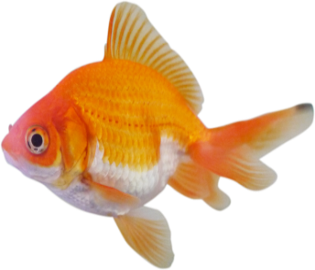
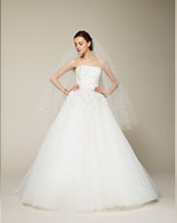
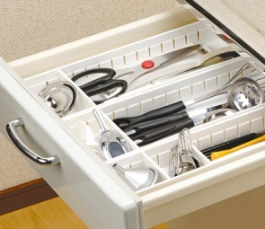
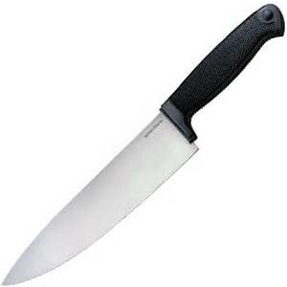
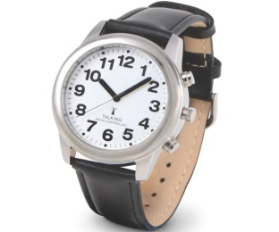
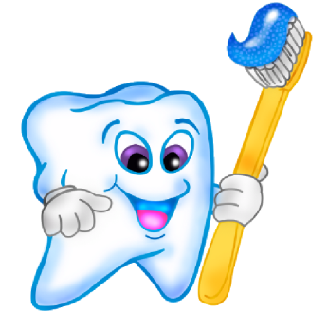
Make the nouns in brackets plural:
1. Five ( ) opened a computer services company.
2. Even ( ) enjoy learning on the Internet.
3. The boys went fishing and caught 10 ( ).
4. The ( ) keep their ( ) on the ( ).
5. At daylight savings time, we have to change our ( ).
6. My ( ) are sensitive to the cold.

Slide 26
Rewrite these sentences in plural making the necessary
changes.
E.g. He is a student. – They are students.
1. She is a business woman.
____________________________________
2. A pediatrician is a doctor for a child.
____________________________________
3. Our university is rather big.
____________________________________
4. A student was at the campus.
____________________________________
5. He is a good person.
____________________________________
6. I am a future surgeon.
____________________________________

Slide 27
Choose the best word to fit into each of the following sentences:
The men sharpened their _____________ before throwing them at the targets.
A – knife B – knifes C – knives
Please eat the rest of your _____________.
A – pease B – peas C – peies
I’d like you to stop leaving your _____________
on the floor.
A – socks B – sockses C – sox
This recipe calls for a lot of _____________.
A – tomatos B – tomatoes C – tomato

Slide 28
Make the nouns in bold singular.
Change sentences if necessary.
1. These factories produce furniture.
2. The wives of the sailors came to the shore.
3. I have hurt my feet and hands.
4. In the farmyard we could see oxen, sheep, cows and geese.
5. Do your teeth still ache?
6. These are my friends’ studies.
7. He keeps his toys in the boxes.
8. These ladies are those gentlemen’s wives.

Slide 29
Answer the questions:
1. What is studied at anatomy classes?
2. What are the principal parts of the human body?
3. What is the organ of thinking called?
4. What is there in the mouth?
5. What is the head connected with the trunk by?
6. How many beats per minute does the heart make?
7. Which organs are located in the abdominal cavity?
8. What is the skeleton?
9. What is the function of the skeleton?
10. What does the arm consist of?
11.Whatdoesthe lower extremity consist of?

