Slide 1
Food & Drinks
Презентацию выполнила Файзутдинова З.Б.,
учитель английского языка

Slide 2
Phonetic drill:
[tS] chocolate, sandwich, chicken, chips, cheese
[d3] jug, jar, juice, jelly, jam, vegetables
[S] shape, fish, dish, sugar, sure, bush

Slide 3
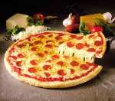

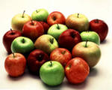
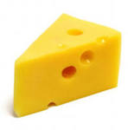
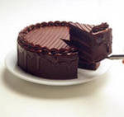
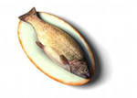
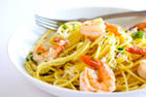

Work in pairs. Ask and answer the questions:
A: Do you like ….?
B: Yes, it’s delicious. / No, it’s horrible.

Slide 4
Choose countable and uncountable nouns
Nouns
countable
uncountable
Cheese
Bread
Tomato
Apple
Juice
Chocolate
Banana
Biscuit

Slide 5
A lot of(+)
много
much (-,?)
many (-,?)
много
много
Some (+)
Некоторое количество
countable
any (-,?)
a little
a few
uncountable
немного
немного, несколько
little
few
мало
мало
no
нисколько

Slide 6
Fill in the gaps with some, any, how much and how many.
some
1 There are .............. bananas in the basket.
2 There isn't ............... milk in the fridge.
3 ...................... biscuits are in the packet?
4 .................... coffee is in the cupboard?
5 ................... girls are there in your class?
any
How many
How much
How many

Slide 7
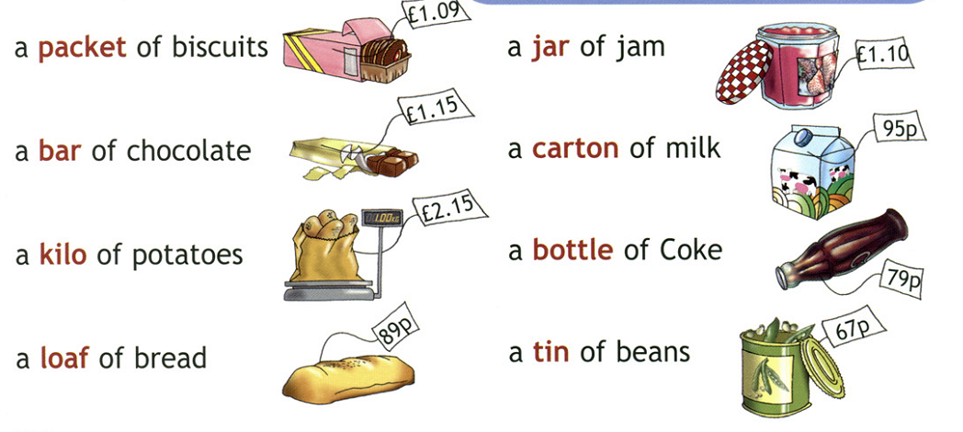

Slide 8
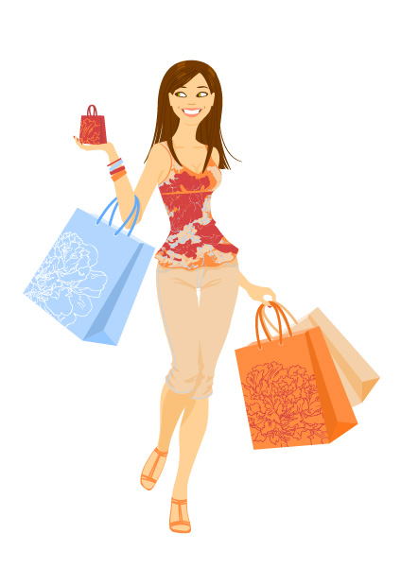
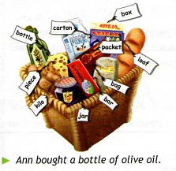
Look at Ann's shopping basket. What did she buy?

Slide 9
Now it’s your turn!
Tell us about your favourite food.
My favourite food is…
I like…
Really I don’t like..
I prefer…
I don’t often eat…

Slide 10



Evaluation Card:
I know the meaning of the words. (recyclable material)
I can answer the questions.
I can use much/many, some/any
I can divide nouns on countables/uncountables
I can talk about my favourite food

Slide 11
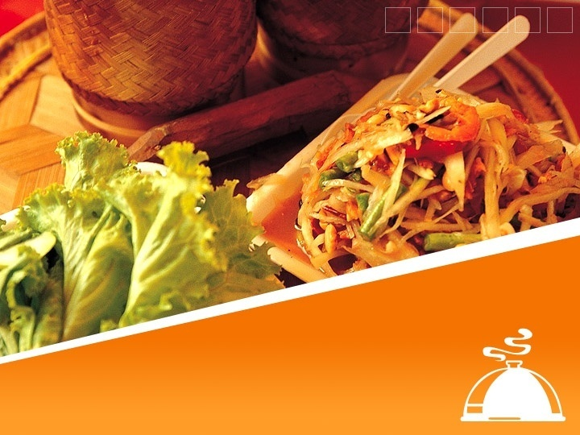
Your home task will be:
Ex.7, p.87. You are to read about British traditional food and be ready to tell the class about it.
If you want you can revise the material using a website:
http://learningapps.org

