Slide 1
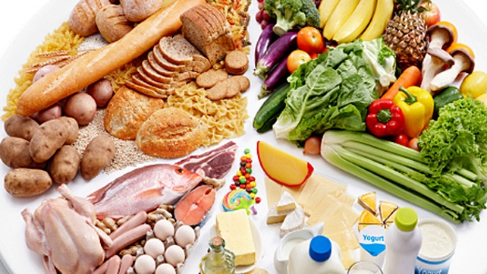
F o o d

Slide 2
[e]
Egg – [eɡ]
bread – [bred]
vegetable – [vedʒtəbl]

Slide 3
[i:]
Cheese – [tʃiːz]
sweet – [swiːt]
meat – [miːt]
tea – [tiː]

Slide 4
[l]
Lemon – [ˈlemən]
milk – [mɪlk]
apple – [ˈæpl]

Slide 5
_an_na
C_isps
Ju_ce
M_lk
Ch_col_te

Slide 6
Seller: Hello, what would you like?
Mike: Hello! Have you got any bananas?
Seller: Yes, here you are, please!
Mike: Thank you! Good-Bye!
Seller: Bye!

Slide 7
Seller: Hello, what would you like?
Mike: Hello! Have you got any crisps ?
Seller: Yes, here you are, please!
Mike: Thank you! Good-Bye!
Seller: Bye!

Slide 8
Seller: Hello, what would you like?
Mike: Hello! Have you got any juice?
Seller: Yes, here you are, please!
Mike: Thank you! Good-Bye!
Seller: Bye!

Slide 9
Seller: Hello, what would you like?
Mike: Hello! Have you got any chocolate?
Seller: Yes, here you are, please!
Mike: Thank you! Good-Bye!
Seller: Bye!

Slide 10
Seller: Hello, what would you like?
Mike: Hello! Have you got any milk?
Seller: Yes, here you are, please!
Mike: Thank you! Good-Bye!
Seller: Bye!

Slide 11
salad, pizza, fruits, juice, coffee, milk, sweets, cheese, hamburgers, ice cream, fish, crisps

Slide 12

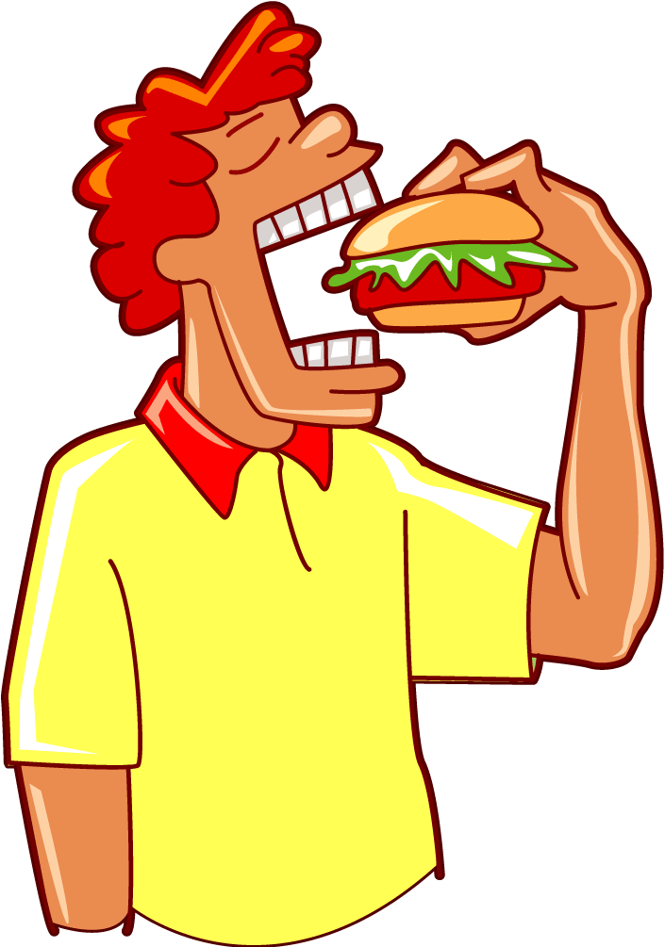

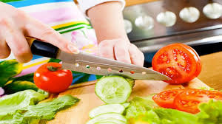
to drink to eat
to cook to cut

Slide 13



