Slide 1
Презентация для 5 класса

Slide 2
Good afternoon!

Slide 3
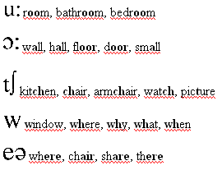
Read the words

Slide 4
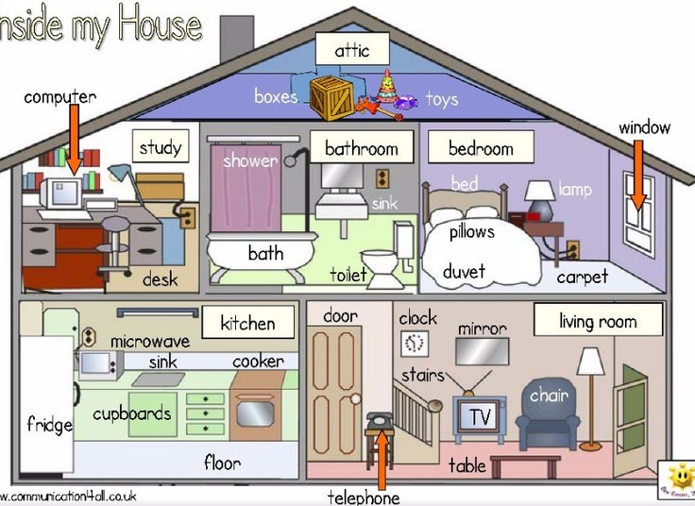
Remember the word of the topic “My bedroom”

Slide 5
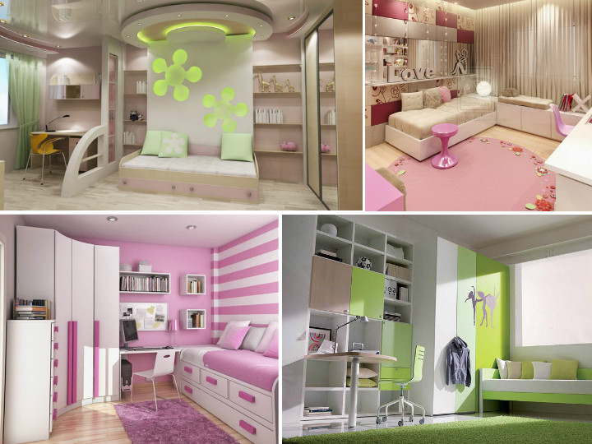
Choose the bedroom and explain your choice

Slide 6
MY FLAT
Read the text
My family and I live in Moscow, in Leninsky Avenue. We live on the seventh floor of a brick block of flats. Our flat is not very big. There are three rooms in it: a kitchen, a bathroom and a toilet.
Our living-room is small, but cozy. It is light, because there is a big window in it. We usually sit there in the evening and watch TV. There is a big bookcase on the left of the door, a flat TV-set on the right and two chairs in front of it. There is also a sofa by the window. In the middle of the room there is a round table. We sometimes drink tea and have dinner in the living-room. I like this room and our guests like it, too.
I have a brother, so we have one room. It is bigger than the others, but I sometimes think that it is too small for the two of us. There is a wall unit, two tables, a big window and two beds in it. We have a TV-set with a DVD-player in our room too. I like our room, but sometimes my brother makes a mess there and I have to clean it.
My parents' bedroom is cozy, too. There is a big bed in the middle, a large wardrobe for clothes, a computer and a stereo. My brother usually plays computer games there.
The kitchen is very nice. The furniture is light brown and the table is big. There is a microwave oven, a fridge and an oven there. We usually have breakfast and supper in the kitchen.
Our bathroom is small, so we have to keep our washing-machine in the kitchen. There is a big hall in our flat. When guests come we dance in the hall.
I like my flat a lot and I think that it is very comfortable.

Slide 7
New words
avenue проспект
block of flats многоквартирный дом
brick кирпичный
cozy уютный
fridge холодильник
make a mess устраивать беспорядок
microwave oven микроволновая печь
oven плита
stereo стереосистема, муз. центр
wall unit стенка
washing-machine стиральная машина

Slide 8
Answer the questions
1. Do you live in a flat?
2. Is your flat big or small?
3. How many rooms are there in your flat?
4. What is there in the living-room?
5. What is there in the kitchen?
6. Do you have your own room? Is it big?
7. What is there in your parents' bedroom?
8. Do you like your flat? Why (not)?

Slide 9
See you later!

