Slide 1


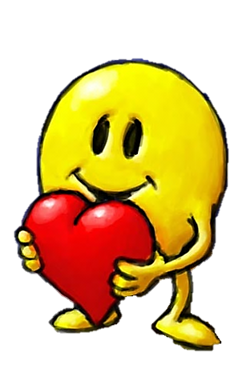
Will you be my Valentine?

Slide 2
Valentine’s Day
Customs
and
Symbols

Slide 3

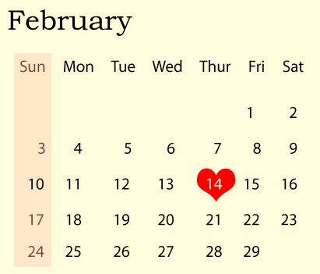
February 14th
People around the world celebrate Valentine’s Day on February 14th.

Slide 4
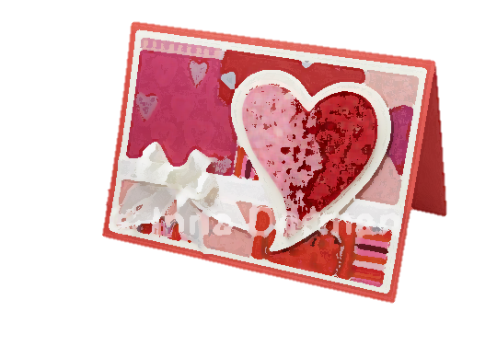
Valentine’s Day Card
Children write Valentine cards to their friends.
A Valentine card usually has a poem and this question:
Will you be my Valentine?

Slide 5


Valentine’s poems
I Love You So Well
I love you,
I love you,
I love you so well.
If I had a peanut
I'd give you the shell.
Roses Are Red
Roses are red,
Violets are blue,
Sugar is sweet,
And so are you!

Slide 6
Valentine’s poems
To My Valentine
If apples were pears
And peaches were plums,
And the rose had a different name,
If tigers were bears
and fingers were thumbs,
I'd love you just the same.
I love coffee,
I love tea,
I love you,
Do you love me?

Slide 7
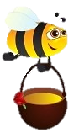
Valentine’s poems
Bee My Valentine
Won't you bee my valentine
And fly away with me?
We'll bumble along together
'Cause you're my Honey bee!
Roses are red,
Violets are blue.
I made this card
Just for you!
I think you’re nice,
I think you’re cool.
If you won’t be my Valentine,
I’ll think you’re a fool!

Slide 8

Chocolate candy
Many people love chocolate candy. They are popular on Valentine’s Day.

Slide 9

Gifts and cards
There is someone who will be grateful and happy to receive a Valentine’s Day gift and a card from you.

Slide 10
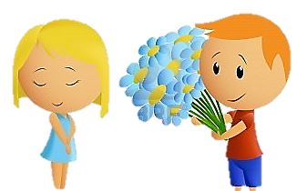
Flowers
Thank you!
This boy is going to give a bouquet of flowers to his friend.

Slide 11
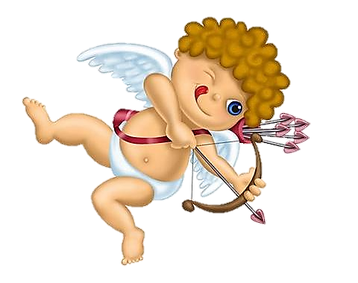

Cupid’s arrows
This is Cupid.
If he strikes you with one of his arrows, you will fall in love with the first person
you see.

Slide 12
Valentine’s Day
Vocabulary

Slide 13
Valentine’s Day vocabulary
1 / 9
Cupid

Slide 14

Valentine’s Day vocabulary
2 / 9
heart

Slide 15

Valentine’s Day vocabulary
3 / 9
arrow

Slide 16
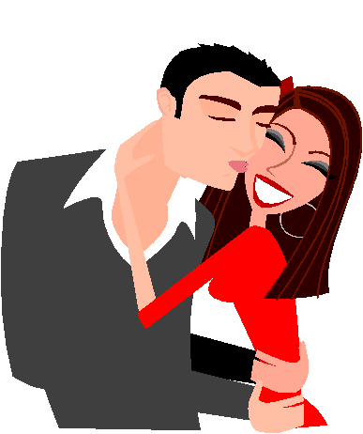
Valentine’s Day vocabulary
4 / 9
couple

Slide 17

Valentine’s Day vocabulary
5 / 9
card

Slide 18
Valentine’s Day vocabulary
6 / 9
chocolate candy

Slide 19

Valentine’s Day vocabulary
7 / 9
bouquet of flowers

Slide 20
Valentine’s Day vocabulary
8 / 9
rose

Slide 21
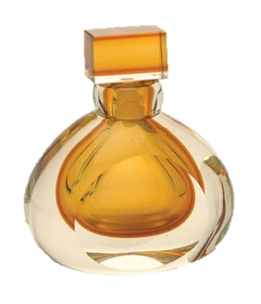
Valentine’s Day vocabulary
9 / 9
perfume

Slide 22
Valentine’s Day
GAME
Cupid’s choice

Slide 23

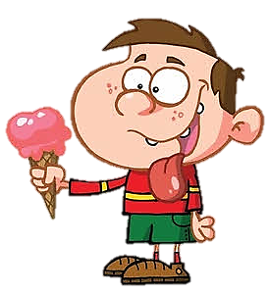
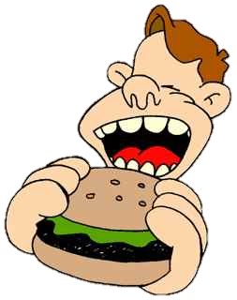
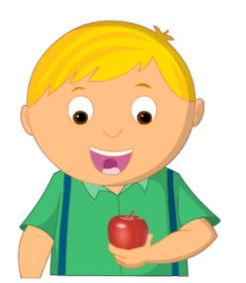
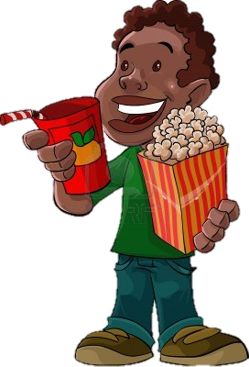

Click the correct heart
BOB
TOM
PAUL
PHIL
He is eating pop corn

Slide 24
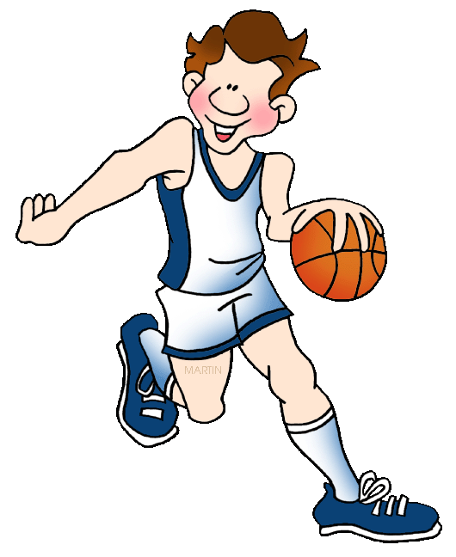
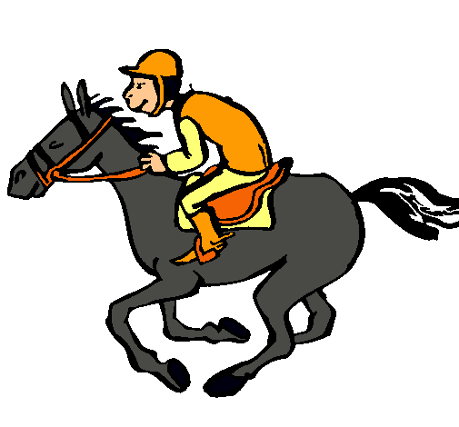
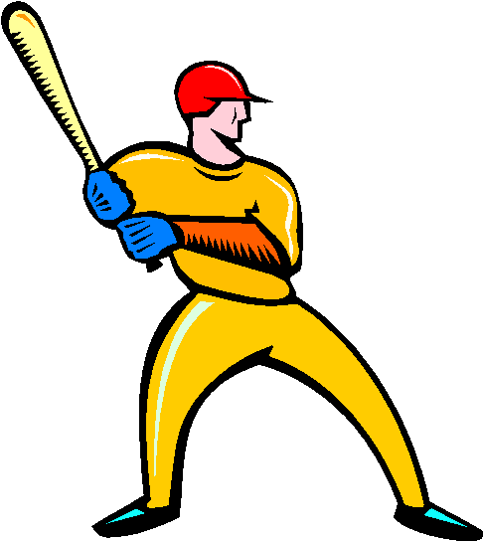

Click the correct heart
ANDY
JOHN
DAVE
JIM
He is playing baseball

Slide 25
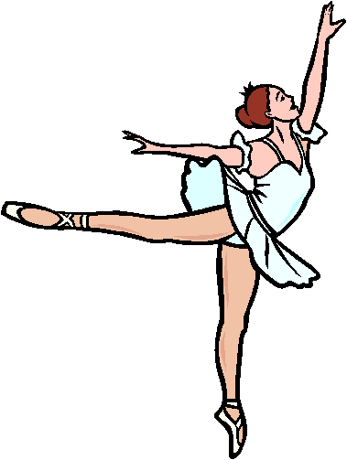
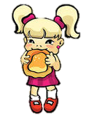


Click the correct heart
LIZ
ANN
MARY
LUCY
She is dancing

Slide 26

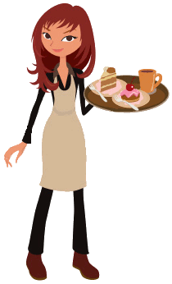

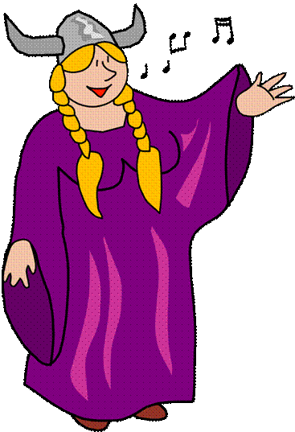
Click the correct heart
MEG
CINDY
LYNN
NORA
She is singing

Slide 27
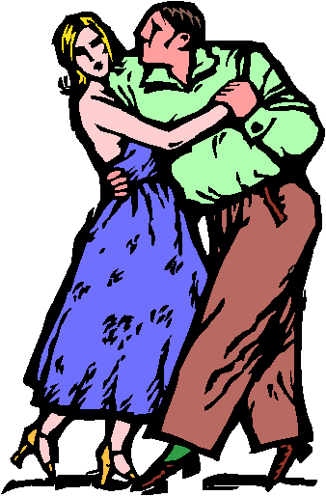
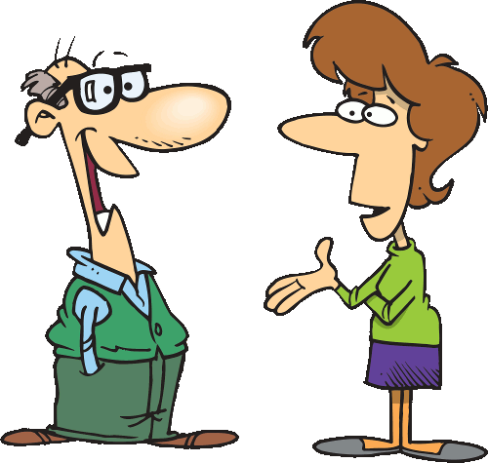

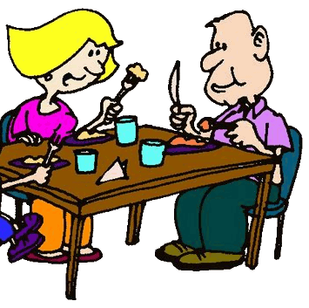
Click the correct heart
Louise & Ben
Peter & Gina
Amy & James
Lisa & Mark
They are waiting

Slide 28
Happy
Valentine's Day

