Slide 1
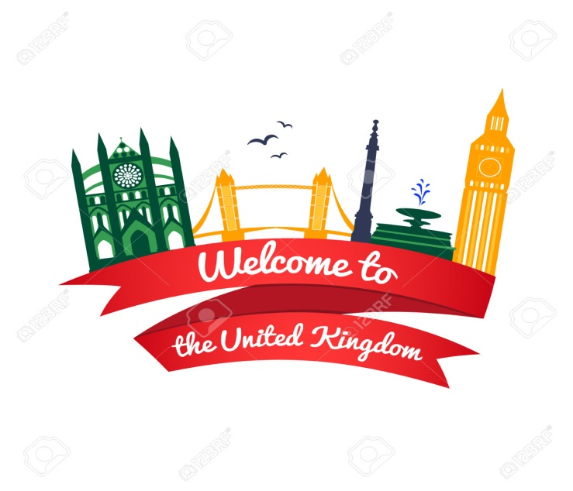
«The United Kingdom of Great Britain and Northern Ireland*»
The theme of lesson:

Slide 2
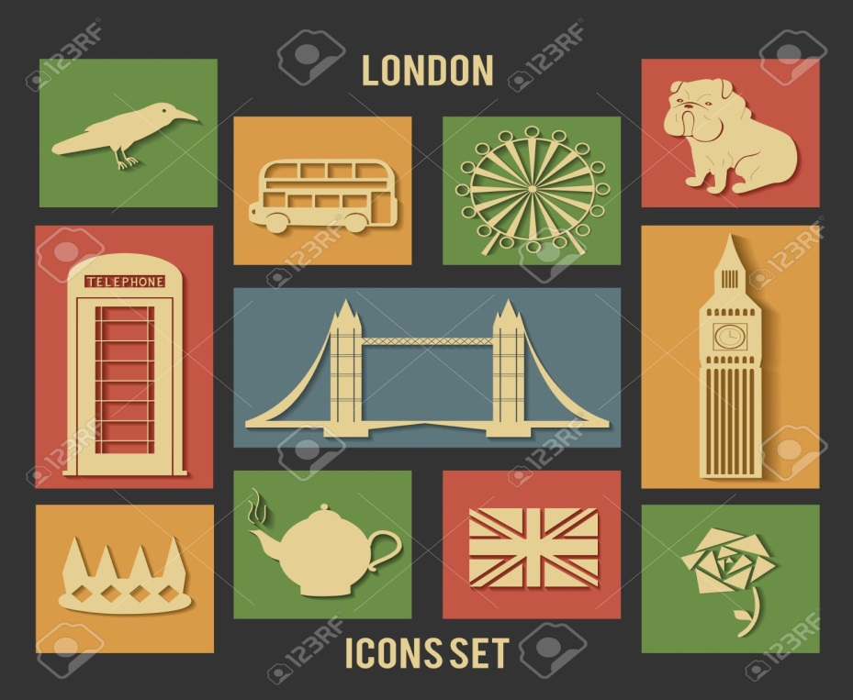
Lesson Plan
Geographical position
Political system
Сities
Sightseeing
Knowledge check

Slide 3
Geographical position

Slide 4
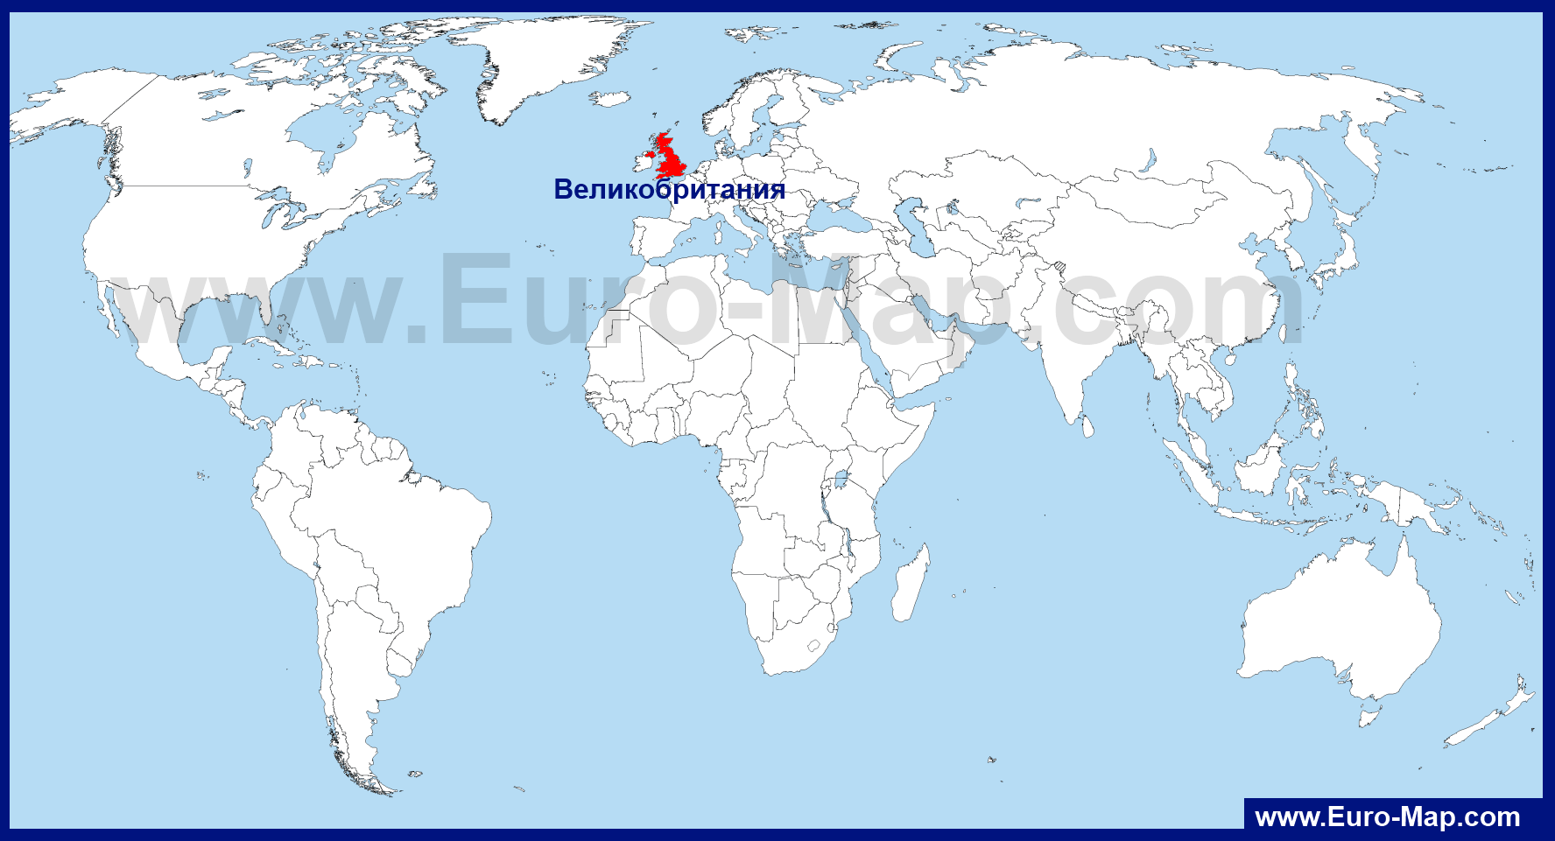

Slide 5
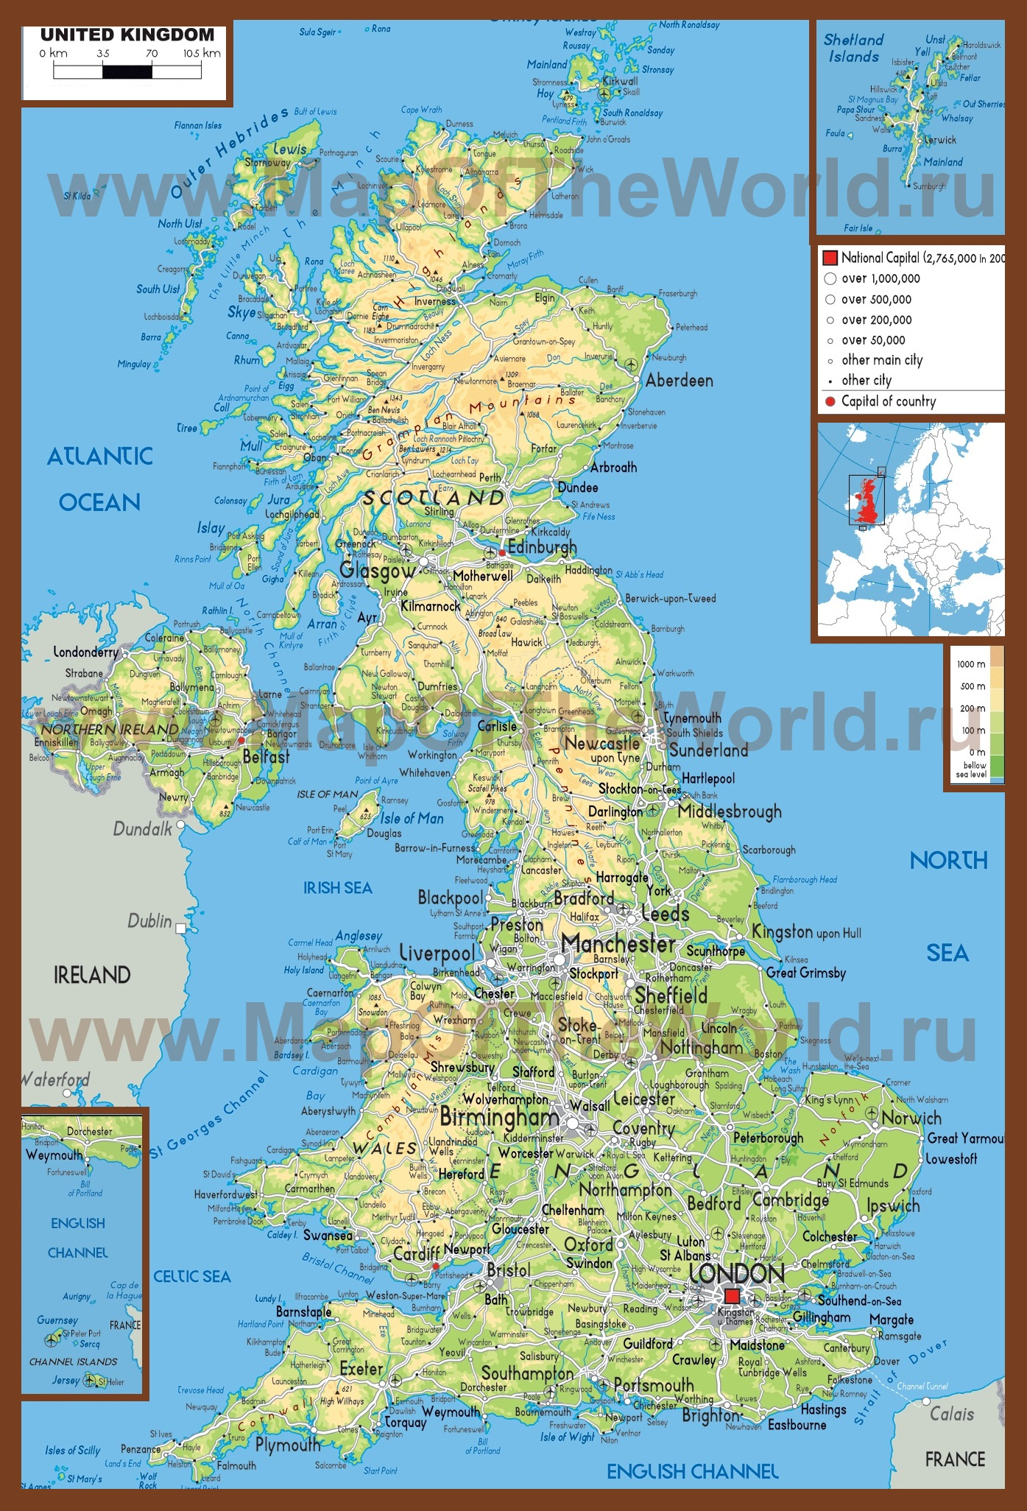

Slide 6
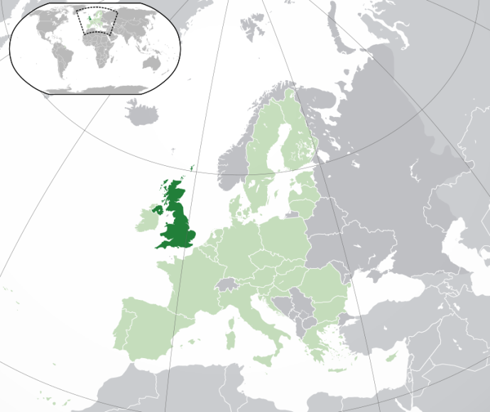
Facts
United Kingdom of Great Britain and Northern Ireland is an island of Western European the state.
Official name: United Kingdom of great Britain and Northern Ireland
Capital: London
Population: 65 102 385 about people (2016)
Area: 9 984 670 square kilometers
Washed by the waters of the Atlantic ocean, North and Irish seas.

Slide 7
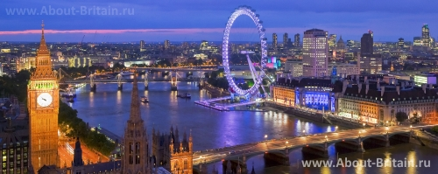
Facts
The official language is English, while actively exist the Scottish language and two Celtic language: Welsh and Gaelic language.
Capital-London, largest cities- London, Edinburgh, Manchester.

Slide 8
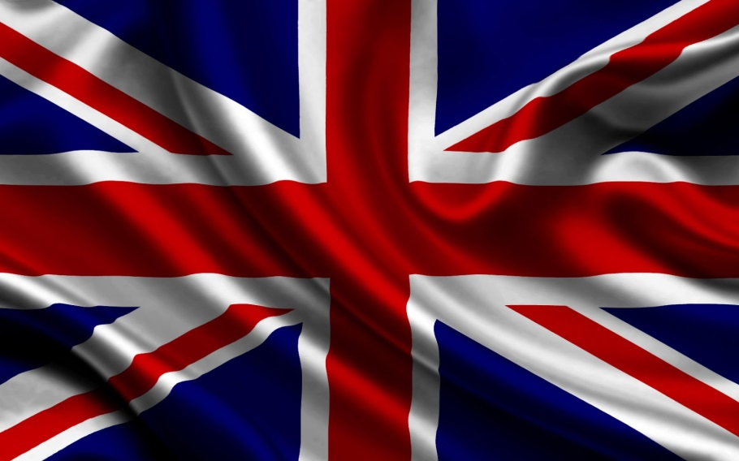
Political system

Slide 9
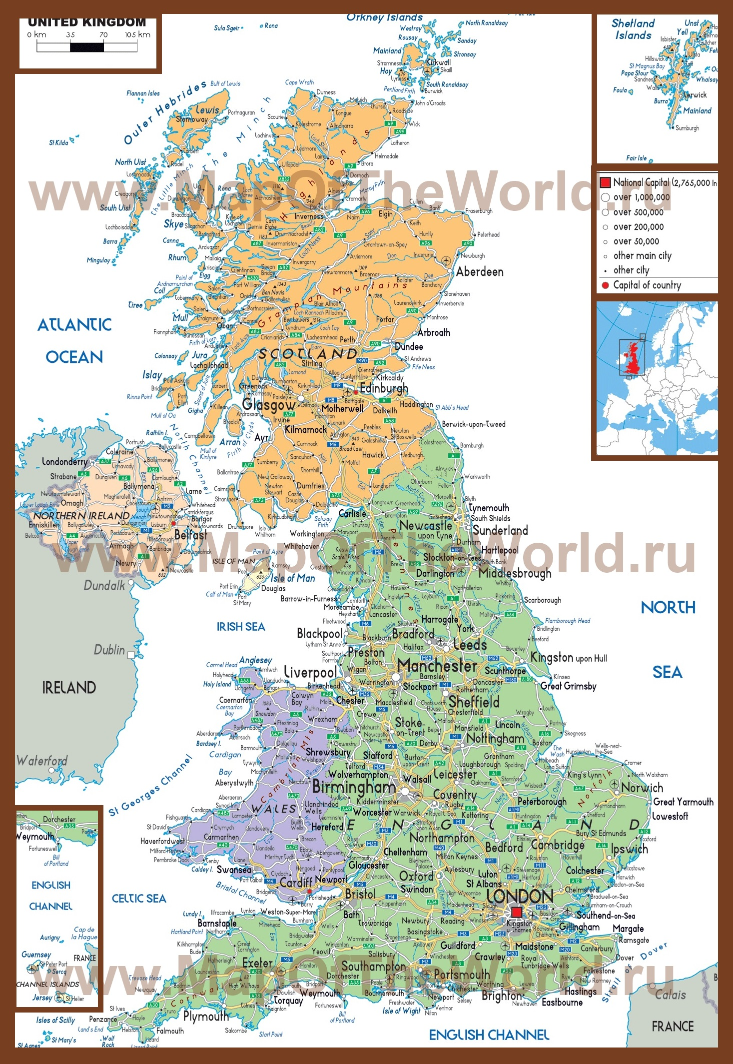

Slide 10
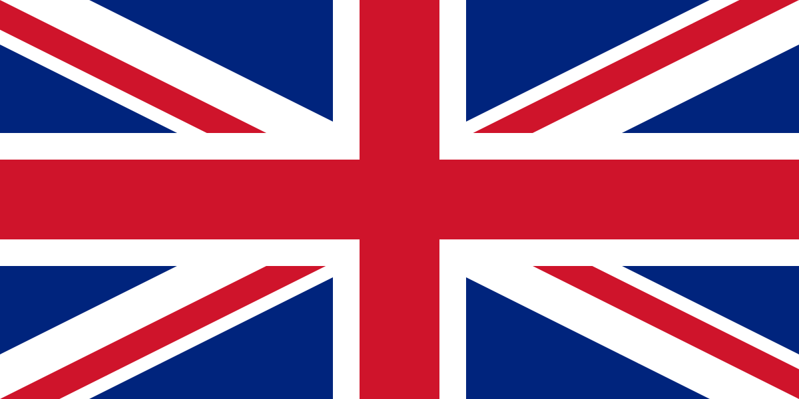
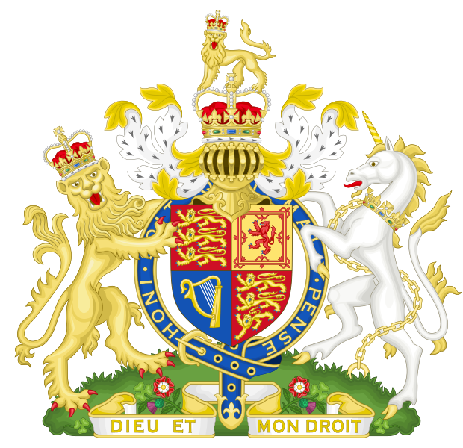
The flag of the United Kingdom better known as "Union Jack" (Union Jack), but its official name "Union flag" (the Union Flag).
The national emblem of the United Kingdom of great Britain and Northern Ireland is depicted in the form of a shield, supported on both sides with a lion and a horse - symbols of power and labour.

Slide 11
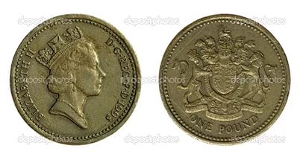
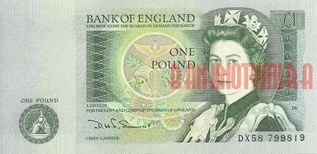
The island nation consists of several countries: England, Scotland, Northern Ireland and Wales.
Status: Constitutional monarchy
the head of state is Queen Elizabeth II, the Prime Minister is determined by the parliamentary elections.
Ireland, France, Belgium and the Netherlands are considered neighbors of the United Kingdom.
Currency: one pound sterling=1,25 dollars
The main political parties -The conservative party, labour party, Liberal Democrats

Slide 12
Cities

Slide 13
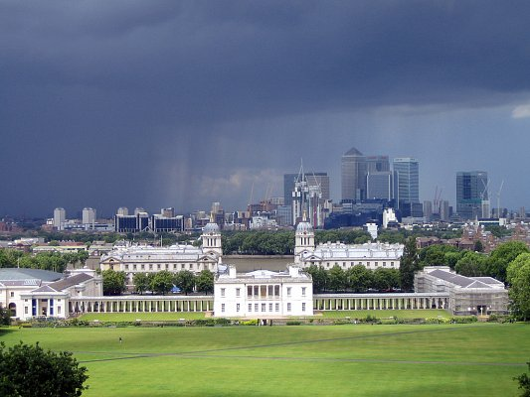
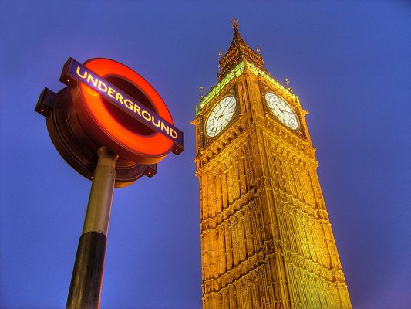
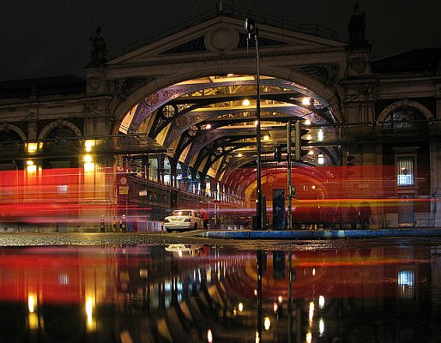
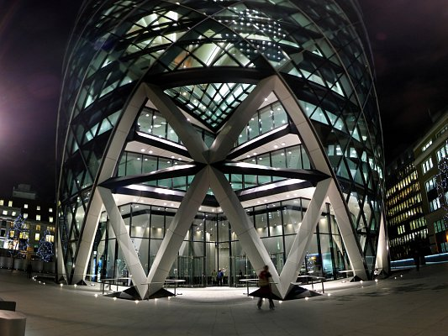
london
London — the British capital and one of the greatest cities of history and modernity. The Westminster government works, here is Buckingham Palace, the best the national galleries, museums, theatres and clubs.
Лондон — столица Великобритании и один из величайших городов истории и современности. В Вестминстере работает правительство, здесь же расположены Букингемский дворец, самые лучшие национальные галереи, музеи, театры и клубы.
Full name: London
Population:8 538 689 about people (2016)
Year of Foundation: 43

Slide 14
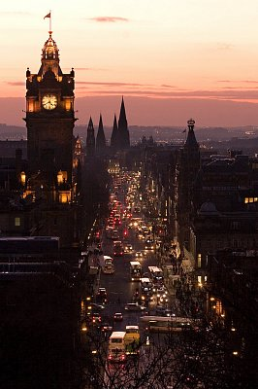
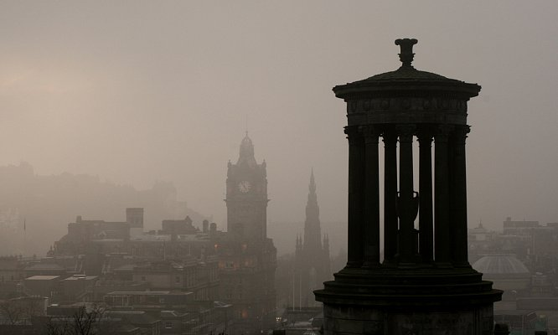
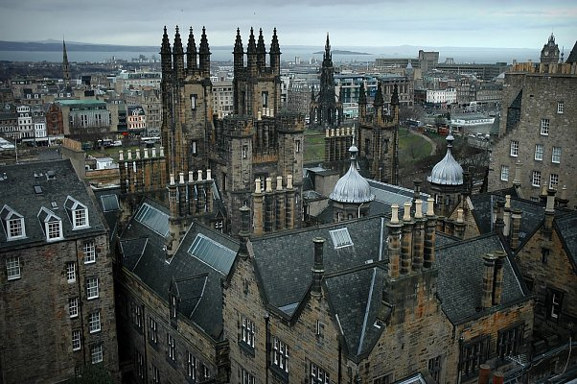
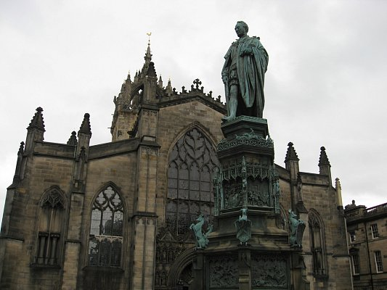
Edinburgh
Edinburgh — capital of Scotland, a popular tourist city with a rich history and monumental architecture. Lively, simple, natural —so take the modern Edinburgh of its inhabitants.
Эдинбург — столица Шотландии, популярный среди туристов город с богатой историей и монументальной архитектурой. Живой, простой, естественный — таким воспринимают современный Эдинбург его жители.
Full name: Edinburgh (capital of Scotland)
Population:492 680 about people (2016)
Year of Foundation: 1583

Slide 15
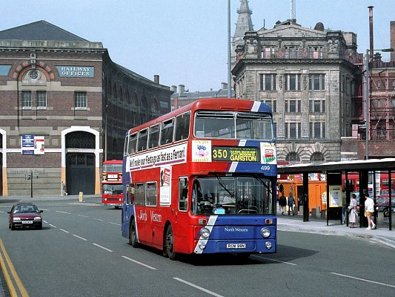
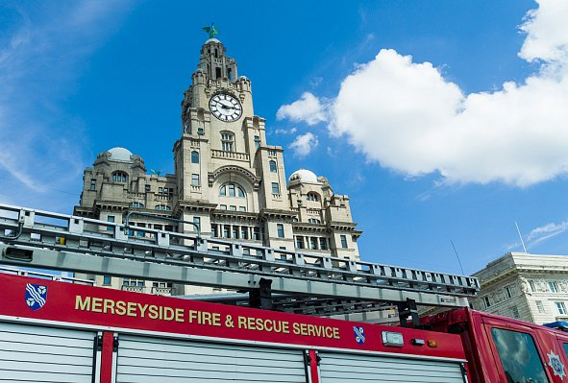
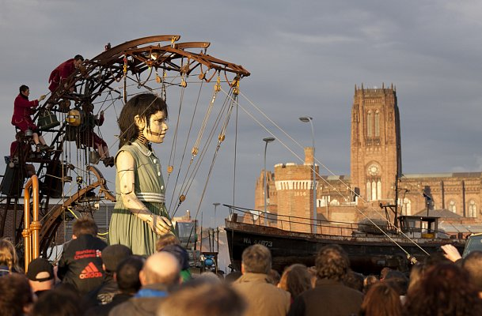
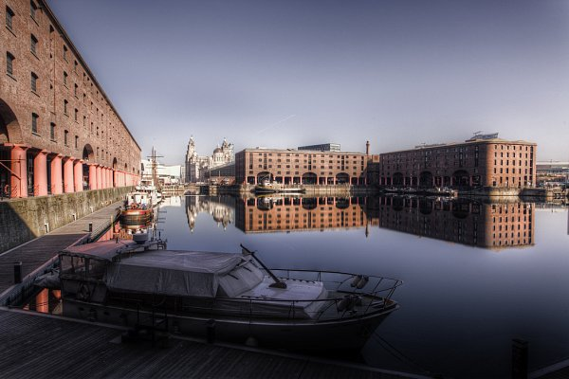
Liverpool
Ливерпуль — город в Великобритании на северо-западном побережье Англии, в графстве Мерсисайд.
Liverpool city in the UK in the North-West coast of England, in the County of Merseyside.
Full name: Liverpool
Population:441 477 about people (2016)
Year of Foundation: 1190

Slide 16
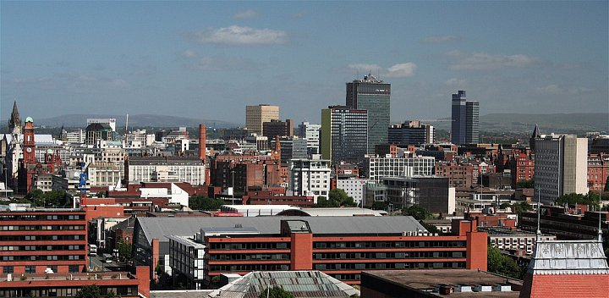
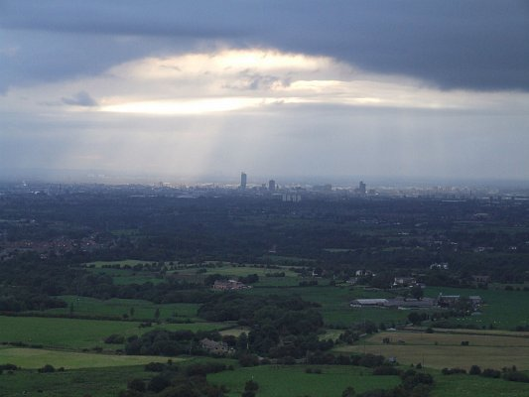
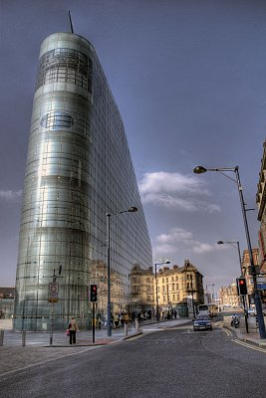
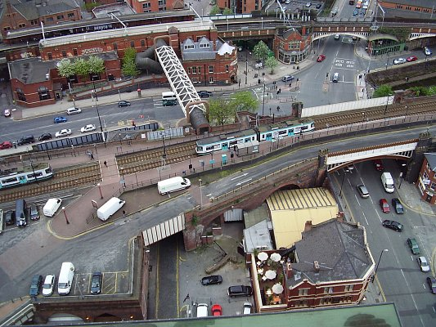
Manchester
Manchester — a city in the North West of the UK, is the slope of the Pennines on the river Irwell. Major cultural, industrial, financial, commercial and transportation centre of the country.
Манчестер — город на северо-западе Великобритании, находится у склона Пеннинских гор, на реке Ирвелл. Крупный культурный, промышленный, финансовый, коммерческий и транспортный центр страны.
Full name: Manchester
Population:514 417 about people (2016)
Year of Foundation: 79

Slide 17
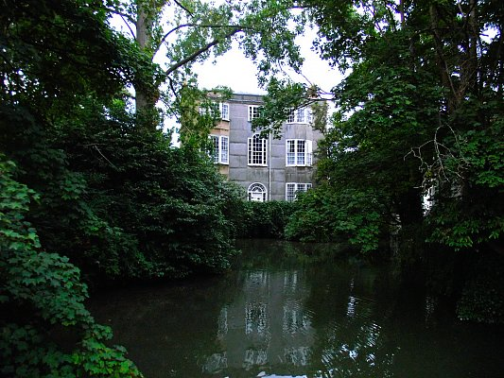
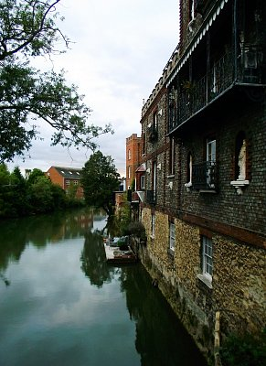
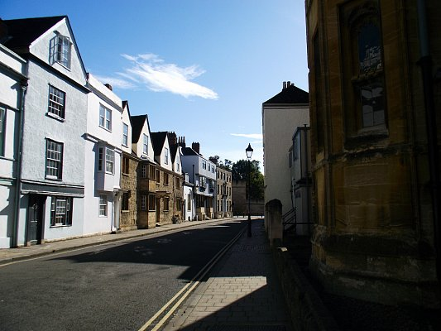
Oxford
Oxford is a city in the UK, the capital of Oxfordshire. Known through one of Europe's oldest universities — Oxford University.
Оксфорд — город в Великобритании, столица графства Оксфордшир. Известен благодаря одному из старейших в Европе высших учебных заведений — Оксфордскому университету.
Full name: Oxford
Population:159 574 about people (2016)
Year of Foundation: 912

Slide 18
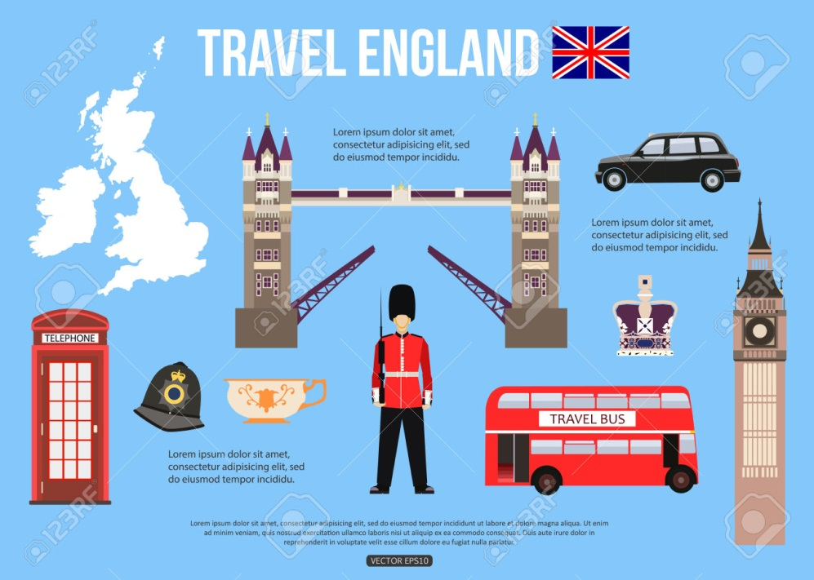
sights of great Britain

Slide 19
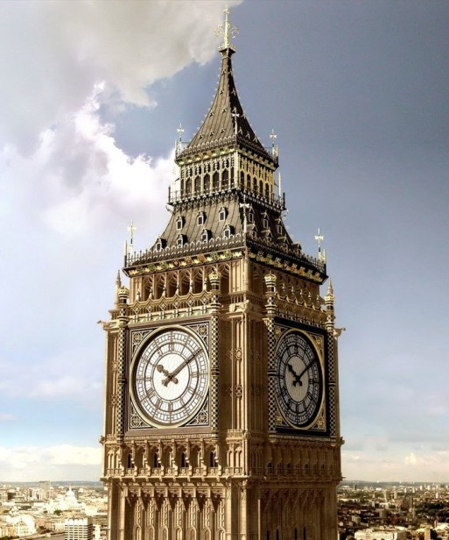
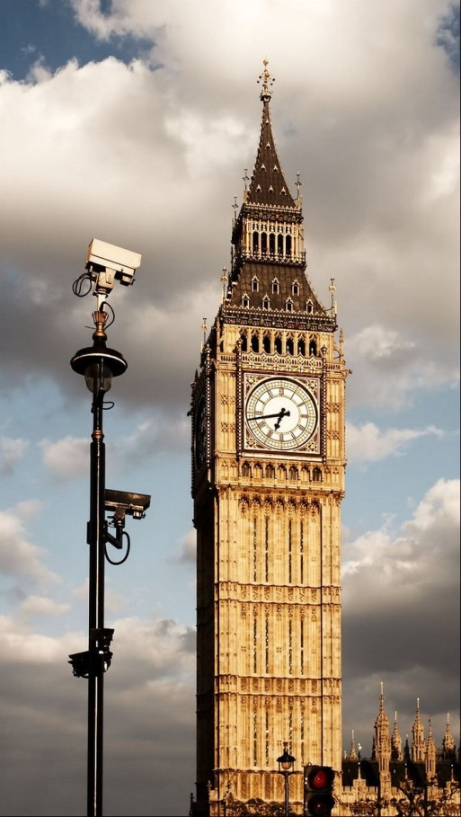
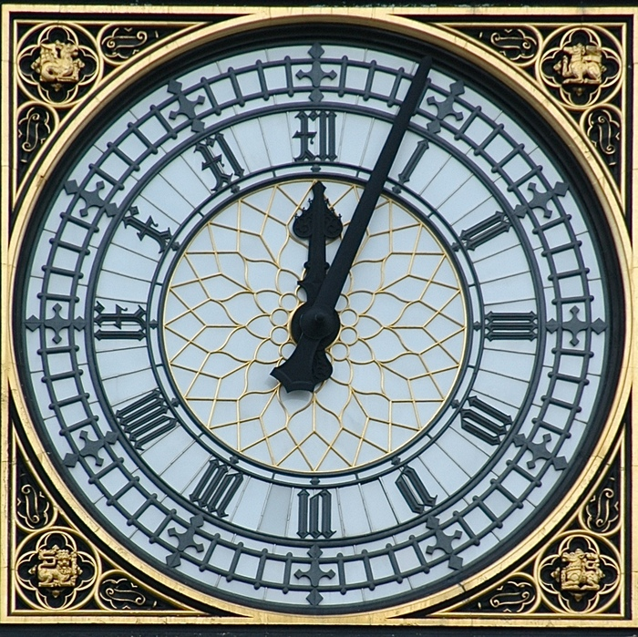
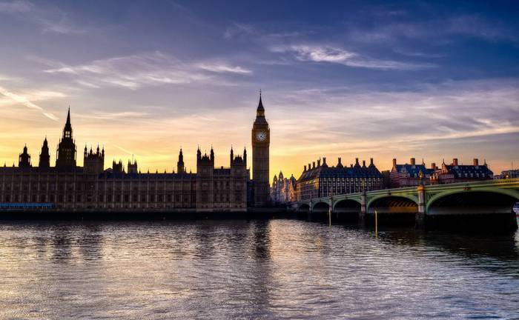
Big ben

Slide 20
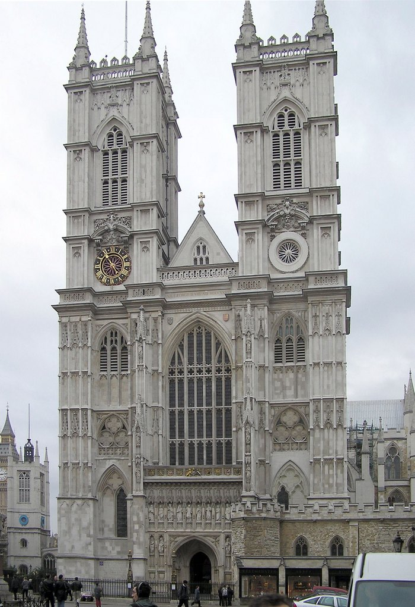
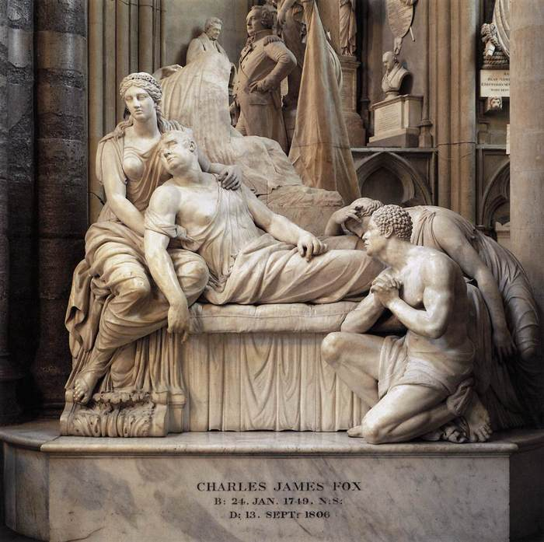
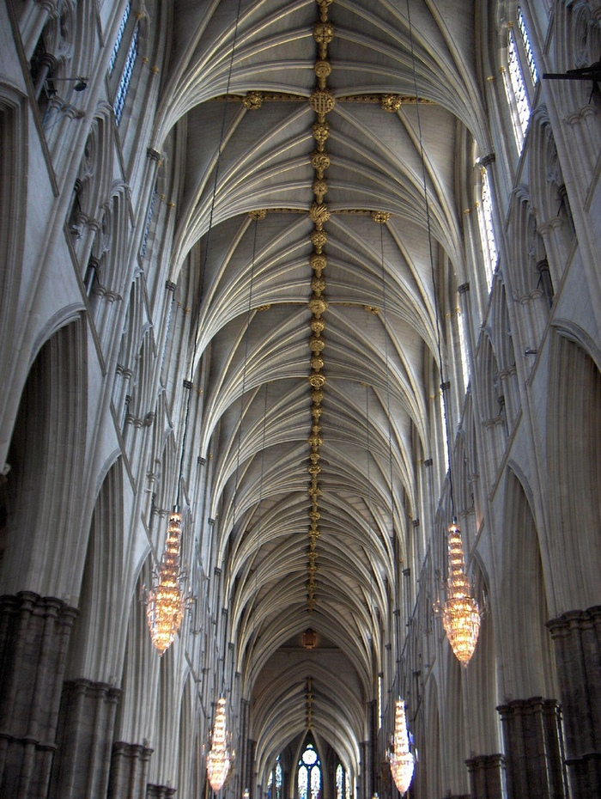
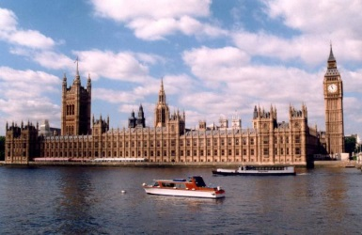
Westminster Abbey

Slide 21
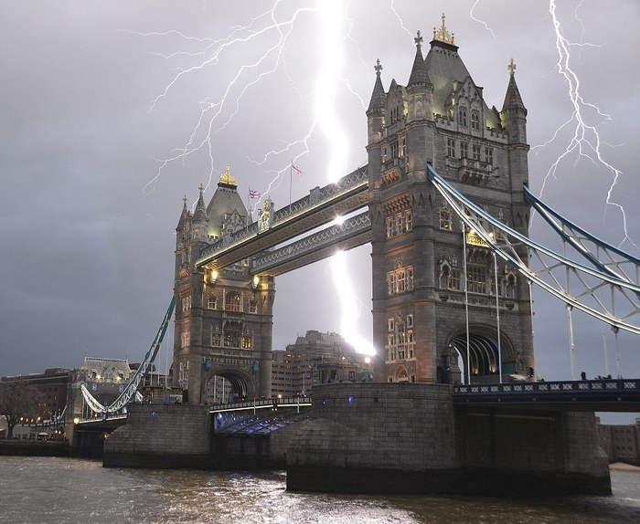
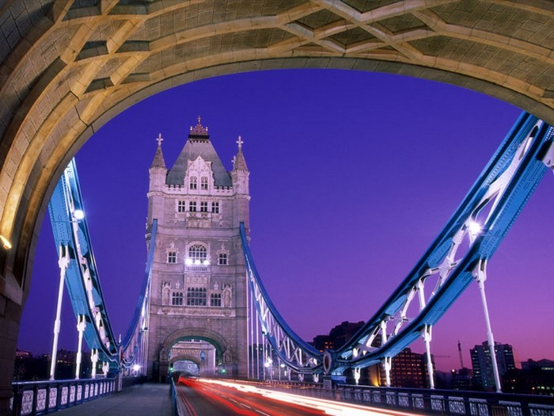
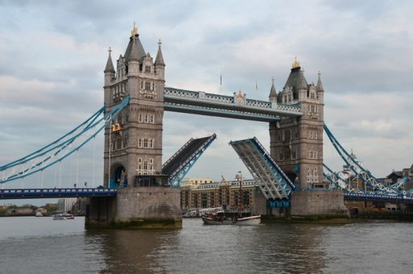
Tower Bridge

Slide 22
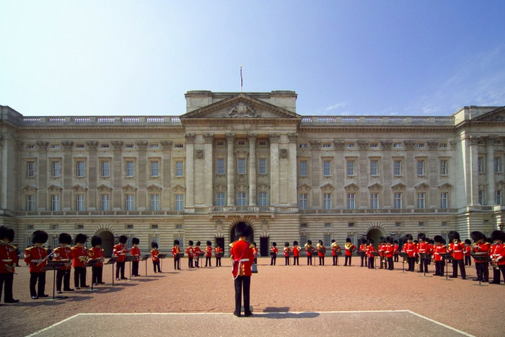
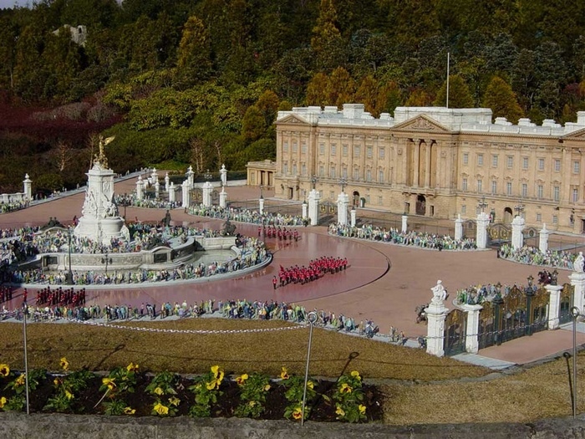
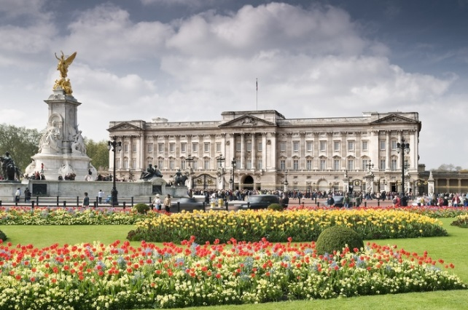
Buckingham Palace

Slide 23
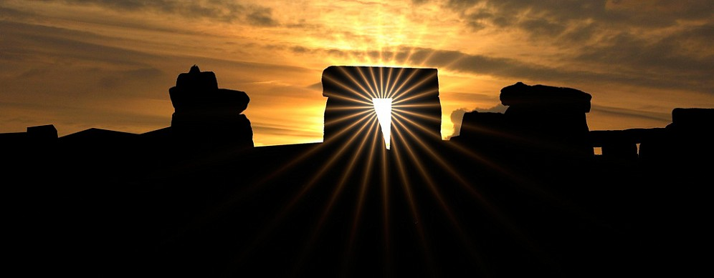
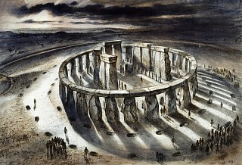
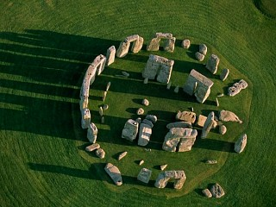
Stonehenge

Slide 24
Knowledge check
What washed seas the UK?
North and Irish seas.
The UK borders with…?
Ireland, France, Belgium and the Netherlands
The capital of the UK…?
London
The UK consists of several countries….
England, Scotland, Northern Ireland and Wales.
The head of state of the UK...
Queen Elizabeth II
Official name…
United Kingdom of great Britain and Northern Ireland

Slide 25
To Learn!
Sightseeing- осмотр достопримечательностей
Capital- столица
Population- население
Area- площадь
To wash- омывать
To consider- рассматривать
Language- язык
The head of state- глава государства
Currency- валюта
To determine- определять
Inhabitant- житель
Coast- побережье
Year of Foundation-год основания
To consist- состоять

Slide 26
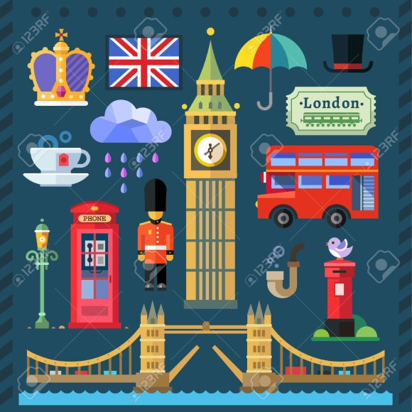
Thank you for attention

