Slide 1

Подготовлена
учителем английского языка
МБОУ СОШ п. Солидарность
Елецкого муниципального района
Липецкой области
Кирсановой Натальей Николаевной

Slide 2

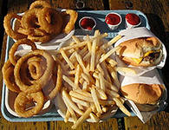
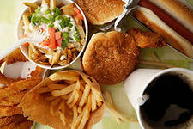
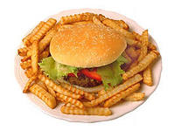
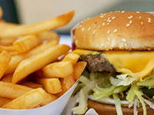
Fast Food:
Pros and Cons

Slide 3

1. Revision the words on the topic “Fast food”.
2. Reading the information about fast food.
3. Listening to the David’s opinion about fast food.
4. Discussing advantages and disadvantages of fast food

Slide 4
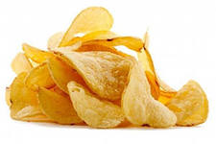

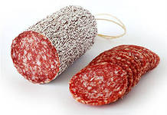

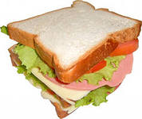
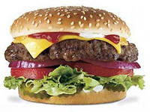
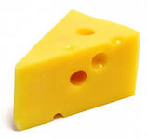
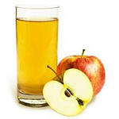
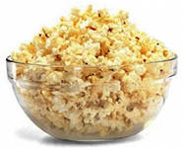
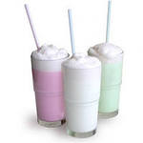
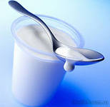
Label the different kinds of fast food
chips
coffee
Coca-Cola=
Coke
sausage
sandwich
hamburger
cheese
apple juice
popcorn
cocktail
=
yoghurt

Slide 5

Mark | How many words?
“5” | 10
“4” | 8-9
“3” | 5-7
“2” | < 5

Slide 6
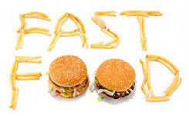
УМК М. З. Биболетовой и др. Enjoy English 5 - 6
Презентация подготовлена
учителем английского языка
МБОУ СОШ п. Солидарность
Елецкого района Липецкой области
Кирсановой Натальей Николаевной

Slide 7
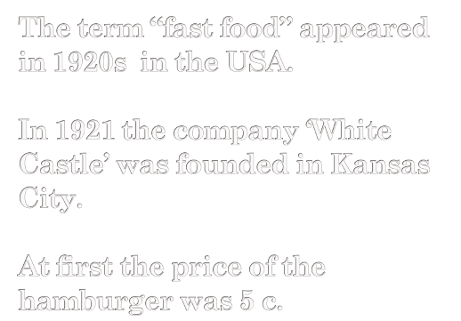
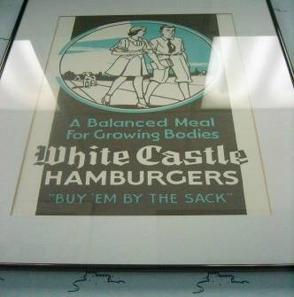
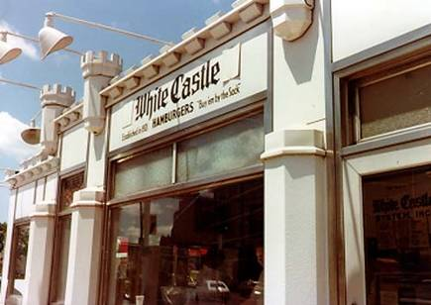
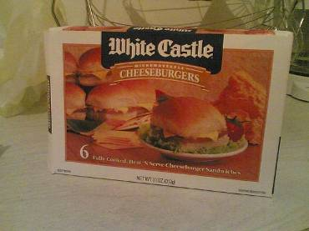

Slide 8
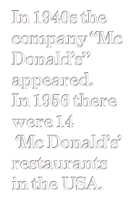
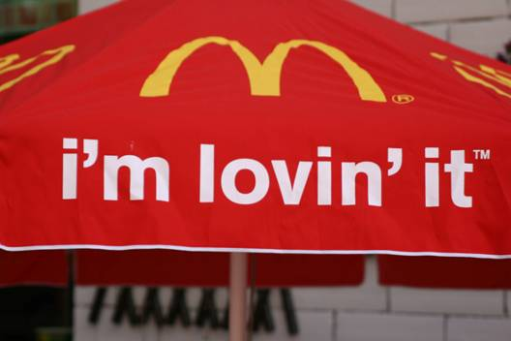
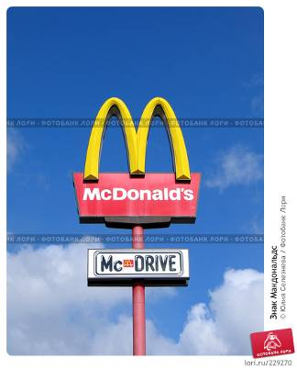
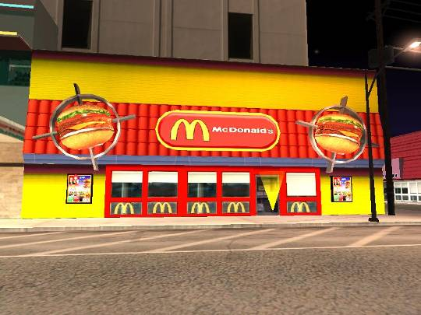
Nowadays
there are more than 30,000 ‘Mc Donald’s’ restaurants
in 119 countries.
In the Russian Federation 66 – 70 % of people attend
fast food restaurants , especially young people.

Slide 9
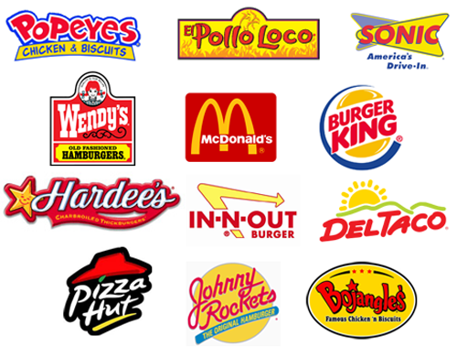
Popular companies producing fast food

Slide 10
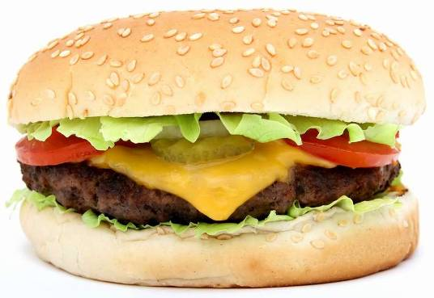
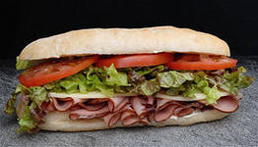
sandwich
hamburger

Slide 11
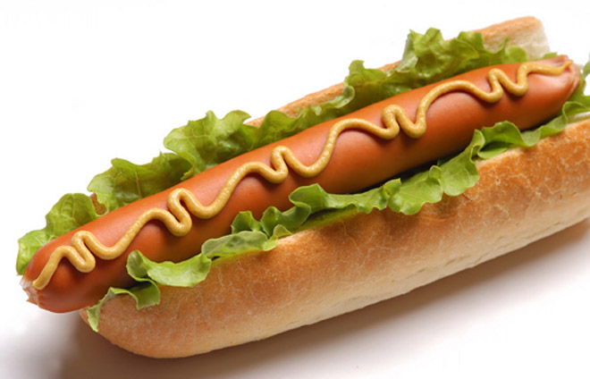
hot dog

Slide 12
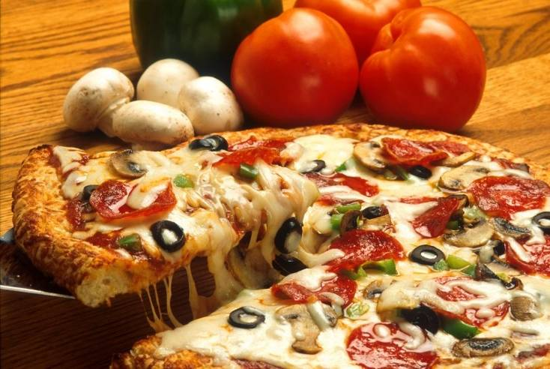
pizza

Slide 13
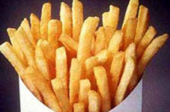
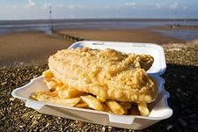
fish and chips
French-fried potatoes

Slide 14
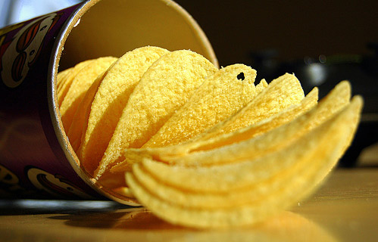
Averagely for a year chips are eaten:
the Russian – 0.5 kg
the European – 1 – 5 kgs
the American – 10 kgs
the Ukrainian – 1.8 – 2.5 kgs
chips

Slide 15
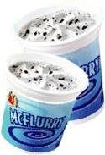
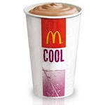

Slide 16
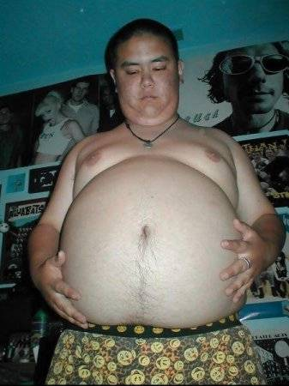
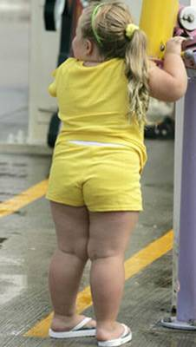
obesity

Slide 17
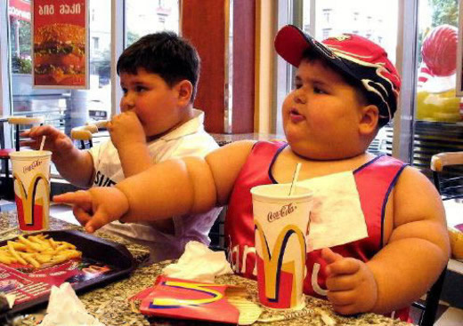
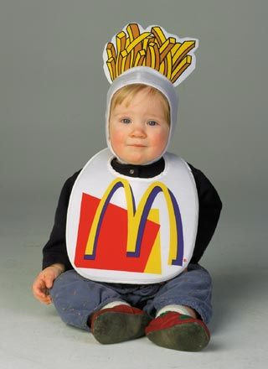
obesity

Slide 18
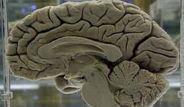
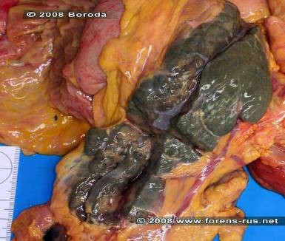
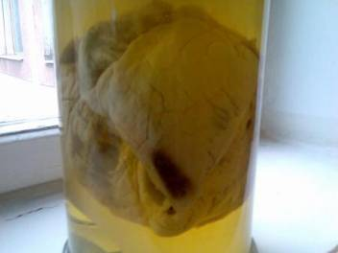
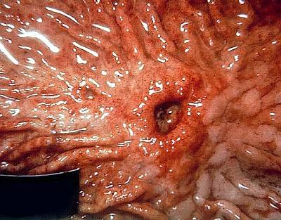
Fast food is bad for brain
Fast food is bad for heart
Fast food is bad for stomach

Slide 19
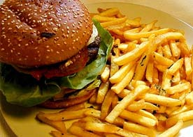
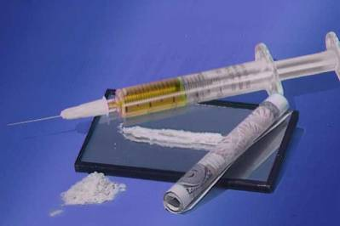

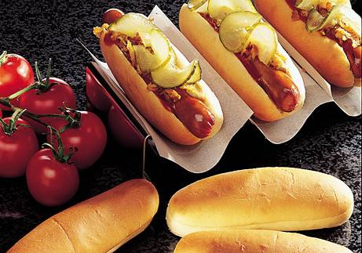
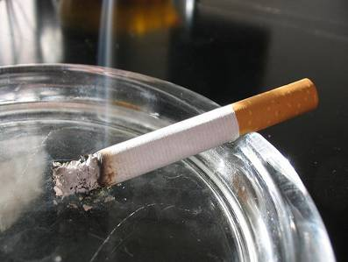

Slide 20
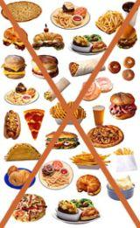

Slide 21
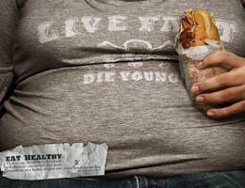
Live fa(s)t, die young!

Slide 22
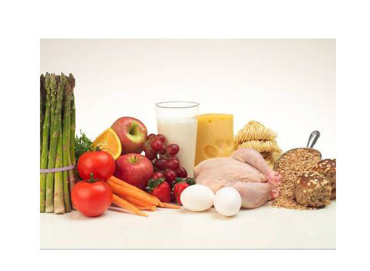
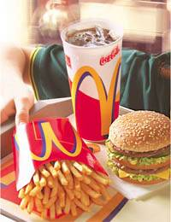


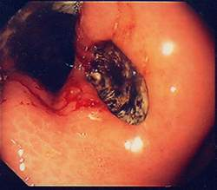
It’s your choice!

Slide 23

1. The first fast food restaurants appeared in … in … .
2. Nowadays fast food is popular not only in …
but also … .
3. There are a lot of kinds of fast food: … .
4. Fast food is … for our health.
5. If you want to be healthy eat … .

Slide 24



Slide 25

1. Does David prefer to eat fast food?
2. What does he usually eat for dinner?
3. What does he usually drink?
4. Does he like to eat while watching TV in his room?
5. Do you prefer fast food?
6. What kinds of fast food do you prefer?
7. What do you like to drink?
8. Do you like to eat while watching TV?

Slide 26




Wonderful!
So-so!
What a bore!

Slide 27


Your opinion about fast food
(5-6 sentences)

Slide 28
Источники информации
1)http://images.yandex.ru/yandsearch?p=1&text=%D0%BA%D0%BE%D0%BC%D0%BF%D0%B0%D0%BD%D0%B8%D1%8F%20White%20Castle%20Hamburger&pos=40&uinfo=sw-1423-sh-728-fw-1198-fh-522-pd-1&rpt=simage&img_url=http%3A%2F%2Faht.seriouseats.com%2Fassets_c%2F2009%2F09%2F20090904-whitecastle-thumb-175xauto-31776.jpg
2)http://images.yandex.ru/yandsearch?text=%D0%BF%D0%B5%D1%80%D0%B2%D0%B0%D1%8F%20%D0%BA%D0%BE%D0%BC%D0%BF%D0%B0%D0%BD%D0%B8%D1%8F%20%D0%BF%D0%BE%20%D0%BF%D1%80%D0%BE%D0%B8%D0%B7%D0%B2%D0%BE%D0%B4%D1%81%D1%82%D0%B2%D1%83%20fast%20food&pos=5&uinfo=sw-1423-sh-728-fw-1198-fh-522-pd-1&rpt=simage&img_url=http%3A%2F%2Fwww.cbc.ca%2Fnews%2Fyourcommunity%2FiStock_fast%2520food.jpg
3)http://images.yandex.ru/yandsearch?text=%D0%BF%D0%B5%D1%80%D0%B2%D0%B0%D1%8F%20%D0%BA%D0%BE%D0%BC%D0%BF%D0%B0%D0%BD%D0%B8%D1%8F%20%D0%BF%D0%BE%20%D0%BF%D1%80%D0%BE%D0%B8%D0%B7%D0%B2%D0%BE%D0%B4%D1%81%D1%82%D0%B2%D1%83%20fast%20food&pos=4&uinfo=sw-1423-sh-728-fw-1198-fh-522-pd-1&rpt=simage&img_url=http%3A%2F%2Fblog.bullfishgraphics.com%2Fwp-content%2Fuploads%2F2011%2F04%2FFast-food-logos.png
4)http://images.yandex.ru/yandsearch?p=1&text=%D0%BF%D0%B5%D1%80%D0%B2%D0%B0%D1%8F%20%D0%BA%D0%BE%D0%BC%D0%BF%D0%B0%D0%BD%D0%B8%D1%8F%20%D0%BF%D0%BE%20%D0%BF%D1%80%D0%BE%D0%B8%D0%B7%D0%B2%D0%BE%D0%B4%D1%81%D1%82%D0%B2%D1%83%20fast%20food&pos=33&uinfo=sw-1423-sh-728-fw-1198-fh-522-pd-1&rpt=simage&img_url=http%3A%2F%2Fwww.vegansoapbox.com%2Fwordpress%2Fwp-content%2Fuploads%2F2009%2F02%2Ffast_food_kills.png
5)http://images.yandex.ru/yandsearch?p=5&text=%D0%BF%D0%B5%D1%80%D0%B2%D0%B0%D1%8F%20%D0%BA%D0%BE%D0%BC%D0%BF%D0%B0%D0%BD%D0%B8%D1%8F%20%D0%BF%D0%BE%20%D0%BF%D1%80%D0%BE%D0%B8%D0%B7%D0%B2%D0%BE%D0%B4%D1%81%D1%82%D0%B2%D1%83%20fast%20food&pos=175&uinfo=sw-1423-sh-728-fw-1198-fh-522-pd-1&rpt=simage&img_url=http%3A%2F%2Fvivirlatino.com%2Fi%2F2008%2F07%2Fmcdonalds-kid.jpg

Slide 29
Источники информации
6)http://images.yandex.ru/yandsearch?p=2&text=White%20Castle%20Hamburger&pos=71&uinfo=sw-1423-sh-728-fw-1198-fh-522-pd-1&rpt=simage&img_url=http%3A%2F%2Fen.academic.ru%2Fpictures%2Fenwiki%2F87%2FWhite_Castle_Building_8.jpg
7)http://images.yandex.ru/yandsearch?p=5&text=McDonald%27s&pos=160&uinfo=sw-1423-sh-728-fw-1198-fh-522-pd-1&rpt=simage&img_url=http%3A%2F%2Frealty.rambler.ru%2Fupload%2Fiblock%2Febd%2Fmcdonalds.jpg
8)http://images.yandex.ru/yandsearch?p=2&text=McDonald%27s%20restaurant&pos=85&uinfo=sw-1423-sh-728-fw-1198-fh-522-pd-1&rpt=simage&img_url=http%3A%2F%2Fwww.london-se1.co.uk%2Frestaurants%2Fimages%2F070714_mcdonalds.jpg
9)http://images.yandex.ru/yandsearch?p=18&text=Mcdonalds%20I%27m%20lovin&pos=557&uinfo=sw-1423-sh-728-fw-1198-fh-522-pd-1&rpt=simage&img_url=http%3A%2F%2Fwww.mcdonalds.com%2Fcontent%2Fdam%2FMcDonalds%2Flogo%2Fmcdonalds-logo.png
10)http://images.yandex.ru/yandsearch?p=2&text=hamburger&pos=64&uinfo=sw-1423-sh-728-fw-1198-fh-522-pd-1&rpt=simage&img_url=http%3A%2F%2Fimg-fotki.yandex.ru%2Fget%2F5801%2F119528728.203c%2F0_f2379_a1c12d4e_XL
11)http://images.yandex.ru/yandsearch?p=3&text=sandwich&pos=116&uinfo=sw-1423-sh-728-fw-1198-fh-522-pd-1&rpt=simage&img_url=http%3A%2F%2Fyoung.rzd.ru%2Fdbmm%2Fimages%2F41%2F4080%2F1351328
12)http://images.yandex.ru/yandsearch?text=hot%20dog&pos=22&uinfo=sw-1423-sh-728-fw-1198-fh-522-pd-1&rpt=simage&img_url=http%3A%2F%2Fwww.frio.ru%2FImage%2Fnews%2Fnews_05_2009%2Fhotdog.jpeg
13)http://images.yandex.ru/yandsearch?text=pizza&pos=24&uinfo=sw-1423-sh-728-fw-1198-fh-522-pd-1&rpt=simage&img_url=http%3A%2F%2Foffersavalanche.com%2Fwp-content%2Fuploads%2F2012%2F05%2Fimages-of-papa-johns-coupons-2012-300x201.jpg

Slide 30
Источники информации
14)http://images.yandex.ru/yandsearch?p=5&text=French-fried%20potatoes&pos=178&uinfo=sw-1423-sh-728-fw-1198-fh-522-pd-1&rpt=simage&img_url=http%3A%2F%2Flarryfire.files.wordpress.com%2F2010%2F04%2F1decl_8068notext.jpg
15)http://images.yandex.ru/yandsearch?text=fish%20and%20chips&pos=3&uinfo=sw-1423-sh-728-fw-1198-fh-522-pd-1&rpt=simage&img_url=http%3A%2F%2Fupload.wikimedia.org%2Fwikipedia%2Fcommons%2F7%2F76%2FFish_and_chips.jpg
16)http://images.yandex.ru/yandsearch?text=sushi&pos=7&uinfo=sw-1423-sh-728-fw-1198-fh-522-pd-1&rpt=simage&img_url=http%3A%2F%2Fimg0.liveinternet.ru%2Fimages%2Fattach%2Fc%2F0%2F51%2F741%2F51741789_rolluy.jpg
17)http://images.yandex.ru/yandsearch?text=burito&pos=24&uinfo=sw-1423-sh-728-fw-1198-fh-522-pd-1&rpt=simage&img_url=http%3A%2F%2Fveganrevolution.free.fr%2Fimages2%2Fveganicone10.gif
18)http://images.yandex.ru/yandsearch?p=11&text=chips&pos=344&uinfo=sw-1423-sh-728-fw-1198-fh-522-pd-1&rpt=simage&img_url=http%3A%2F%2Fexperiencelife.com%2Fwp-content%2Fuploads%2F2013%2F02%2FMar13_how-junk-food-inflames-us-384x240.jpg
19)http://images.yandex.ru/yandsearch?p=3&text=mcflurry&pos=113&uinfo=sw-1423-sh-728-fw-1198-fh-522-pd-1&rpt=simage&img_url=http%3A%2F%2Fwww.calorizator.ru%2Fsites%2Fdefault%2Ffiles%2Fimagecache%2Fproduct_192%2Fproduct%2Fmcflurry-3.jpg
20)http://images.yandex.ru/yandsearch?text=%D0%BA%D0%BE%D0%BA%D1%82%D0%B5%D0%B9%D0%BB%D1%8C%20%D0%B2%20McDonald%27s&pos=10&uinfo=sw-1423-sh-728-fw-1198-fh-522-pd-1&rpt=simage&img_url=http%3A%2F%2Fimage.rus.newsru.ua%2Fpict%2Fid%2F149661_20090704204116.jpg

Slide 31
Источники информации
21)http://images.yandex.ru/yandsearch?p=6&text=obesity&pos=207&uinfo=sw-1423-sh-728-fw-1198-fh-522-pd-1&rpt=simage&img_url=http%3A%2F%2Fcs203.userapi.com%2Fu1105177%2Fa_d376c873.jpg
22)http://images.yandex.ru/yandsearch?p=9&text=brain&pos=288&uinfo=sw-1423-sh-728-fw-1198-fh-522-pd-1&rpt=simage&img_url=http%3A%2F%2Fimg.lenta.ru%2Fnews%2F2009%2F05%2F26%2Fsize%2Fpicture.jpg
23)http://images.yandex.ru/yandsearch?p=3&text=%D0%B3%D0%B0%D1%81%D1%82%D1%80%D0%B8%D1%82&pos=116&uinfo=sw-1423-sh-728-fw-1198-fh-522-pd-1&rpt=simage&img_url=http%3A%2F%2Fwww.pathology.vcu.edu%2Feducation%2Fdental2%2Fimages%2Fsc3-2.jpg
24)http://prezentacii.com/angliiskii_yazik/476-fast-food.html
25)http://nsportal.ru/shkola/inostrannye-yazyki/angliiskii-yazyk/library/prezentaciya-po-teme-bystraya-eda
26)https://www.youtube.com/watch?v=L89IDDq30J8

