Slide 1
The structure of the flower
The purpose of this lesson: Flower knowledge construction, understanding dust

Slide 2
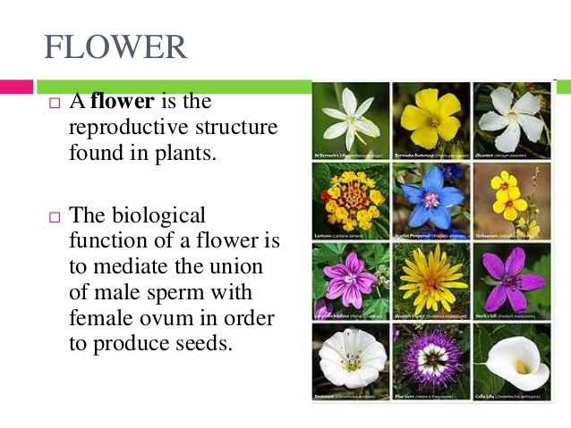

Slide 3
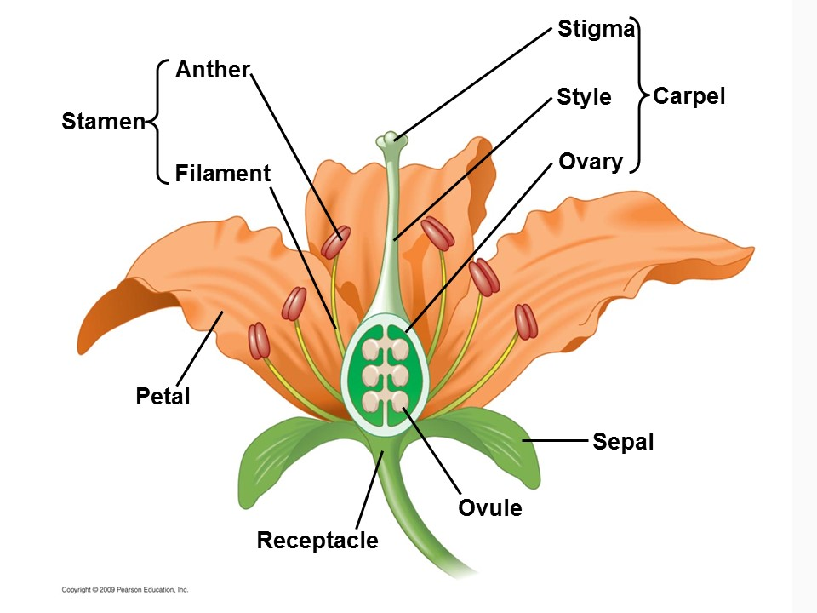
Parts of the flower

Slide 4
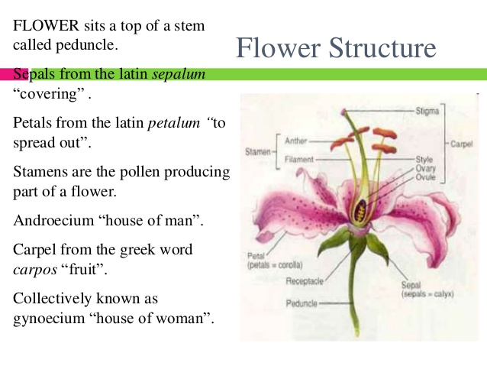

Slide 5
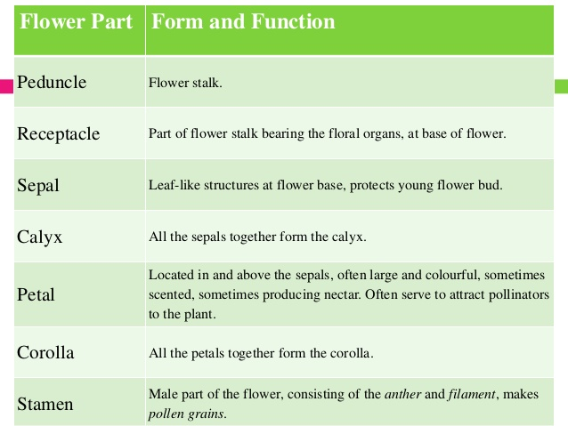

Slide 6
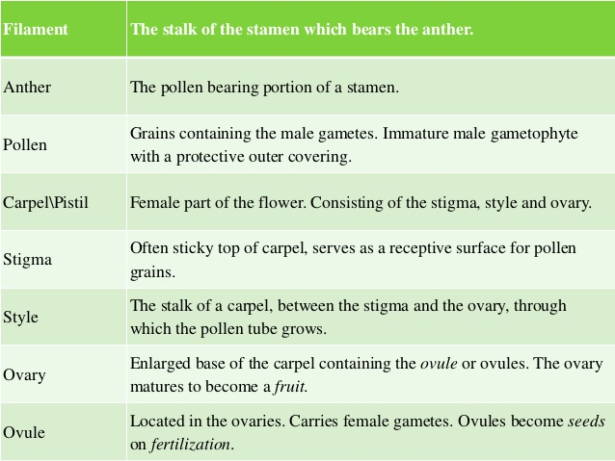

Slide 7
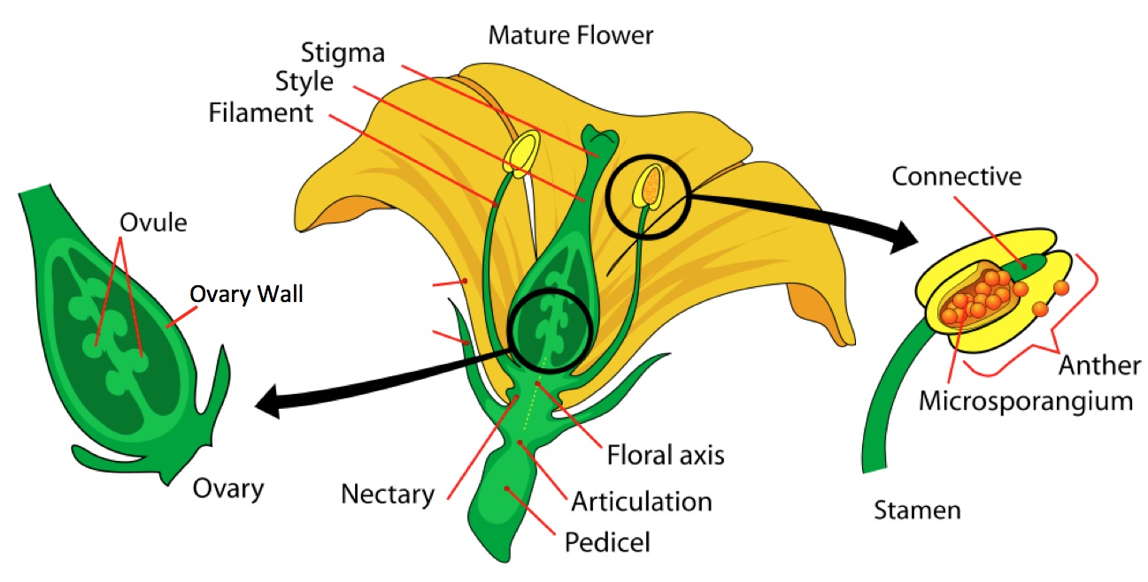

Slide 8
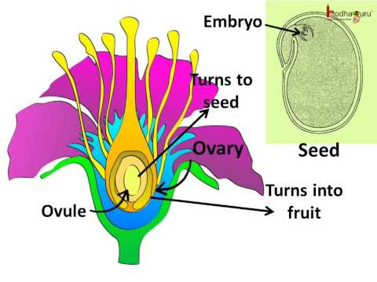

Slide 9
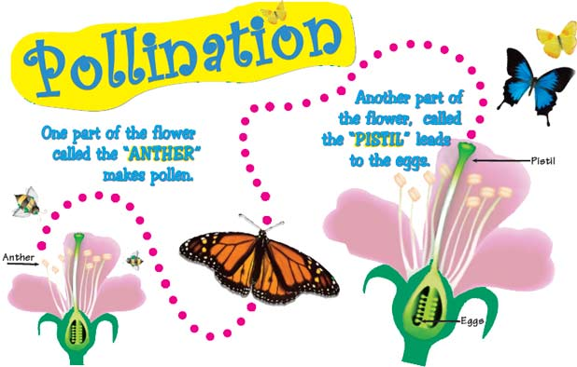

Slide 10
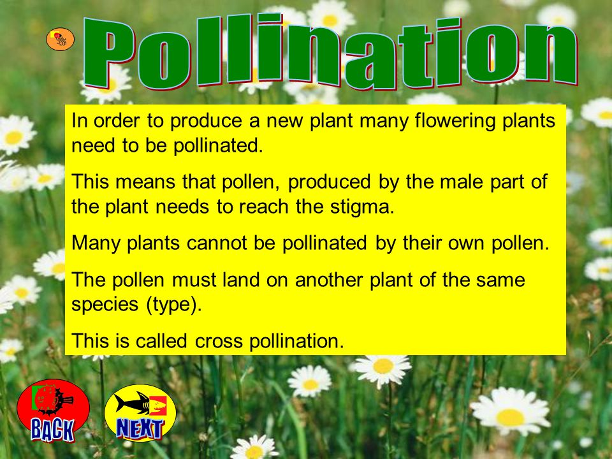

Slide 11
There are two main types of pollination: self - pollination (when the plant is pollinated with its own pollen) and cross-pollination. If cross - pollination plants can produce two basic types of plants: monoecious and dioecious. Biotic pollination (with the help of living organisms) Entomophily — pollination by insects; as a rule, bees, wasps and sometimes ants (Hymenoptera), beetles (Coleoptera), butterflies (Lepidoptera) and flies (Diptera). Zoophilia pollination by vertebrates: birds (ornithophily, agents of pollination are birds such as hummingbirds, sunbirds, medonosy), bats (chiropterophily), rodents, some marsupials (in Australia), lemurs (in Madagascar). Artificial pollination — the transfer of pollen from stamens to pistils of the flowers through the human.

Slide 12
Questions on for size:
1. What are the main sections of the flower?
2. What is pollination ?
3. How many types of pollination of flowers you know?
4. Give an example

