Slide 1

AUSTRALIA

Slide 2
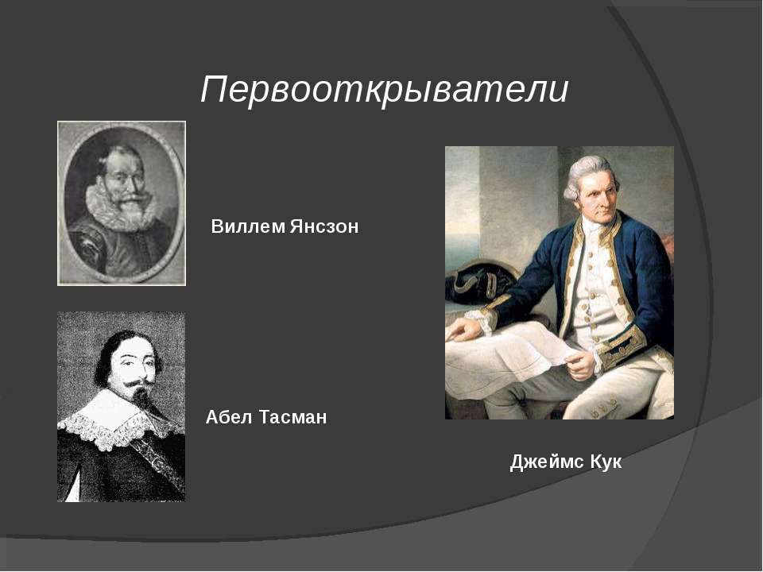

Slide 3
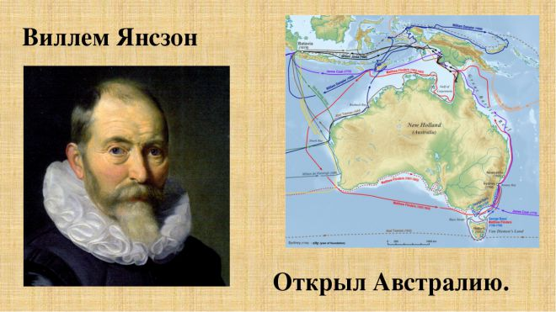
WILLEM JANSZOON

Slide 4
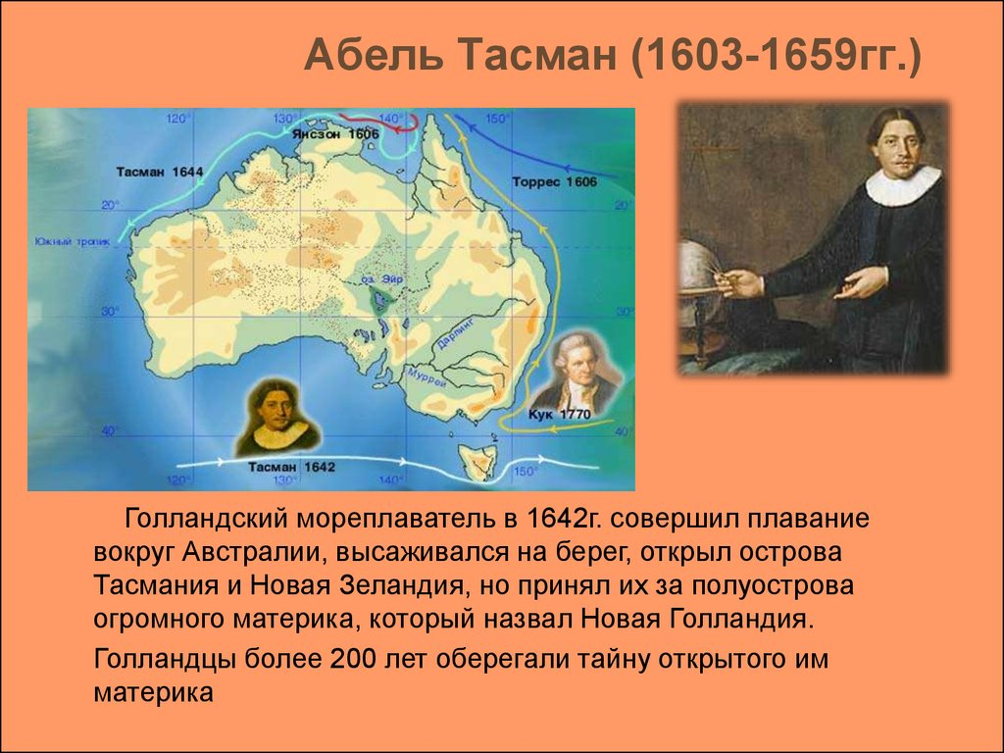

Slide 5
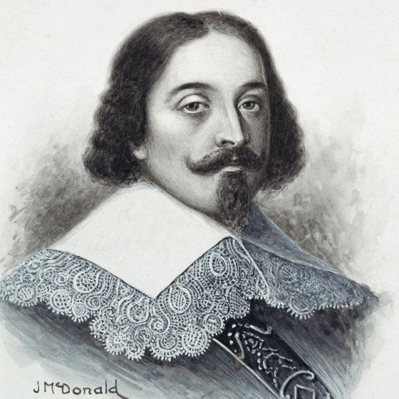
ABEL TASMAN

Slide 6
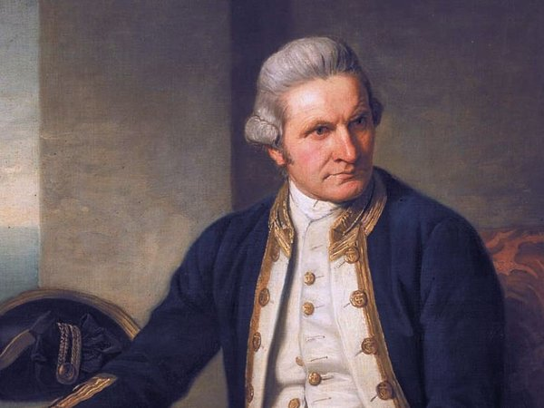
JAMES COOK

