Slide 1
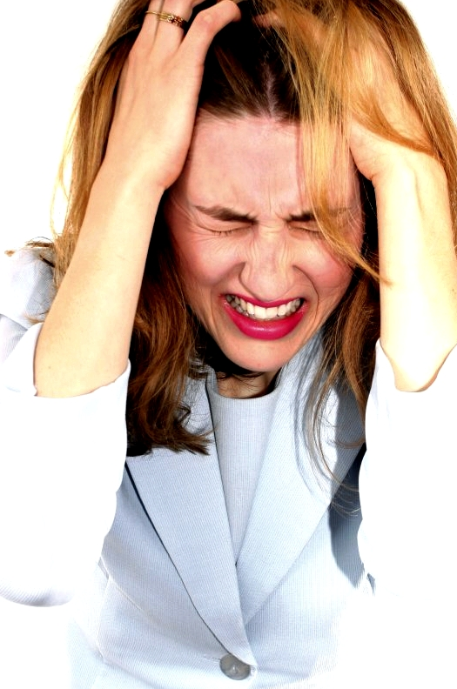
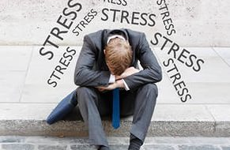
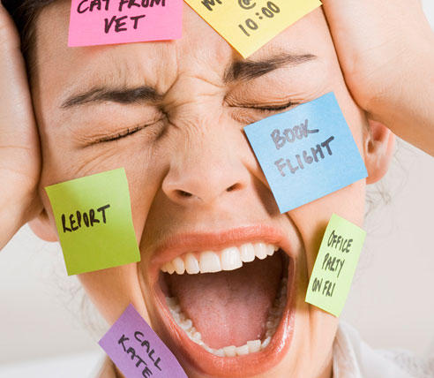
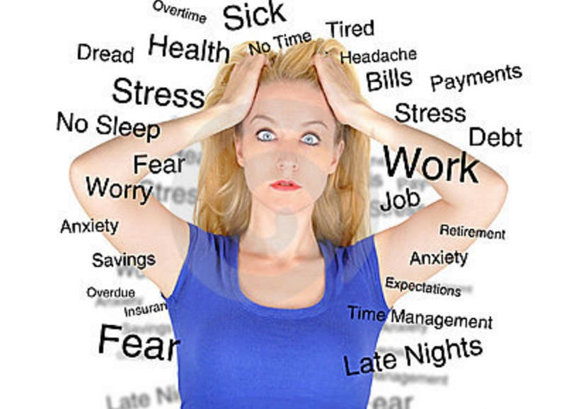
Stress

Slide 2
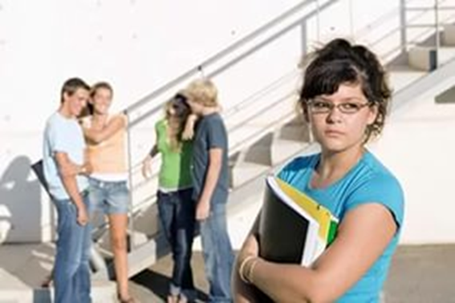
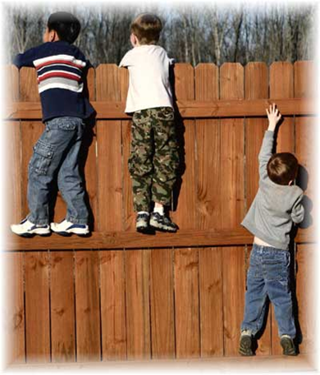
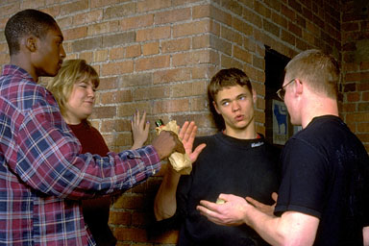
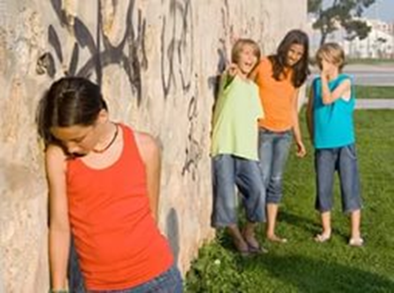
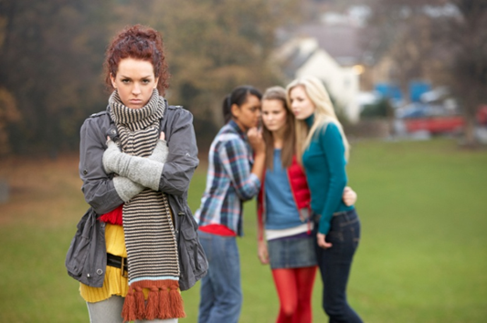
Peer pressure
What do the pictures have in common?
What is different about them?
Lexical support
Peer pressure (phr): pressure from people of one’s own age to behave in a way similar or acceptable of them.

Slide 3

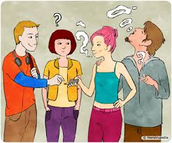
Peer Pressure
Peer pressure social pressure by members of one's peer group to take a certain action, adopt certain values, in order to be accepted.

Slide 4
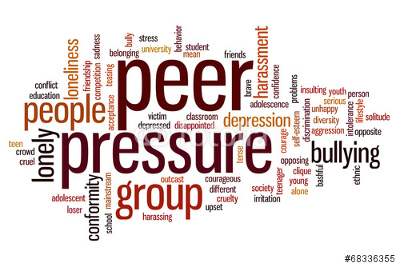
Peer pressure
What do you associate the word “peer pressure” with?

Slide 5
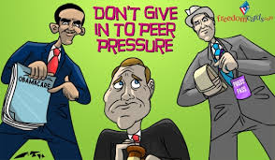
Handling peer pressure
What can you suggest doing to handle peer pressure?

Slide 6
idioms
one in a million
a hundred and one reasons
at sixes and sevens
in two minds
six of one and half a dozen of the other
There are ______________why you should resist peer pressure. It’s not even worth being __________! Boost your confidence and self-esteem (frankly speaking, they are _____________) and remember you are unique, _______________. You must be strong and assertive. Are you still _______________? Come on, you can do it!

Slide 7
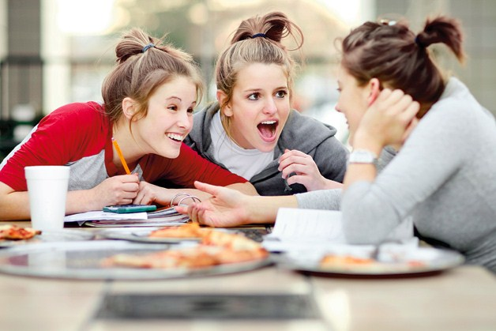

Монолог-рассуждение
Task 4. Study the two photographs. In 1.5 minutes be ready to compare and contrast the photographs:
Give a brief description of the photos (action, location)
Say what the pictures have in common
Say in what way they are different
Say which of the walks presented in the pictures you’d prefer.
Explain why.
You will speak for not more than 2 minutes. You have to speak continuously.
For lexical support look at p.16.

