Slide 1

Every day and at weekends
Mironova A.V.
Azov_2017

Slide 2

The tree is brown
It has no leaves or flowers

Slide 3
PHONETIC EXERCISE
Task: read and find the forms of Present Simple and Present Continuous.
RAIN
by R. STEVENSON
The rain is raining all around,
It falls on field and tree
It rains on the umbrella here
And on the ships at sea.

Slide 4
LET’S CHECK

Slide 5
The forms of Present Simple and Present Continuous
RAIN by R. STEVENSON
The rain is raining all around,
It falls on field and tree
It rains on the umbrella here
And on the ships at sea.

Slide 6
LET’S TALK ABOUT THE RULES
PRESENT SIMPLE
PRESENT CONTINUOUS
We use Present Simple to describe the action which takes place regularly, every day.
For example:
I go to school every day.
We use Present Continuous to describe the actions which takes place right now.
For example:
I am listening to the teacher now.

Slide 7
Forms of the verbs
Present Simple
Present Continuous
I-
write
I-
He
She -
It
am listening
He
She -
It
are eating
reads
They
You -
We
is writing
They
You -
We
read
do, does

Slide 8
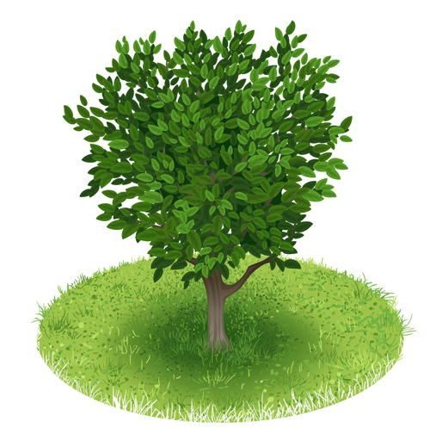
The tree is green
It has a lot of leaves

Slide 9
IT IS HIGH TIME
TO HAVE A REST!!!

Slide 10
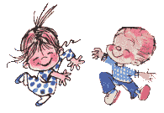
Physical activity
With my foot I tap, tap, tap,
With my hands I clap, clap, clap,
Right foot first, left foot then,
Round and round and back again.

Slide 11


Slide 12
FIND THE MISTAKES:
1. He go to school every day.
He goes at school every day.
2. She are listening to the radio now.
She is listening to the radio now.
3. Do he like swimming?
Does he like swimming?
4. I is a student.
I am a student.

Slide 13
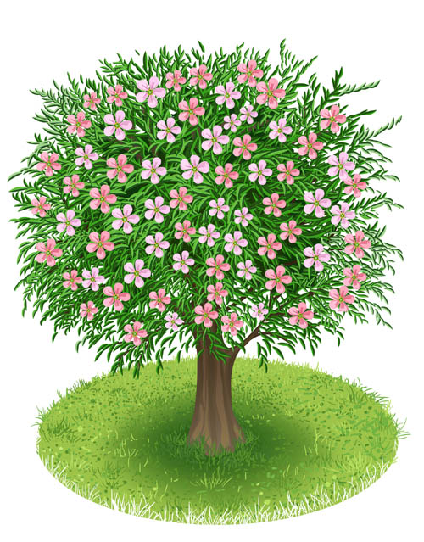
The tree is very beautiful
It has leaves and flowers

Slide 14
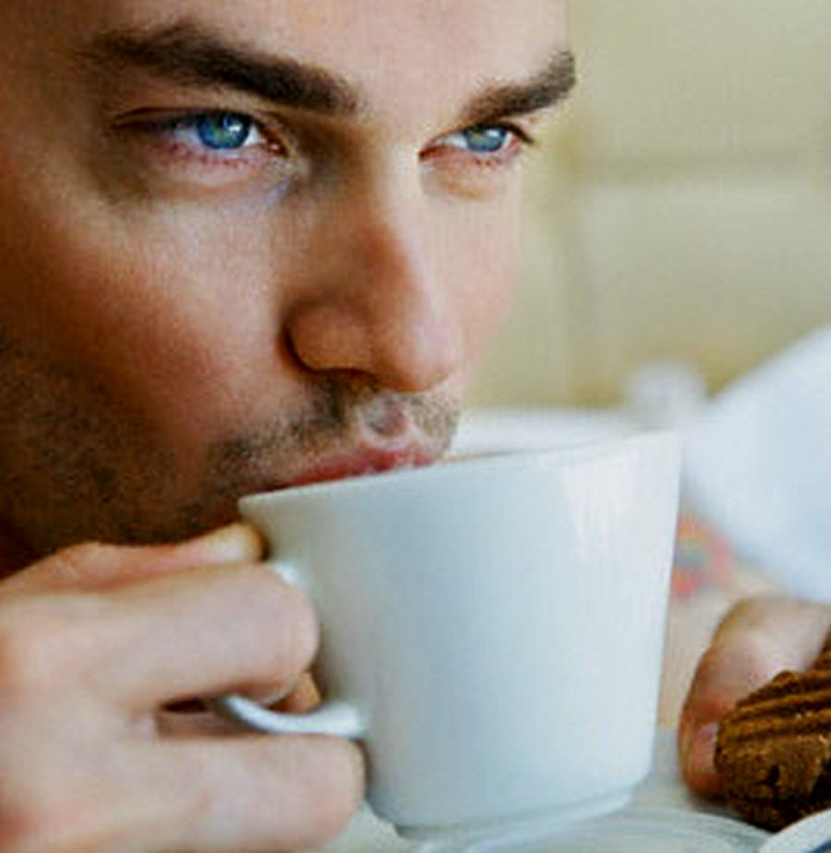

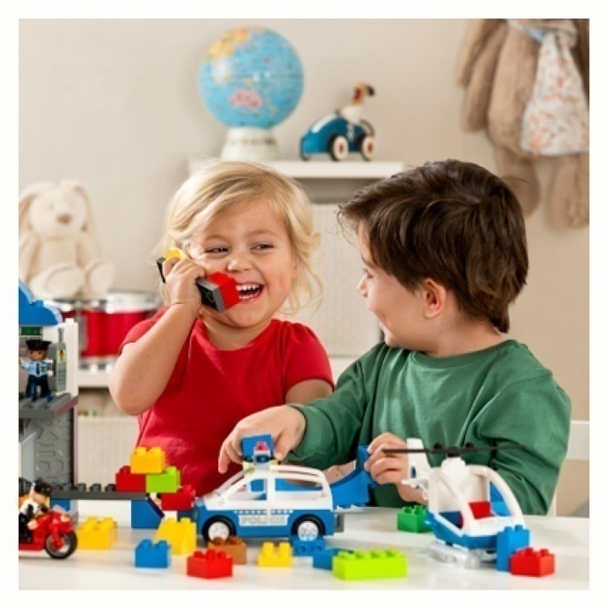
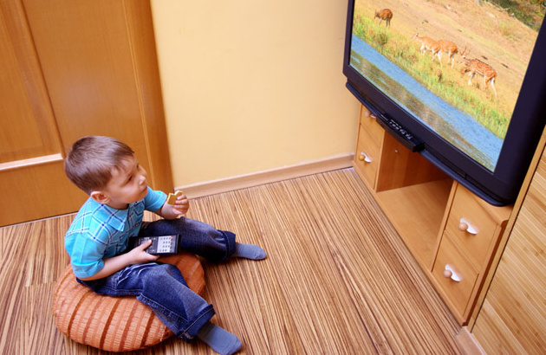
Listen to the text and find the forms of Present Continuous and Present Simple:

Slide 15

DESCRIBE THE PICTURES IN ONE SENTENCE

Slide 16
SHE IS PAINTING NOW

Slide 17
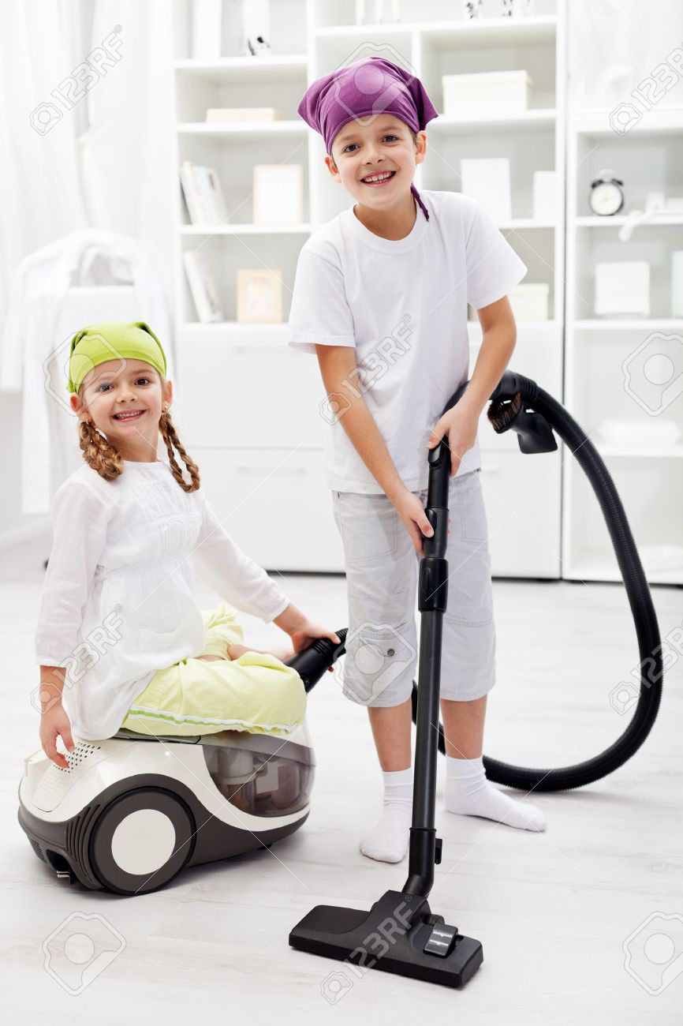
EVERY SUNDAY

Slide 18
THEY CLEAN THE ROOM EVERY
SUNDAY

Slide 19
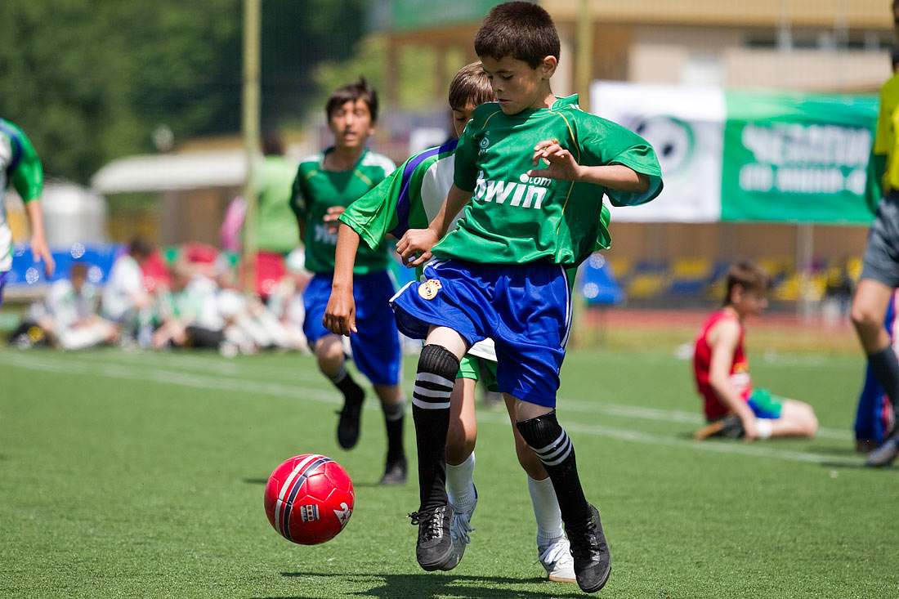
NOW

Slide 20
THE ВOYS ARE PLAYING FOOTBALL

Slide 21
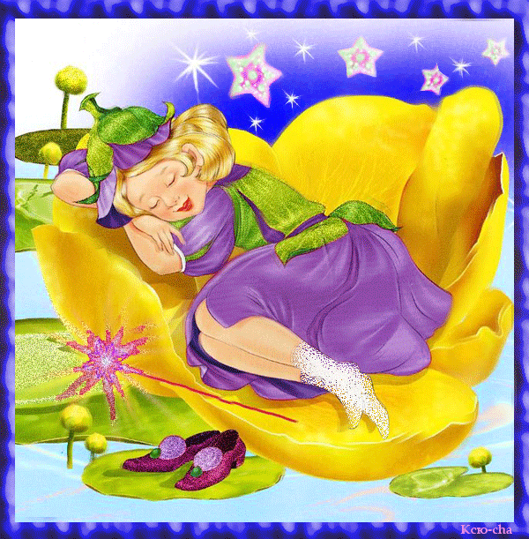
NOW

Slide 22
SHE IS SLEEPING NOW

Slide 23
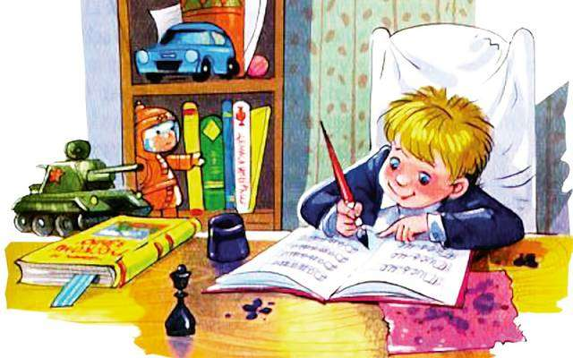
USUALLY

Slide 24
HE USUALLY DOES HIS HOMEWORK

Slide 25

OFTEN

Slide 26
HE OFTEN READS BOOKS

Slide 27
CHOOSE between Present Continuous and Present Simple
1) I …. (to listen) to the radio now.
2) I … (to go) to school every day.
3) I usually … (to do) my homework in the evening.
4) He …. (to write ) a letter now.
5) Ann … (to drive) a car at the moment.

Slide 28
CHECK!!!
Am listening
Go
Do
Is writing
Is driving

Slide 29
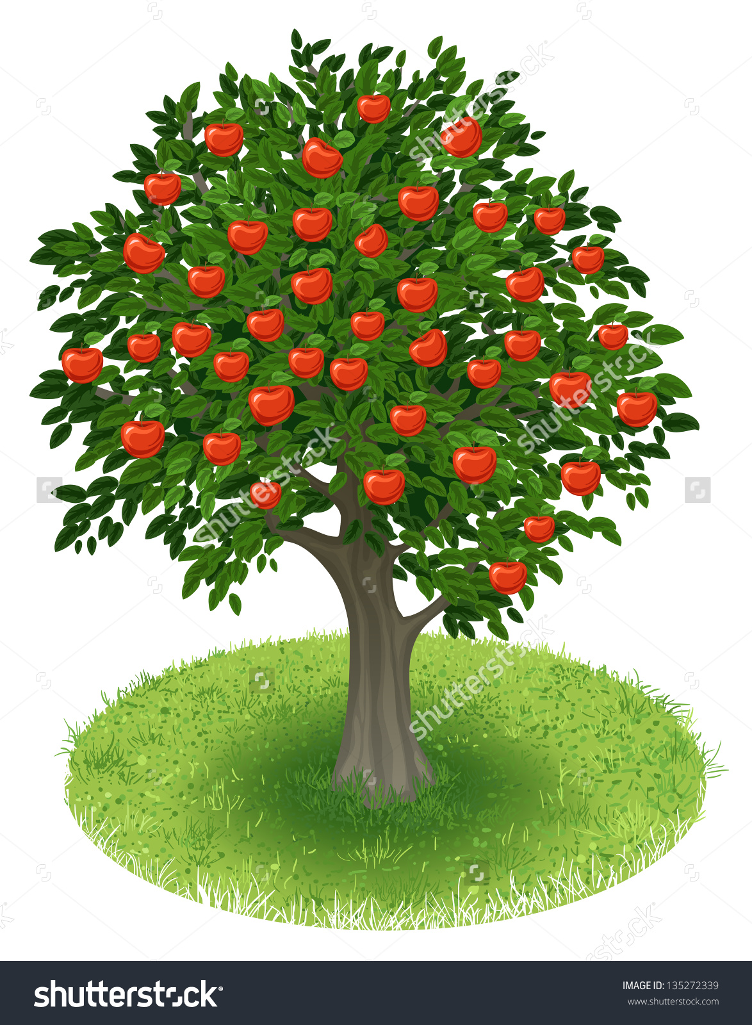
It's time to harvest.

Slide 30
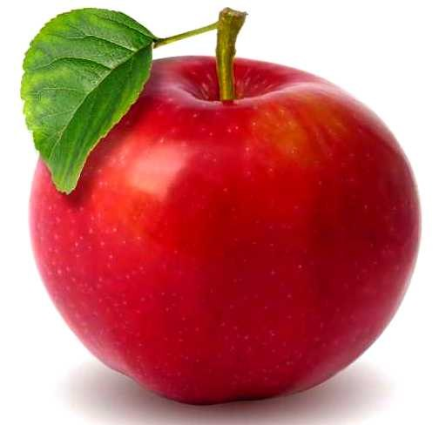
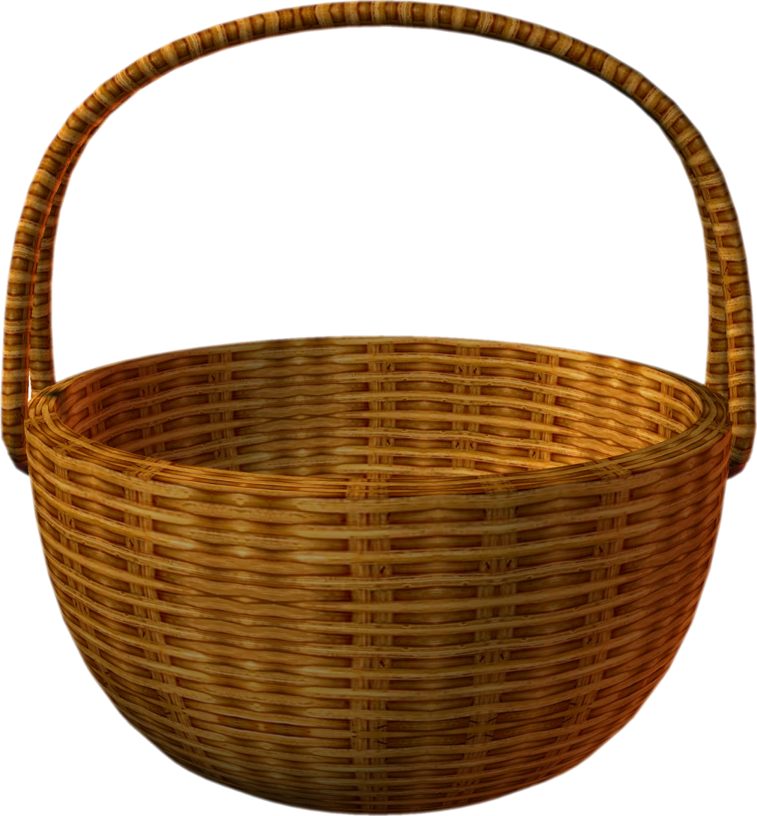
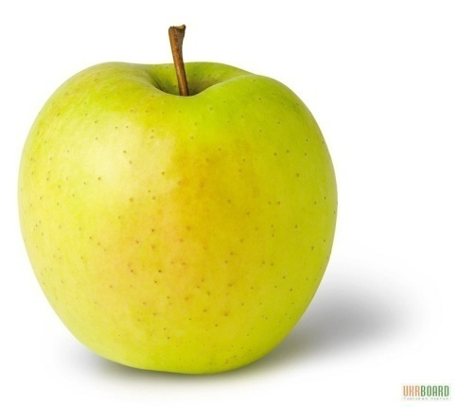
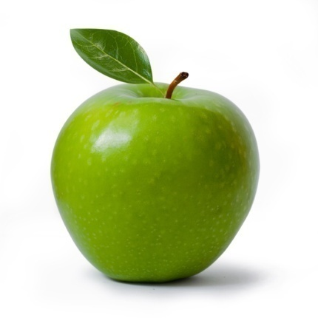
Let's summarize!
Very good
Good
Not so good

Slide 31


