Slide 1
ЛЕКСИКО-ГРАММАТИЧЕСКИЙ ПРАКТИКУМ к учебнику О. Н. Афанасьевой, И.В.Михеевой
АНГЛИЙСКИЙ ЯЗЫК 5 класс
Unit 2
Family History

Slide 2
1.Write the verbs in the past forms.
a) to dream — dreamed to marry to stop to visit to decide | to travel to hop to cry to phone to die to stay

Slide 3
b) to make to become to sing to swim can to ring to speak to grow to sit to fly | to blow to come to ride to spend to go to dream to drink to read

Slide 4
c) to know to feed to say to leave to get to hear to steal

Slide 5
2.Write general questions to the following sentences.
1. They made a wonderful cake yesterday.
Did they make a wonderful cake yesterday?
2. Billy came home early in the evening.
3. My parents flew to Canada last summer.
4. Her friend wrote for the school newspaper last year.
5. Len learnt Italian at the university 2 years ago.

Slide 6
6. You swam in the sea when you were in Spain.
7. Tim spoke on the phone in the morning.
8. Ann sat on the sofa and read a book in the afternoon.
9. Dick spent his holidays in France last year.
10. My granny grew roses in the garden last spring.

Slide 7
3.Mary does these things every day. Write what she did yesterday.
1. Mary gets up at 8 in the morning.
Mary got up at 8 in the morning yesterday.
2. Mary leaves for her work at about 9.
3. Mary drives to her work.
4. Mary writes letters in the morning
5. Mary has lunch in a café.
6. Mary speaks on the phone in the afternoon.

Slide 8
7. Mary goes to the bank at 5 o’clock.
8. Mary comes home at 7 o’clock.
9. Mary eats dinner with her daughter.
10. Mary feeds her cat in the evening.
11. Mary listens to the news on TV at 10 o’clock.
12. Mary usually spends her evenings at home.

Slide 9
4.Make the sentences negative and write them down.
1. Tom drove to the sea yesterday.
Tom didn't drive to the sea yesterday.
2. Sarah flew to Glasgow 2 days ago.
3. Mary grew vegetables in her garden last summer.
4. They learnt to play the piano 3 years ago.
5. We stayed with my uncle yesterday.

Slide 10
6. Len spent a wonderful time in the country.
7. Nina rang her parents three times last week.
8. I got up late on Sunday.
9. They sang an English song at the last lesson,
10. A strong wind blew yesterday.

Slide 11
5.Use the necessary forms of the verbs in the brackets.
1. Last summer a lot of people________( leave) left the city when it was hot.
2. Some people__________( steal) Mike’s car last week.
3. My granny __________________( make)a lemon cake.
4. When I was in Spain,___________(swim) I in the sea a lot.
5. My mother____________(speak) on the phone in the evening.

Slide 12
6. A strong wind__________(blow) yesterday.
7. Aunt Ann_____________(grow) roses in her garden last summer.
8. When Tim___________( come) home, he__________(ring)
the doorbell as he didn’t have a key.
9. Dan _________(dream) to be a banker when he was four.
10 Last week Rose __________(hear) a new song and _________(sing) it.

Slide 13
6.Use the necessary forms of the verbs in the brackets to complete the story.
Don’s Day
Yesterday Don (1get) got up at 6 o’clock in the morning.
Don (2 ride) his bike in the park. He (3drink) a cup of black coffee and (4 eat) a ham sandwich. He (5leave) home for school at 8 o’clock. He (6 stay) at school till late afternoon.

Slide 14
At 4 o’clock he(7 go ) back home, where he (8 feed) his dog and (9 take) it out for a walk.
After that Don (10 do) his homework. He (11 spend) evening with his friends.
Don (12 enjoy) his day a lot.

Slide 15
7.Use the necessary forms of the verbs in the brackets to complete the story.
Lulu Green
Lulu Green (1 be) was born in Glasgow. She was the daughter of a businessman and
a dressmaker. She (2 grow) up near the sea. After school Lulu 99 go) to Glassgow University: she (4 want) be a journalist. Lulu (5 have) a talent for writing.

Slide 16
She (6 can) write funny and interesting stories when she was small. Soon Lulu (7 become) a good journalist. In Glasgow Lulu (8 meet) Ben, a famous actor and (9 marry) him. They ( 10 be) a happy family now.

Slide 17
8.Write who-questions to the following sentences.
1. My cousin was born in Scotland.
Who was born in Scotland?
2.1 am interested in sports.
3. We were in Moscow Zoo yesterday.
4. They are good pupils.
5. Olga was born in February.

Slide 18
6. Kate and Don are in Rome now.
7. Bob and Tim were in Glasgow last week.
Richard and Mary are in the hotel now.
My parents were in Ottawa last winter.
Tim was interested in dancing when he was 10.

Slide 19
9. Write who-questions to the following sentences.
1. My sister fed the dog in the morning.
Who fed the dog in the morning?
2. Liz sang very well at the party yesterday.
3. We had a good time in the country on Saturday.
4. They left London for Moscow last week.
5. The teacher said it to us at the lesson yesterday.

Slide 20
6. Dan spoke a lot on the phone last night.
7. Bob and Tim heard that last Friday.
8. Richard made a nice present for his sister.
9. My parents flew to Kiev last month.
10. Bob came home late at night.

Slide 21
10A. Write true answers to the questions about your family.
1. Who usually makes breakfast for you? — My mom does.
2. Who plays computer games?
3. Who drinks tea in the morning?
4. Who usually goes to the shops?
5. Who washes up?

Slide 22
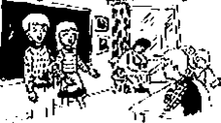
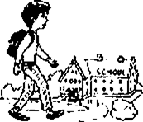
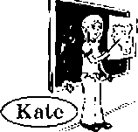
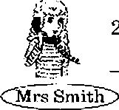

10 B. Look at the pictures and write the answers to the following questions.
Who sang yesterday? Bob and Mary did.
Who spoke on the phone yesterday?
Who walked to school yesterday?
Who rode the bike in the park in summer?
Who knew the answer to the question at the lesson yesterday?
Steve

Slide 23
11. Write 10 things you could/couldn't do when you were 7 years old.
I could swim when I was 7 years old.
____________________________
____________________________
____________________________
____________________________
____________________________
____________________________
____________________________
____________________________
____________________________

Slide 24
12 A. Write who-questions to the following sentences.
1. Ben could sing songs when a child.
Who could sing songs when a child?
2. Bess could read books when she was 6.
3. Don could ride a bike when he was 4.
4. Mary could work on the computer when she was 8.
5. Ted and Tim could ride a horse when they were at school.
6. Mr Green could drive a car when he was 22.

Slide 25
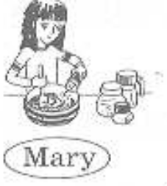
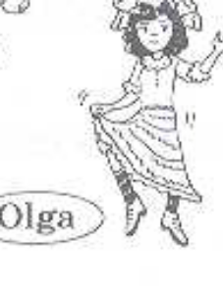
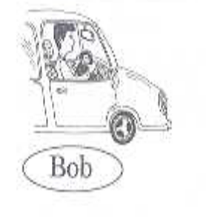

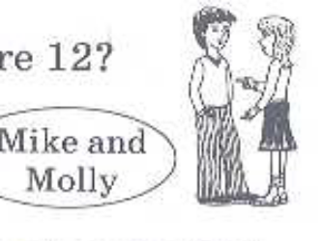
В. Answer the following questions.
Who could cook when she was 17? Mary could.
Who could dance well when she was five?
. Who could speak French when they were 12?
Who could fly a plane when he was 33 ?
Who could do sums when she was 10?
Who could drive a car when he was 18?

Slide 26
13.Make the sentences negative and write them down.
1. Bob could run fast when he was at school.
Bob couldn't run fast when he was at school.
2. Sue could read books when she was 5 years old.
3. Mary could drive a car when she was 18.
4. They could play computer games when they were 3.
5. Sam could play the piano well when he was 11.

Slide 27
6. Len could write funny stories when he was at school.
Nina could sing nice songs when she was small.
I could swim when I was 5
They could go to the country at the weekend.
Pete could dance very well when he was 15 years old.

Slide 28
14. Write the ordinal numerals.
1. one — (the) first 2. two — 3. eight — 4. seven — 5. thirteen — 6. three — 7. five — | 8 eighteen — 9. four — 10. six — 11.nineteen — 12.eleven — 13.twenty — 14.ten — 15.twelve —

Slide 29
15. Write when the people were born using ordinal numerals.
1. Peter was born on the (1st) first of December.
2. Tim and Bess were born on the (22nd) of October.
3. Linda was born on the (11th) of March.
4. My mother was born on the (5th) of November.
5. Her teacher was born on the (23nd) of April.

Slide 30
6. Sally was born on the (8th) of
August.
7. Dick was born on the (4th) of
October.
8. Martha and Kevin were born on the (12th) of June.
9. Sam was born on the (9th) of May.
10. My dad was born on the (16th) of September.

Slide 31
16. Use the where necessary.
1. …London is the capital of … Great Britain.
2 …John lives in …Glasgow. After school he wants to go to … Glasgow University.
3. We want to see …Lake District and … Scotland very much.
4. … Dvortsovaya Square is the most beautiful
square in… St Petersburg.
5 …Alexandrovsky Garden is near … Red
Square.

Slide 32
6. … Russian Museum is a famous museum of … Russia.
7. … Alexander Pushkin is a Russian poet.
8. … Jim’s Spanish is better than his …French.
9. … Washington, D.C. is the capital of… USA.
10. We saw ... Moscow Zoo and … Pushkin
Museum last Friday.

Slide 33
16.Use a, an or the where necessary.
1. I take … Bus 10 to go to …school.
2. D is … fourth letter of … English alphabet.
3. … Room 44 is on … second floor of
… hotel.
4. …text is on … page 2 of … book.
5. … third story in … book is funnier than
… first.

Slide 34
6. There is …. interesting text in … Step 4.
7. .. singer was . .. third child in … family.
8. … journalist is .. person who works in
… magazine or … newspaper.
9 … Mr Black is … good father and …
good husband.
10. Dan wanted to become … doctor when he was … child.

Slide 35
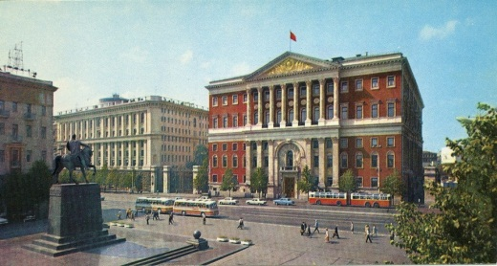
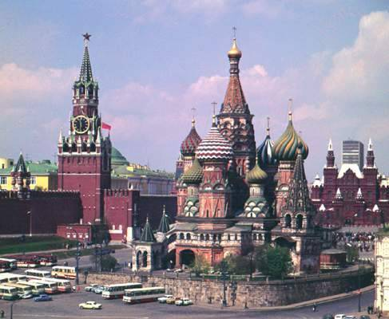
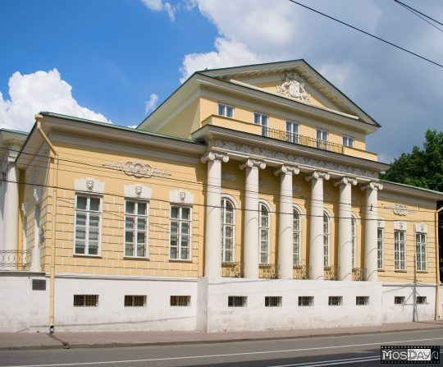
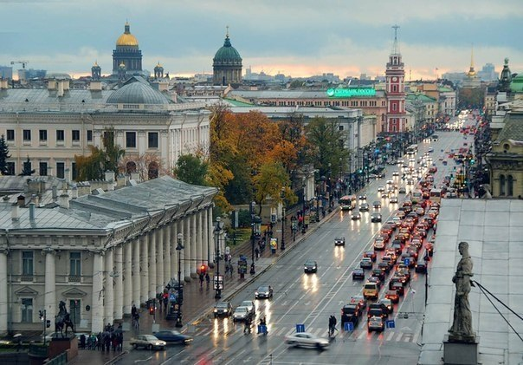
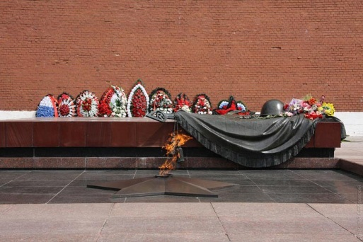
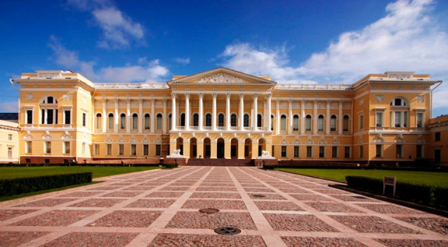
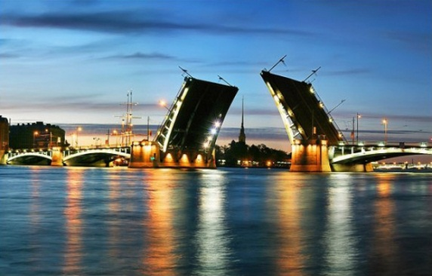
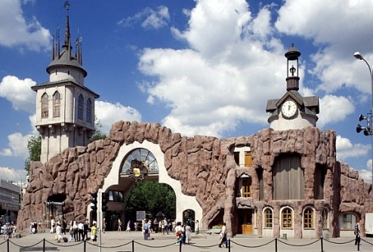
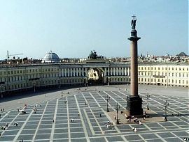
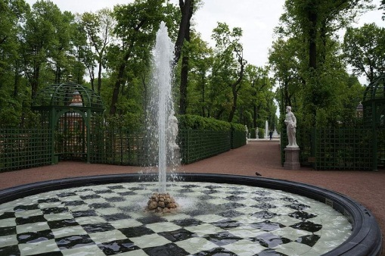
17.Match the pictures to their names
d
a
g
1. Moscow Zoo
2.the Summer Garden
3. Nevsky Prospect
4. Tverskaya Street
5. the Pushkin Museum
6. Dvortsovaya Square
7. Moscow
8. Alexandrovsky Garden
9. the Russian Museum
10. St Petersburg .
i
b
f
c
h
e

Slide 36
18.Complete the sentences using the new words from the box.
journalist, uncle, life, interest, address, dream, university, newspaper, medicine, country, stayed
1.Denis wants to be a doctor. He goes to university and does __________there.
2.Ben is a __________and he writes interesting stories
for the „
3There was no _____________ in the letter.
4.Mary’s _______________ and her aunt are nice people.
5. Her ________________ is to become a famous singer.
6.James has a strong ____________ in farming.
7._______________ in a city is easier than in the _______ .
8. Lily ______________ with her grandparents yesterday.

Slide 37
19.Use the prepositions from the box where necessary to complete the sentences. about, at, by, for, in, of, on, to, up, with
1. They left __ Glasgow for London yesterday.
2. My parents went ___ the sea ___ train and I drove there __ my car.
3.__ 7 o’clock Peter usually comes__ home.
4. What’s your address? — I live___15 Green
Street, __Leeds.
5. You’ll visit a lot of places___ interest___
Washington, D.C.
6. Martha has a talent __music and she wants to be a music teacher __ school.

Slide 38
19.Use the prepositions from the box where necessary to complete the sentences. about, at, by, for, in, of, on, to, up, with
7. What are you dreaming ______ ? — I want to make a career______medicine.
8. Room 132 is ______the fourth floor ______ the hotel.
9. When Ron went______Glasgow, he never stayed
a hotel, he stayed ______ his grandparents.
10. Some children don’t want to get___and go
______school______Monday mornings.
11. Bob spent a lot of time doing sums and reading books when he went_____university.
12. Ted was born ______ the fifth September___
2004.

Slide 39
20.What are the capitals of the following countries?
Helsinki, Kiev, Moscow, Rome, Madrid, London, Paris, Washington, D.C., Ottawa
1. Rome is the capital of Italy.
2. _______ is the capital of Great Britain.
3.__________ is the capital of Finland.
4.________ is the capital of Spain.

Slide 40
Helsinki, Kiev, Moscow, Rome, Madrid, London, Paris,
Washington, D.C., Ottawa
Helsinki, Kiev, Moscow, Rome, Madrid, London, Paris,
Washington, D.C., Ottawa
5. ____ is the capital of Russia.
____ is the capital of France.
7.______ is the capital of Ukraine.
_____is the capital of the USA.
______is the capital of Canada.

Slide 41
21. Write who these people are.
1. Your father’s daughter is your sister.
Your father’s sister is your _______.
Your father’s father is your _________.
Your mother’s mother and father are your________.
Your mother’s son is your _________.

Slide 42
6. Your mother and father are your ___.
7. Your aunt’s daughter is your___.
8. Your father’s mother is your ____.
9. Your uncle’s son is your____.
10. Your mother’s brother is your ____.

Slide 43
22.Write when and where these people were born.
1.Sally/Paris/August
Sally was born in Paris in August.
2.Wendy and Peter/Glasgow/March
3.Ira/Kiev/July
4.Pedro/Madrid/November
5.Olga and Natasha/Novgorod/February

Slide 44
6. Kate and Ann/St.Petersburg/January
7. Steven/Washington, D.C./October
8. Rob/Helsinki/May
Nick/Rome/April
Tom and John/Leeds/September
Mike/Ottawa/June

Slide 45
23.Write the numbers in words and do the sums.
50+22= Fifty and twenty two is seventy two 28+7= 33+34= 77+13= 45+6= | 11+18= 92+8= 14+52= 30+50= 66+9= 73+7=

Slide 46
24.Write the years in words.
1. 1945 Nineteen forty-five 1903 3. 1812 4. 2013 5. 1147 | 6. 2002 7. 2000 8. 1948 9. 1492 10. 1973 11. 1961

Slide 47
25.Write 5—7 true sentences about your family.
My father | is interested in | music
 | are | computer games
 |  | sport
My mother |  | dances
My cousin(s) |  | old films
My grandmother |  | books
My grandfather |  | photography
My grandparents |  | animals
My uncle(s) |  | travelling
My aunt(s) |  | going abroad

Slide 48
26. Write what their jobs are.
1.Sue and Bob work on the farm.
They are farmers.
Mary teaches music at school.
3.Denis cooks food.
4.Margaret makes dresses,
5.Tom works in a shop.

Slide 49
6. David flies planes.
7. Bess and Kate write books.
8. Liz sings songs.
9. Boris and Alex work in a hospital
10. Dan works in a bank.
11. Susan makes bread.

Slide 50
27.Match the words to make the names of some jobs and write them down.
1. dress | a) man
2. shop | b) man
3. business | c)teacher
4. sports | d) maker
5. fisher | e) woman
6. music | f) assistant

Slide 51
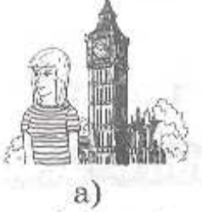
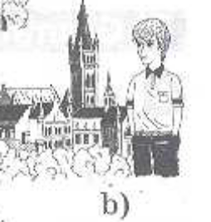
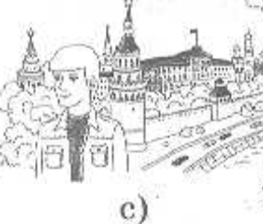
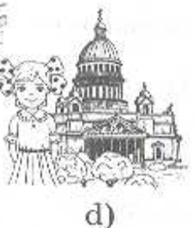
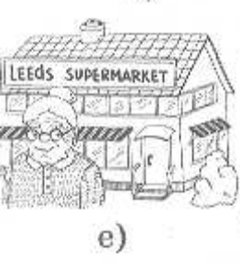
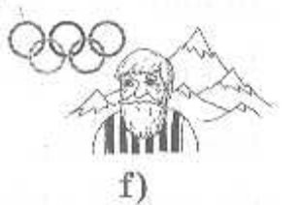
28.Match the pictures of the people to the addresses where they live.
I live at 22 Tverskaya Street, Moscow.
I live at 10 High Street, London.
I live at 15 Apple Street, Leeds.
I live at 22 Green Street, Glasgow.
I live at 1 Central Park, Sochi.
I live at 14Nevsky Prospect, St. Petersburg.

