Slide 1
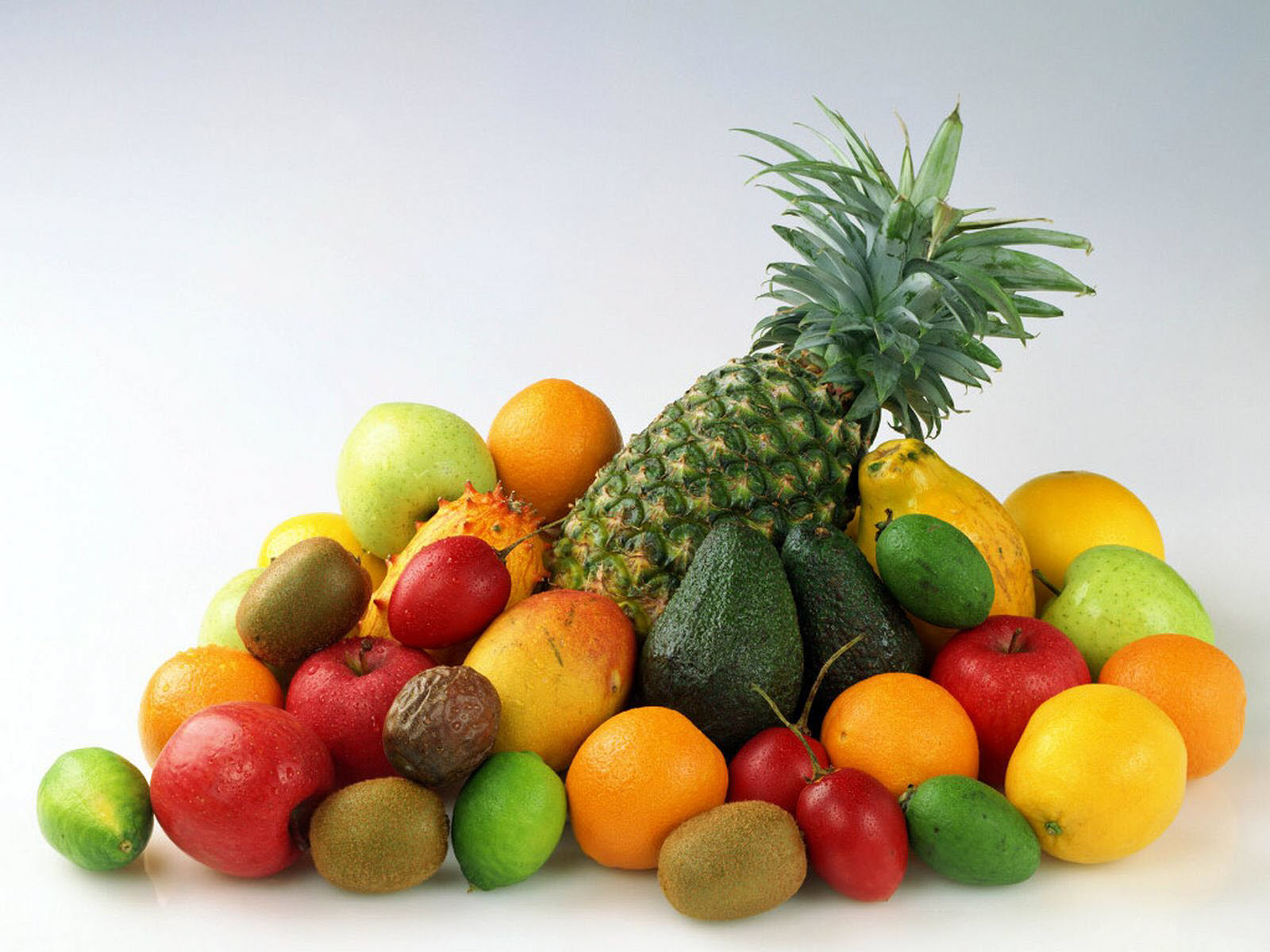
Pirate’s fruit salad!
Учитель английского языка
ГБОУ ООШ с. Заплавное
М.И. Анисимова

Slide 2
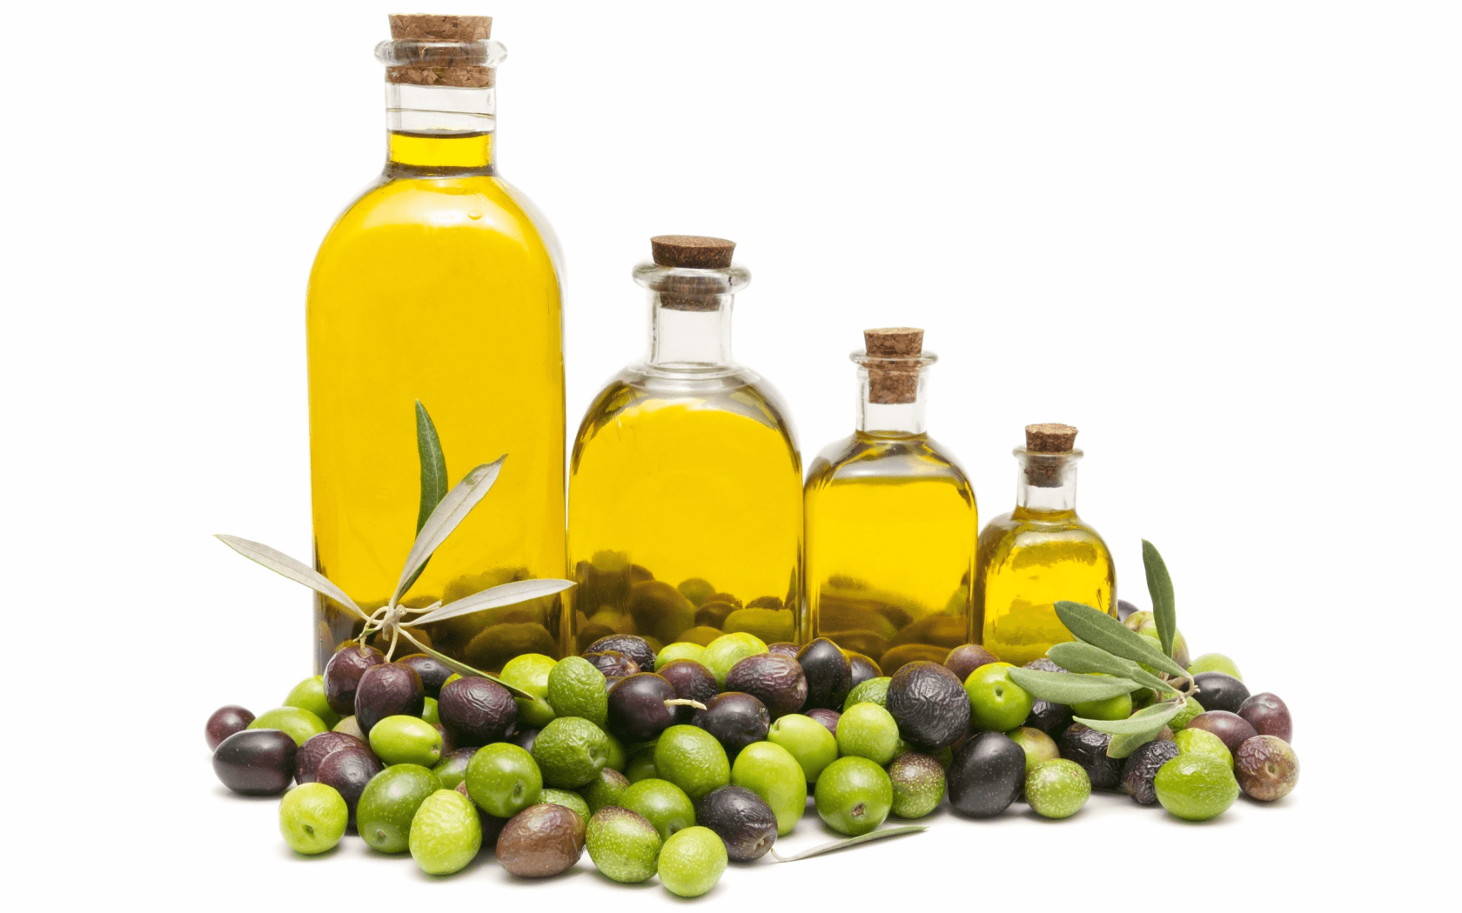
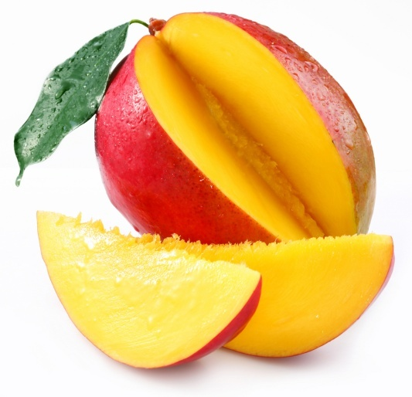
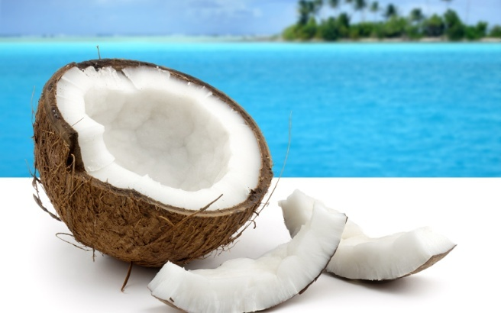
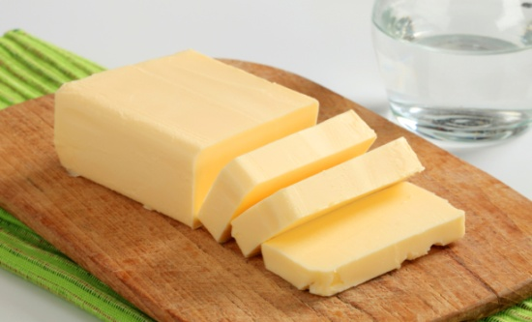
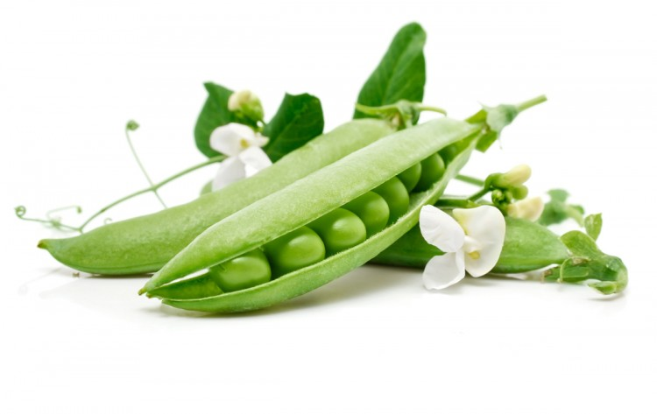
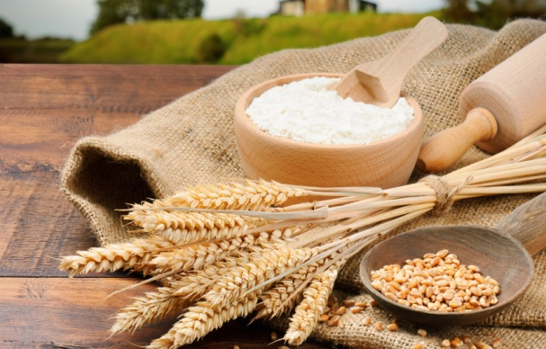
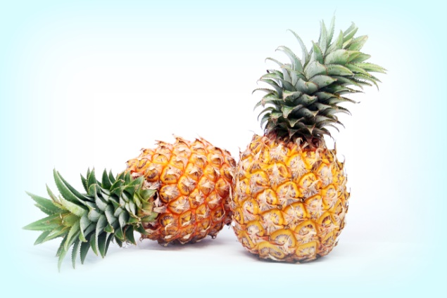
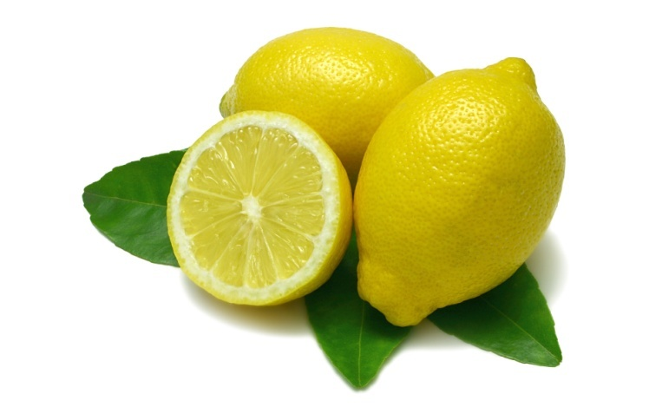
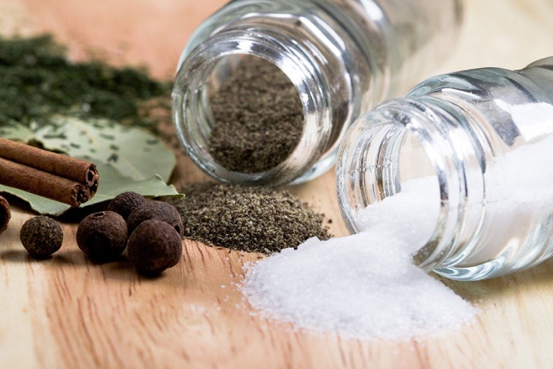
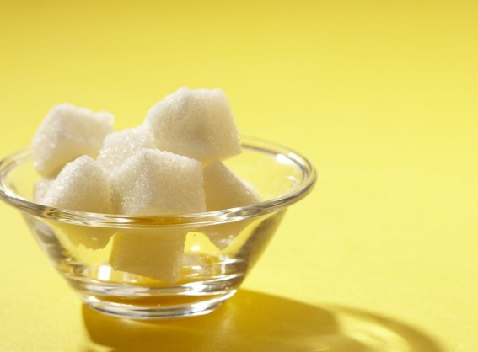
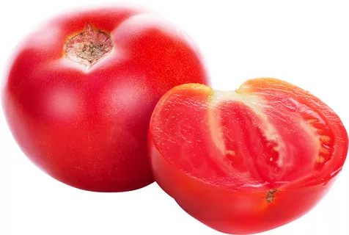

Slide 3

mloen epepiplan
lemon pineapple

Slide 4
sbean olvielio ngoma
beans olive oil mango

Slide 5
arsug tebutter eeprpp lsat
sugar butter pepper salt

Slide 6

nootucc rfuol otmaot
coconut flour tomato

Slide 7
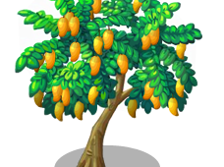
In the magic garden there are lots of oranges on the green mango tree.

Slide 8
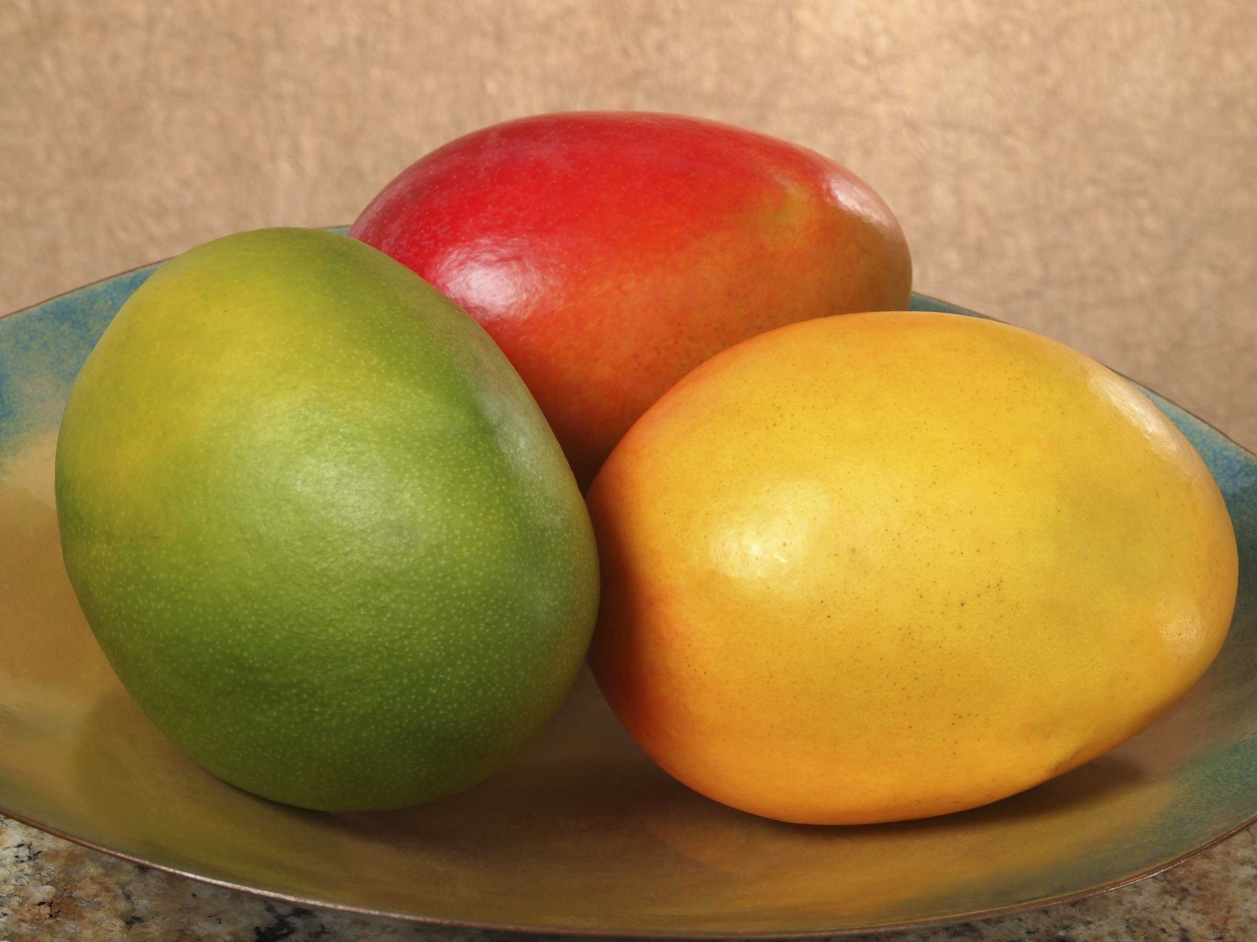
How many mangos are there?

Slide 9
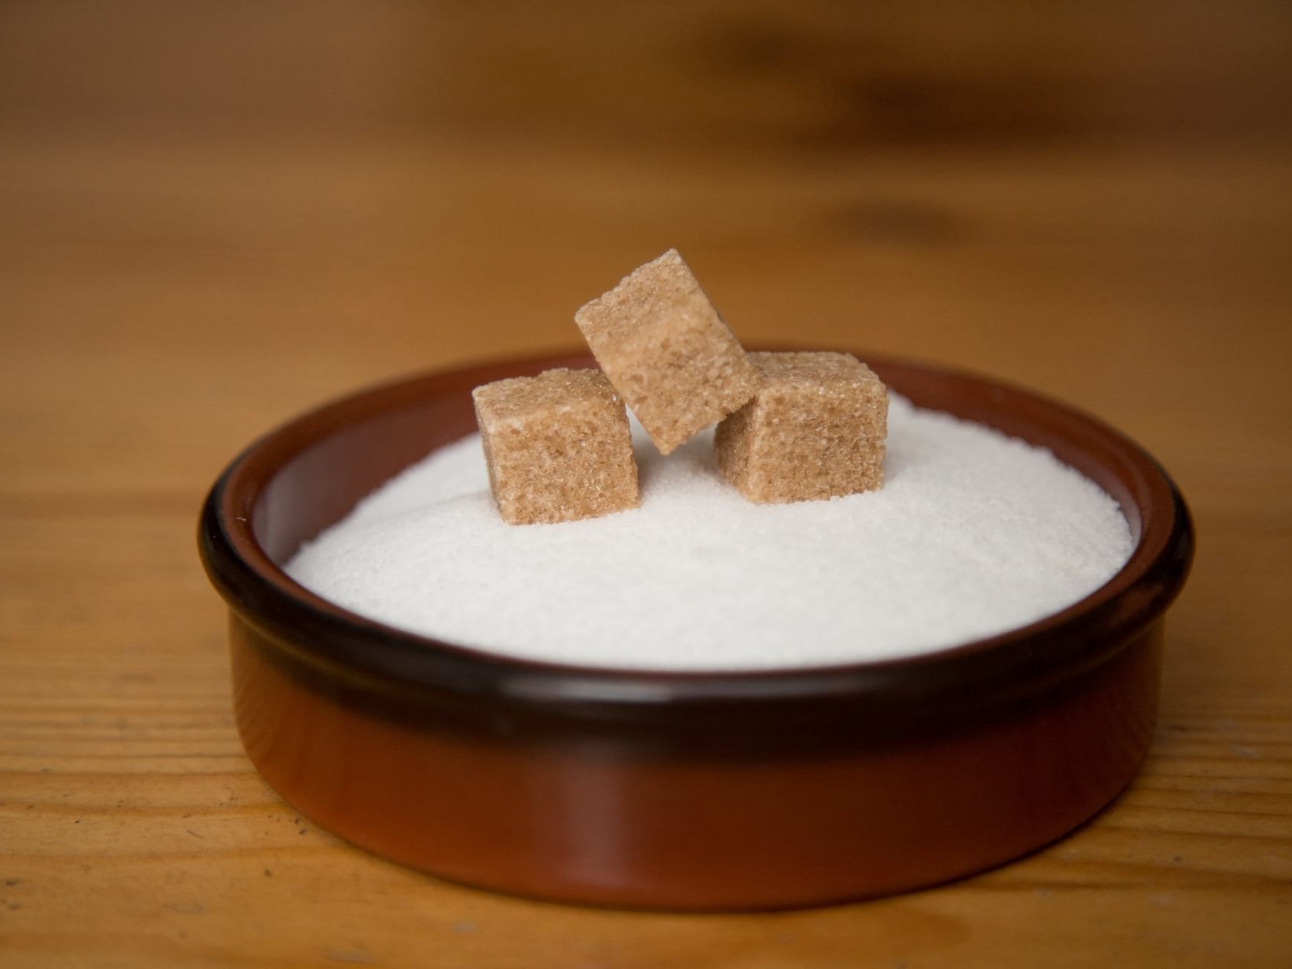
How much sugar are there?

Slide 10
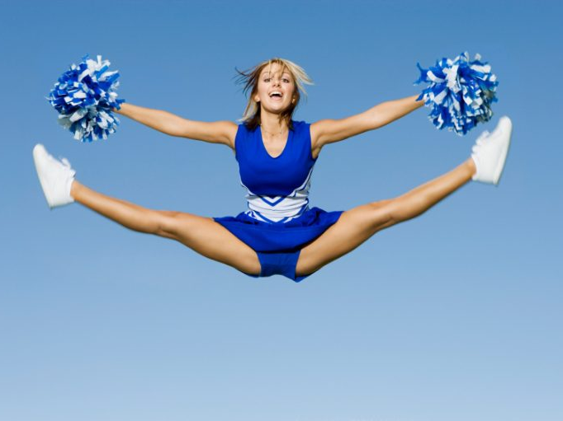
We’ll jump so high, high, high,
We’ll touch the sky, sky, sky

Slide 11
Use «much» or «many»!
How ... lemons?
How ... sugar?
How ... flour?
How ... coconut?
How ... salt?
How ... tomatoes?
How ... juice?

Slide 12
I have got ______________ friends.
I see ___________ cars in the street.
Have you got _________ books?
We don’t have __________ books at home.
In the park you can see _________ trees.
We don’t have _________ apple trees in the garden.
There is __________ snow in winter in Russia.
Children must drink __________ milk.
Do you see ________ cars in the street?
Have you got __________ sweets in the pocket?
You must drink __________ juice.
We must not eat __________ sweets.
I don’t have __________ water in the glass.
Do you read ___________ books?
In my room I have not __________ pictures.
In my classroom we have _______ pictures.
My friend has got ____________ pencils.
Can you see ________ animals in the zoo?
There isn’t _________sugar in the tea.
They don’t eat __________ fruit in winter.
I have got ___________ pens in my pencil box.

