Slide 1
«FOOD EXPERTS»
(урок обобщения и систематизации знаний
по теме «Food»)
The 6th form
Учитель
II квалификационной категории
Лисовская Оксана Валентиновна

Slide 2
The aims of the lesson:
Today at the lesson we are going to:
Use active vocabulary of the unit in speech
Work in groups and pairs (mini projects, dialogues)
Sum up all the information about healthy/unhealthy food
Improve our pronunciation skills (sounds [p], [t], [ei], [i:])
Revise such a grammar phenomenon as “The Present Simple Passive Voice”
Develop our listening skills
Work out rules of a healthy diet

Slide 3
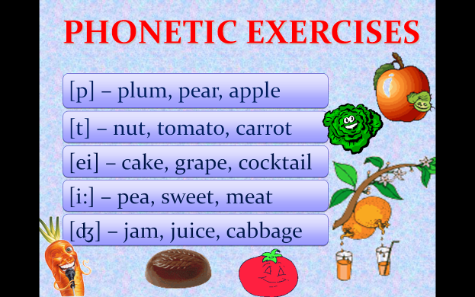

Slide 4

DO YOU LIVE TO EAT
OR
EAT TO LIVE ?
I think/In my opinion/As for me

Slide 5
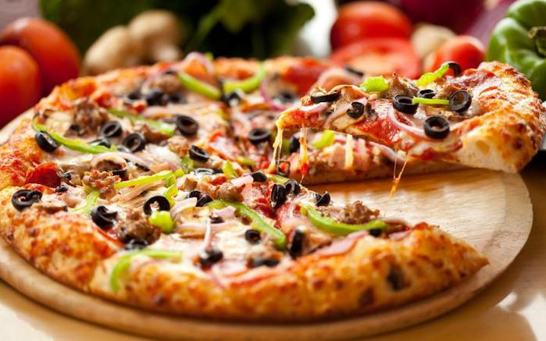

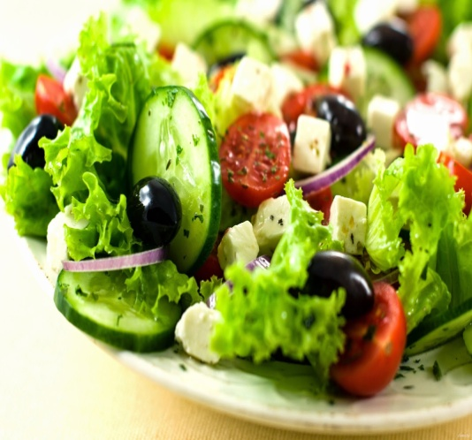
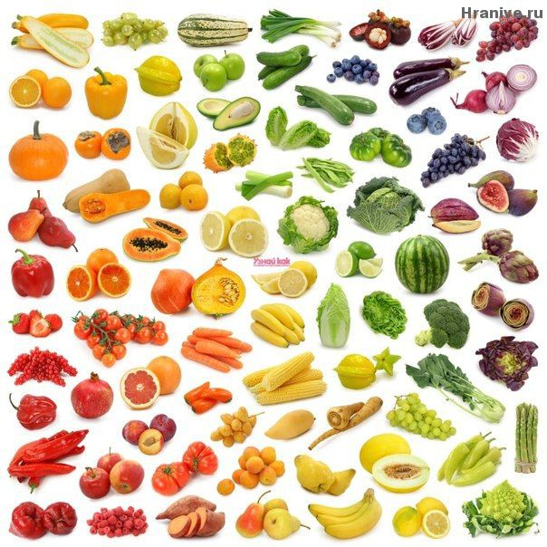
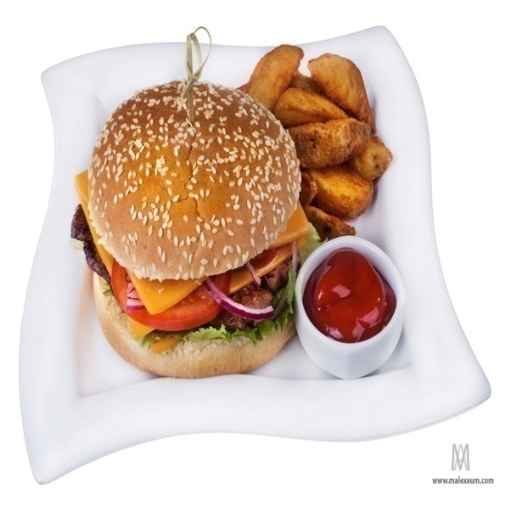
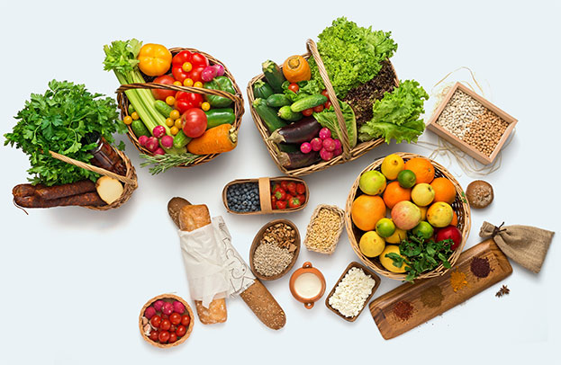
FOOD IN PICTURES

Slide 6
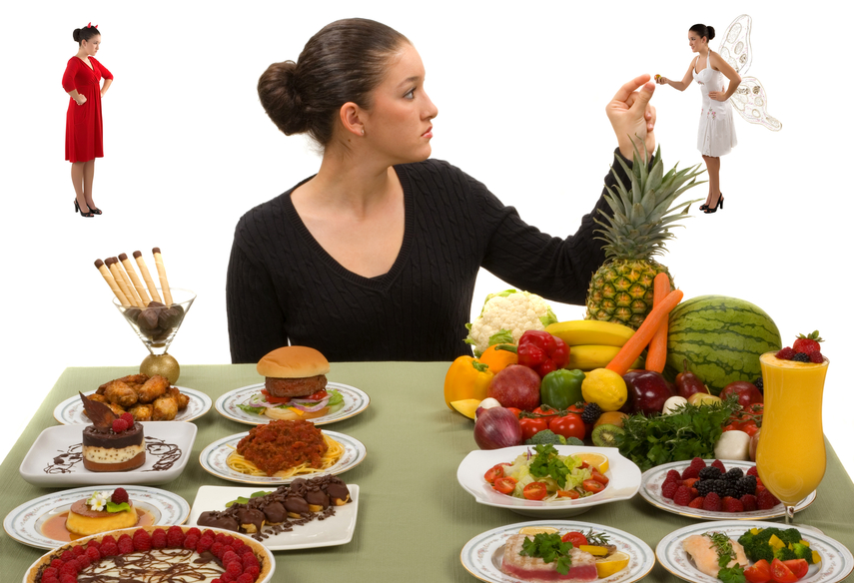
Is your diet healthy?
My diet is healthy because I eat…
My diet is unhealthy because I eat….

Slide 7



THE GUESSING GAME
It is made from ………..
It is served with …………
I think/in my opinion/ it’s ………

Slide 8
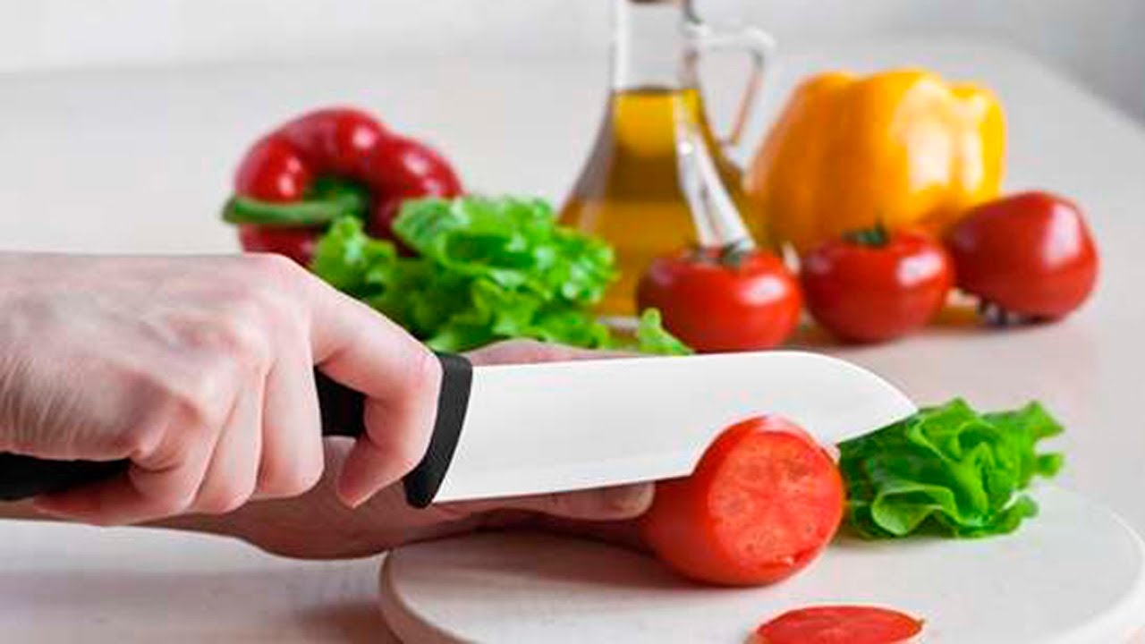
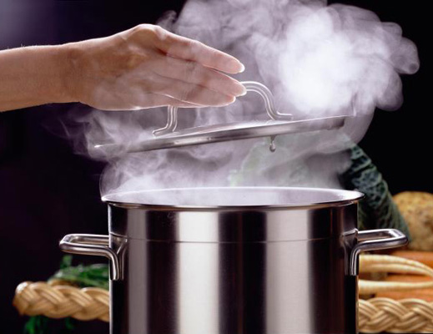
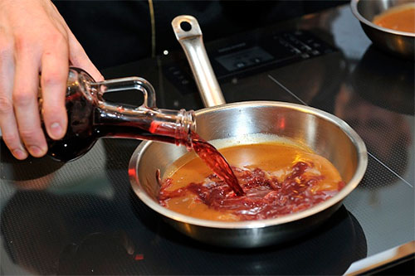
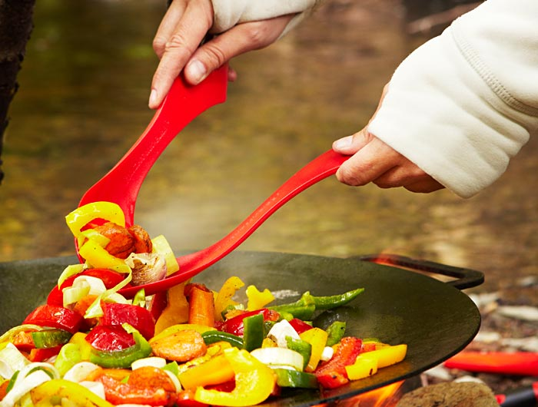
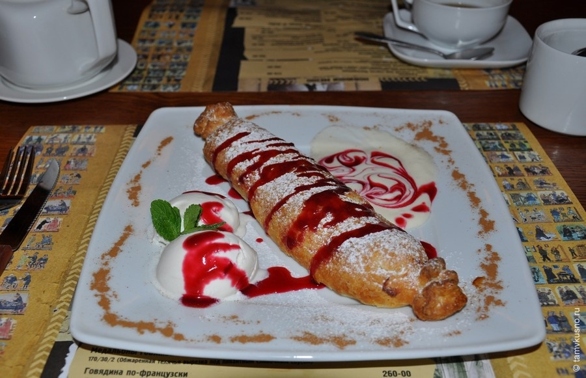
MINI PROJECTS

Slide 9

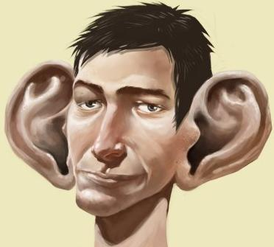

HIGH TIME
FOR LISTENING!!!!!

Slide 10
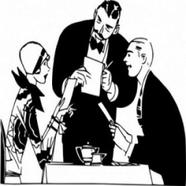
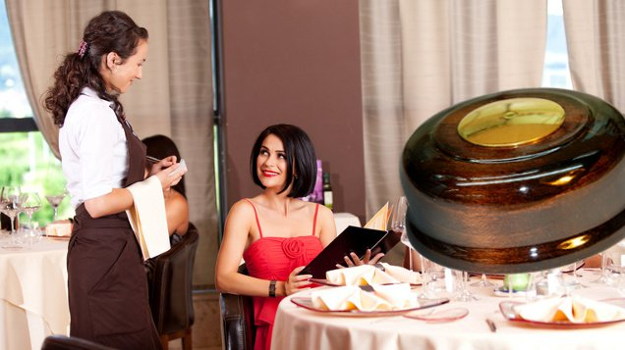

“AT THE CAFE”

Slide 11
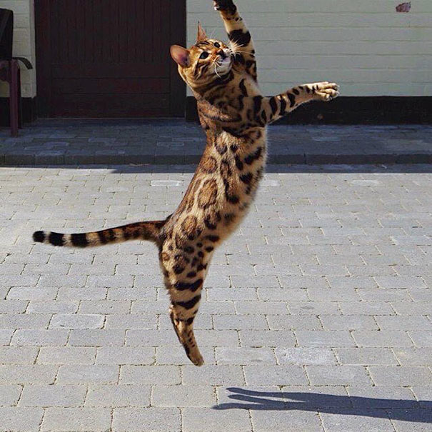
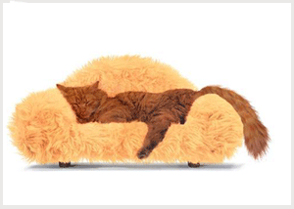
GRAMMAR SECRET
PASSIVE VOICE
Is the subject
Active or Passive?

Slide 12
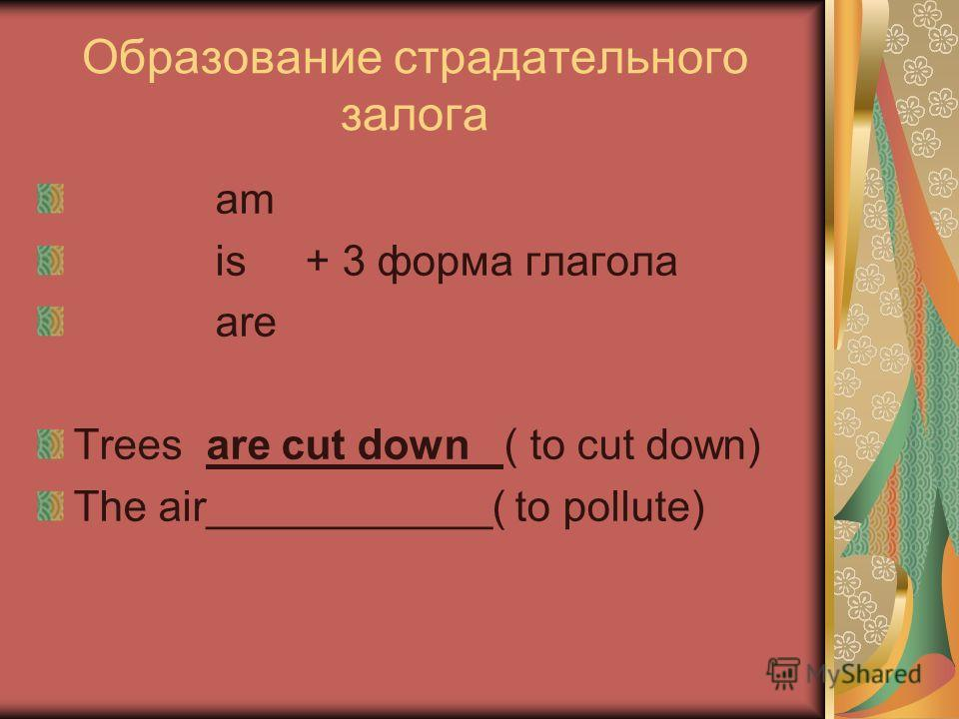

Slide 13
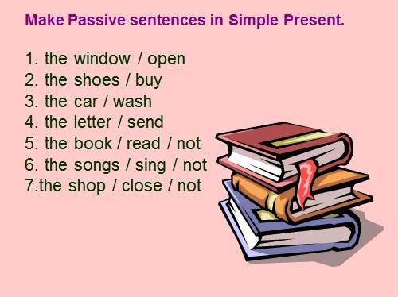

Slide 14
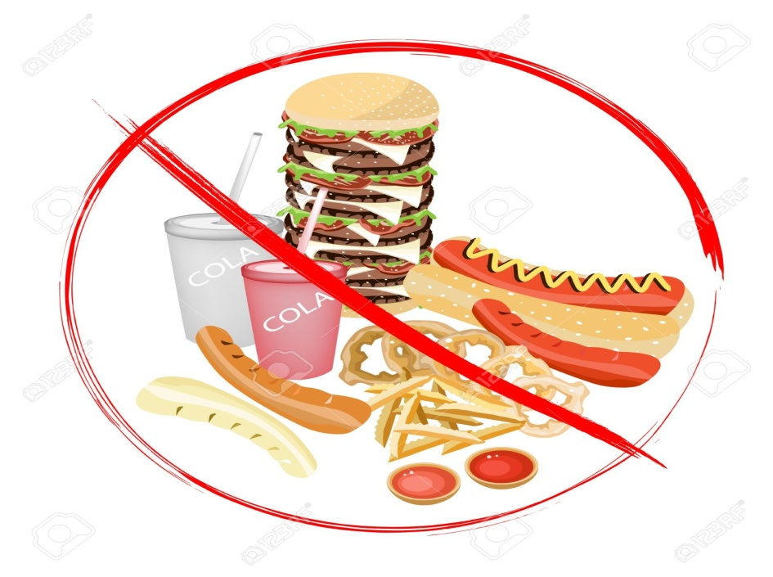
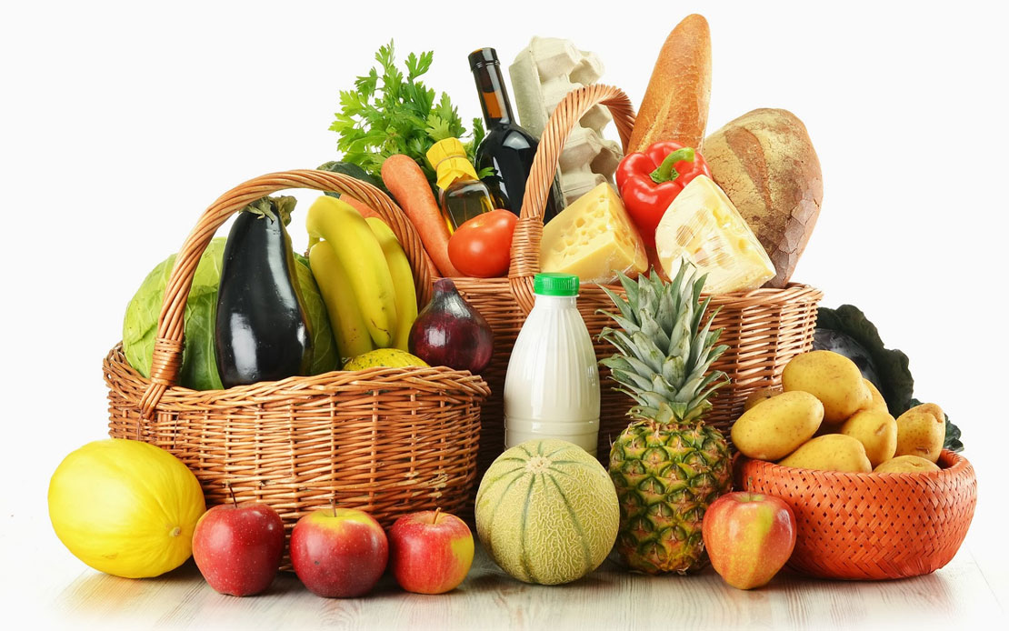
Rules of a healthy diet ☺
WE SHOULD EAT ……. BECAUSE……
WE SHOULDN’T EAT……. BACAUSE….

Slide 15
My opinion about the lesson
If you like the lesson say:
I choose a green apple because the lesson was….
If you don’t like the lesson say:
I choose a red apple because the lesson was….

Slide 16
H/t: правило стр. 258-260 слова стр. 135-153

Slide 17


