Slide 1
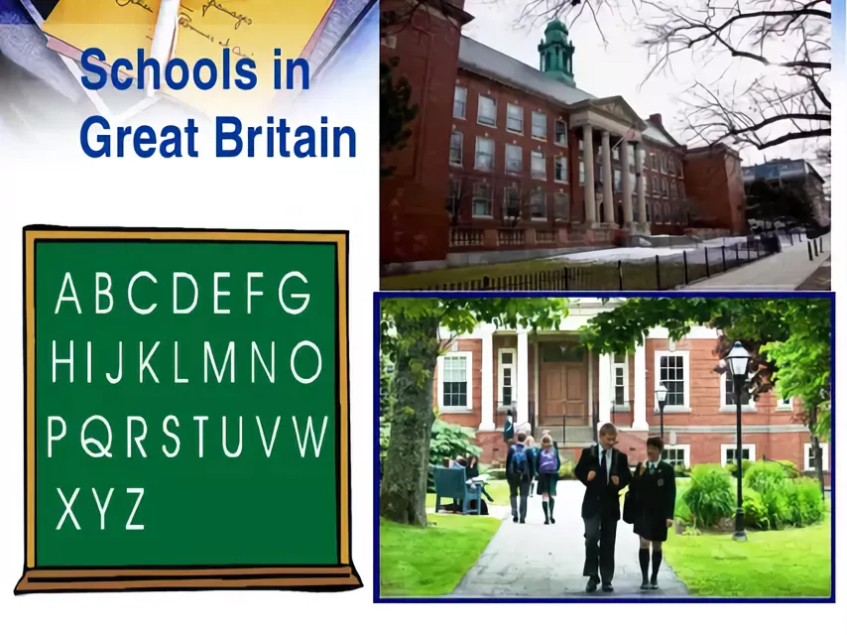

Slide 2
Check up your homework.

Slide 3
2.Brainstorming.
Let’s repeat
Primary
Ordinary
Comprise
Curriculum
Secondary
Compulsory

Slide 4
Pre-listening stage
compulsory - міндетті
nursery school – балабақша (от 2 до 5 лет)
pre-school – мектепалды
state school – мемлекеттік мектеп
free - тегін
primary – бастауыш
infant school – мектепалды даярлық сынып (младшая начальная школа для детей от 5 до 7 лет)
junior school – бастауыш сынып (от 7 до 11 лет)
to attend – қатысу
secondary – орта
comprehensive school – жалпы білім беретін орта мектеп (общеобразовательная) школа
Prefects – cтароста
boarding schools - школа-интернат
To explane - тусіндіру
Ability –способность, қабілет
Church schools - Діни мектептер, церковная школа
GCSE – General Certificate of Secondary Education- орта білім туралы сертификат алуға арналған емтихан
“A” !advanced! level exam “A”деңгейіндегі емтихан продвинутых кенейтілген

Slide 5
b. While - listening Stage

Slide 6
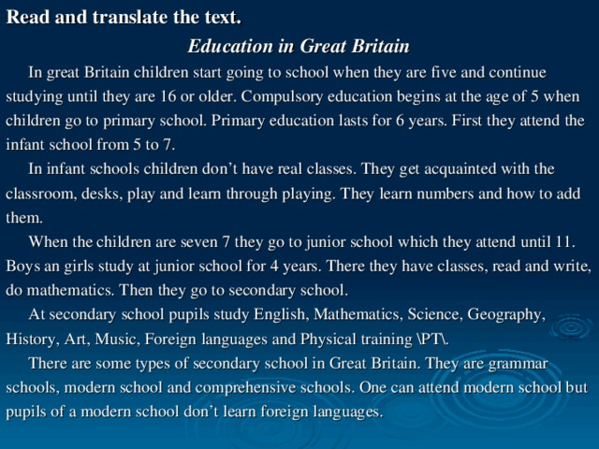

Slide 7
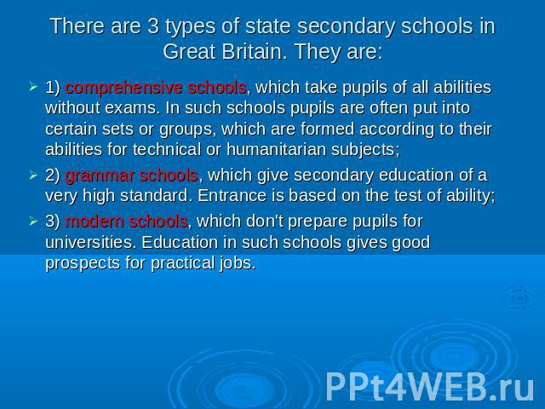

Slide 8
c. Post listening Stage
Is it TRUE or FALSE?
1. In GB children start going to school when they are seven.
2. Compulsory Education begins at the age of 11.
3. Primary education lasts for four years.
4. Students in GB wear uniforms.
5. Students get acquainted with their teacher on the 25th of May
6. In primary schools children learn how to write and read, and do mathematics.

Slide 9
2. You should listen and answer the questions. Students of 10th grade prepare some questions according this text.
In what schools does primary education take place in Britain?-
How long does compulsory secondary education last?-
What can children do after the 5th form?-
When do students take their 1st public exams GCSE?-
How long does the 6th form last?-
What schools are called boarding schools?-

Slide 10
C. Complete the sentences according to the listening text
1. Compulsory education in England begins at the age of five when children go to ………. school.
2. ……….. education lasts for six years.
3. When children are seven they go to ……. school which they attend until eleven.
4. One can attend …….. school , but pupils of modern school don’t learn foreign languages.
5. English, Maths and Science are called “…… ” subjects.
6. A boy’s ……… consists of a special suit, a school cap, a tie and a blazer.

Slide 11
5.Relaxation. Lets Sing a song
1.Listen and write down the lost words
2. Sing a song together

Slide 12
4.Translate the following sentences into English
1.Ол алты жылдық бастауыш мектепті бітірген соң , орта мектепке барады.
2.Бастауыш және орта мектеп бірігіп он бір жылды құрайды.
3.Оқу жылы тоғыз айға созылады.
4.Англияда міндетті оқу бес жастан басталады.
5.Тоғыз жылдық оқу жалпыға бірдей міндетті.

Slide 13
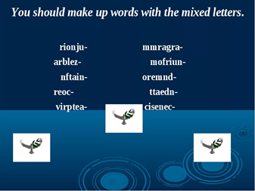

Slide 14
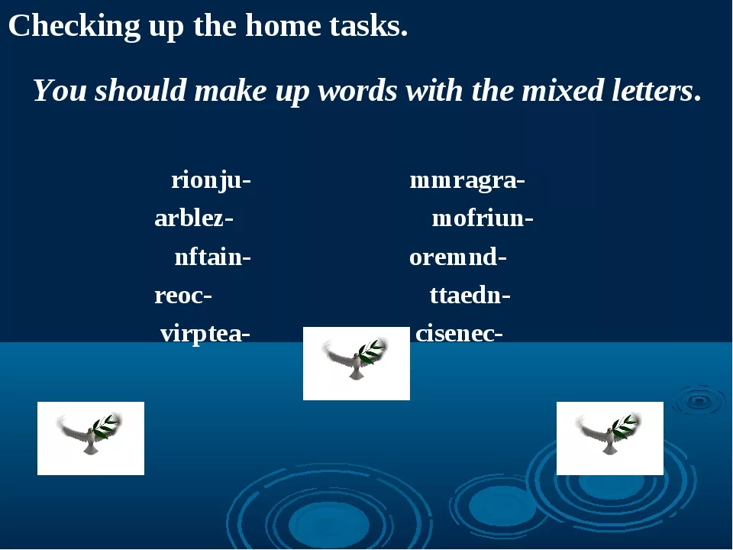
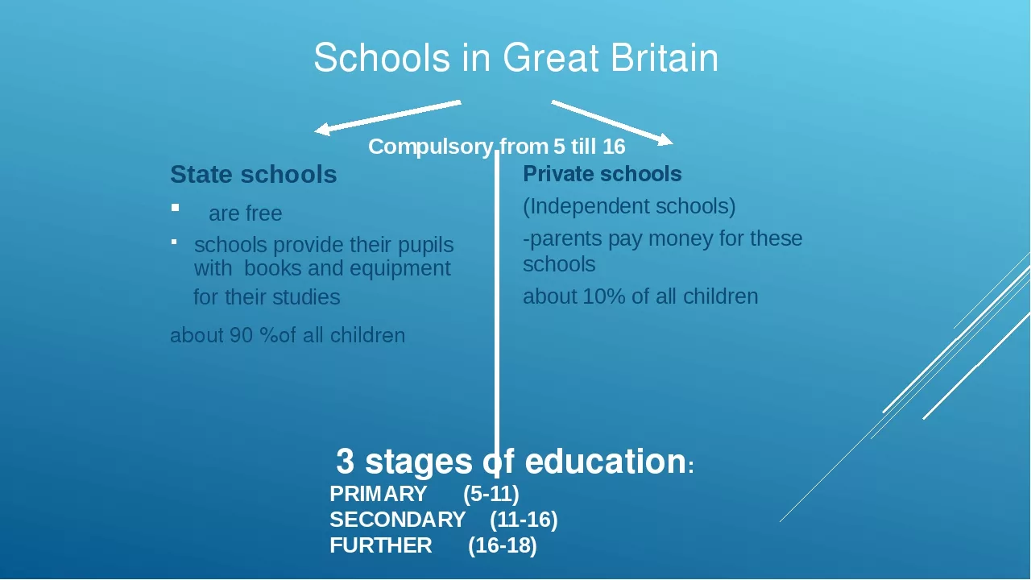
FEEDBACK What I have known?

Slide 15
FEEDBACK What I have known?
2-4
5-7
7-11
11-16
17-18

Slide 16
Home task:
retell the text “Schools in GB”

Slide 17
