Slide 1
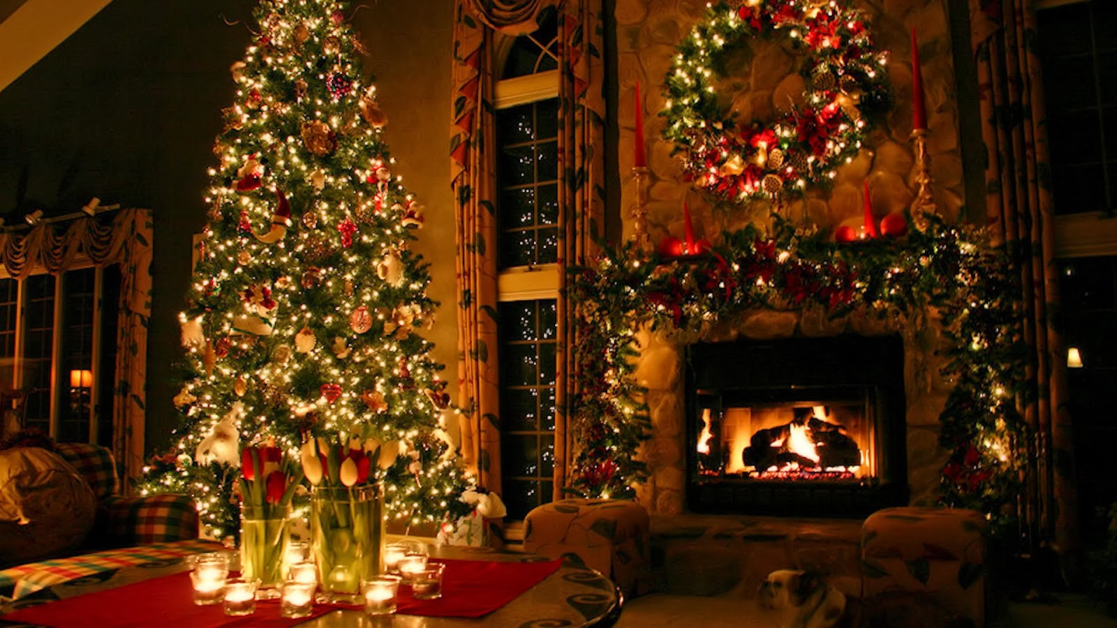
Merry Christmas!

Slide 2
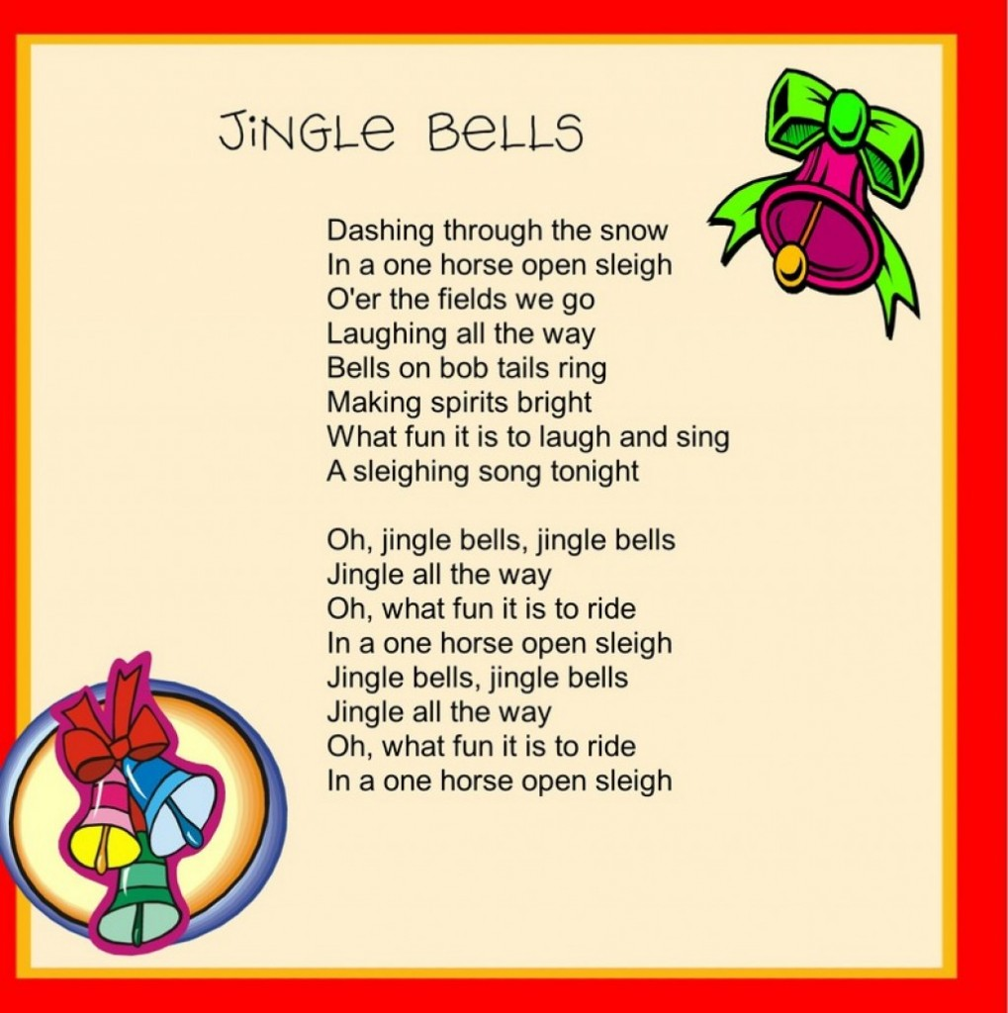

Slide 3
How many Christmas words do you know?
The 24th of December is called Christmas … .
There is a … … in every house and family decorate it together.
People give …. on Christmas Day.
On the morning of 25 December children find a lot of presents in their … .
Traditional Christmas food is … and … .
Santa climbs down the … to leave presents for children.
We can see a … at the top of a Christmas tree.
The Christmas tree has lots of … on it.
A … … is a special Christmas cake that people eat in the United Kingdom.
Children write letters to … … .
A … is a special Christmas song.
Santa Claus, Eve, chimney, presents, Christmas tree, star, turkey and Christmas pudding, decorations, mince pie, stockings, Jingle Bells

Slide 4
Make up 3 word combinations and 3 sentences with the word “Christmas”

Slide 5
Find as much Christmas words as possible and write them down

Slide 6
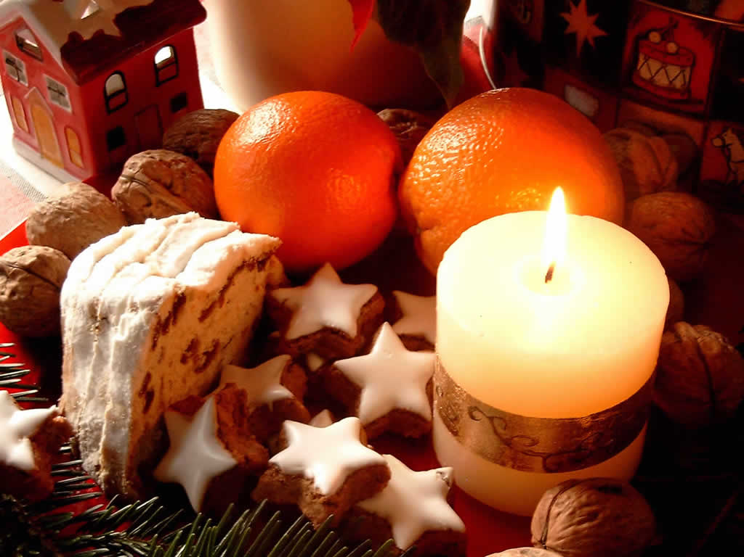
Christmas quiz!

Slide 7
When is Christmas celebrated in Europe?
1. It is celebrated on the 25th of December
2. It is celebrated on the 14th of January
3. It is celebrated on the last day of December

Slide 8
It is celebrated on the 25th of December

Slide 9
Whose birthday is celebrated on Christmas?
1. Santa Claus’s birthday
2. Jesus Christ's birthday
3. Queen Elizabeth’s birthday

Slide 10
Jesus Christ's birthday

Slide 11
Do the Russians celebrate this holiday? When do they celebrate it?
1. Yes, they do. Russians celebrate Christmas on the 1st day of January
2. No, they don’t celebrate it
3. Yes, they do. Russians celebrate Christmas on the 7th of January

Slide 12
Yes, they do. Russians celebrate Christmas on the 7th of January.

Slide 13
When did the custom of sending Christmas Cards to friends, relatives and colleagues appear?
1. This custom appeared in the 19th century.
2. This custom appeared in the 20th century.
3. This custom appeared in the 18th century.

Slide 14
This custom appeared in the 19th century.

Slide 15
Where does Santa Claus live?
1. Lapland
2. Greenland
3. Britain

Slide 16
Lapland

Slide 17
How does Santa Claus enter houses to give children Christmas presents and where does he put them?
1. He doesn’t come into houses at all. He just leaves his presents near the doors.
2. He enters houses through windows and leaves presents hear the Christmas tree.
3. He enters houses climbing down the chimney. He puts presents in long socks or Christmas stockings at the end of the children's beds or by the chimney.

Slide 18
He enters houses climbing down the chimney. He puts presents in long socks or Christmas stockings at the end of the children's beds or by the chimney.

Slide 19
How does Santa travel?
1. by car
2. by raindeer team
3. by plane

Slide 20
By reindeer team

Slide 21
What are the Christmas symbols?
1. Christmas tree, stockings, Santa
2. Mandarins, toys, turkey
3. Apples, vine, tree

Slide 22
Christmas tree, stockings, Santa

Slide 23
What is the traditional Christmas food?
1. Pudding
2. Apple pie
3. Raspberry cake

Slide 24
Pudding

Slide 25
What do people put into Christmas pudding?
1. Pearl
2. Bean
3. Coin

Slide 26
Coin

Slide 27
What do British children prepare for Santa on Christmas night?
1. Apple pudding
2. Cookies and milk
3. Fried turkey

Slide 28
Cookies and milk

Slide 29
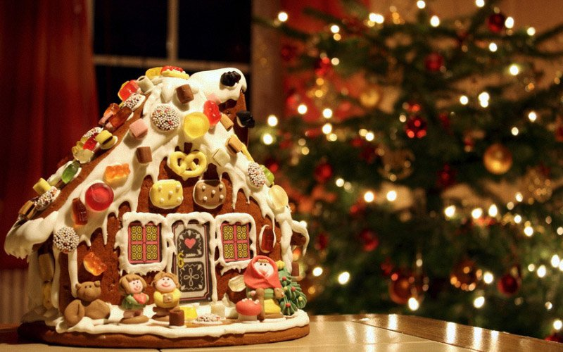
Congratulations!

