Slide 1
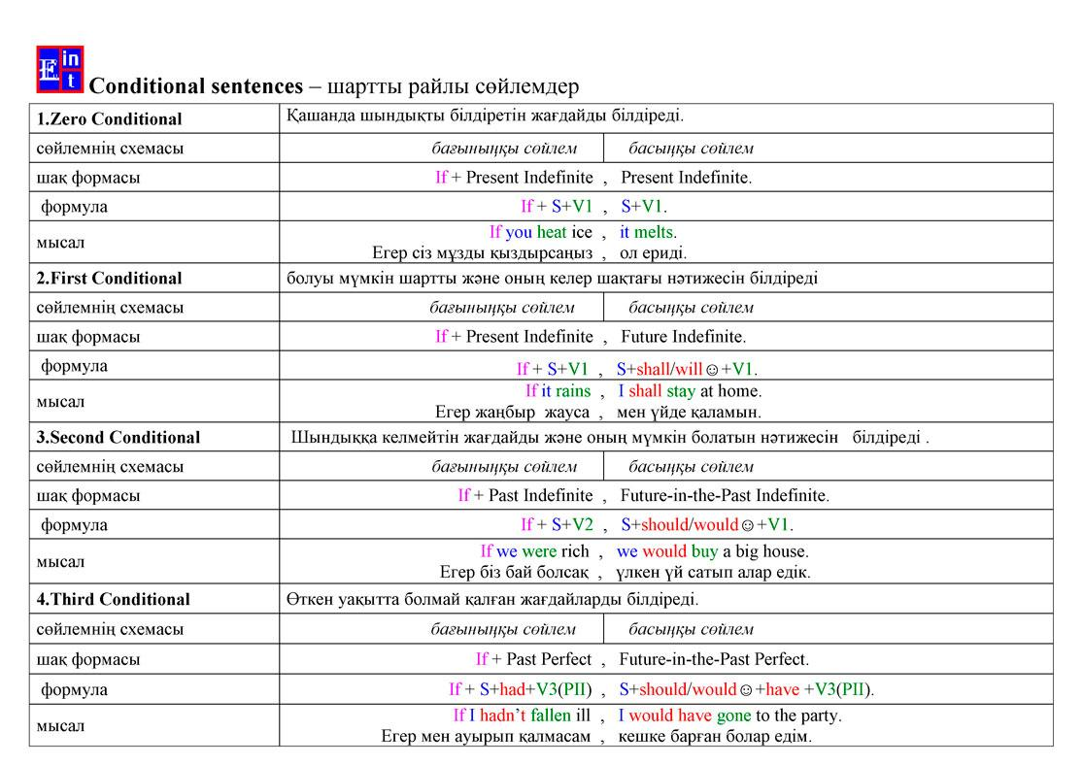

Slide 2


Slide 3
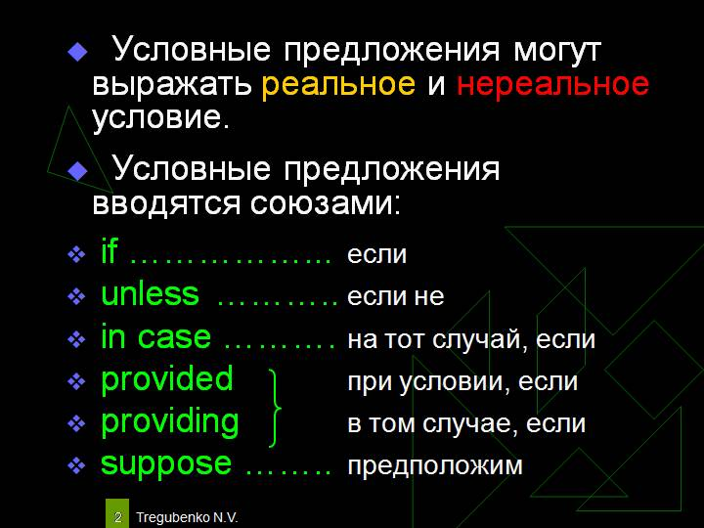

Slide 4
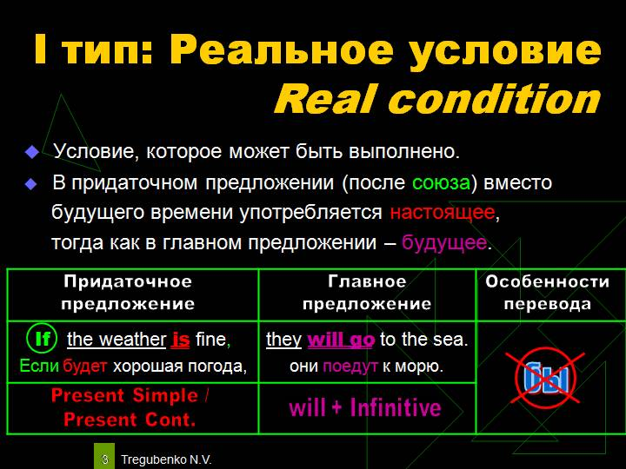

Slide 5
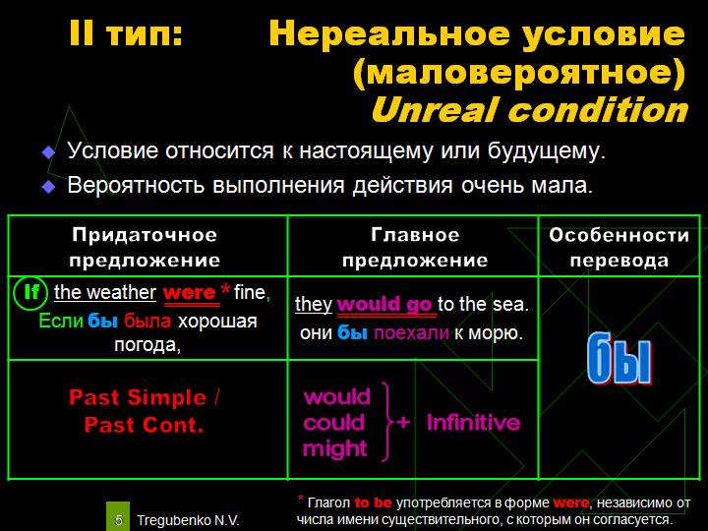

Slide 6
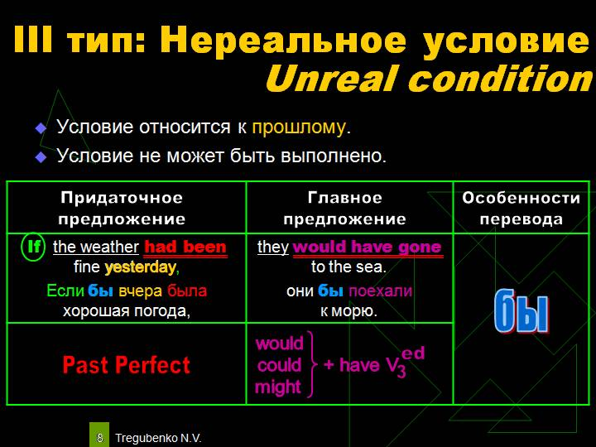

Slide 7
to get involved with the charity- заняться благотворительностью
to raise lots of money- собирать много денег
altitude [ˈæltɪtju:d] - высота
to be useful- быть полезным
to have sponsors- иметь спонсоров
to get sponsors- получить спонсоров
to get fit- набирать форму
backed- поддерживать
collaborate [kəˈlæbəreɪt] – сотрудничать
voluntary [ˈvɔləntərɪ] – добровольный
volunteer [ˌvɔlənˈtɪə] добровольно предлагать
hand [hænd- вручать , передавать
sponsored walk - субсидируемый поход
Субсидирование - это безвозмездная помощь, т.е. выплачивается денежная выплата или пособие в денежной форме за счет государства..

Slide 8
Ex 1
1.If you want to get involved with a charity, we will raise lots of money for the charity
2.If you wanted to be useful in some way, we had raise lots of money for the charity
3.If she walks too fast at this altitude, he won’t play
4.If she had walked any faster at this altitude,he wouldn’t have played
5.If we got lots of sponsors, there are lots of things you can do
6.If we had more sponsors, there had lots of things you could do
7.If he is feeling ill ,she will get a really bad headache
8.If he had been feeling ill, she had have got a really bad headache

Slide 9
Ex 2 p 30
1.a
2.d
3.c
4.f
5.b
6.e
Ex 3 p 30
2. would have
3.goes
4.visited
5.had not
6.don’t go

Slide 10
The 6th of December
Class work
Ex 1.
1.If he practices every day, he will become a champion.
2.She will help us if we ask.
3.If they have enough money, they will open a restaurant next year.
4.I won’t talk to you anymore if you insult me.
5.If Bob doesn’t keep his word, Anna will be angry with him.
Ex 2.
1.If you had a driving license, you would get this job.
2.My dog would be 20 years old today if it were alive.
3.I would go to the police if I were you.
4.If people didn’t buy guns, the world would become safer.
5.Tom wouldn’t eat much “fast food” if his wife cooked at home.

Slide 11
Ex 3.
1.I would have visited Sarah yesterday if I had known that she was ill.
2.If you had gone with me to Paris last month, you would have seen the Eifel Tower too.
3.We wouldn’t have got wet if you had taken an umbrella.
4.If Mum hadn’t opened the windows, our room wouldn’t have been full of mosquitoes.
5.Nick wouldn’t have been so tired this morning if he had gone to bed early last night.
Ex 4.
2 – а (Если будет много дождя, цветы вырастут очень быстро.)
3 – е (Если бы я знал английский хорошо, я бы был переводчиком.)
4 – а (Мои дети не заплакали бы, если бы он не крикнул на них.)
5 – d (Я бы позвонила ему на твоем месте.)
6 – b (Она наденет это платье, если похудеет.)

