Slide 1
My hands
Here’s my left hand
And here’s my right,
I can clap them
With all my might.

Slide 2
The 12th of November
Theme of our lesson:
«My body»

Slide 3
a head [hed] бас
a hair [heә’] шаш
a face [feɪs] бет
eyes [aɪs] көздер
an ear [ɪә] құлақ
a nose [nǝus] мұрын

Slide 4
a mouth [mauθ] ауыз
a lip [lɪp] ерін
a shoulder [‘ʃouldә] иық
a hand [hӕnd] қол
a leg [leg] аяқ

Slide 5
Warming up

Slide 6
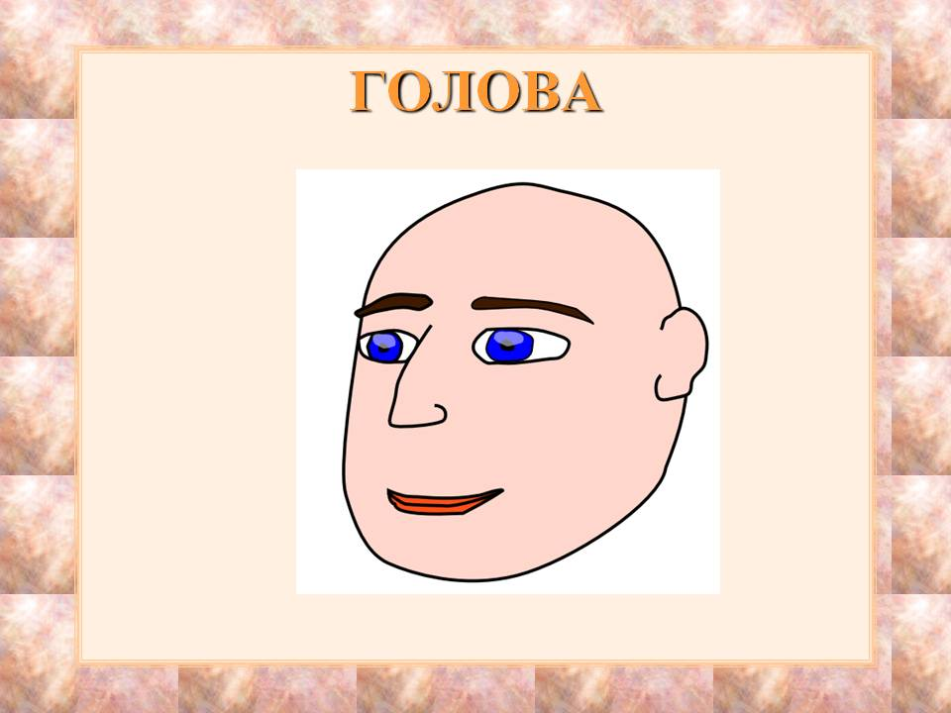
What is this?

Slide 7
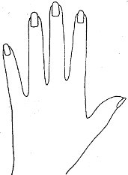
What is this?

Slide 8
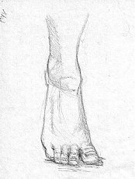
What is this?

Slide 9
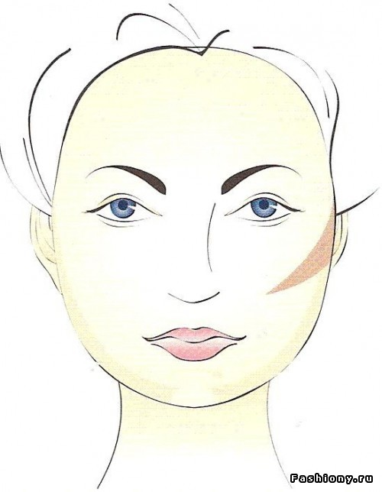
What is this?

Slide 10
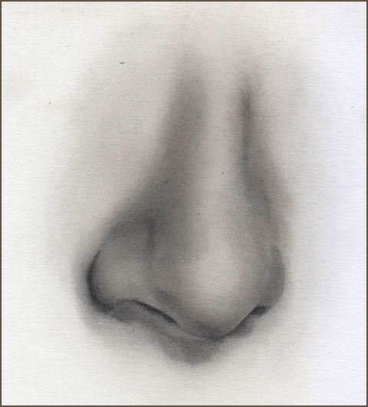
What is this?

Slide 11
What is this?

Slide 12
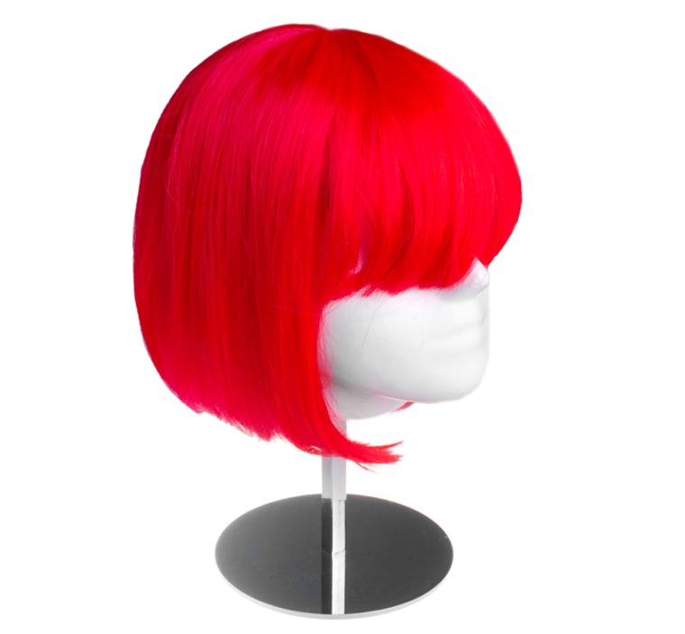
What is this?

Slide 13
Where is your
hand?

Slide 14
Where is your
face?

Slide 15
Where is your
hair?

Slide 16
Where is your
head?

Slide 17
Where is your
nose?

Slide 18
Where is your
lip?

Slide 19
Where is your
mouth?

Slide 20
Where is your
shoulder?

Slide 21
1. Шаш; 2. Аяқ; 3. Мұрын; 4. Ерін; 5. Бас...

Slide 22
You see with your ___

Slide 23
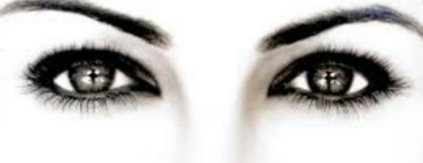

Slide 24
You hear with your ___

Slide 25
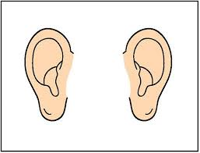

Slide 26
You eat with your ___

Slide 27


Slide 28
You walk with your ___

Slide 30
You write with your ___

Slide 31
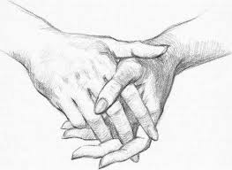

Slide 32
Home task…
- To learn new words …
- Continuous this sentence: This is my………..

Slide 33
Good bye!

