Slide 1
Unit 8 b “Shall we?”
Учитель английского языка
Мамедова Э.В
ГСОШИ I-II ст. №16

Slide 2








Slide 3
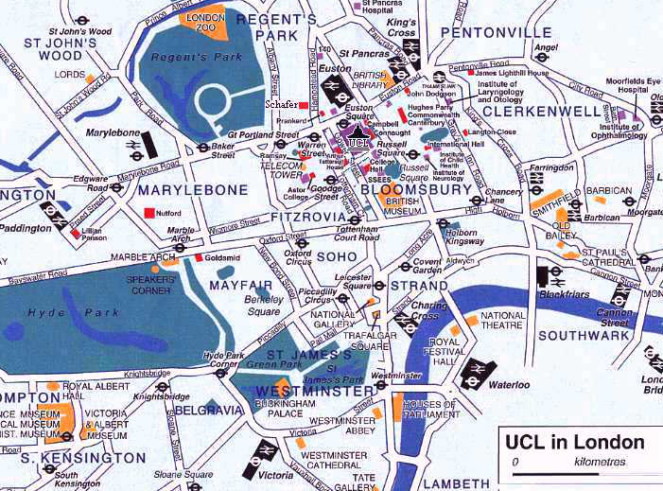
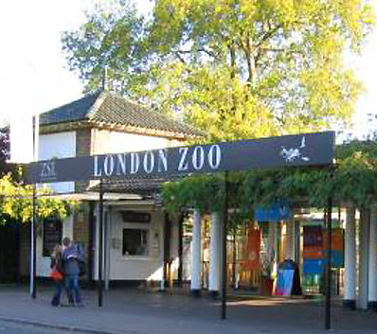
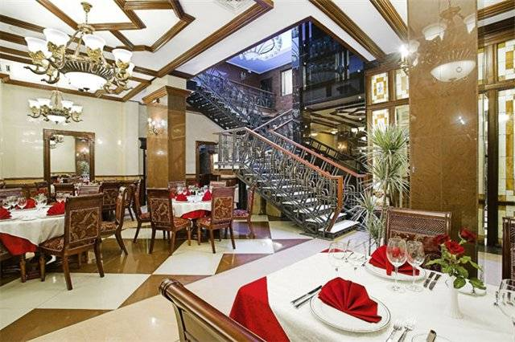
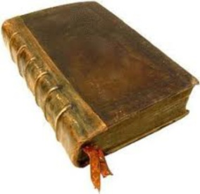

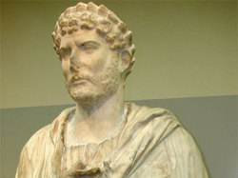
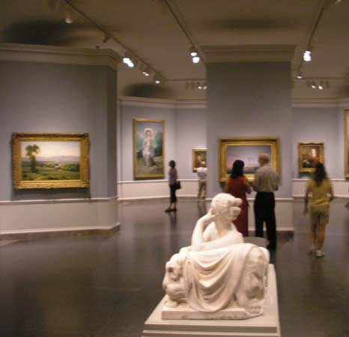

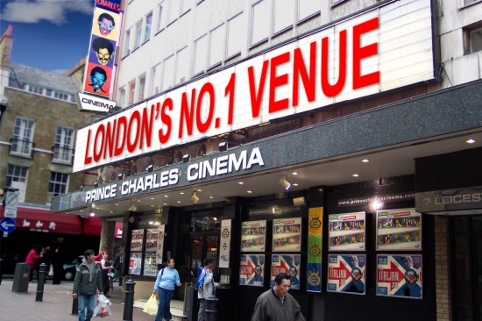

Slide 4
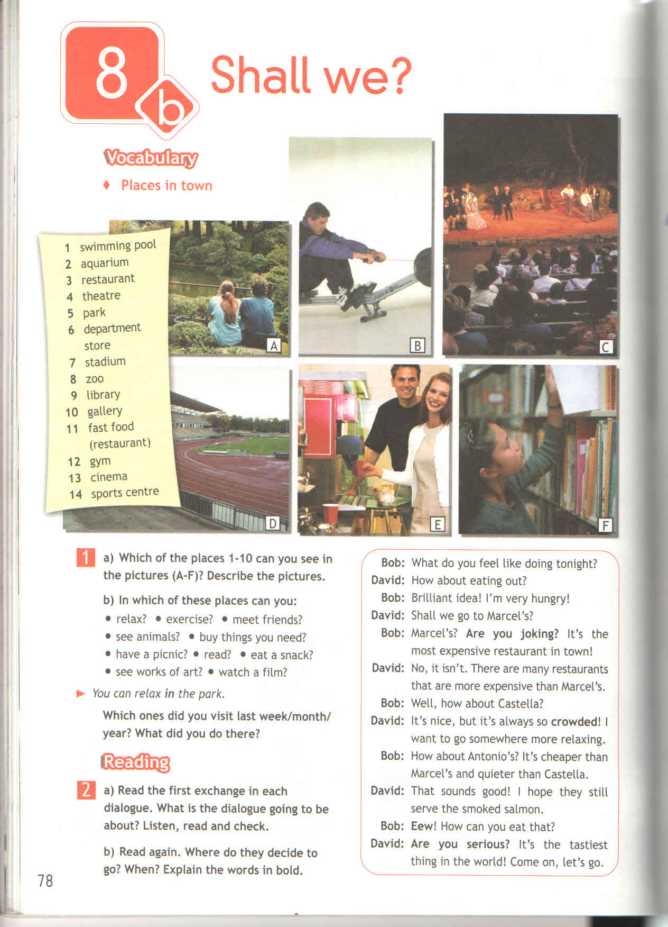
C
A
D
F
E
B

Slide 6
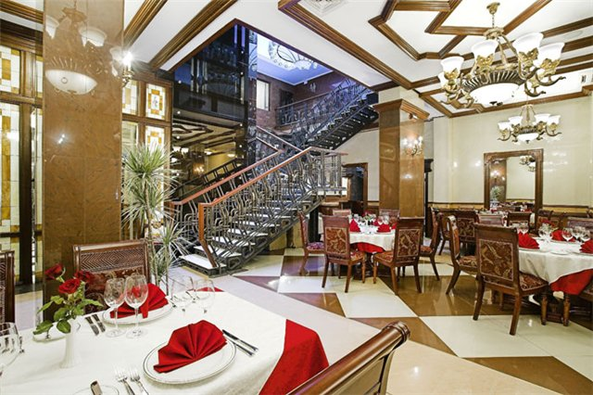

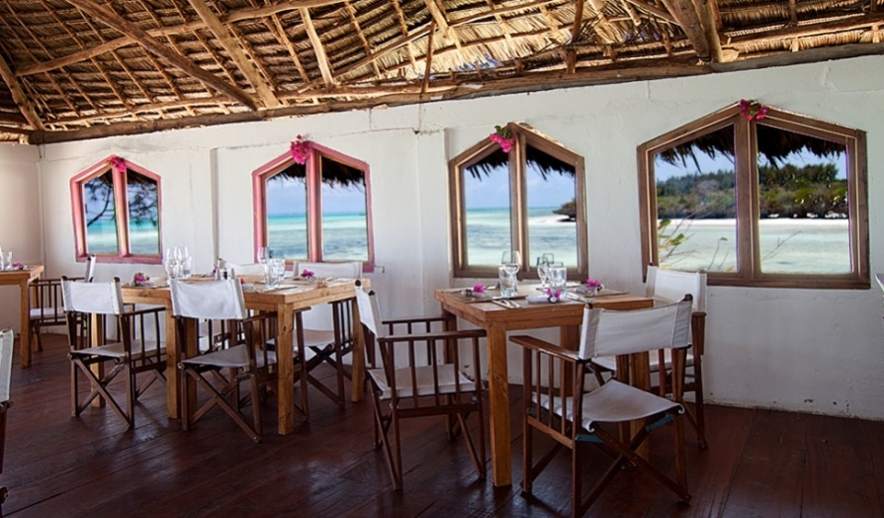
Size: big or small?
Small – smaller – the smallest
Big – bigger – the biggest

Slide 7
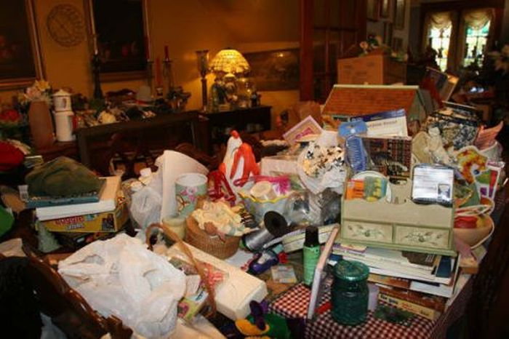
Clean or dirty?
Clean – cleaner – the cleanest
Dirty – dirtier – the dirtiest

Slide 8

Cheap or expensive?
55 $
100 $
40 $
Cheap – cheaper – the cheapest
Expensive – more expensive – the most expensive

Slide 9
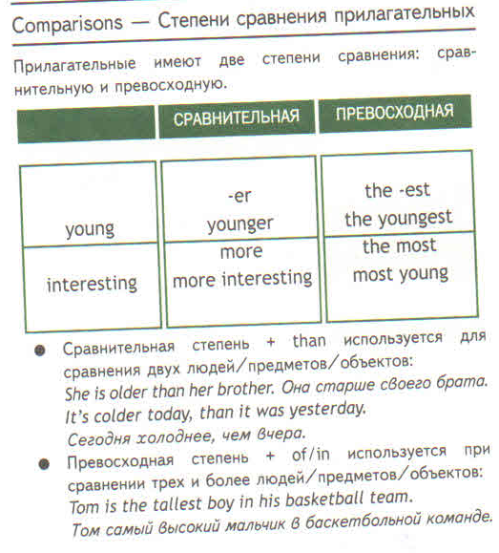
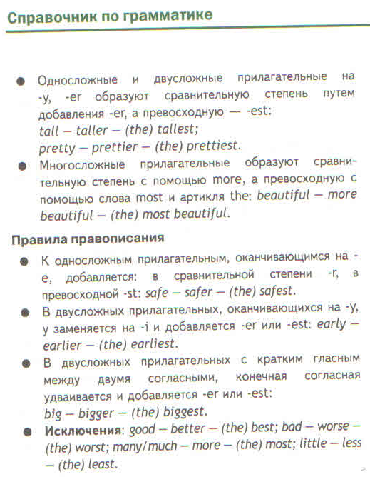

Slide 10
Let’s have a rest!

Slide 11
Grammar
Comparisons
cheap – cheaper – the cheapest
dirty – dirtier – the dirtiest
expensive – more expensive – the most expensive
than
Good – better – the best
Bad – worse – the worst
Much/many – more – the most
Little – less – the least

Slide 12
Test

Slide 13


Slide 14

Home task
WB p. 52 ex. 7, 8

Slide 15

Thank you for the lesson!

