Slide 1
The 19 ^{th} of May
Classwork
“What can we do?”

Slide 2
Фонетическая разминка
[∫] – shell, English, wish, shy, shape
[ŋ] – song, ring, sing, long, strong
[w] –we, weather, draw, watch, what

Slide 3

What can we do if … ?
We can …

Slide 4
CAN
Глагол can переводится на русский язык глаголами «мочь, уметь» и обозначает физическую способность выполнять какое-либо действие.

Slide 5
Модальный глагол CAN
I can
to … .
He/She cans sing.
Вспомогательный глагол

Slide 6
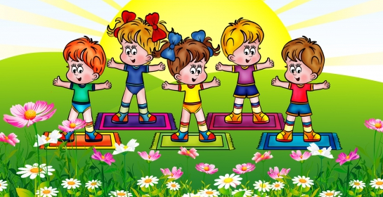
Warm-up
Boys hands up
Boys hands down
Boys and girls
Turn around
Girls hands up
Girls hands down
Girls and boys
Turn around

Slide 7
Утвердительные предложения
I can swim. We can swim.
You can swim. You can swim.
He/She can swim. They can swim.
It can swim.
Подлежащее + can + основной глагол + второстепенные члены предложения.

Slide 8
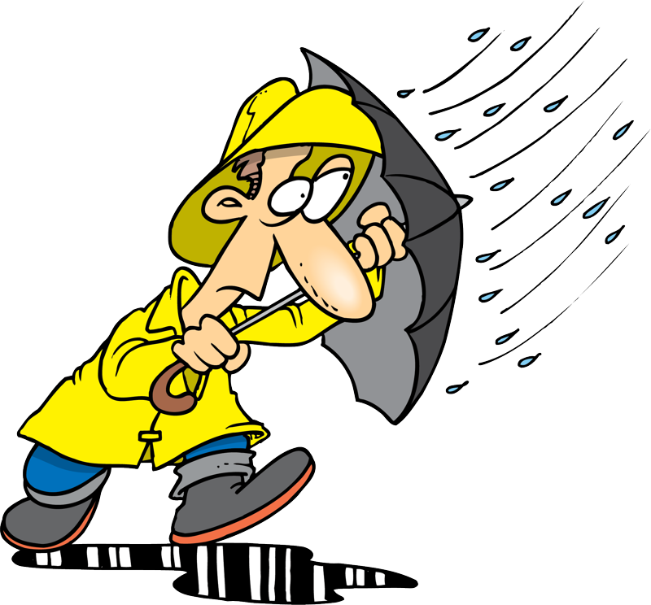
What people can do if… ?
I sing. You draw. He can read. We watch TV. They

Slide 9
Отрицательные предложения
I can not swim. = I can’t swim.
He can not swim. = He can’t swim.
They can not swim. = They can’t swim.
Подлежащее + cannot / can’t + второстепенные члены предложения.

Slide 10
Общий вопрос
Can you swim? – Yes, I can.
No, I can’t.
Can + подлежащее + основной глагол + второстепенные члены предложения.

Slide 11
Exercises
Find the mistakes/ найдите ошибки
I can to swim.
He cans dance.
We can speak English.
Can she sing?
Does he can play the piano?
We can’t stay with you.

Slide 12
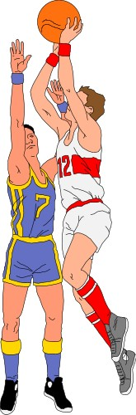
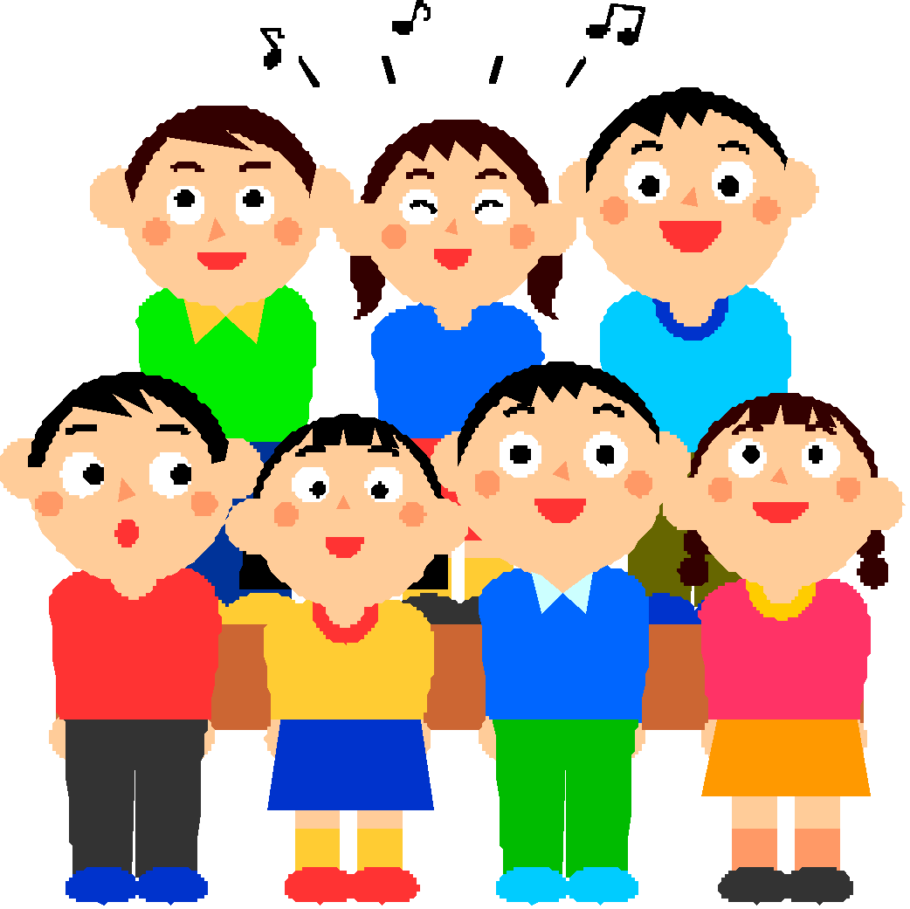

Exercises
Can или cannot/can’t.
1
They … play basketball.
can
2
We … sing.
can
3
Snail … run.
can’t

Slide 13
Homework
Learn the pronunciation of the verb CAN/CAN’T
Write 9 sentences with CAN/CAN’T and questions.

