Slide 1
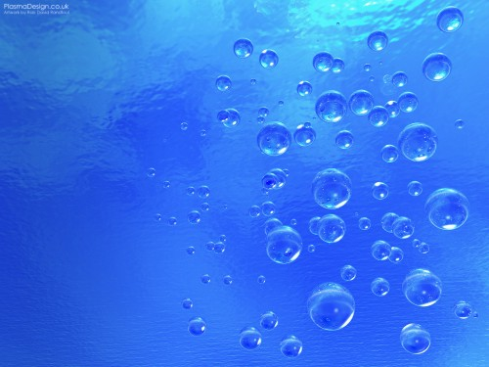
Ecological condition of the river Volga in Engels region in Saratov oblast: water quality and ways of purification.
Done by: Irina Rakcheeva
Class: 8 a
School №5, Engels
Teacher: Sarancha V. V.

Slide 2
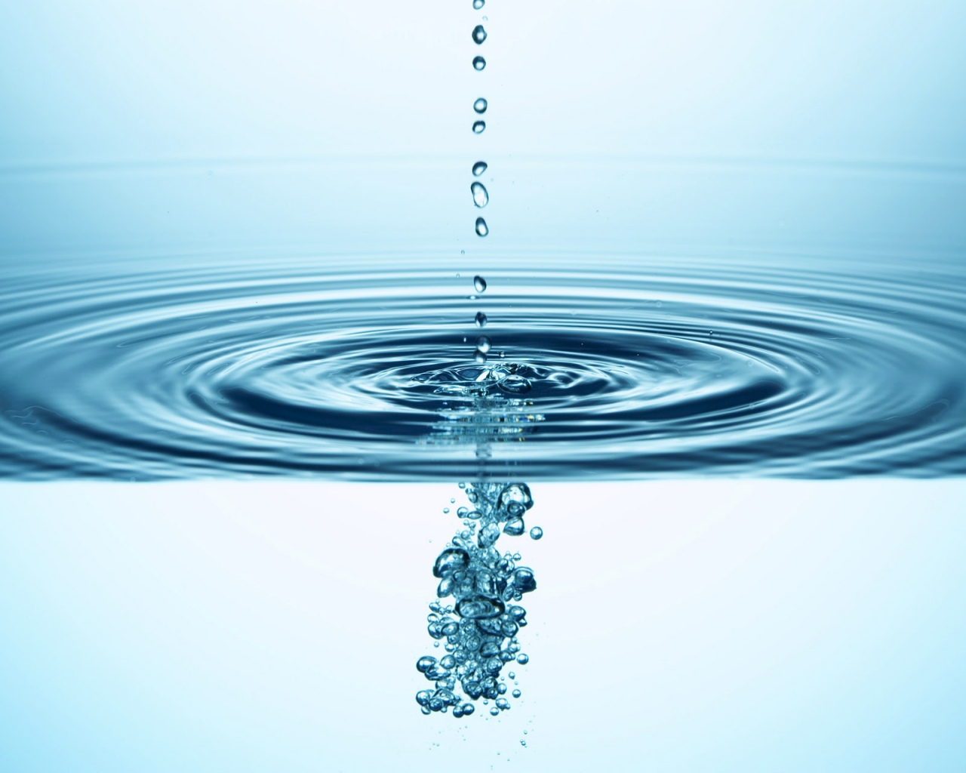
Water, water, everywhere
To wash my hand and wash my hair
It’s nice to drink it by the pool
Slurp it, sip it, nice and cool
It comes from clouds. Don’t you know
Falls in rain and also snow
Keep it clean or you will be
Sick as sick, as sick can be.

Slide 3
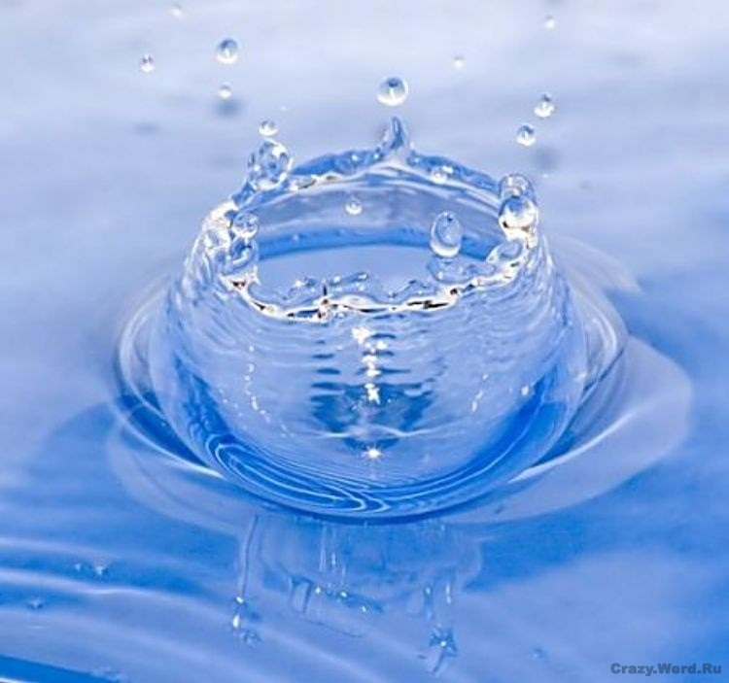
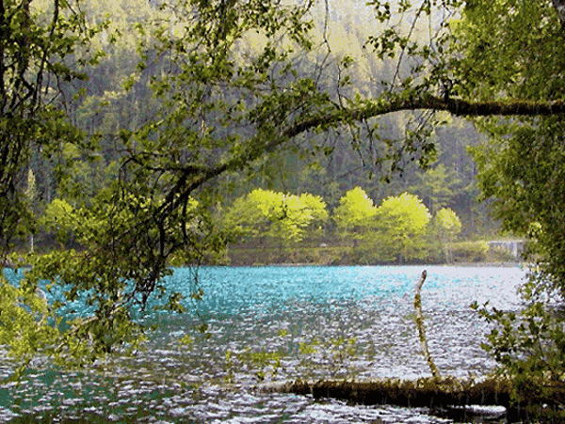
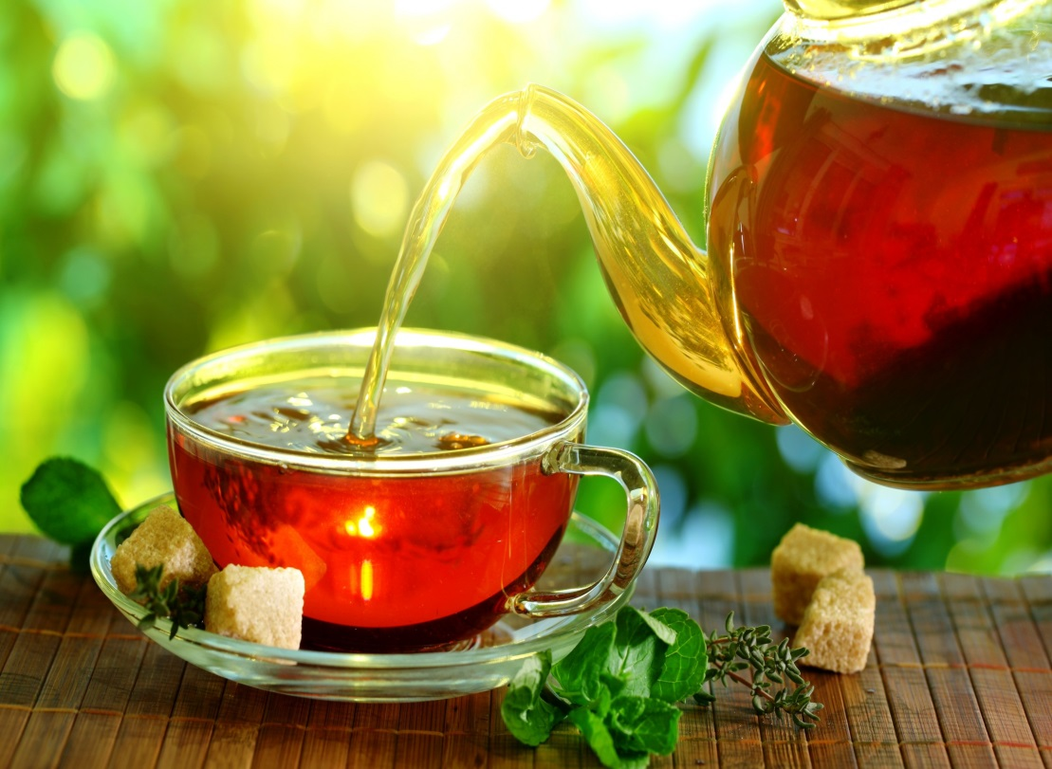
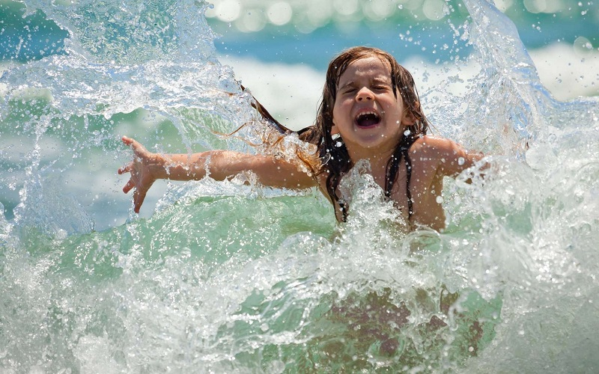
Water is the most widespread substance on the Earth, we meet it everywhere, we all know it. We meet every day: when we drink tea, when we wash up, when we swim and when we jump over the puddles after the summer rain..

Slide 4
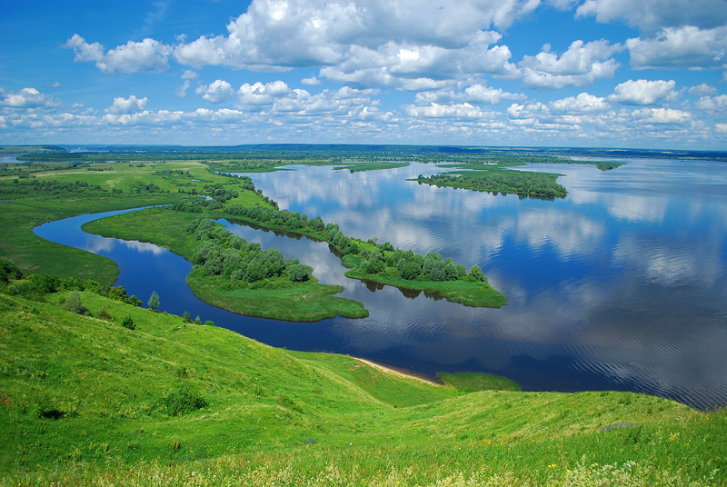
There are 358 rivers which are more than 10km long and 58 of them are more than 50km long. But the main source of water is the Volga.

Slide 5
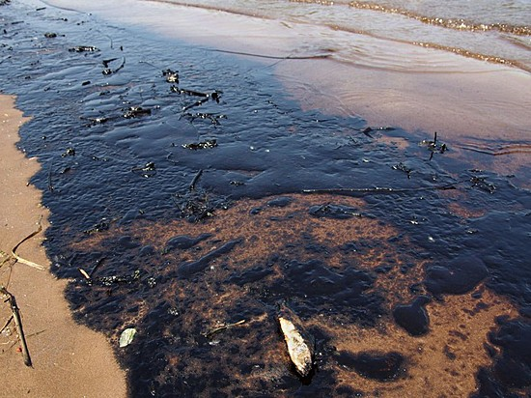
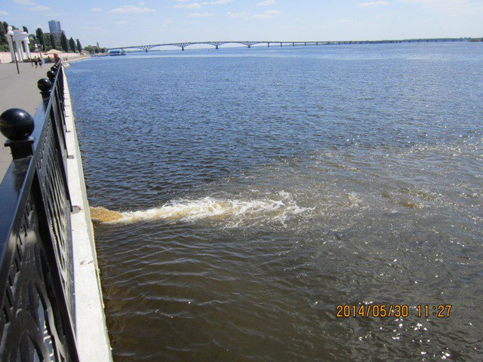
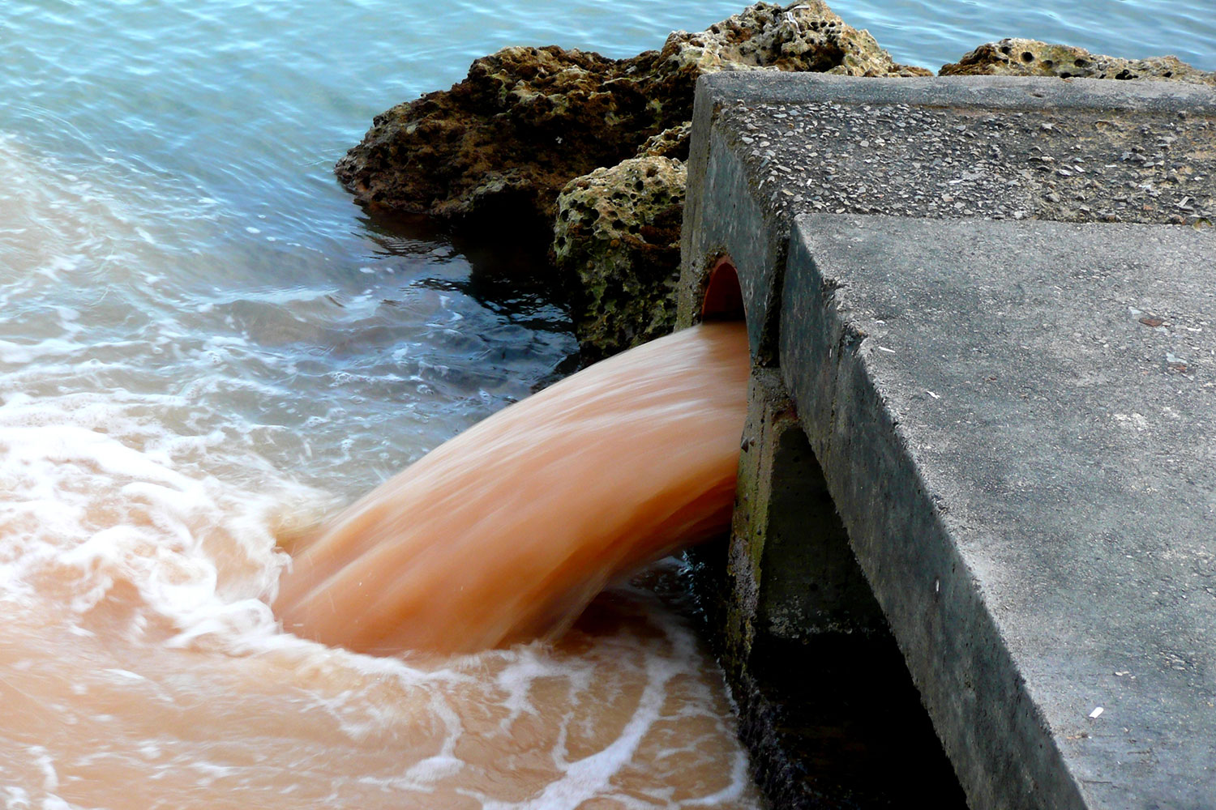
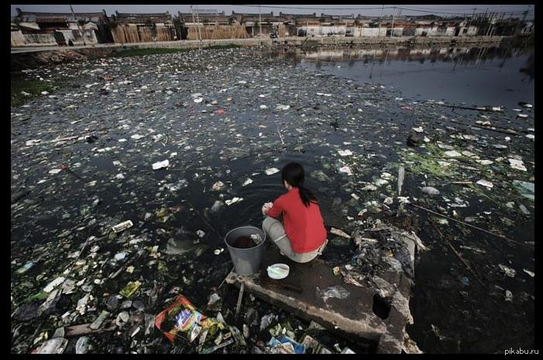
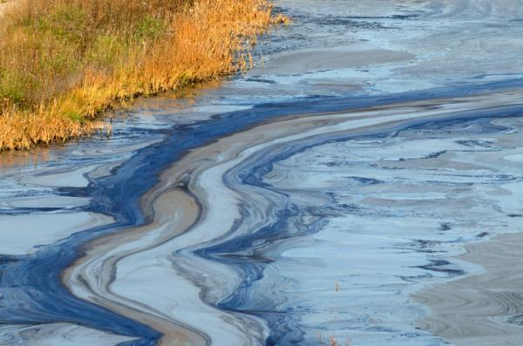
Ecological state of the river Volga gets worse every year because of its pollution:
- Big population;
- Dams and water storages;
- Salty water;
- Oil production;
- Garbage;

Slide 6
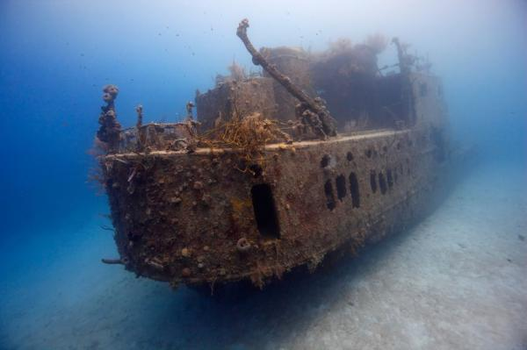
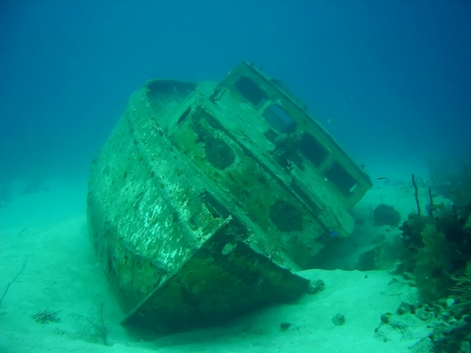
There are lots of sunken boats and ships on the bottom of the Volga.
The bottom turned into a junk yard.

Slide 7
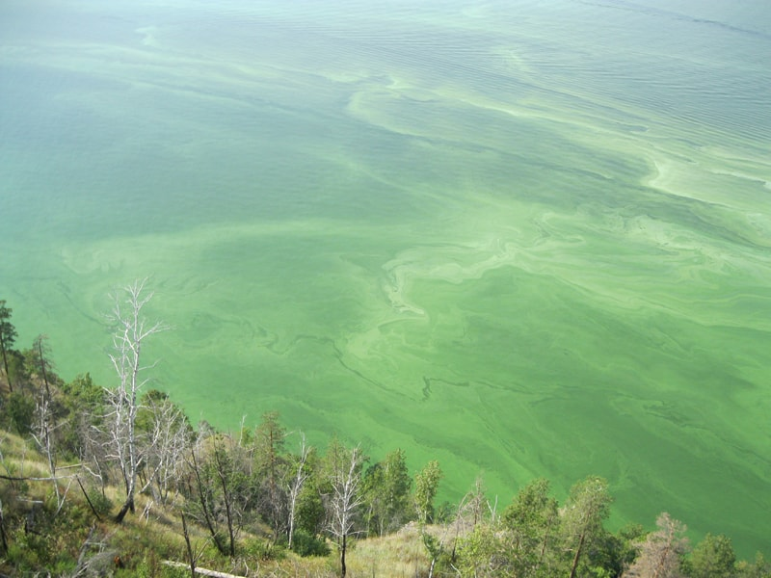
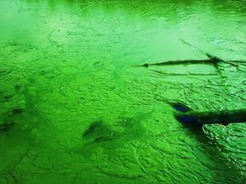
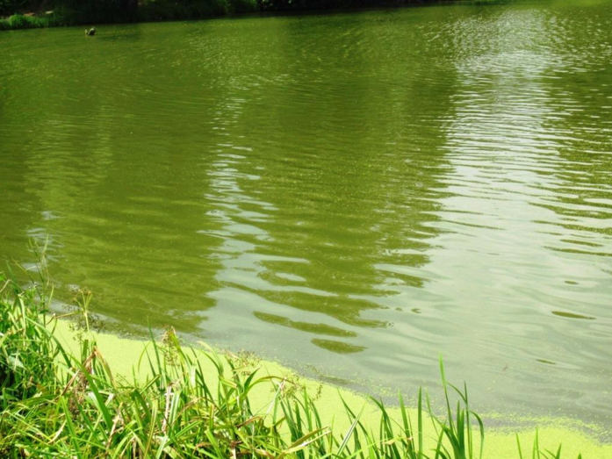
Another important problem is blue and green algae, that grows rapidly along the bank in summer.

Slide 8
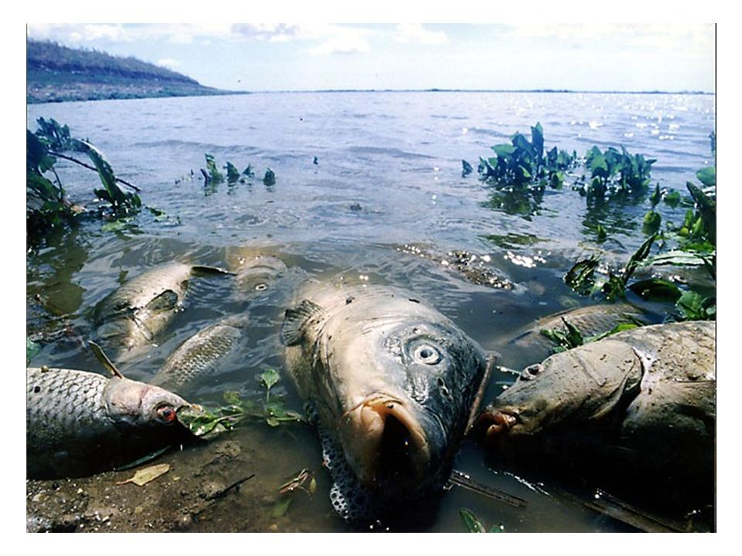
Because of water pollution a lot of fish die and turn into mutants

Slide 9
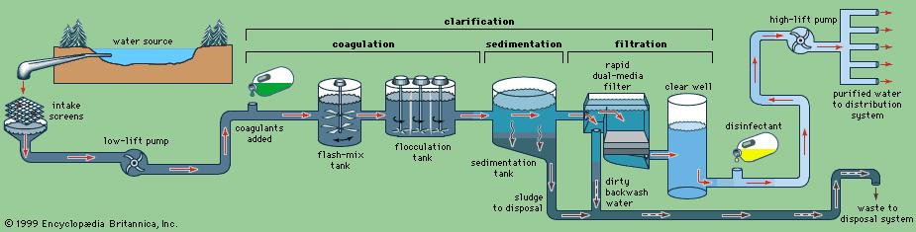

Engels has a central system of water supply. Water from the Volga river goes through this system right to our houses and schools. During this process water goes through several stages of chlorination.

Slide 10
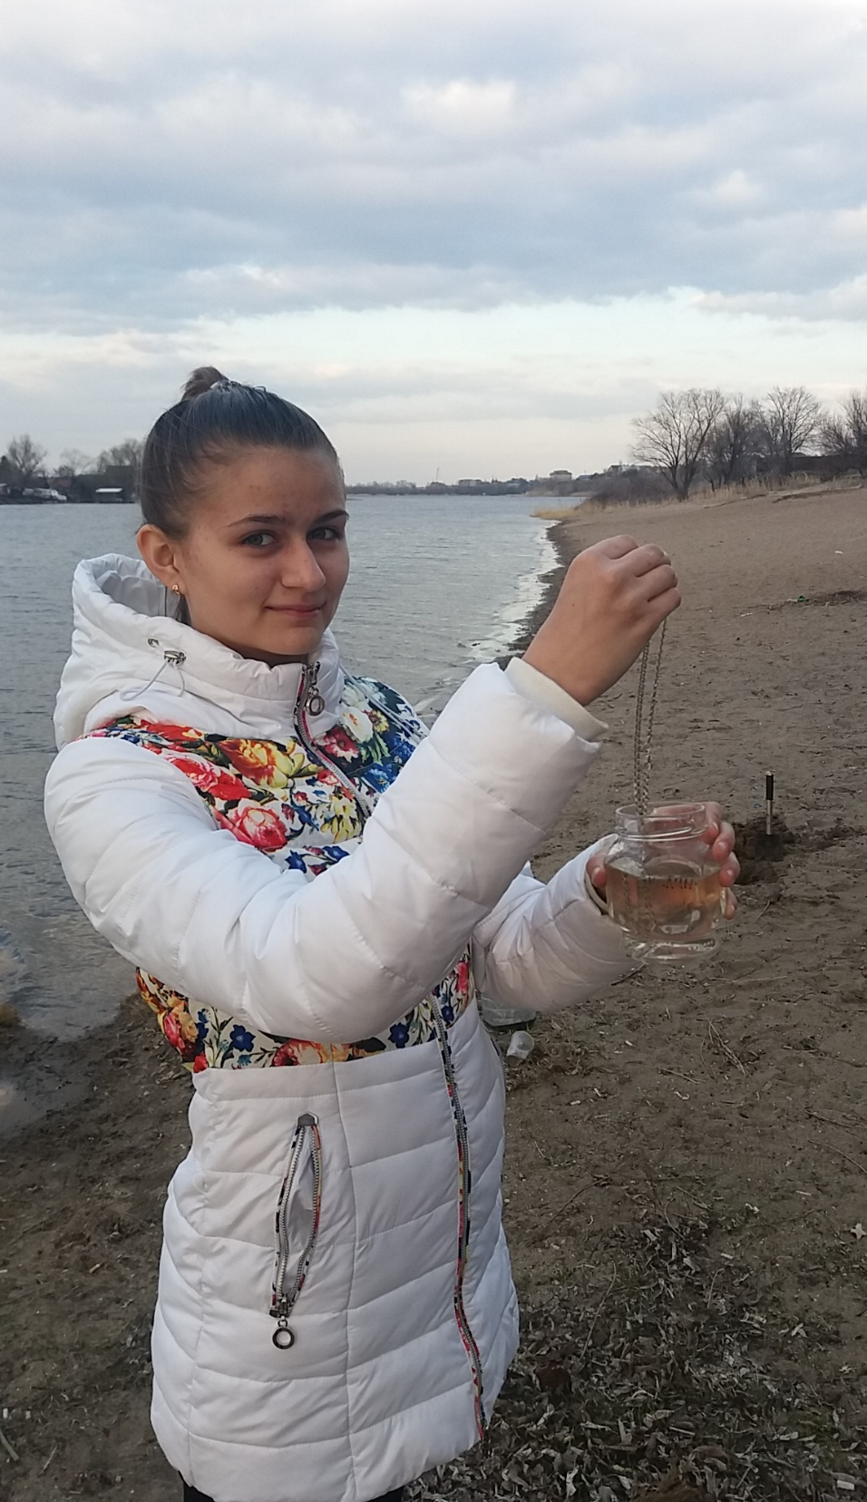
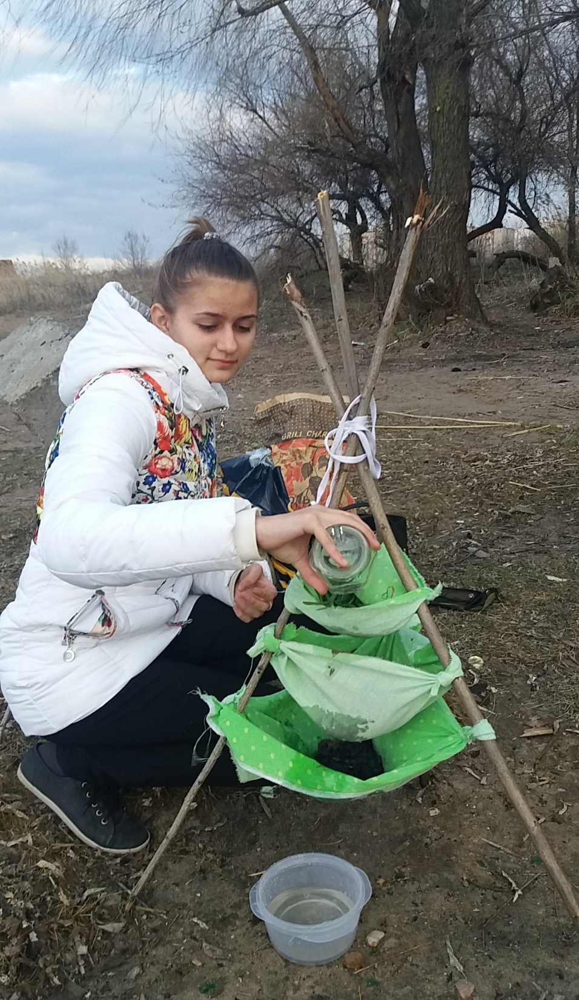
1. A filter made of grass, sand and coal is useful. You can drink water after filtration.
2. Put something silver in water. It’s not useful, because silver only helps to keep water fresh, but doesn’t clear it.

Slide 11
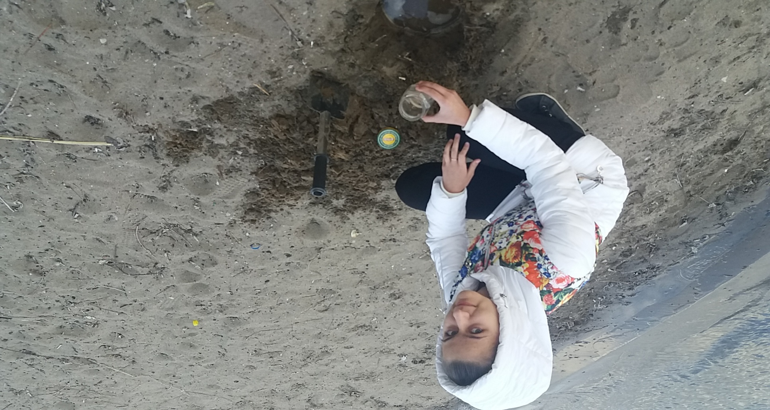
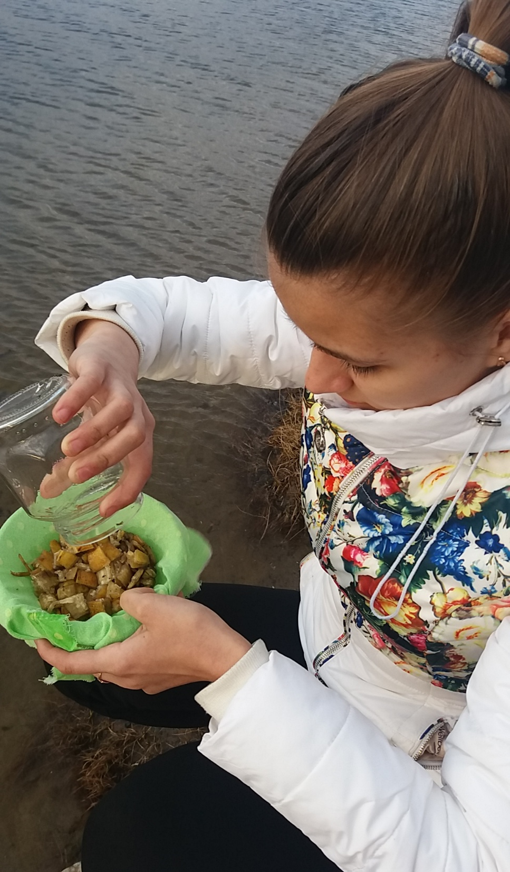
3. To clear water you need to dig up a hole in the ground not far from the river and wait for water to fill the hole. This method isn’t useful too. You need to wait for a long time before sediment will be separated.
4.You need to cut banana peel and pour water through it. And it works!!! Banana molecules pull bad substances to themselves.
5. Pour water in the plastic bag and hang it on the tree so that the Sun can go through it. This method doesn’t work. You need much more ultra-violet to make this water suitable for drinking.

Slide 12
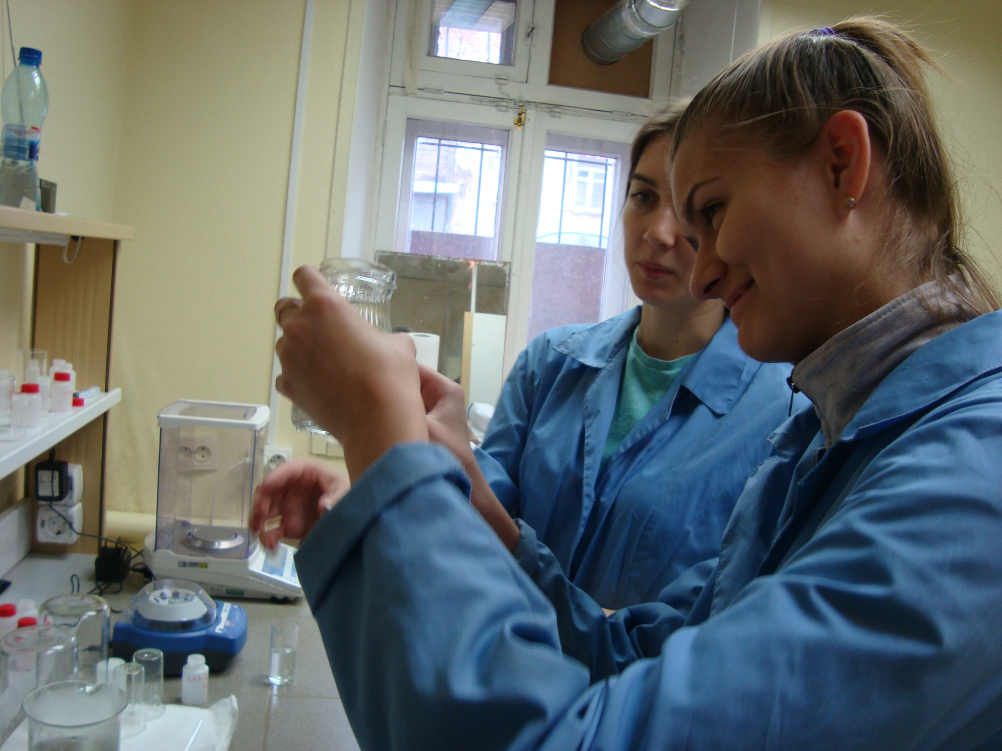
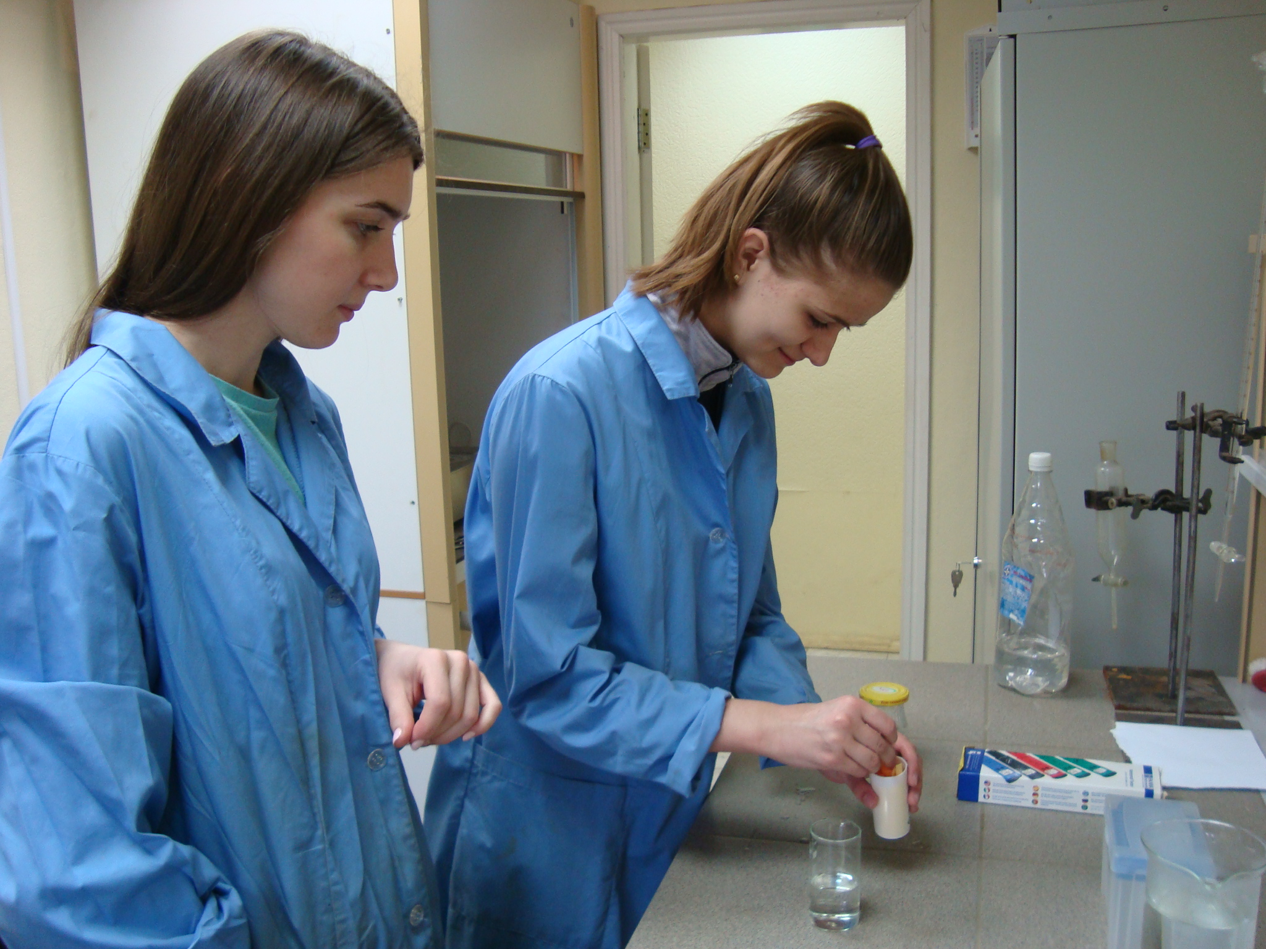

Slide 13
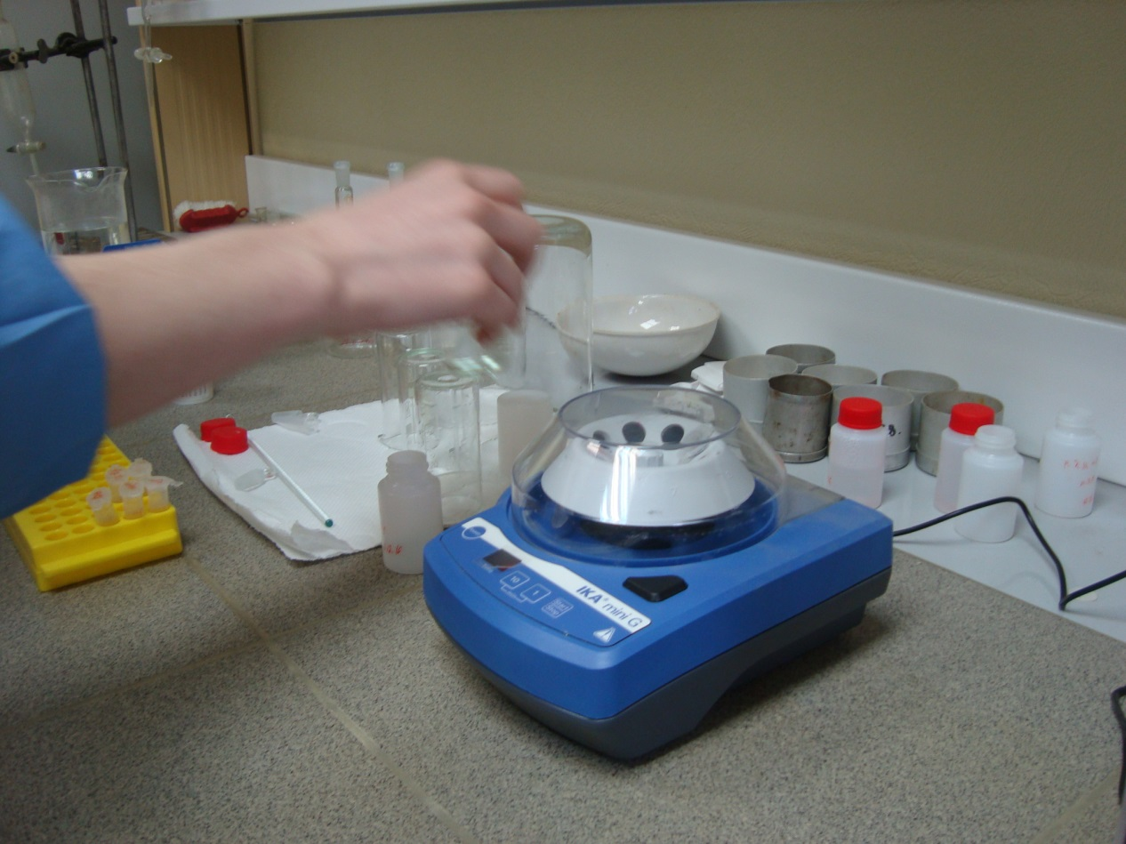
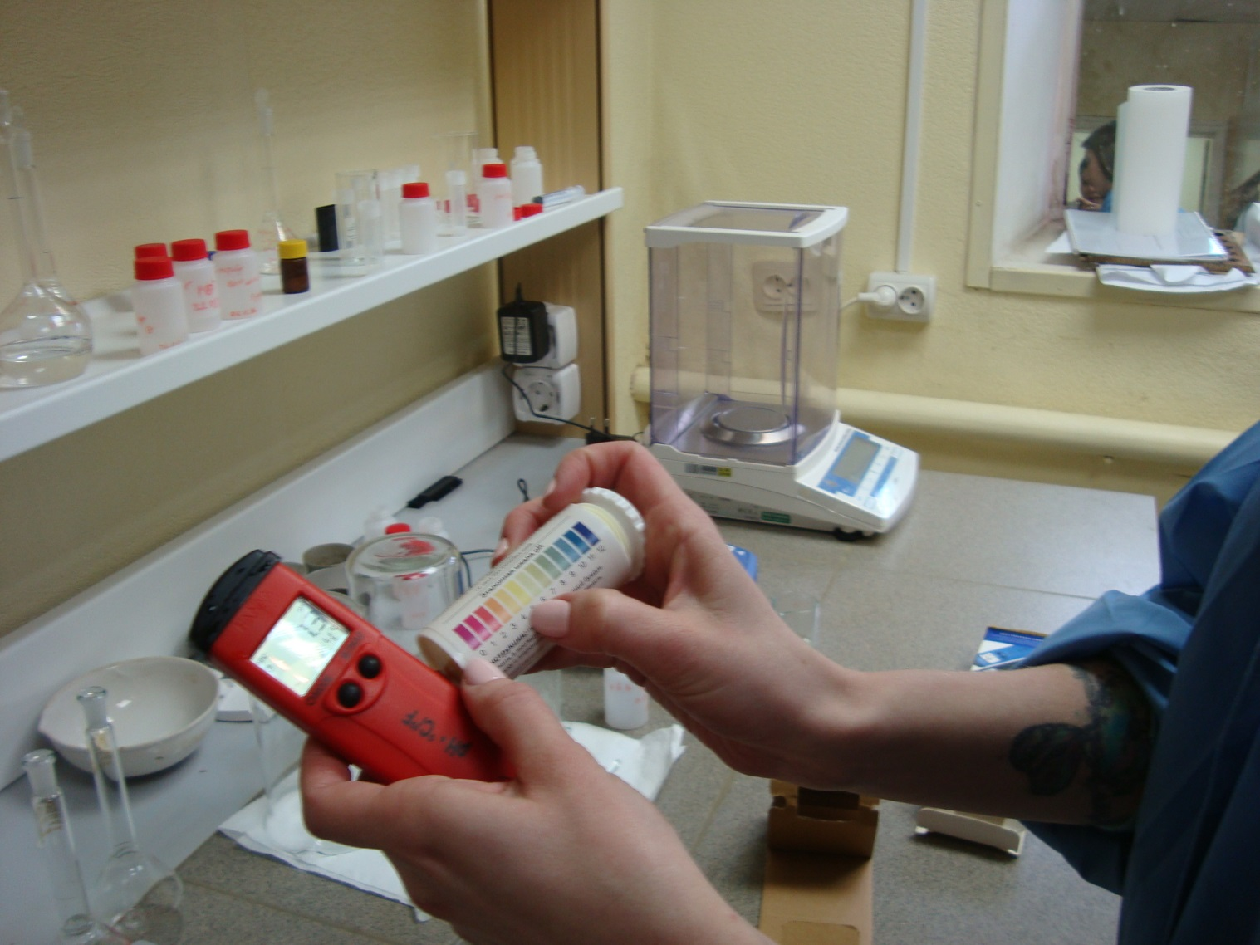

Slide 14
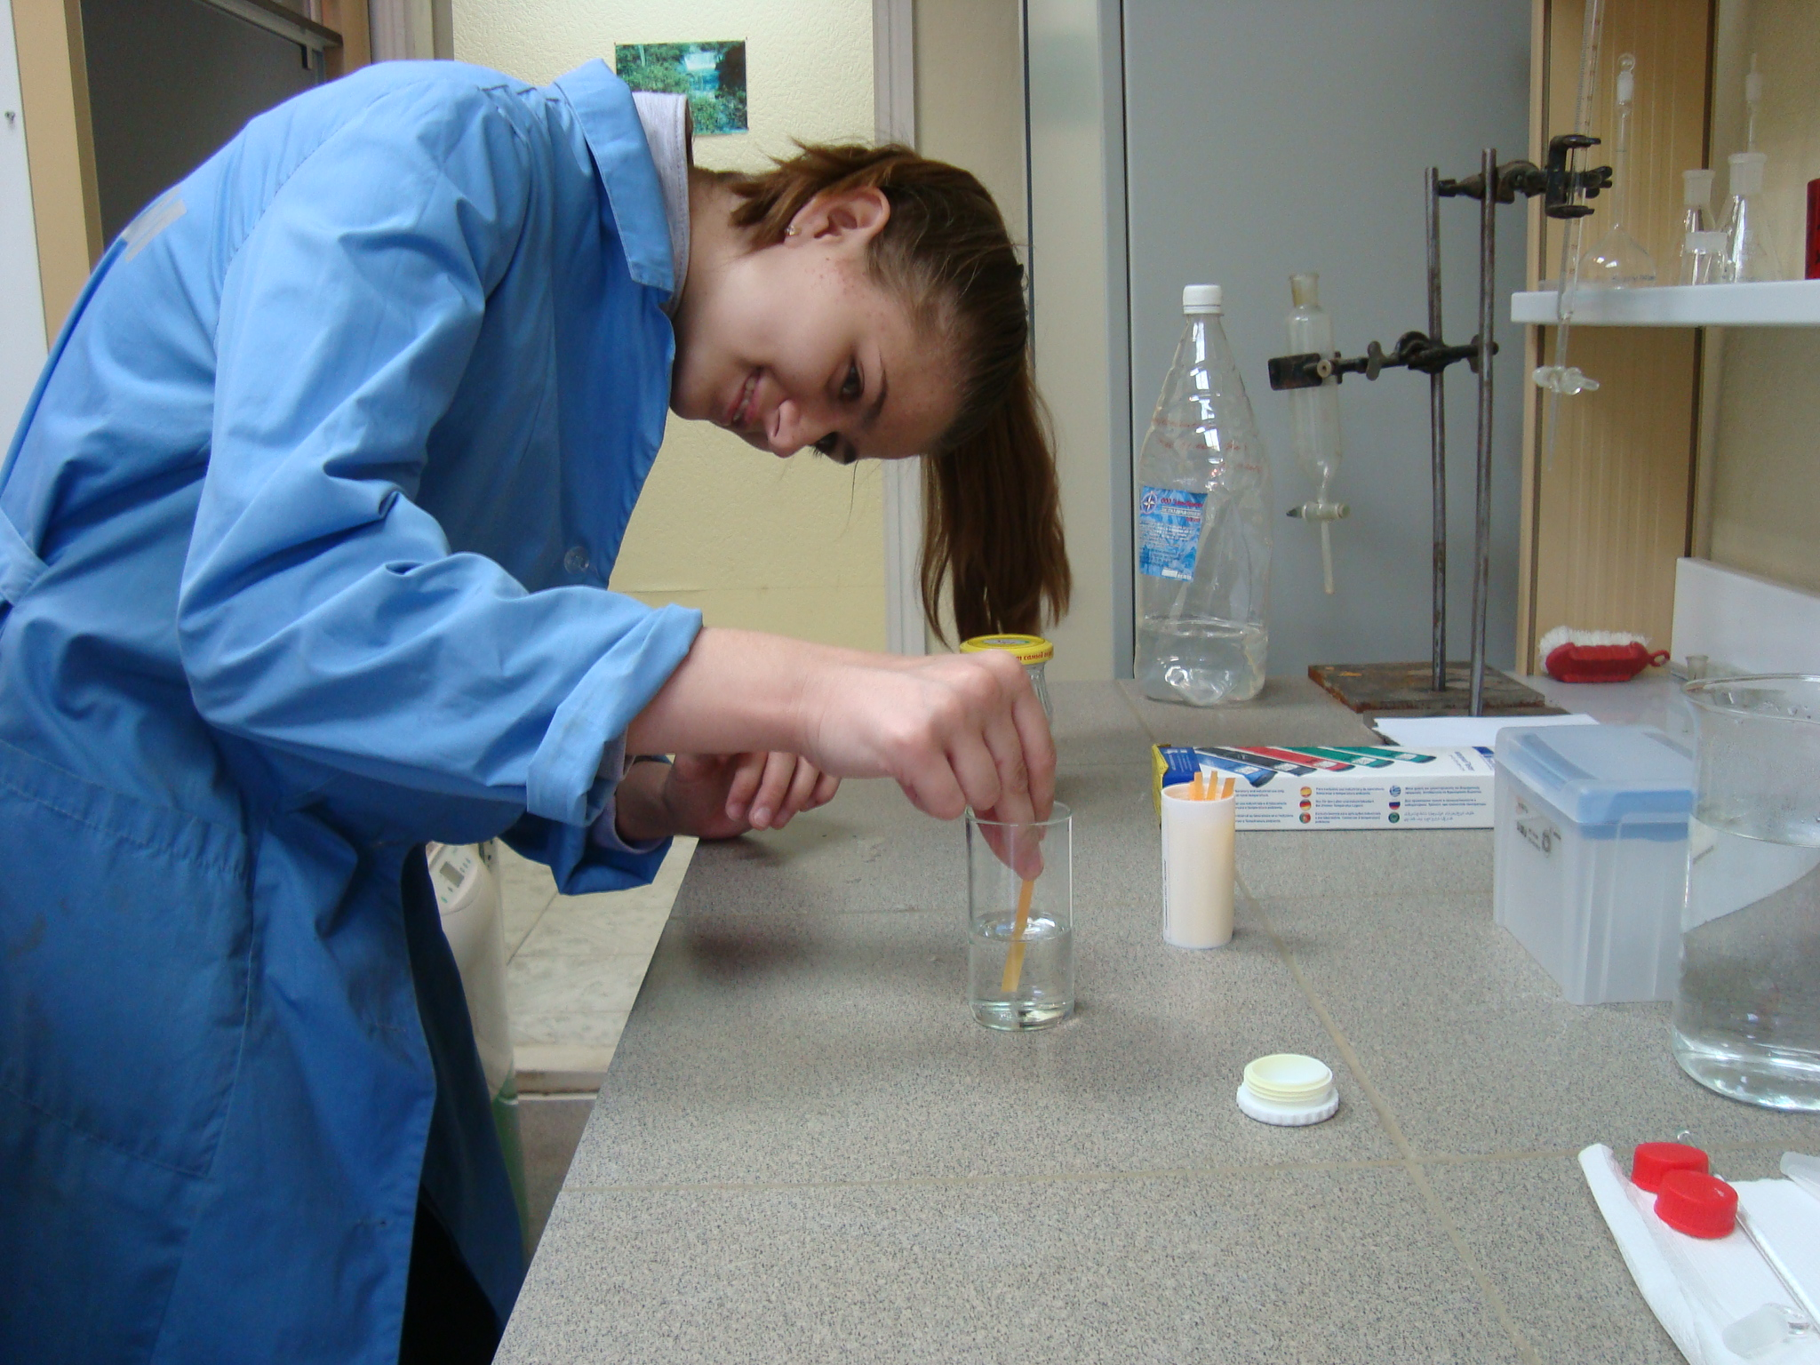
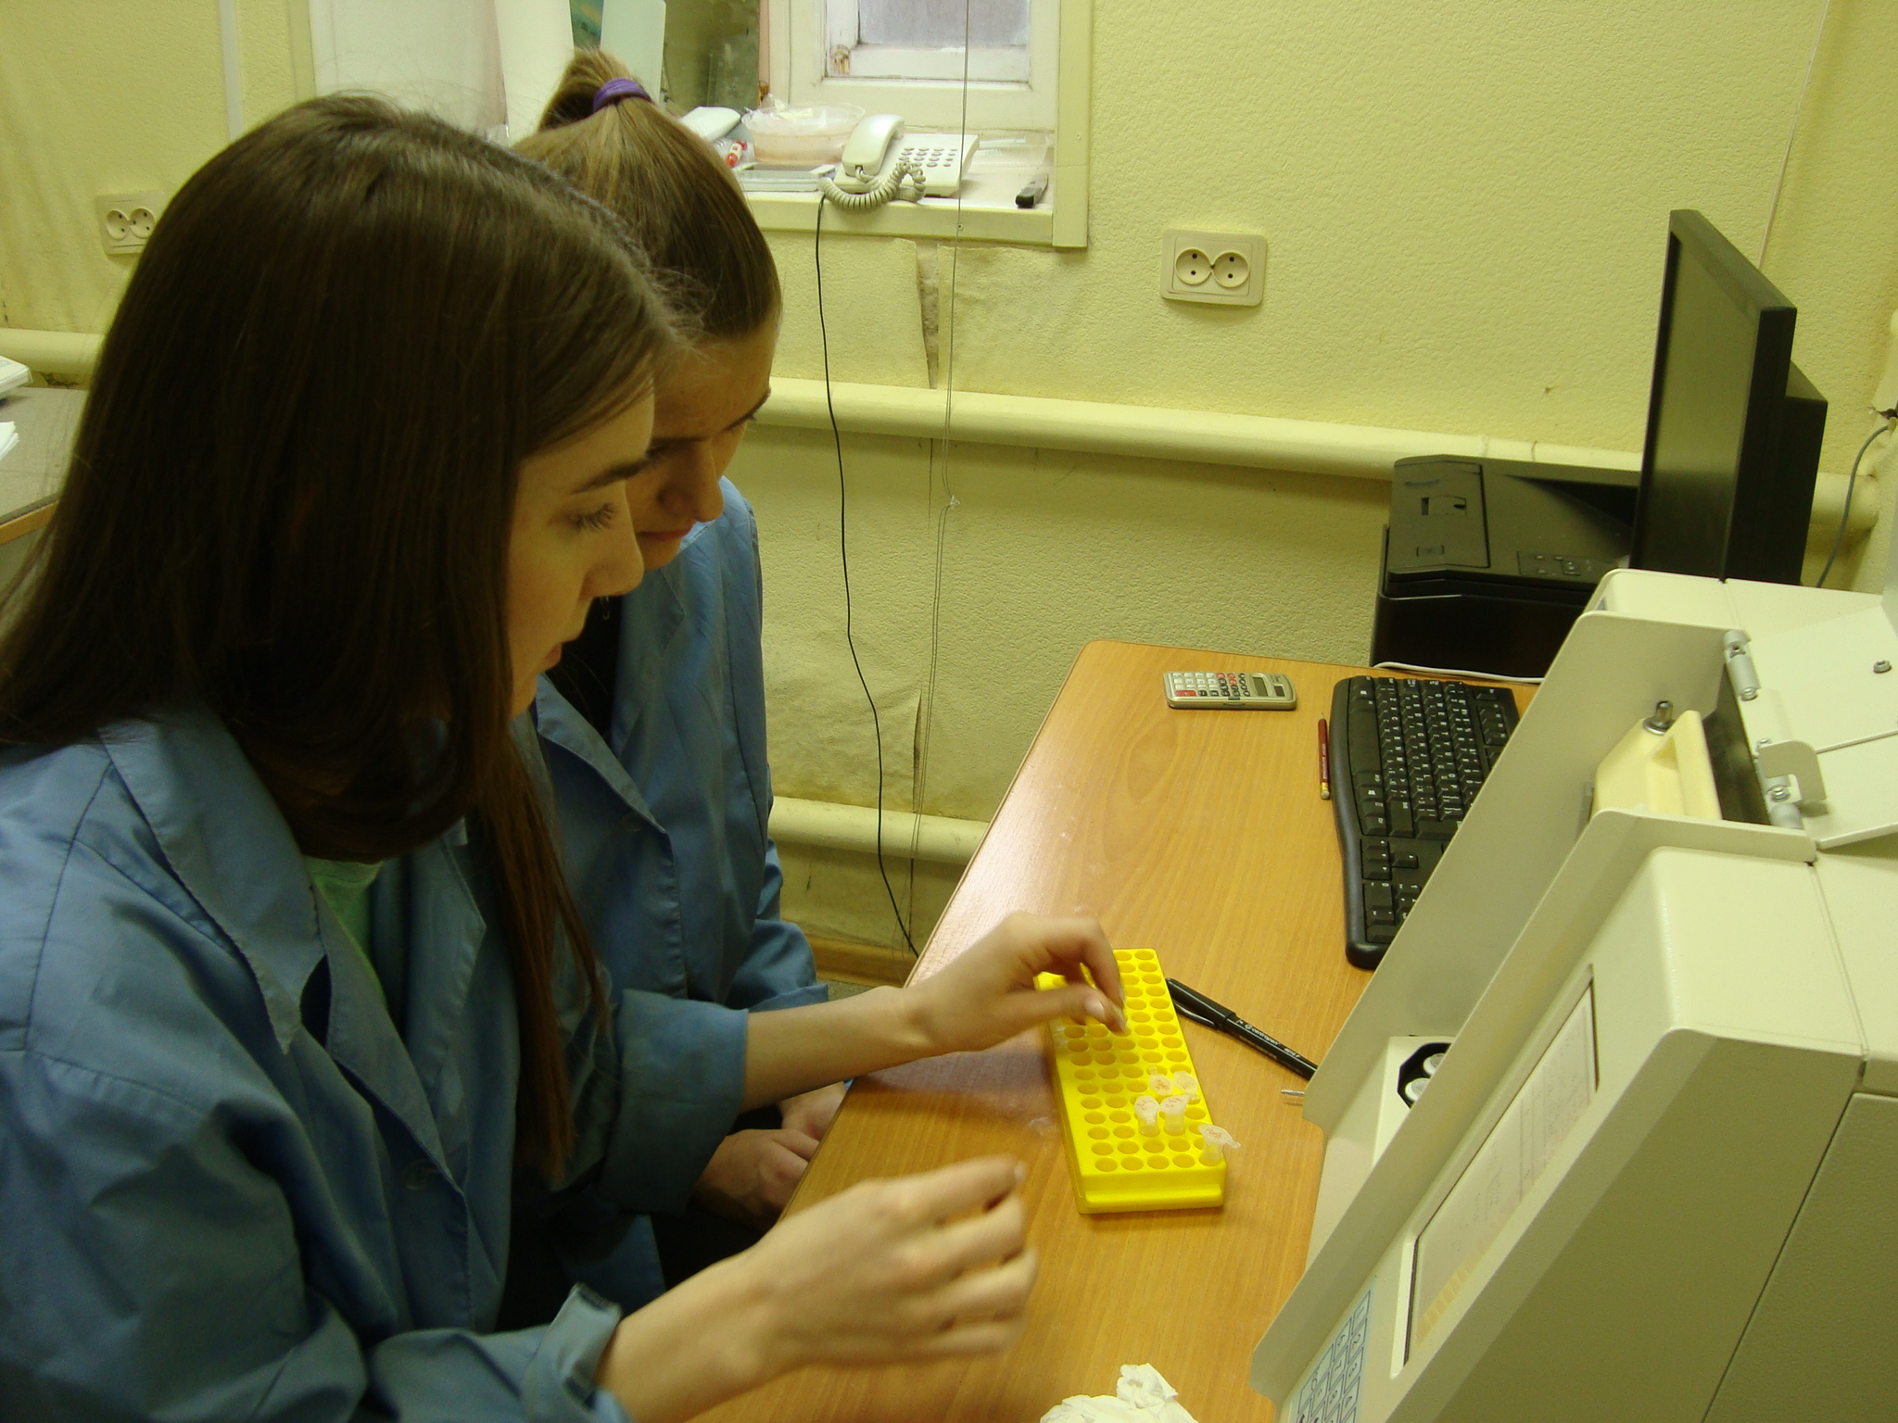
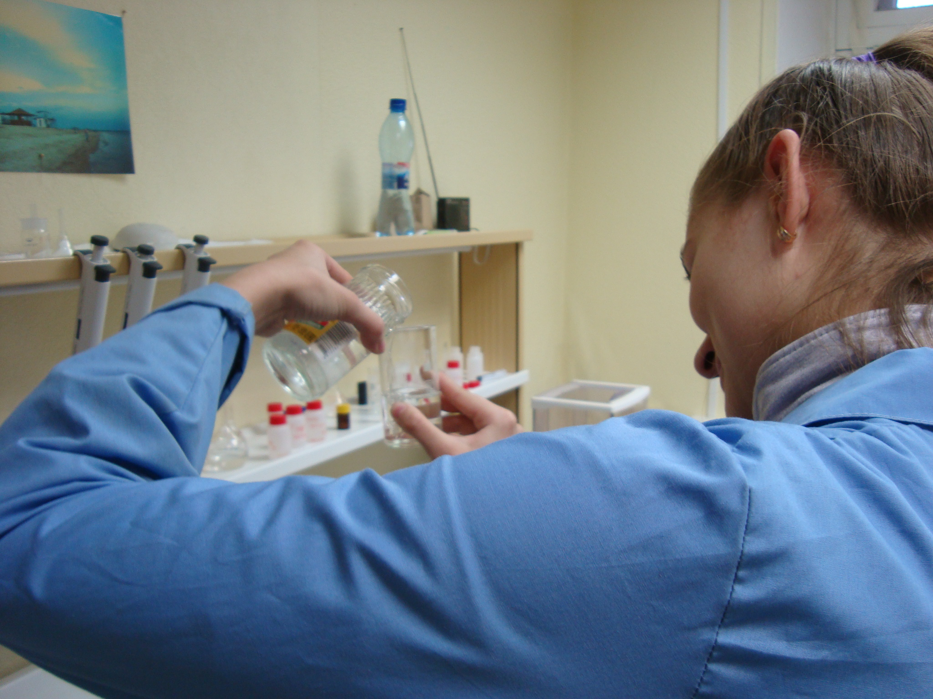
We also made an analysis of water taken from the Volga and from our school and come to the conclusion, that water in our school is suitable for drinking only after settling for half an hour, because settling removes the smell of chlorine and the temperature condition is obeyed.

