Slide 1
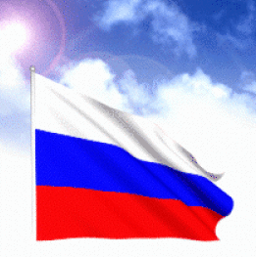
Welcome to Russia

Slide 2
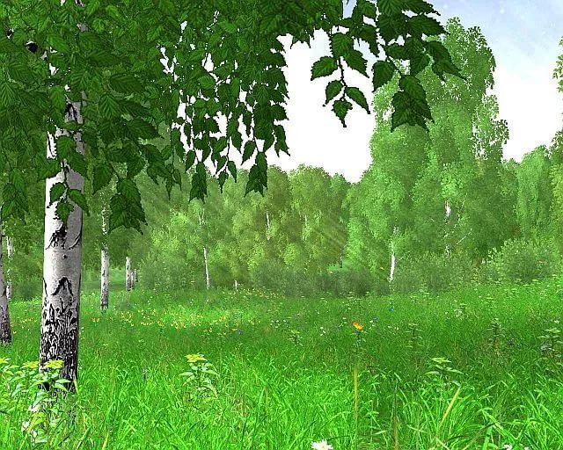
Фонетическая зарядка
[Ι]
[au]
[Λ]
[æ]
man
flag
Canada
animal
capital
symbol
biggest
rich
river
city
hill
mouse
house
tower
mountain
but
Russia
Russian
country

Slide 3
So many countries, so many customs.
There is no place like home.
East or West, home is best.

Slide 4
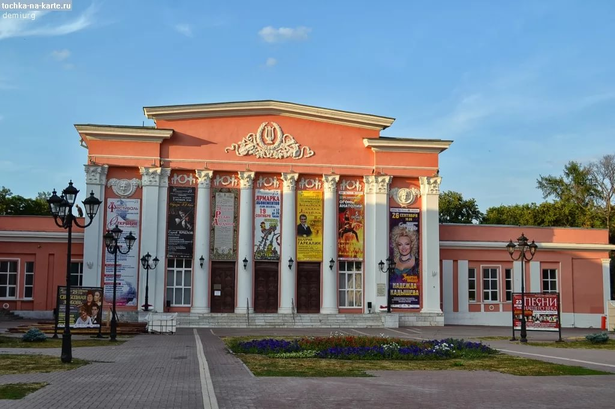
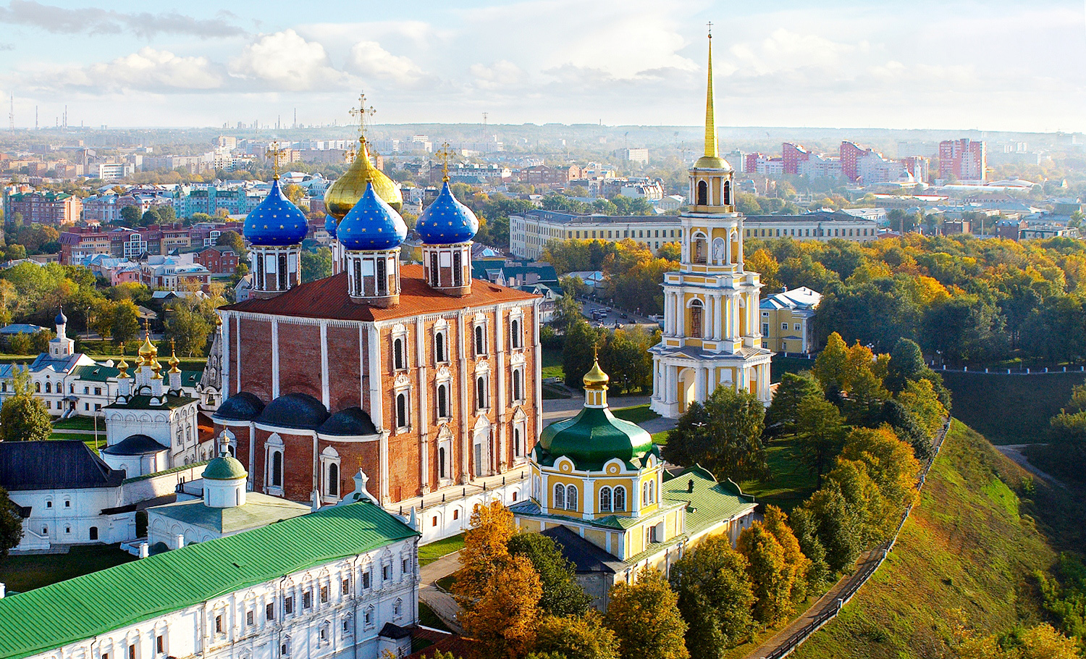
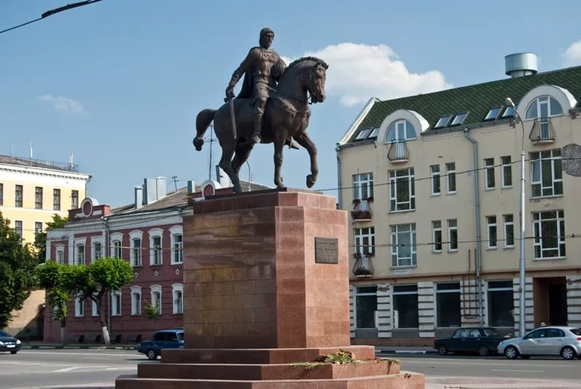
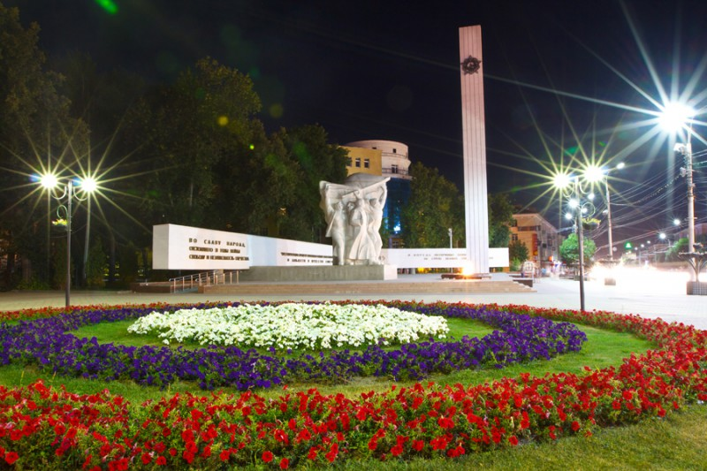
What city is it?
Ryazan

Slide 5
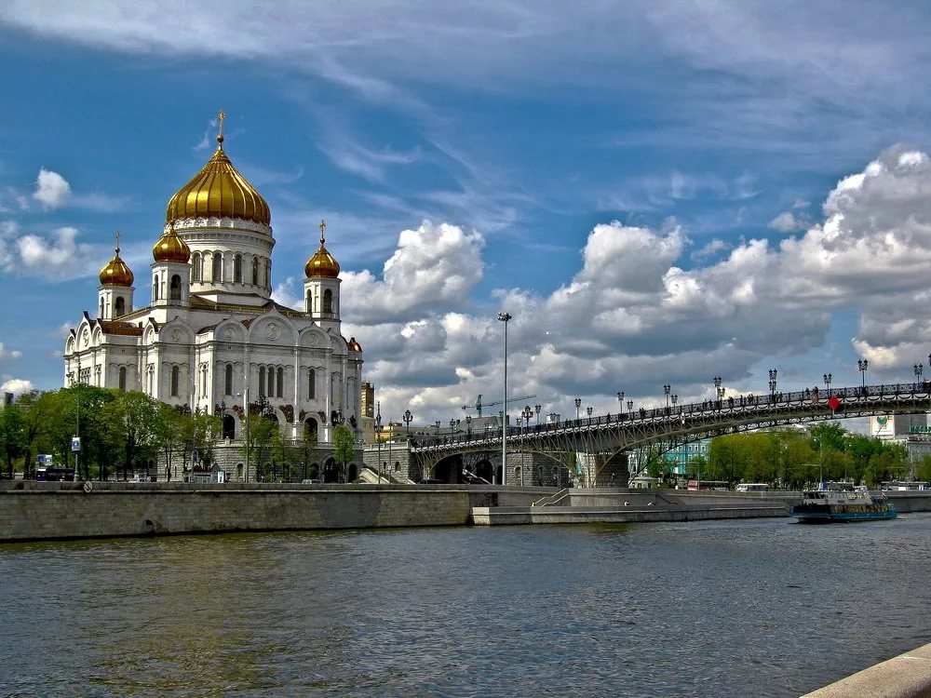
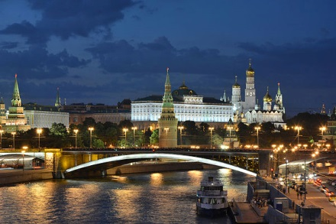
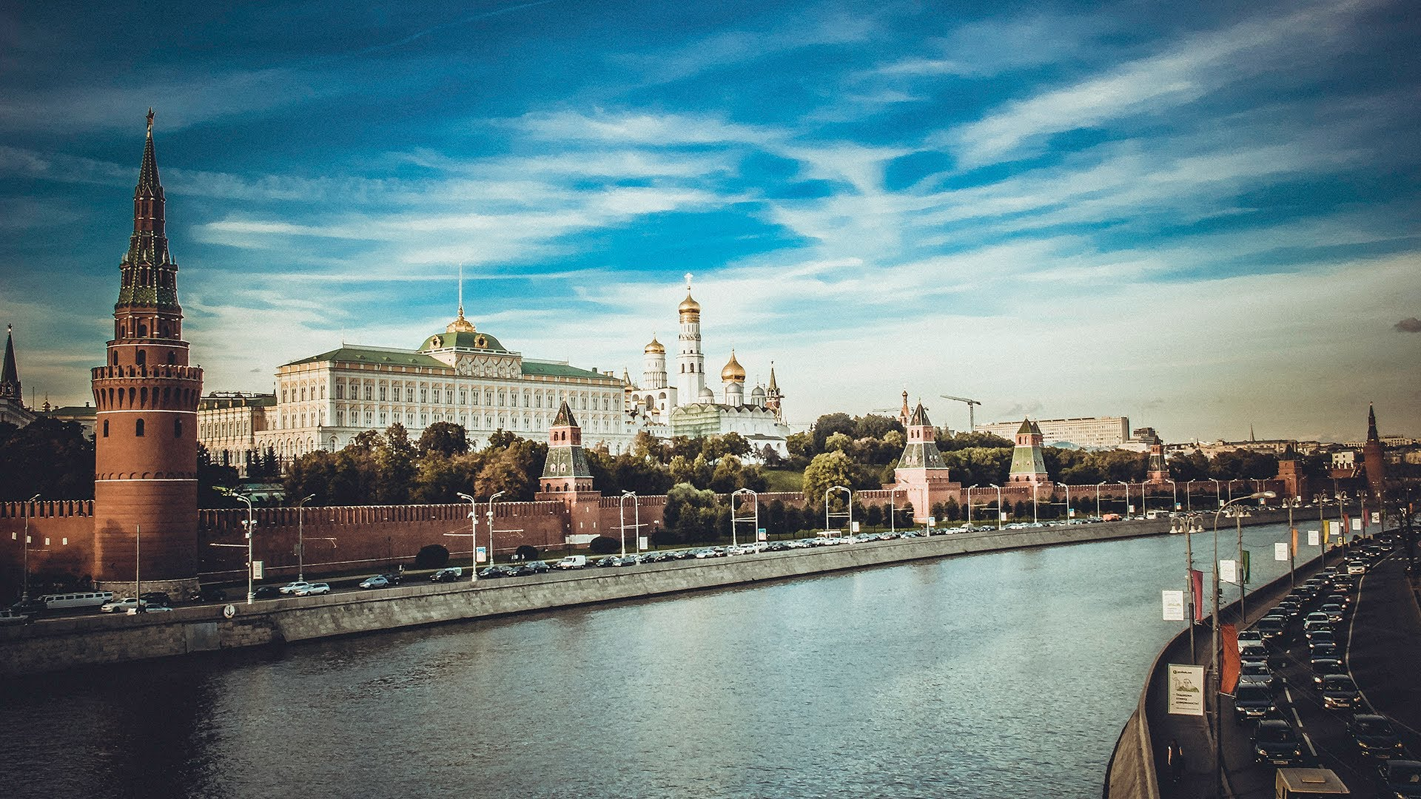
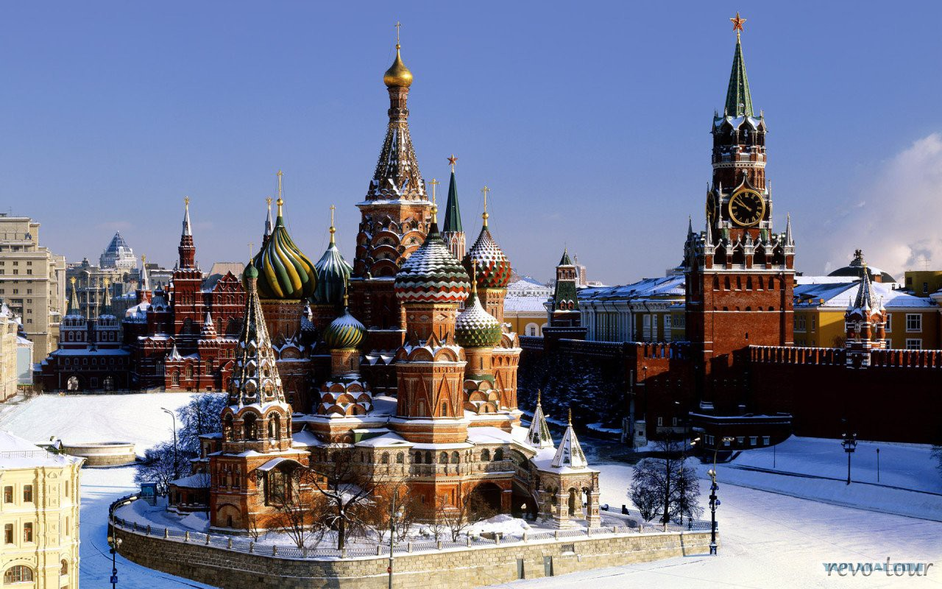
What city is it?
Moscow

Slide 6
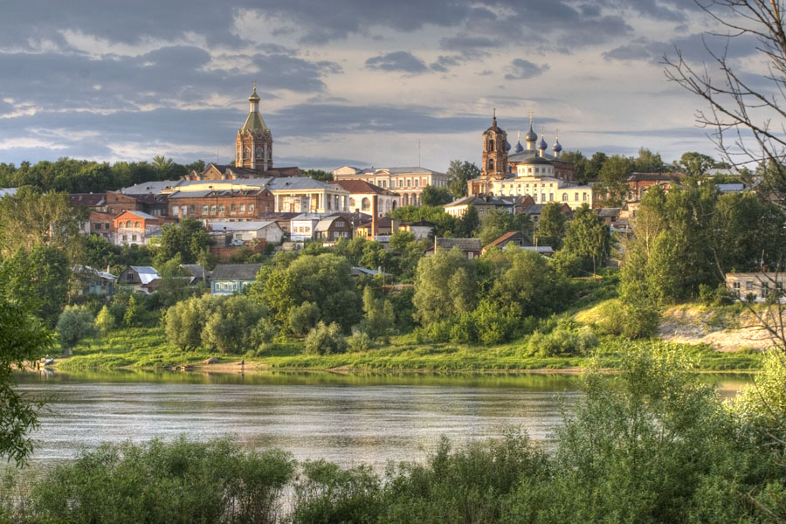
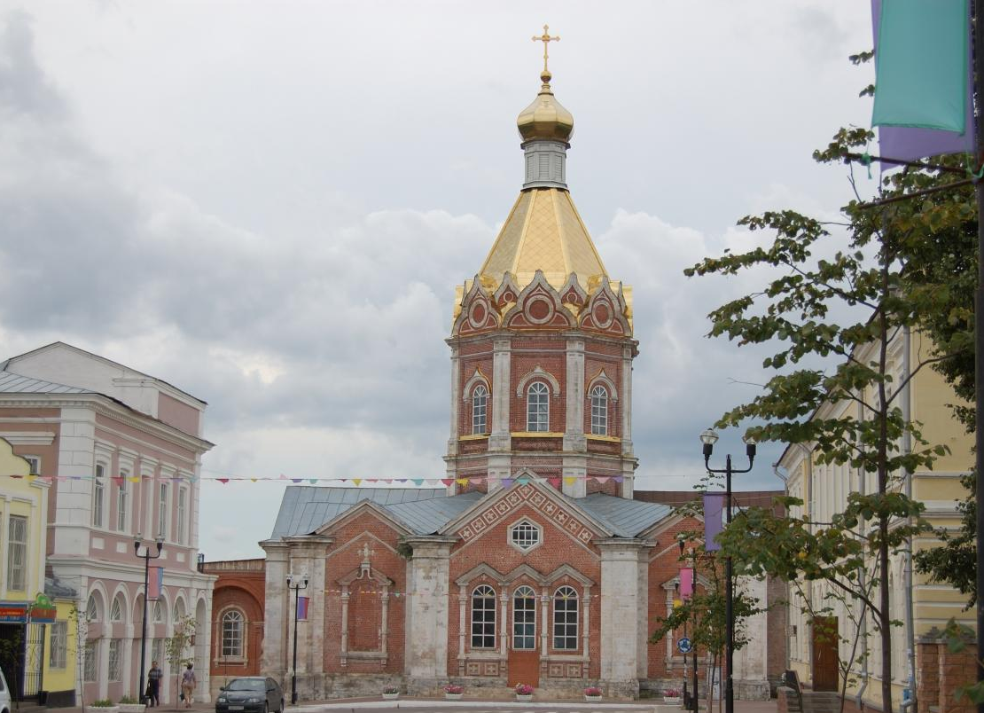
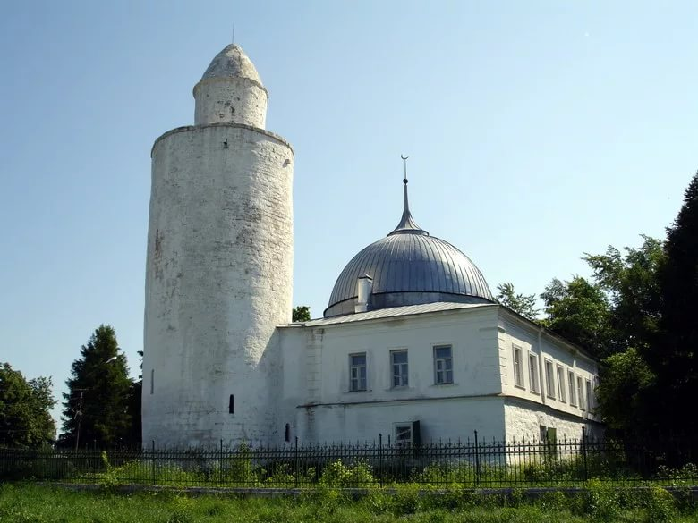
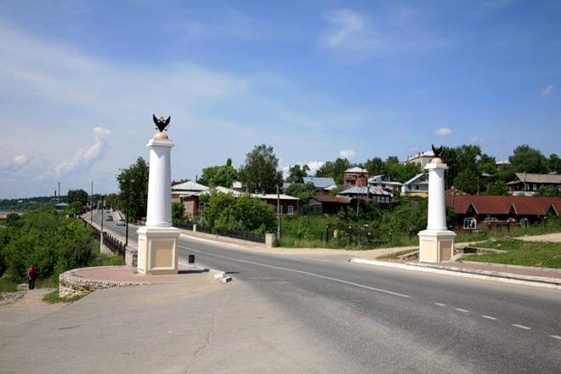
What city is it?
Kasimov

Slide 7
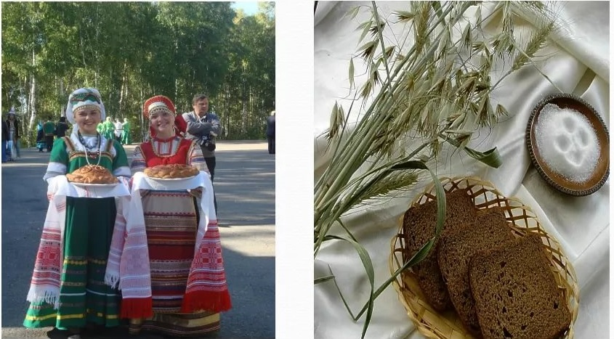

Slide 8
What is the biggest countries in the world?
Choose the right answer.
1. America
2. Russia
3. Canada

Slide 9

It is fouls!!!
.
Try again)

Slide 10

Great! It is true
Next question

Slide 11
What mountains divide Russia into two parts?
Choose the right answer.
1. The Urals
2. The Alps
3. The Caucasus

Slide 12
It is fouls!!!
Try again)

Slide 13
Great! It is true
Next question

Slide 14
What is the capital of Russia?
Choose the right answer.
1. Moscow
2. Ryazan
3. St. Petersburg

Slide 15
It is fouls!!!
.
Try again)

Slide 16
Great! It is true
Next question

Slide 17
What is the name of the Russian president?
Choose the right answer.
1.Vladimir Putin
2. Dmitry Medvedev
3. Sergey Shoigy

Slide 18
It is fouls!!!
.
Try again)

Slide 19
Great! It is true
Next question

Slide 20
How many stripes does the Russian flag have?
Choose the right answer.
1. 2 stripes
2. 3 stripes
3. 4 stripes

Slide 21
It is fouls!!!
.
Try again)

Slide 22
Great! It is true
Next question

Slide 23
What has red stripe symbol?
Choose the right answer.
1. noble and sincere
2. honest and devoted
3. love and bravery

Slide 24
It is fouls!!!
.
Try again)

Slide 25
Great! It is true

Slide 26
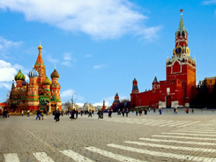
Russia's famous places of interest
Red Square

Slide 27
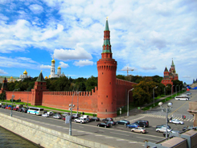
Russia's famous places of interest
The Kremlin

Slide 28
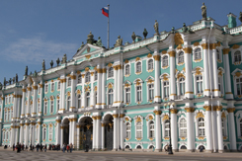
Russia's famous places of interest
The Hermitage

Slide 29
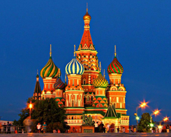
Russia's famous places of interest
Saint Basil's Cathedral

Slide 30
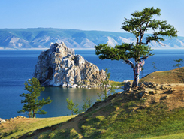
Russia's famous places of interest
Lake Baikal

Slide 31
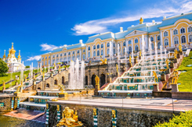
Russia's famous places of interest
Petergof

Slide 32
I know about …
I can speak about …

