Slide 1
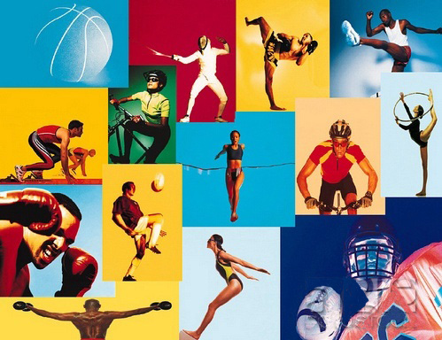
Sport is one of the most popular pastimes all over the world.

Slide 2
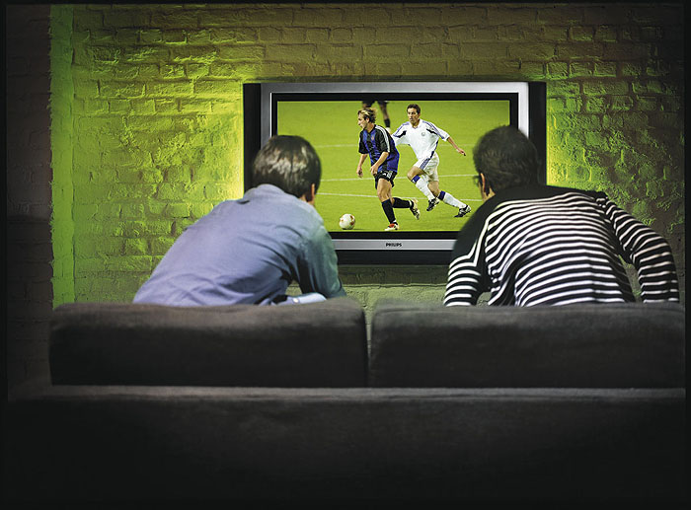
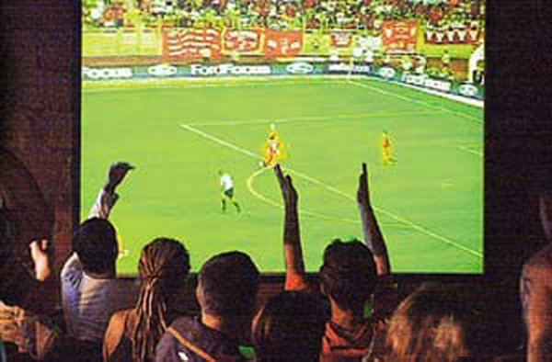
Lots of people watch sports programmes on TV ……

Slide 3
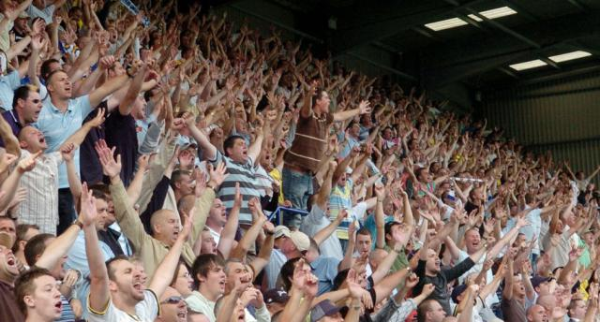

..support their teams at stadiums and go in for different kinds of sport.

Slide 4
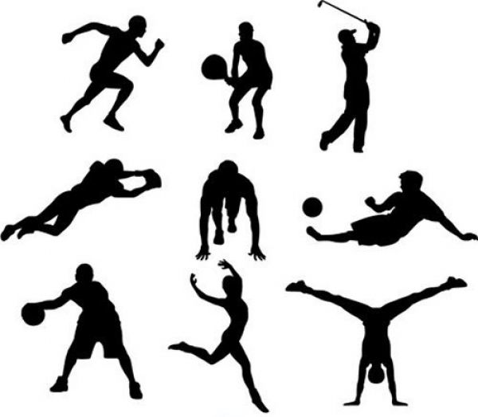
Some sports are common, others are not.
It is difficult to find a person who has not heard about such team games as…

Slide 5
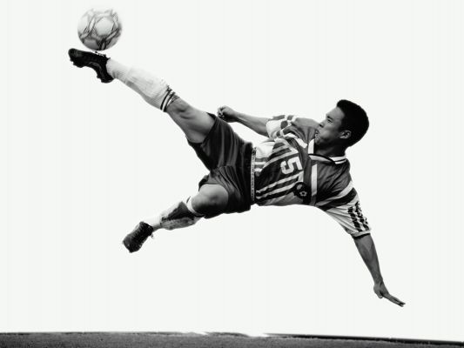
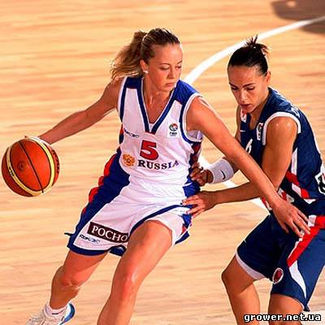
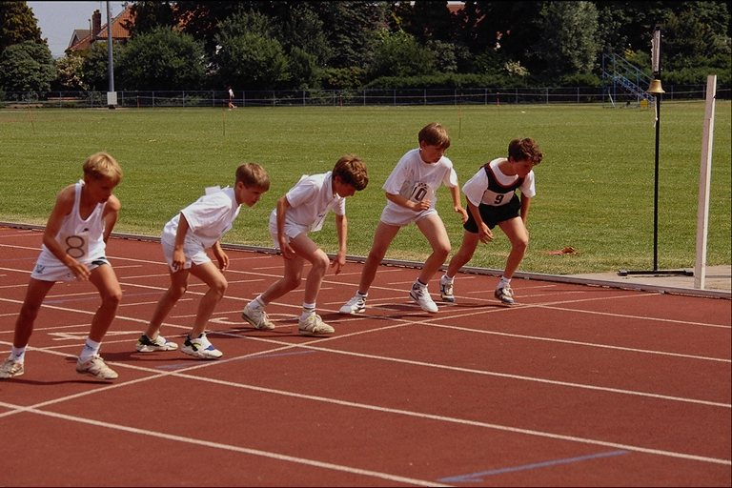
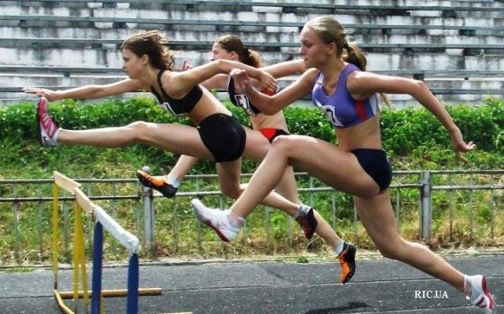
…football or basketball or such athletics as running and jumping.

Slide 6
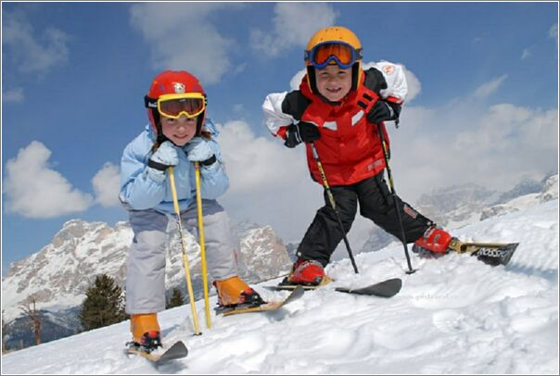
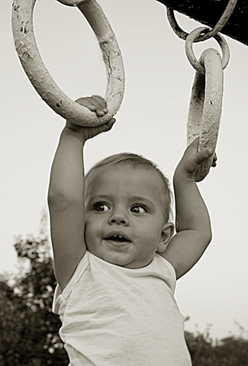
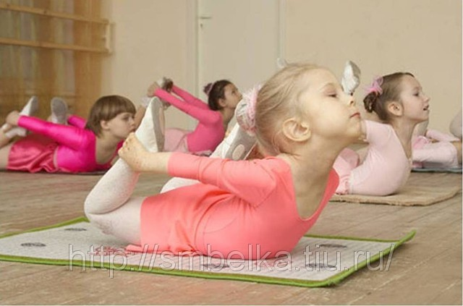
with most childhood we consolidate its health an occupation by sport...the game of plays with friends, go in athletic schools and etc. The Sport surrounds us everywhere, on length of the lifes.

Slide 7
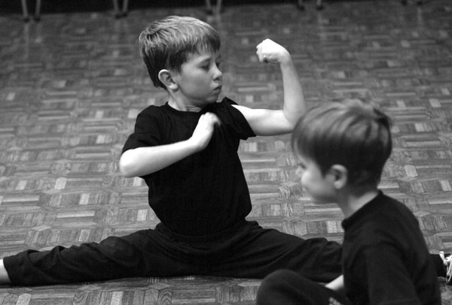
At the same time there are sports and games that are less common, for example…

Slide 8
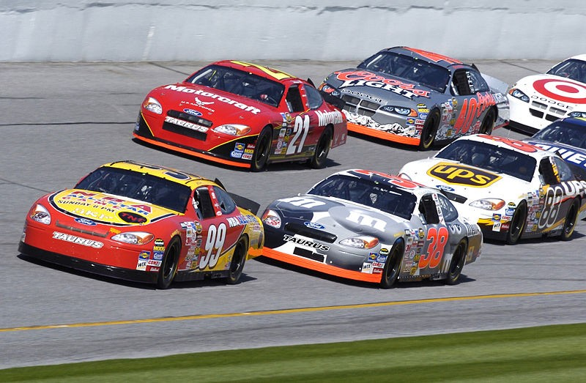
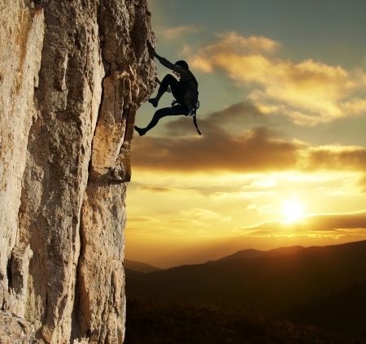
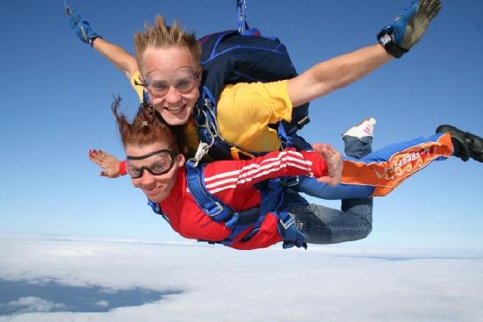
motor races, rock climbing and parachute jumping are not to everyone’s taste.

Slide 9
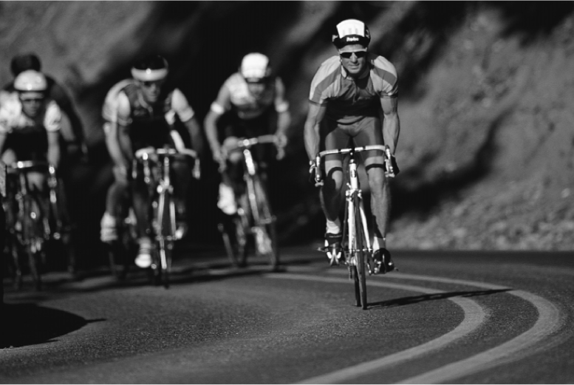
Going in for sport gives you a lot of advantages. It gives you physical exercise, you spend a lot of time in the open air, you meet people who enjoy the same sport.

Slide 10
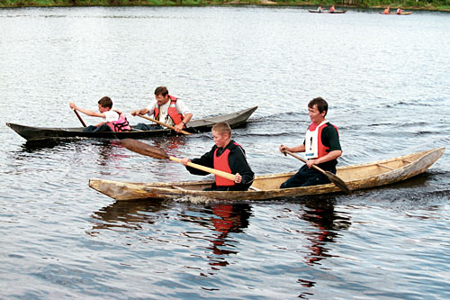
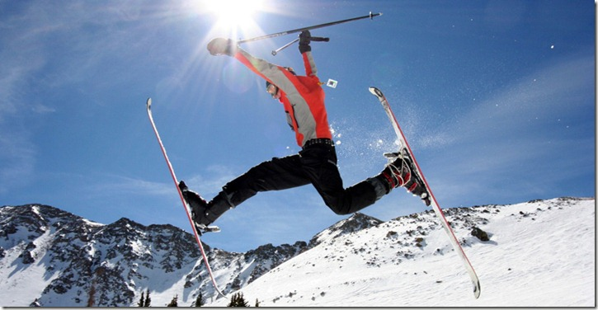
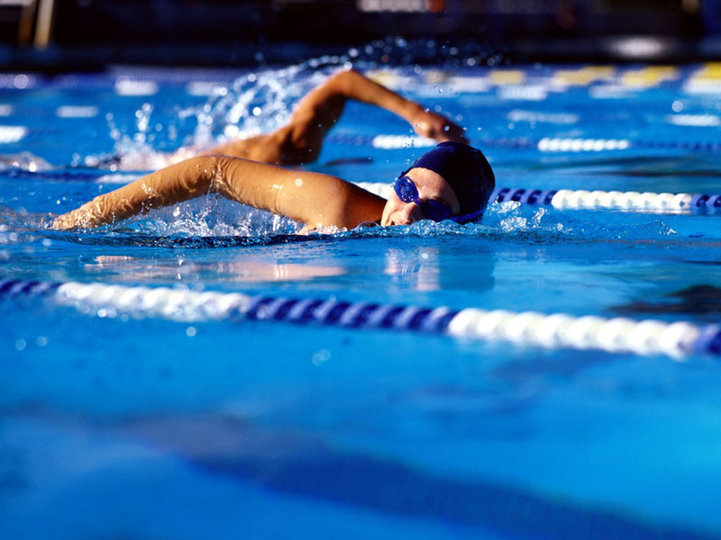
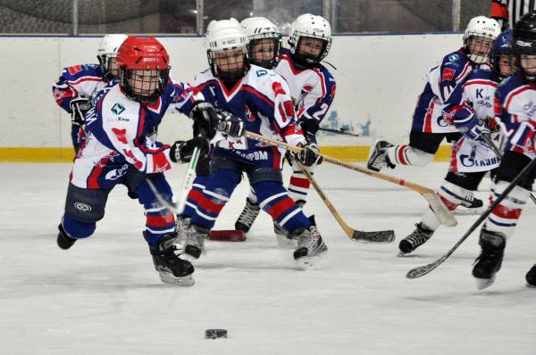
go in for sport!

