Slide 1
Present Continuous Tense

Slide 2
Present Continuous Tense
Настоящее продолженное время
Настоящее продолженное – означает, что действие происходит в данный момент, сейчас.
Я сейчас играю.
Моя мама сейчас пьёт молоко.
Мы сейчас смотрим телевизор.

Slide 3
Present Continuous Tense
Настоящее продолженное время
Глагол «to be»
Окончание – ing к глаголу действия
am
is
are

Slide 4
Правила прибавления окончания - ing
Если слово заканчивается на «немую» -е, то при прибавлении окончания – ing, эта буква не пишется.
Dance – dancing
Make - making
1.

Slide 5
Правила прибавления окончания - ing
Если в слове 1 гласная и 1 согласная на конце, то при прибавлении окончания – ing, последняя согласная удваивается.
Swim - swimming
Run - running
2.

Slide 6
Вставь верный глагол to be
I _ wearing a blue T-shirt.
_ she wearing a pink dress?
We _ wearing yellow socks.
_ I wearing grey shorts?
He _ wearing a red jacket.
He _ not wearing a skirt.
_ you wearing a green hat?
You _ wearing brown shoes.
They _ not wearing jeans.
_ we wearing white coats?

Slide 7
Ответь кратко на вопросы.
Is it flying?
Is she swimming?
Are the birds singing?
Are the monkeys climbing?
Is he dancing?
Are they running?
Is the baby jumping?
Am I swinging?
Is the hippo swimming?
Are you playing football?
No,
Yes,
No,
Yes,
No,
No,
Yes,
No,
Yes,
Yes,

Slide 8
Ответь кратко на вопросы.
Is it flying?
Is she swimming?
Are the birds singing?
Are the monkeys climbing?
Is he dancing?
Are they running?
Is the baby jumping?
Am I swinging?
Is the hippo swimming?
Are you playing football?
No, it is not.
Yes,
No,
Yes,
No,
No,
Yes,
No,
Yes,
Yes,

Slide 9
Ответь кратко на вопросы.
Is it flying?
Is she swimming?
Are the birds singing?
Are the monkeys climbing?
Is he dancing?
Are they running?
Is the baby jumping?
Am I swinging?
Is the hippo swimming?
Are you playing football?
No, it is not.
Yes, she is.
No,
Yes,
No,
No,
Yes,
No,
Yes,
Yes,

Slide 10
Ответь кратко на вопросы.
Is it flying?
Is she swimming?
Are the birds singing?
Are the monkeys climbing?
Is he dancing?
Are they running?
Is the baby jumping?
Am I swinging?
Is the hippo swimming?
Are you playing football?
No, it is not.
Yes, she is.
No, they are not.
Yes,
No,
No,
Yes,
No,
Yes,
Yes,

Slide 11
Ответь кратко на вопросы.
Is it flying?
Is she swimming?
Are the birds singing?
Are the monkeys climbing?
Is he dancing?
Are they running?
Is the baby jumping?
Am I swinging?
Is the hippo swimming?
Are you playing football?
No, it is not.
Yes, she is.
No, they are not.
Yes, they are.
No,
No,
Yes,
No,
Yes,
Yes,

Slide 12
Ответь кратко на вопросы.
Is it flying?
Is she swimming?
Are the birds singing?
Are the monkeys climbing?
Is he dancing?
Are they running?
Is the baby jumping?
Am I swinging?
Is the hippo swimming?
Are you playing football?
No, it is not.
Yes, she is.
No, they are not.
Yes, they are.
No, he is not.
No,
Yes,
No,
Yes,
Yes,

Slide 13
Ответь кратко на вопросы.
Is it flying?
Is she swimming?
Are the birds singing?
Are the monkeys climbing?
Is he dancing?
Are they running?
Is the baby jumping?
Am I swinging?
Is the hippo swimming?
Are you playing football?
No, it is not.
Yes, she is.
No, they are not.
Yes, they are.
No, he is not.
No, they are not.
Yes,
No,
Yes,
Yes,

Slide 14
Ответь кратко на вопросы.
Is it flying?
Is she swimming?
Are the birds singing?
Are the monkeys climbing?
Is he dancing?
Are they running?
Is the baby jumping?
Am I swinging?
Is the hippo swimming?
Are you playing football?
No, it is not.
Yes, she is.
No, they are not.
Yes, they are.
No, he is not.
No, they are not.
Yes, he is.
No,
Yes,
Yes,

Slide 15
Ответь кратко на вопросы.
Is it flying?
Is she swimming?
Are the birds singing?
Are the monkeys climbing?
Is he dancing?
Are they running?
Is the baby jumping?
Am I swinging?
Is the hippo swimming?
Are you playing football?
No, it is not.
Yes, she is.
No, they are not.
Yes, they are.
No, he is not.
No, they are not.
Yes, he is.
No, I am not.
Yes,
Yes,

Slide 16
Ответь кратко на вопросы.
Is it flying?
Is she swimming?
Are the birds singing?
Are the monkeys climbing?
Is he dancing?
Are they running?
Is the baby jumping?
Am I swinging?
Is the hippo swimming?
Are you playing football?
No, it is not.
Yes, she is.
No, they are not.
Yes, they are.
No, he is not.
No, they are not.
Yes, he is.
No, I am not.
Yes, it is.
Yes,

Slide 17
Ответь кратко на вопросы.
Is it flying?
Is she swimming?
Are the birds singing?
Are the monkeys climbing?
Is he dancing?
Are they running?
Is the baby jumping?
Am I swinging?
Is the hippo swimming?
Are you playing football?
No, it is not.
Yes, she is.
No, they are not.
Yes, they are.
No, he is not.
No, they are not.
Yes, he is.
No, I am not.
Yes, it is.
Yes, you are.

Slide 18
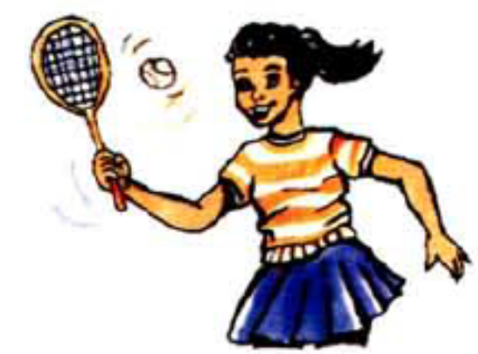
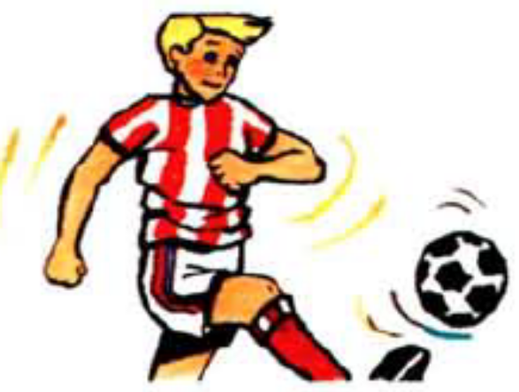

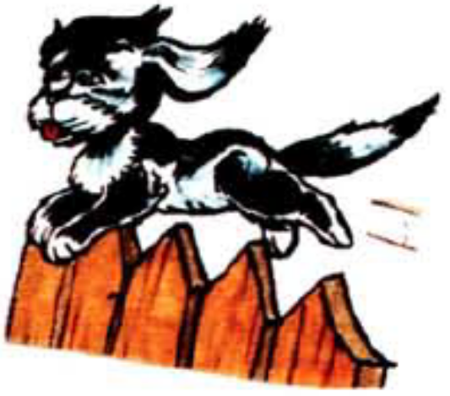
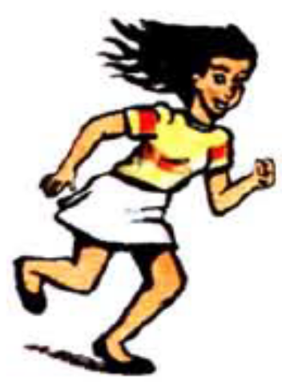
Скажи, что делают герои.

Slide 19
Скажи, что делают герои.
She is playing tennis.

Slide 20
Скажи, что делают герои.
She is playing tennis.
He is playing football.

Slide 21
Скажи, что делают герои.
She is playing tennis.
He is playing football.
They are dancing.

Slide 22
Скажи, что делают герои.
She is playing tennis.
He is playing football.
They are dancing.
A dog is jumping.

Slide 23
Скажи, что делают герои.
She is playing tennis.
He is playing football.
They are dancing.
A dog is jumping.
She is running.

Slide 24
Задай вопросы к следующим ответам.
1. | 1. Yes, Mary is dancing.
2. | 2. Yes, we are swimming.
3. | 3. Yes, he is singing.
4. | 4. Yes, a fish is jumping.
5. | 5. Yes, a giraffe is eating.
6. | 6. Yes, crocodiles are drinking.

Slide 25
Задай вопросы к следующим ответам.
1. Is Mary dancing? | 1. Yes, Mary is dancing.
2. | 2. Yes, we are swimming.
3. | 3. Yes, he is singing.
4. | 4. Yes, a fish is jumping.
5. | 5. Yes, a giraffe is eating.
6. | 6. Yes, crocodiles are drinking.

Slide 26
Задай вопросы к следующим ответам.
1. Is Mary dancing? | 1. Yes, Mary is dancing.
2. Are we swimming? | 2. Yes, we are swimming.
3. | 3. Yes, he is singing.
4. | 4. Yes, a fish is jumping.
5. | 5. Yes, a giraffe is eating.
6. | 6. Yes, crocodiles are drinking.

Slide 27
Задай вопросы к следующим ответам.
1. Is Mary dancing? | 1. Yes, Mary is dancing.
2. Are we swimming? | 2. Yes, we are swimming.
3. Is he singing? | 3. Yes, he is singing.
4. | 4. Yes, a fish is jumping.
5. | 5. Yes, a giraffe is eating.
6. | 6. Yes, crocodiles are drinking.

Slide 28
Задай вопросы к следующим ответам.
1. Is Mary dancing? | 1. Yes, Mary is dancing.
2. Are we swimming? | 2. Yes, we are swimming.
3. Is he singing? | 3. Yes, he is singing.
4. Is a fish jumping? | 4. Yes, a fish is jumping.
5. | 5. Yes, a giraffe is eating.
6. | 6. Yes, crocodiles are drinking.

Slide 29
Задай вопросы к следующим ответам.
1. Is Mary dancing? | 1. Yes, Mary is dancing.
2. Are we swimming? | 2. Yes, we are swimming.
3. Is he singing? | 3. Yes, he is singing.
4. Is a fish jumping? | 4. Yes, a fish is jumping.
5. Is a giraffe eating? | 5. Yes, a giraffe is eating.
6. | 6. Yes, crocodiles are drinking.

Slide 30
Задай вопросы к следующим ответам.
1. Is Mary dancing? | 1. Yes, Mary is dancing.
2. Are we swimming? | 2. Yes, we are swimming.
3. Is he singing? | 3. Yes, he is singing.
4. Is a fish jumping? | 4. Yes, a fish is jumping.
5. Is a giraffe eating? | 5. Yes, a giraffe is eating.
6. Are crocodiles drinking? | 6. Yes, crocodiles are drinking.

Slide 31
Скажи, что не делают герои.
Tom is jumping. (drink)
Dogs are running. (swim)
Cows are drinking. (fly)
My brother is singing. (dance)
His cats are climbing. (swing)
I am eating. (jump)

Slide 32
Скажи, что не делают герои.
Tom is jumping. (drink)
Dogs are running. (swim)
Cows are drinking. (fly)
My brother is singing. (dance)
His cats are climbing. (swing)
I am eating. (jump)
1. Tom is not drinking.

Slide 33
Скажи, что не делают герои.
Tom is jumping. (drink)
Dogs are running. (swim)
Cows are drinking. (fly)
My brother is singing. (dance)
His cats are climbing. (swing)
I am eating. (jump)
Tom is not drinking.
Dogs are not swimming.

Slide 34
Скажи, что не делают герои.
Tom is jumping. (drink)
Dogs are running. (swim)
Cows are drinking. (fly)
My brother is singing. (dance)
His cats are climbing. (swing)
I am eating. (jump)
Tom is not drinking.
Dogs are not swimming.
Cows are not flying.

Slide 35
Скажи, что не делают герои.
Tom is jumping. (drink)
Dogs are running. (swim)
Cows are drinking. (fly)
My brother is singing. (dance)
His cats are climbing. (swing)
I am eating. (jump)
Tom is not drinking.
Dogs are not swimming.
Cows are not flying.
My brother is not dancing.

Slide 36
Скажи, что не делают герои.
Tom is jumping. (drink)
Dogs are running. (swim)
Cows are drinking. (fly)
My brother is singing. (dance)
His cats are climbing. (swing)
I am eating. (jump)
Tom is not drinking.
Dogs are not swimming.
Cows are not flying.
My brother is not dancing.
His cats are not swinging.

Slide 37
Скажи, что не делают герои.
Tom is jumping. (drink)
Dogs are running. (swim)
Cows are drinking. (fly)
My brother is singing. (dance)
His cats are climbing. (swing)
I am eating. (jump)
Tom is not drinking.
Dogs are not swimming.
Cows are not flying.
My brother is not dancing.
His cats are not swinging.
I am not jumping.

Slide 38

Составь отрицательные предложения, вставив верный
глагол to be и окончание -ing
They/not/play tennis.
A cat/not/drink milk.
Sisters/not/swing.
I/not/jump.
You/not/swim.
She/not/dance.

Slide 39
Составь отрицательные предложения, вставив верный
глагол to be и окончание -ing
They/not/play tennis.
A cat/not/drink milk.
Sisters/not/swing.
I/not/jump.
You/not/swim.
She/not/dance.
They are not playing tennis.

Slide 40
Составь отрицательные предложения, вставив верный
глагол to be и окончание -ing
They/not/play tennis.
A cat/not/drink milk.
Sisters/not/swing.
I/not/jump.
You/not/swim.
She/not/dance.
They are not playing tennis.
A cat is not drinking milk.

Slide 41
Составь отрицательные предложения, вставив верный
глагол to be и окончание -ing
They/not/play tennis.
A cat/not/drink milk.
Sisters/not/swing.
I/not/jump.
You/not/swim.
She/not/dance.
They are not playing tennis.
A cat is not drinking milk.
Sisters are not swinging.

Slide 42
Составь отрицательные предложения, вставив верный
глагол to be и окончание -ing
They/not/play tennis.
A cat/not/drink milk.
Sisters/not/swing.
I/not/jump.
You/not/swim.
She/not/dance.
They are not playing tennis.
A cat is not drinking milk.
Sisters are not swinging.
I am not jumping.

Slide 43
Составь отрицательные предложения, вставив верный
глагол to be и окончание -ing
They/not/play tennis.
A cat/not/drink milk.
Sisters/not/swing.
I/not/jump.
You/not/swim.
She/not/dance.
They are not playing tennis.
A cat is not drinking milk.
Sisters are not swinging.
I am not jumping.
You are not swimming.

Slide 44
Составь отрицательные предложения, вставив верный
глагол to be и окончание -ing
They/not/play tennis.
A cat/not/drink milk.
Sisters/not/swing.
I/not/jump.
You/not/swim.
She/not/dance.
They are not playing tennis.
A cat is not drinking milk.
Sisters are not swinging.
I am not jumping.
You are not swimming.
She is not dancing.

Slide 45



Составь вопросительные предложения и ответь на них кратко.
Her mother/jump?
Dogs/swing?
A fish/fly?
He/run?
Giraffes/swim?
A horse/drink?

Slide 46

Составь вопросительные предложения и ответь на них кратко.
Her mother/jump?
Dogs/swing?
A fish/fly?
He/run?
Giraffes/swim?
A horse/drink?
1. Is her mother jumping? No, she isn’t.
2.
3.
4.
5.
6.

Slide 47
Составь вопросительные предложения и ответь на них кратко.
Her mother/jump?
Dogs/swing?
A fish/fly?
He/run?
Giraffes/swim?
A horse/drink?
1. Is her mother jumping? No, she isn’t.
2. Are dogs swinging? Yes, they are.
3.
4.
5.
6.

Slide 48
Составь вопросительные предложения и ответь на них кратко.
Her mother/jump?
Dogs/swing?
A fish/fly?
He/run?
Giraffes/swim?
A horse/drink?
1. Is her mother jumping? No, she isn’t.
2. Are dogs swinging? Yes, they are.
3. Is a fish flying? No, it isn’t.
4.
5.
6.

Slide 49
Составь вопросительные предложения и ответь на них кратко.
Her mother/jump?
Dogs/swing?
A fish/fly?
He/run?
Giraffes/swim?
A horse/drink?
1. Is her mother jumping? No, she isn’t.
2. Are dogs swinging? Yes, they are.
3. Is a fish flying? No, it isn’t.
4. Is he running? Yes, he is.
5.
6.

Slide 50
Составь вопросительные предложения и ответь на них кратко.
Her mother/jump?
Dogs/swing?
A fish/fly?
He/run?
Giraffes/swim?
A horse/drink?
1. Is her mother jumping? No, she isn’t.
2. Are dogs swinging? Yes, they are.
3. Is a fish flying? No, it isn’t.
4. Is he running? Yes, he is.
5. Are giraffes swimming? No, they are not.
6.

Slide 51
Составь вопросительные предложения и ответь на них кратко.
Her mother/jump?
Dogs/swing?
A fish/fly?
He/run?
Giraffes/swim?
A horse/drink?
1. Is her mother jumping? No, she isn’t.
2. Are dogs swinging? Yes, they are.
3. Is a fish flying? No, it isn’t.
4. Is he running? Yes, he is.
5. Are giraffes swimming? No, they are not.
6. Is a horse drinking? Yes, it is.

Slide 52
Составь из слов предложения.
is/my/singing/sister.
dogs/his/jumping/are?
not/football/we/playing/are.
running/horse/is/her?
blue/are/flying/birds.
dancing/your/are/cats/not.

Slide 53
Составь из слов предложения.
is/my/singing/sister.
dogs/his/jumping/are?
not/football/we/playing/are.
running/horse/is/her?
blue/are/flying/birds.
dancing/your/are/cats/not.
My sister is singing.

Slide 54
Составь из слов предложения.
is/my/singing/sister.
dogs/his/jumping/are?
not/football/we/playing/are.
running/horse/is/her?
blue/are/flying/birds.
dancing/your/are/cats/not.
My sister is singing.
Are his dogs jumping?

Slide 55
Составь из слов предложения.
is/my/singing/sister.
dogs/his/jumping/are?
not/football/we/playing/are.
running/horse/is/her?
blue/are/flying/birds.
dancing/your/are/cats/not.
My sister is singing.
Are his dogs jumping?
We are not playing football.

Slide 56
Составь из слов предложения.
is/my/singing/sister.
dogs/his/jumping/are?
not/football/we/playing/are.
running/horse/is/her?
blue/are/flying/birds.
dancing/your/are/cats/not.
My sister is singing.
Are his dogs jumping?
We are not playing football.
Is her house running?

Slide 57
Составь из слов предложения.
is/my/singing/sister.
dogs/his/jumping/are?
not/football/we/playing/are.
running/horse/is/her?
blue/are/flying/birds.
dancing/your/are/cats/not.
My sister is singing.
Are his dogs jumping?
We are not playing football.
Is her house running?
Blue birds are flying.

Slide 58
Составь из слов предложения.
is/my/singing/sister.
dogs/his/jumping/are?
not/football/we/playing/are.
running/horse/is/her?
blue/are/flying/birds.
dancing/your/are/cats/not.
My sister is singing.
Are his dogs jumping?
We are not playing football.
Is her house running?
Blue birds are flying.
Your cats are not dancing.

Slide 59

Переведи на английский язык.
Его кошка сейчас лазиет.
Они сейчас не плавают.
Вы сейчас бегаете?
Мы сейчас пьём (drink) молоко.
Её тётя сейчас не поёт.
Обезьяны сейчас качаются?

Slide 60
Переведи на английский язык.
Его кошка сейчас лазиет.
His cat is climbing.
Они сейчас не плавают.
Вы сейчас бегаете?
Мы сейчас пьём (drink) молоко.
Её тётя сейчас не поёт.
Обезьяны сейчас качаются?

Slide 61
Переведи на английский язык.
Его кошка сейчас лазиет.
His cat is climbing.
Они сейчас не плавают.
They are not swimming.
Вы сейчас бегаете?
Мы сейчас пьём (drink) молоко.
Её тётя сейчас не поёт.
Обезьяны сейчас качаются?

Slide 62
Переведи на английский язык.
Его кошка сейчас лазиет.
His cat is climbing.
Они сейчас не плавают.
They are not swimming.
Вы сейчас бегаете?
Are you running?
Мы сейчас пьём (drink) молоко.
Её тётя сейчас не поёт.
Обезьяны сейчас качаются?

Slide 63
Переведи на английский язык.
Его кошка сейчас лазиет.
His cat is climbing.
Они сейчас не плавают.
They are not swimming.
Вы сейчас бегаете?
Are you running?
Мы сейчас пьём (drink) молоко.
We are drinking milk.
Её тётя сейчас не поёт.
Обезьяны сейчас качаются?

Slide 64
Переведи на английский язык.
Его кошка сейчас лазиет.
His cat is climbing.
Они сейчас не плавают.
They are not swimming.
Вы сейчас бегаете?
Are you running?
Мы сейчас пьём (drink) молоко.
We are drinking milk.
Её тётя сейчас не поёт.
Her aunt is not singing.
Обезьяны сейчас качаются?

Slide 65
Переведи на английский язык.
Его кошка сейчас лазиет.
His cat is climbing.
Они сейчас не плавают.
They are not swimming.
Вы сейчас бегаете?
Are you running?
Мы сейчас пьём (drink) молоко.
We are drinking milk.
Её тётя сейчас не поёт.
Her aunt is not singing.
Обезьяны сейчас качаются?
Are monkeys swinging?

