Slide 1
Mass Media

Slide 2
Round 1

Slide 3
TV | 100 | 200 | 300 | 400
Radio | 100 | 200 | 300 | 400
What about inventions? | 100 | 200 | 300 | 400
The Internet | 100 | 200 | 300 | 400
What to read? | 100 | 200 | 300 | 400

Slide 4

This program is broadcasted on THIS channel.

Slide 5


Slide 6
People don’t like it, when they watch a TV.

Slide 7
Аdvertisement

Slide 8
Who is the presenter of «KVN»?

Slide 9
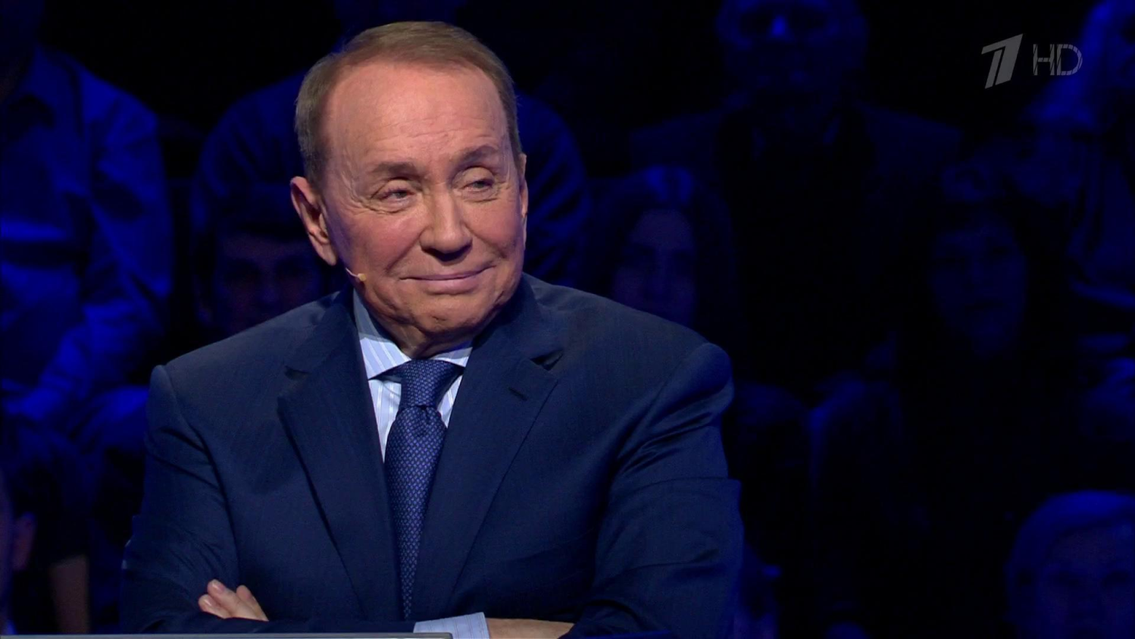
Alexander Maslyakov

Slide 10


What is THIS program?

Slide 11


Slide 12
«The cat in the bag»

Slide 13
Who said on the radio about the beginning of the war?

Slide 14
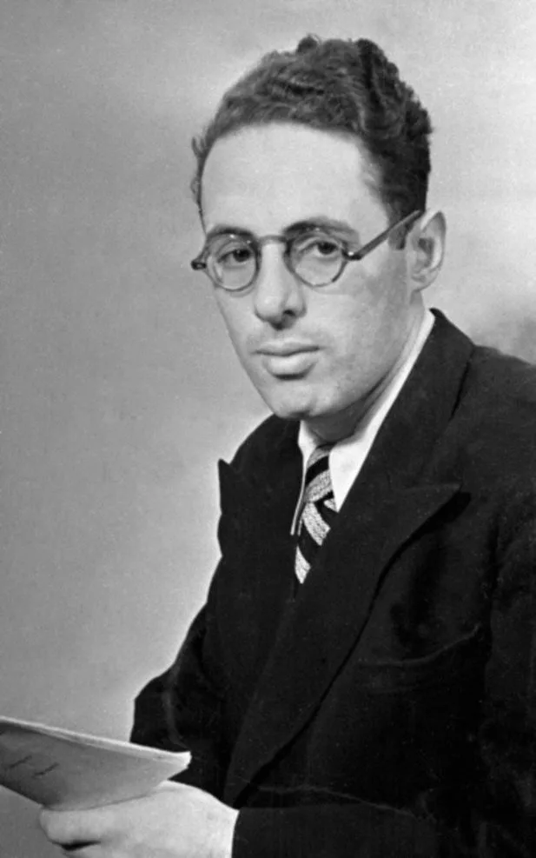
Yuri Levitan

Slide 15
What are the three popular radio?

Slide 16
Where is Popov's first radio being now?

Slide 17
Saint-Petersburg

Slide 18

What is this radio?

Slide 20
Where was invented the first TV?

Slide 21
Germany

Slide 22
Who invented the radio?

Slide 23
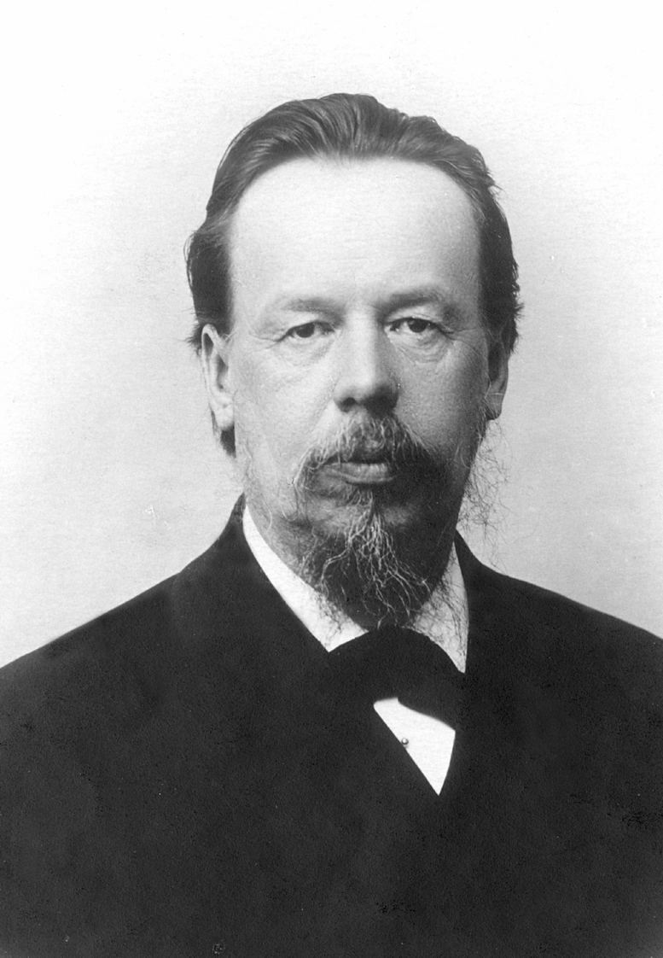
Alexander Stepanovich Popov

Slide 24
Who is invented «VKontakte»?

Slide 25
Pavel Durov

Slide 26
Аuction

Slide 27
Where was created the first book?

Slide 28
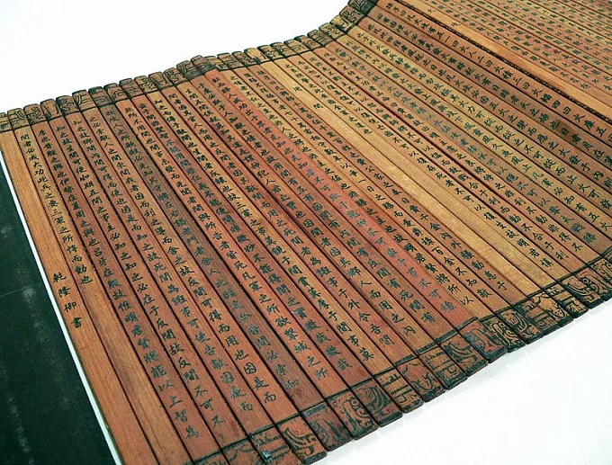
China

Slide 29
What is the Internet?

Slide 30
Global Network

Slide 31
People from THIS country invented the Internet.

Slide 32
The USA

Slide 33
In THIS encyclopedia everybody can make corrections.

Slide 34


Slide 35
What are the three popular social network?

Slide 36
What was the Emperor of Russia, when the first newspaper was printed?

Slide 37
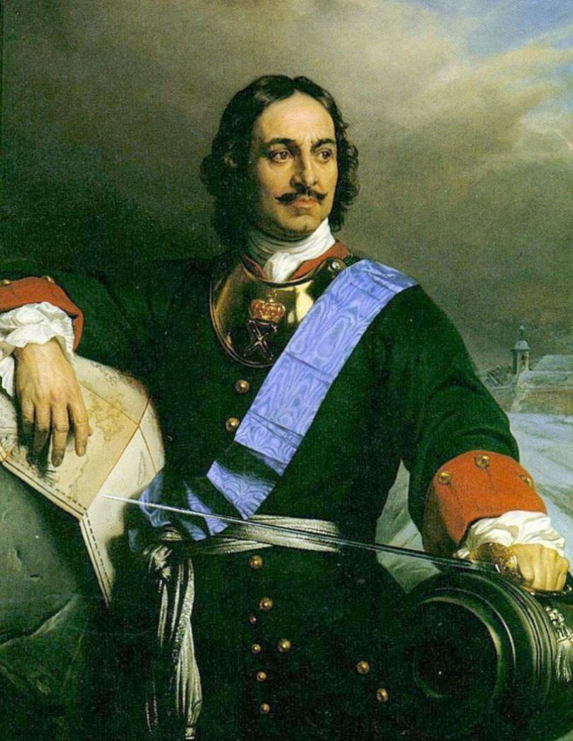
Peter the First

Slide 38
What are the three popular magazines?

Slide 39

What is this book?

Slide 41
THIS newspaper is the thickest.

Slide 42
«The New-York Times»

