Slide 1
«Tasty stories»

Slide 2
Breakfast, dinner, supper, lunch
I like all them very much

Slide 3
Food еда healthy здоровая junk нездоровая eat кушать fruit фрукт vegetable овощ drink пить, питье berry ягода

Slide 4


Slide 5
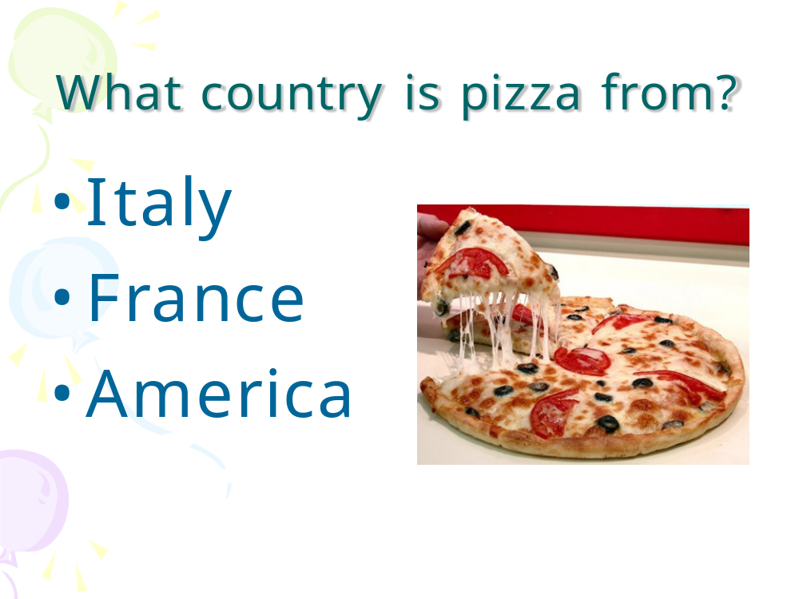

Slide 6
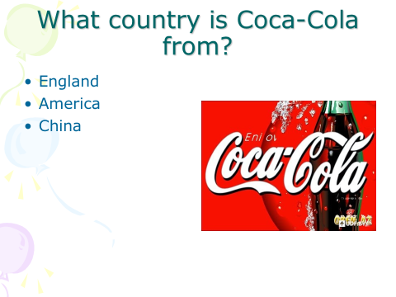

Slide 7
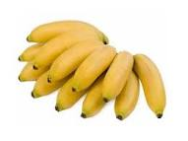
What country is bananas from?
Brazil
Africa
Russia

Slide 8
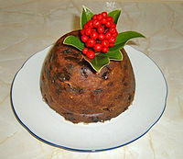
What country is pudding from?
England
India
China

Slide 9
B r e a k f a s f
e e a t u o r t r
R f r u I o t d u
R j u n k d I u i
Y s u p p e rn t

Slide 10

My name is Ann,
I like to eat ……… .

Slide 11

My big brother Jack
likes eating ………. .

Slide 12
Thank you!

