Slide 1
[ai]
[i:]
[æ]
I
have
two
eyes
And
I
can
see
A book and a pen
in front of
me.
I
see
a window and a
door.
I
see
the
ceiling
and
the
floor.
[ð]
[o:]

Slide 2
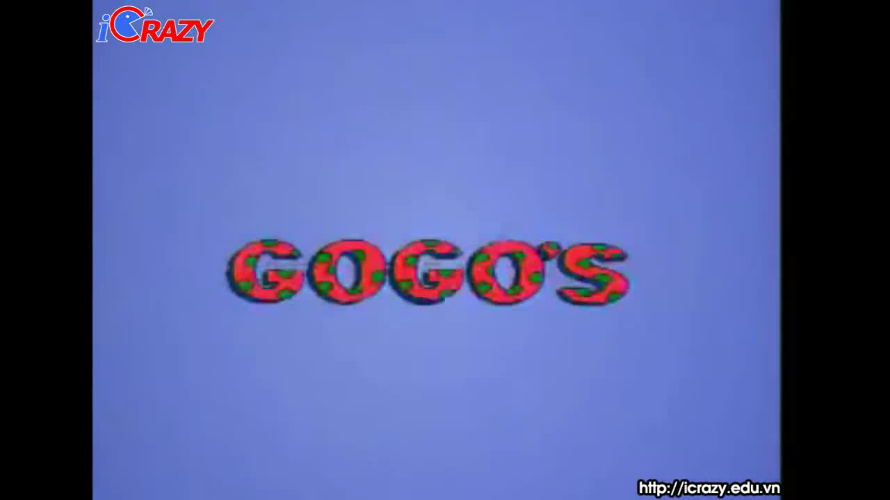

Slide 3
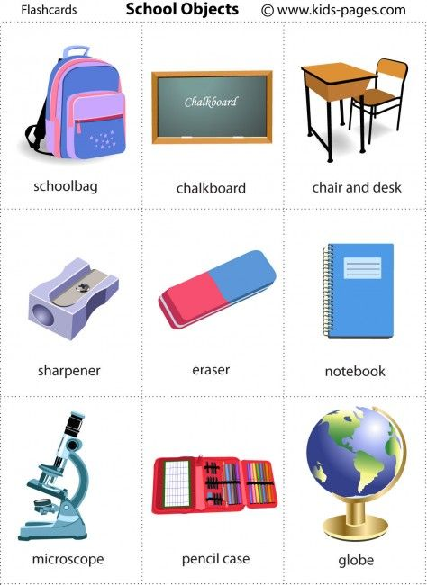
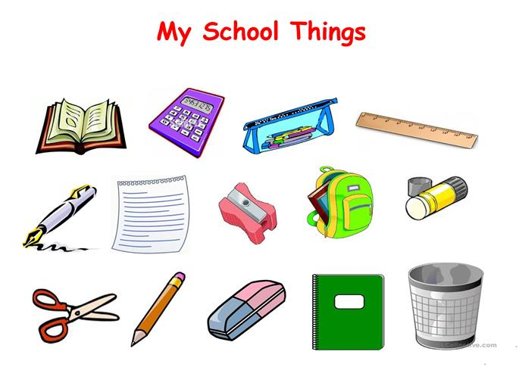
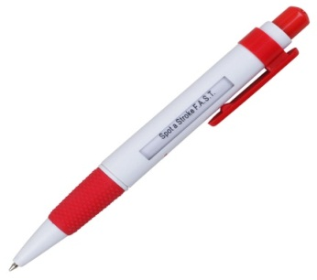
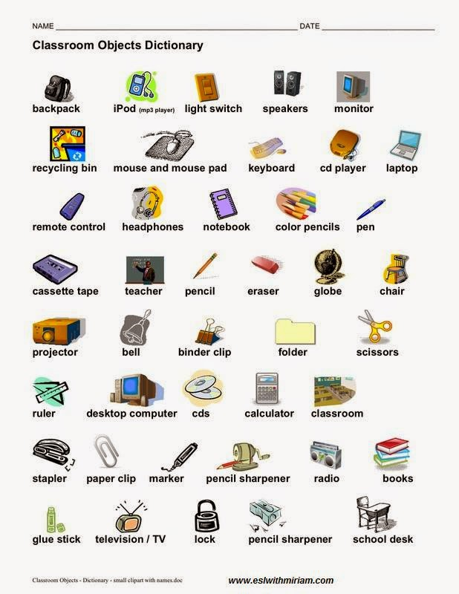

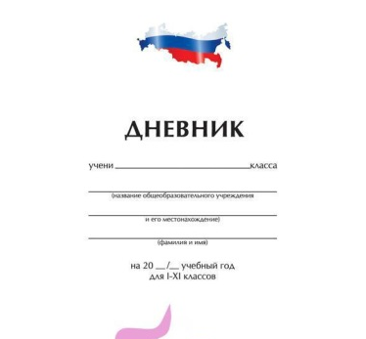
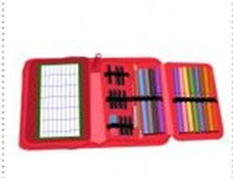
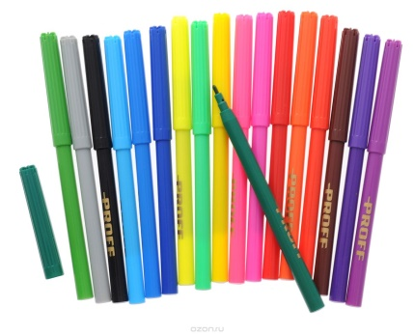

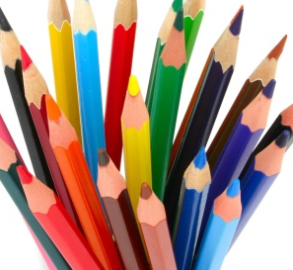
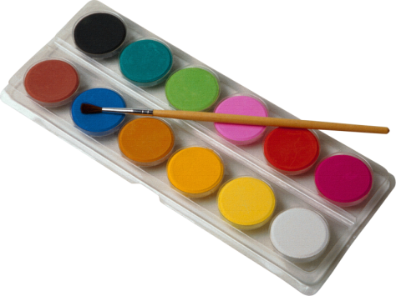
SCHOOL THINGS
a diary
a pencil case
a sharpener
felt pens
an eraser
a dictionary
coloured pencils
paints
a ruler

Slide 4


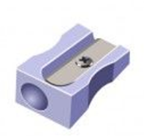

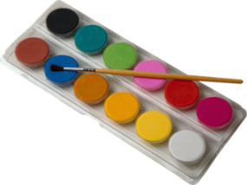
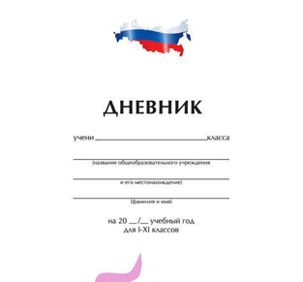



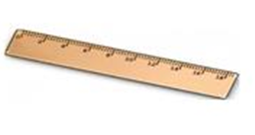
WRITE THE WORDS UNDER THE PICTURES

Slide 5


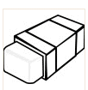

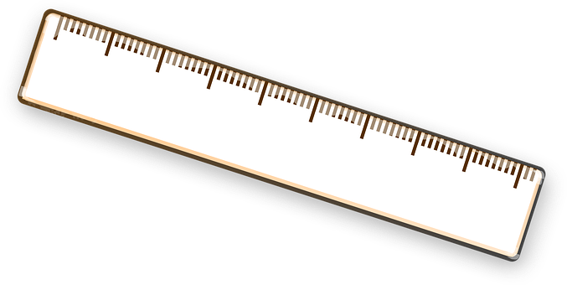
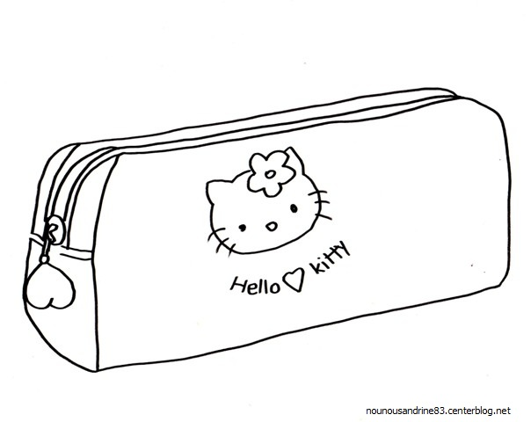
READ THE SENTENCES AND COLOUR THE PICTURE
Colour the second pencil purple.
Colour the pencil case green.
Colour the first pencil red.
Colour the ruler blue.
Colour the sharpener brown.
6. Colour the eraser blue.
7. Colour the copybook yellow.
8. Colour the third pencil orange.
9. Colour the pen black.

Slide 6
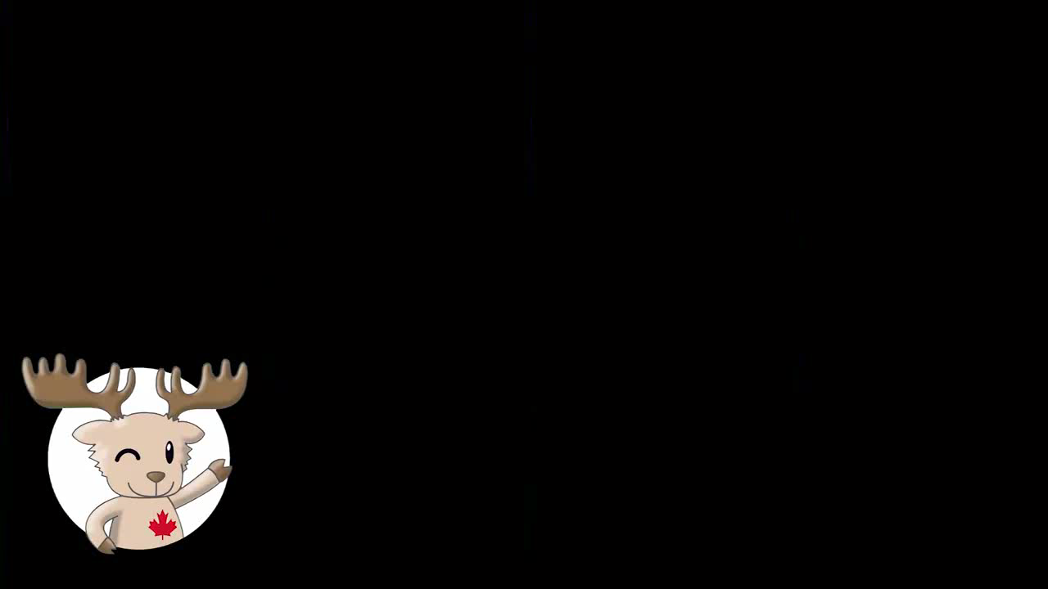

Slide 7
You must take a copybook for Russian.
Ты должен взять тетрадь на урок рус. яз.
You will take a copybook for Russian.
Ты возьмешь тетрадь на урок рус. яз.
ПОДЛЕЖАЩЕЕ + WILL + ОСН.ГЛАГОЛ + ВТОР.ЧЛ.ПРЕДЛ.
Он должен будет взять словарь.
???

Slide 8
SB. p.79
WILL HAVE TO
«придется,
должен будет»

Slide 9
SB. ex.1 p.80
SB. ex.2 p.80.
MUST WILL HAVE TO
You will have to wear a uniform.
I’ll have to buy a new pen.
My friend will have to сome to my place.
Mum’ll have to go to work on Saturday.
I’ll have to do my homework.
You’ll have to come with us.

Slide 10
YOUR HOMEWORK
WB. p. 42 ex.1-3,
выучить слова

