Slide 1

English for children

Slide 2
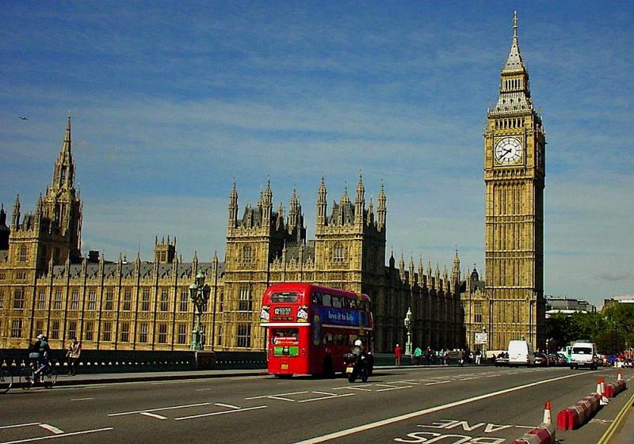

GREAT BRITAIN

Slide 3


AMERICA

Slide 4


AUSTRALIA

Slide 5


NEW ZEALAND

Slide 6

GREETINGS

Slide 7
HELLO!
HI!

Slide 8


GOOD MORNING!

Slide 9

GOOD AFTERNOON!

Slide 10

GOOD EVENING!

Slide 11
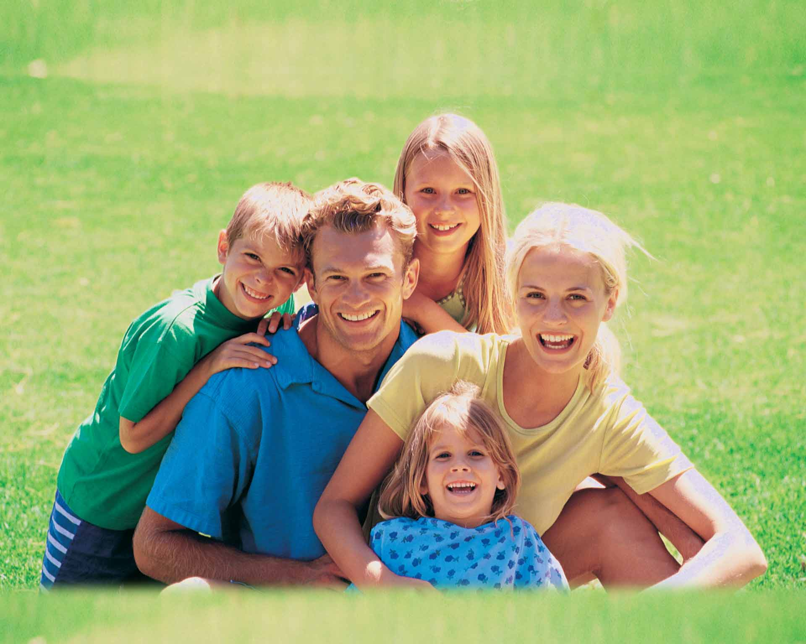
FAMILY

Slide 12
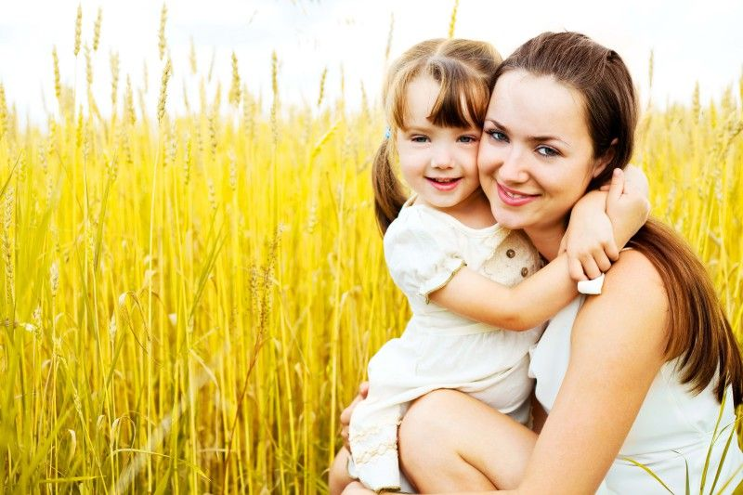
A MOTHER

Slide 13
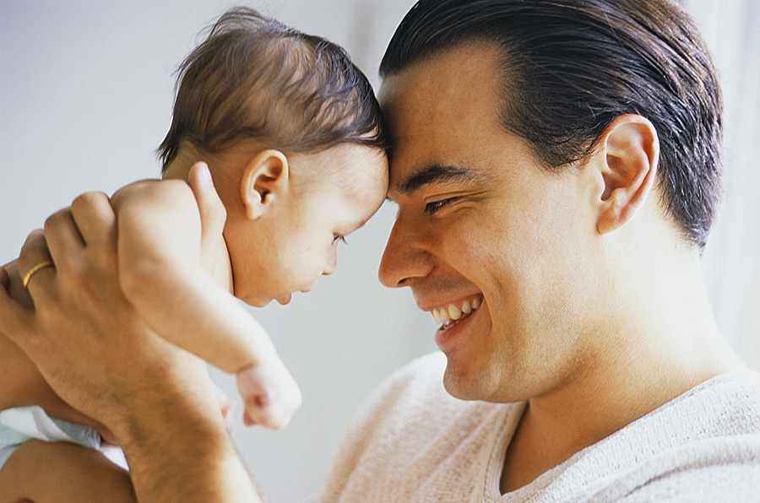
A FATHER

Slide 14
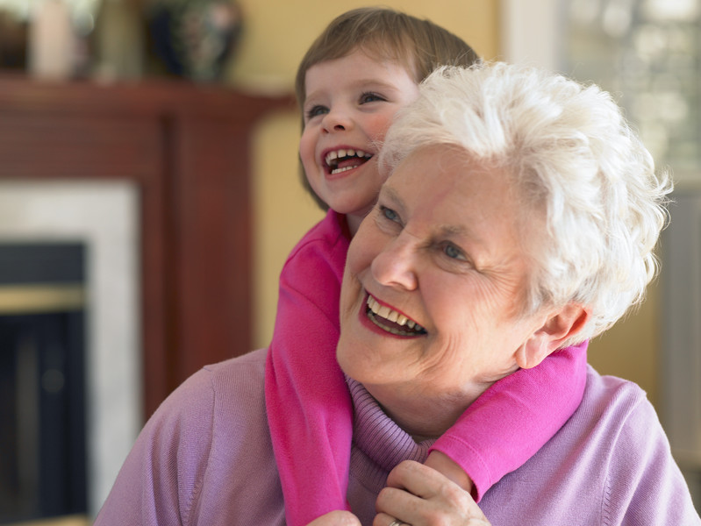
A GRANDMOTHER

Slide 15
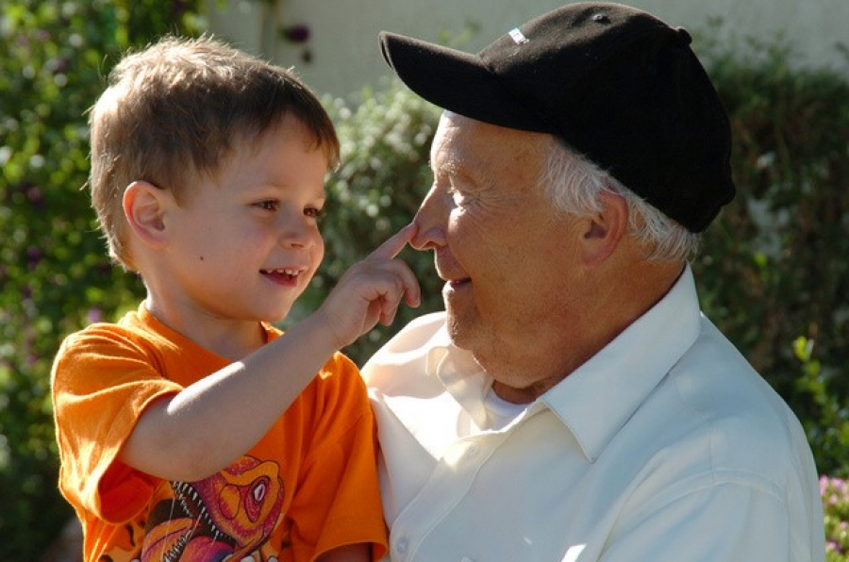
A GRANDFATHER

Slide 16
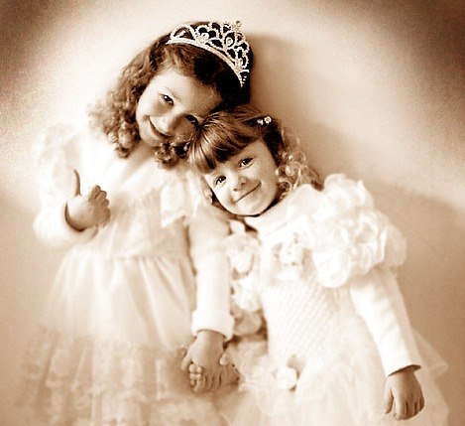
A SISTER

Slide 17
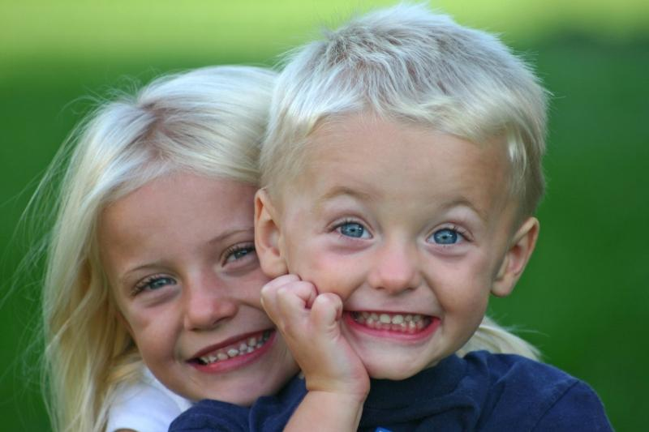
A BROTHER

Slide 18
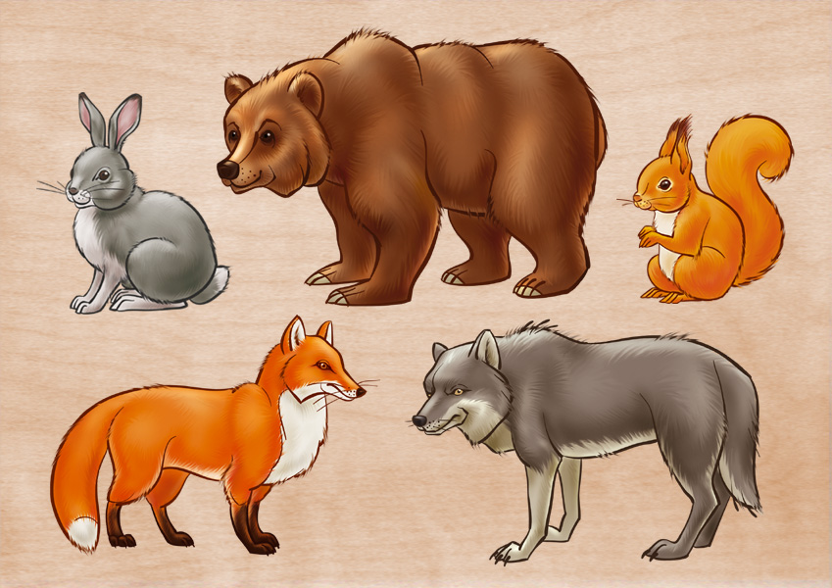
ANIMALS

Slide 19
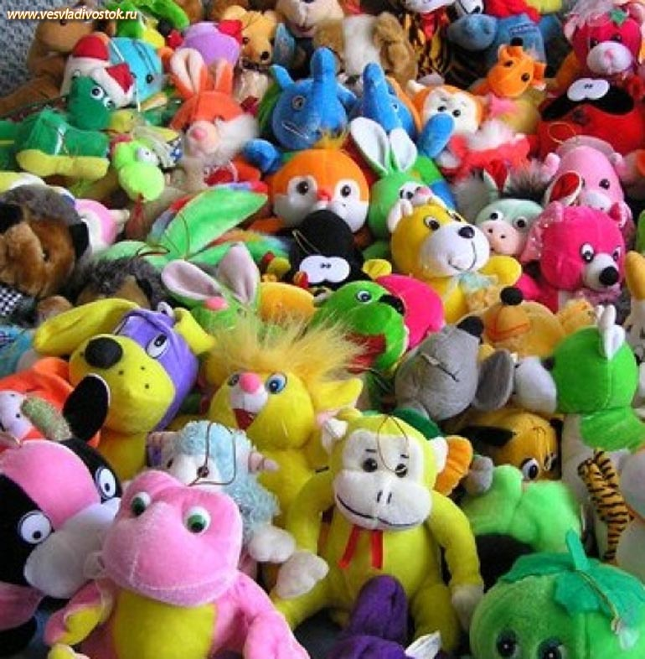
TOYS

Slide 20
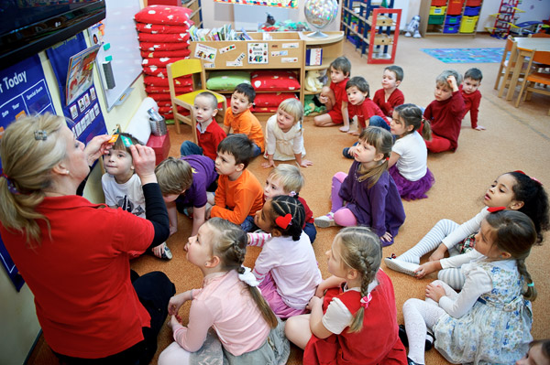
Teacher and Pupils

Slide 21
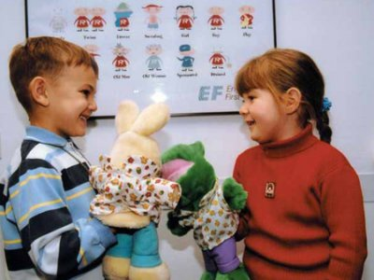

Slide 22
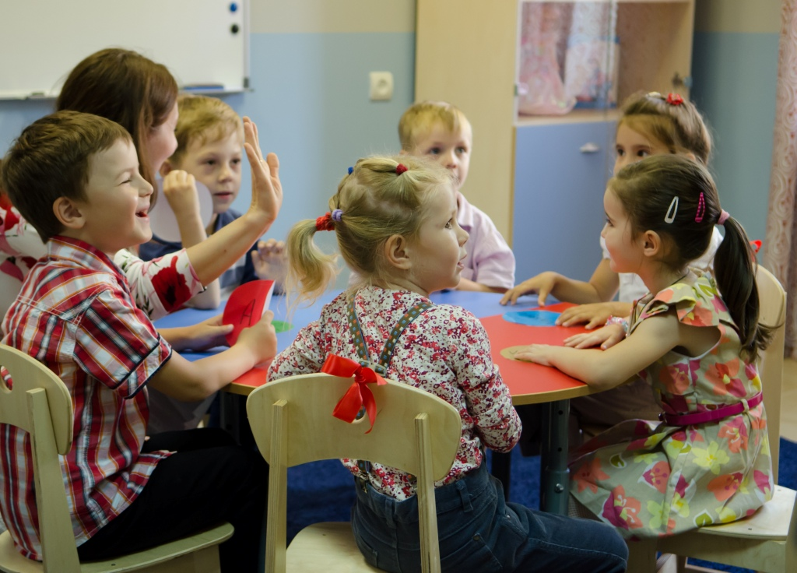

Slide 23
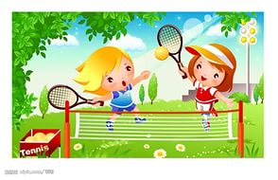
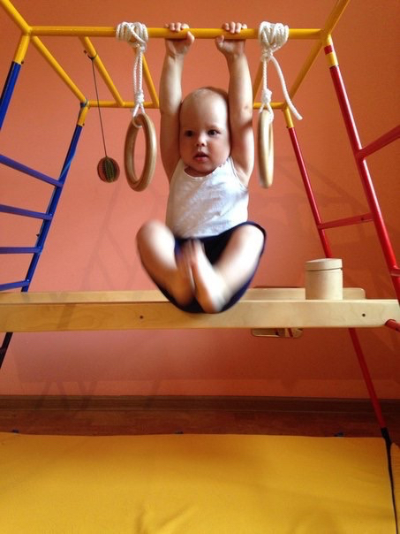
I can/ I can’t (Я могу/Я не могу)

Slide 24
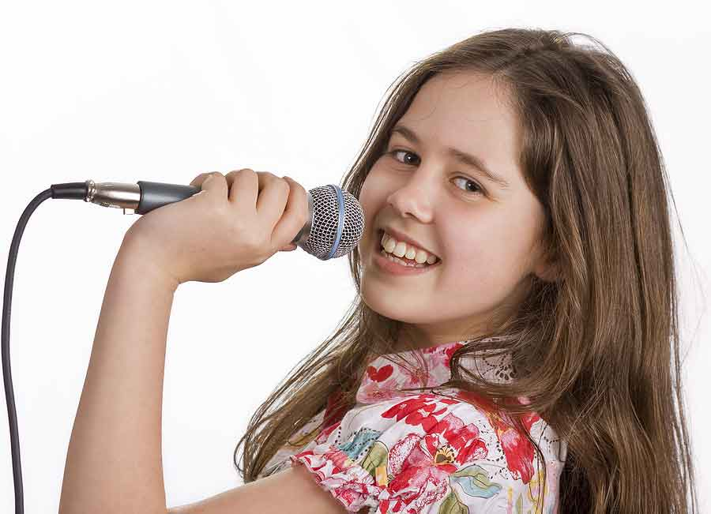
I CAN SING

Slide 25
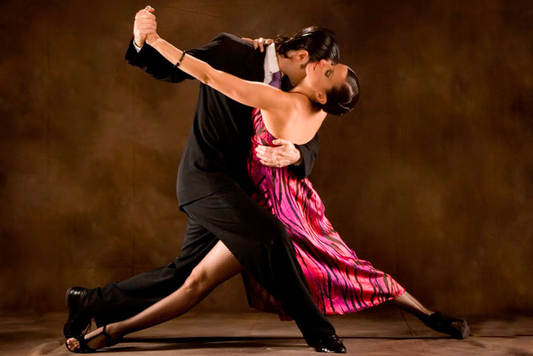
I CAN DANCE

Slide 26
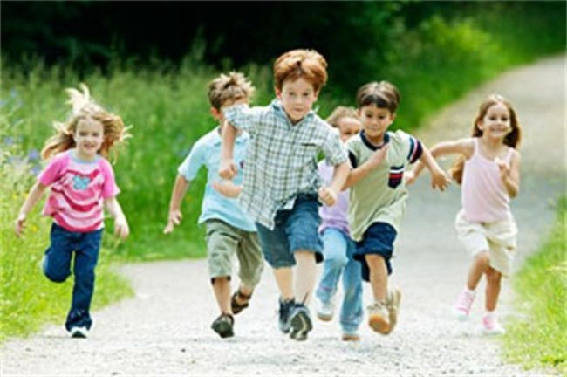
I CAN RUN

Slide 27
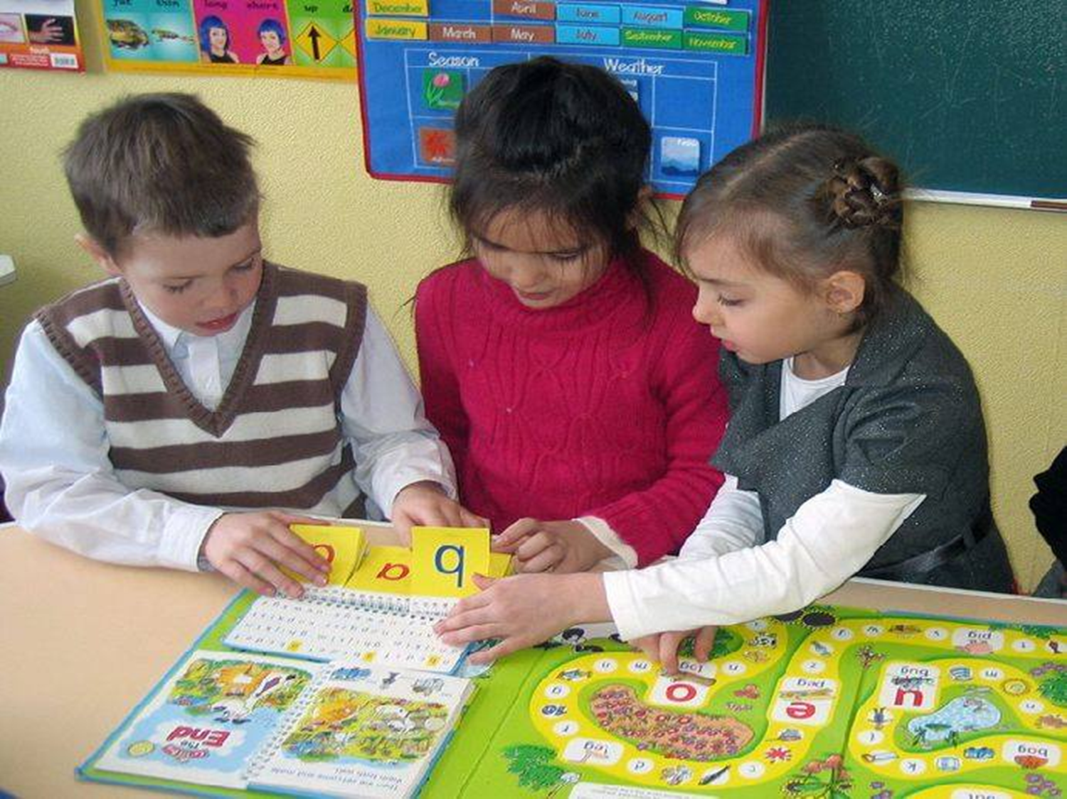
I CAN STUDY

