Slide 1
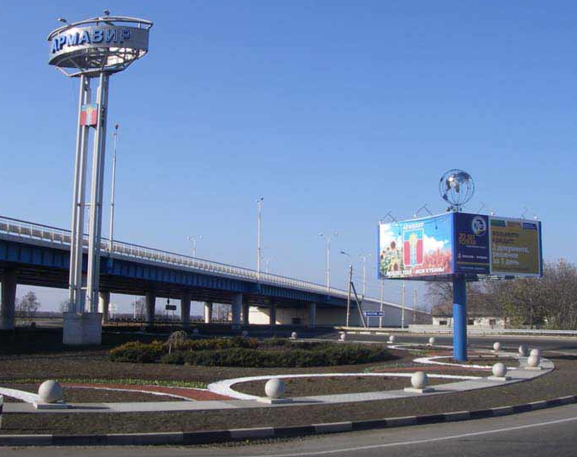
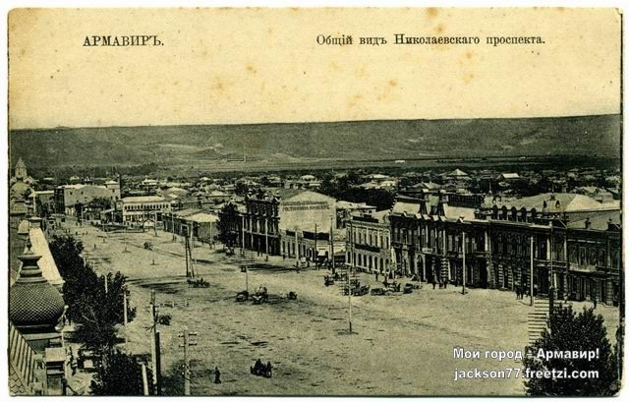
Armavir (Russian: Армави́р) is a town in Krasnodar Krai

Slide 2
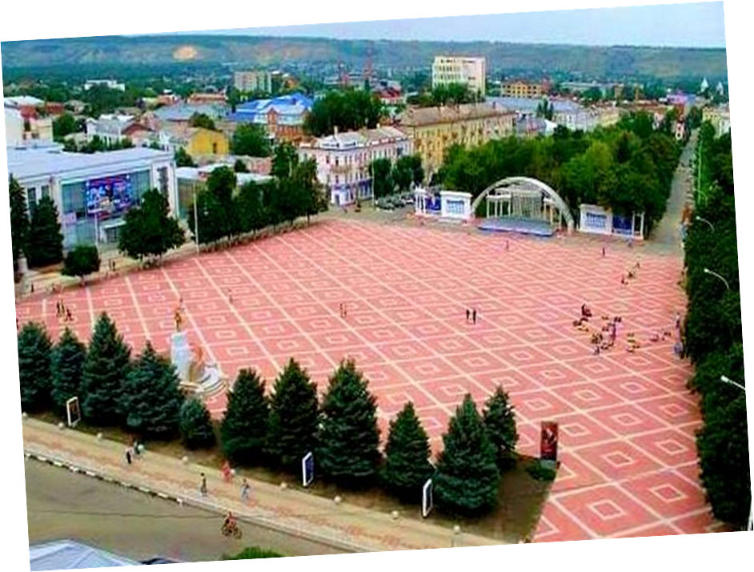
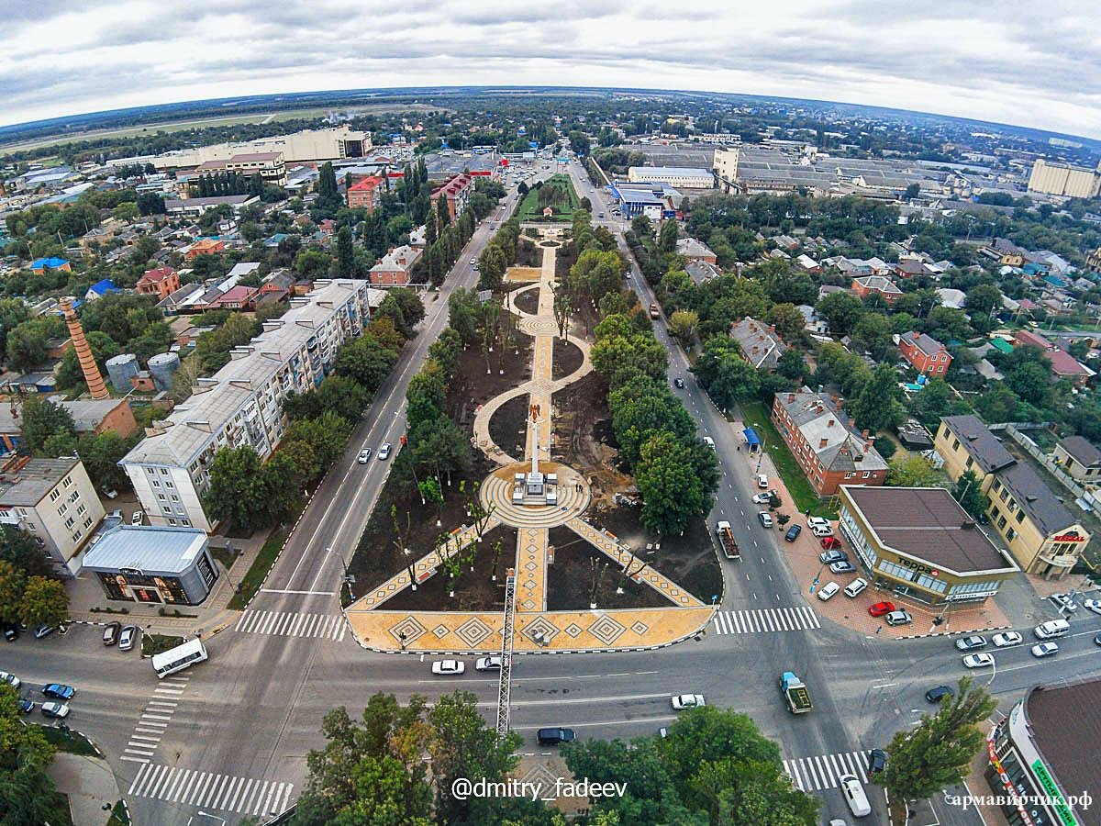
My name is SLAVA.
I live in a small town in the south of Russia. It’s called Armavir.
It’s considered to be one of the most beautiful cities of Krasnodar region.
The population of Armavir is about 200 000 (two hundred thousand) people.

Slide 3

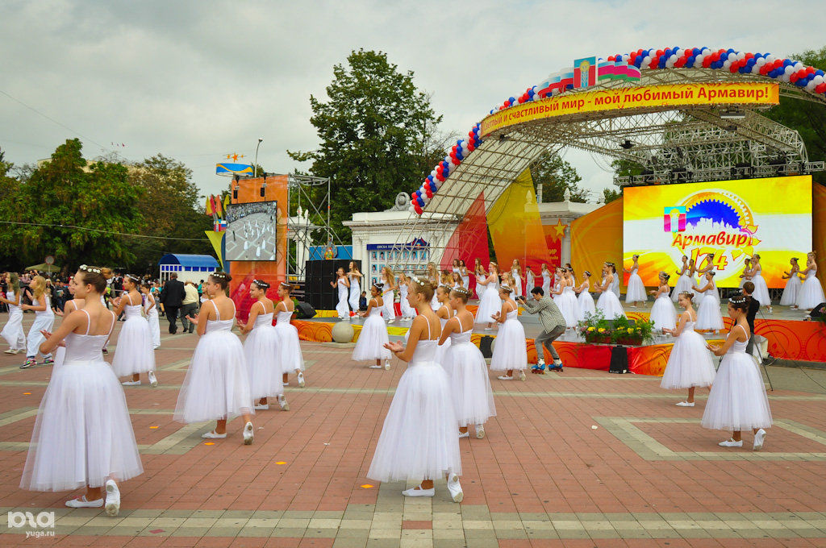
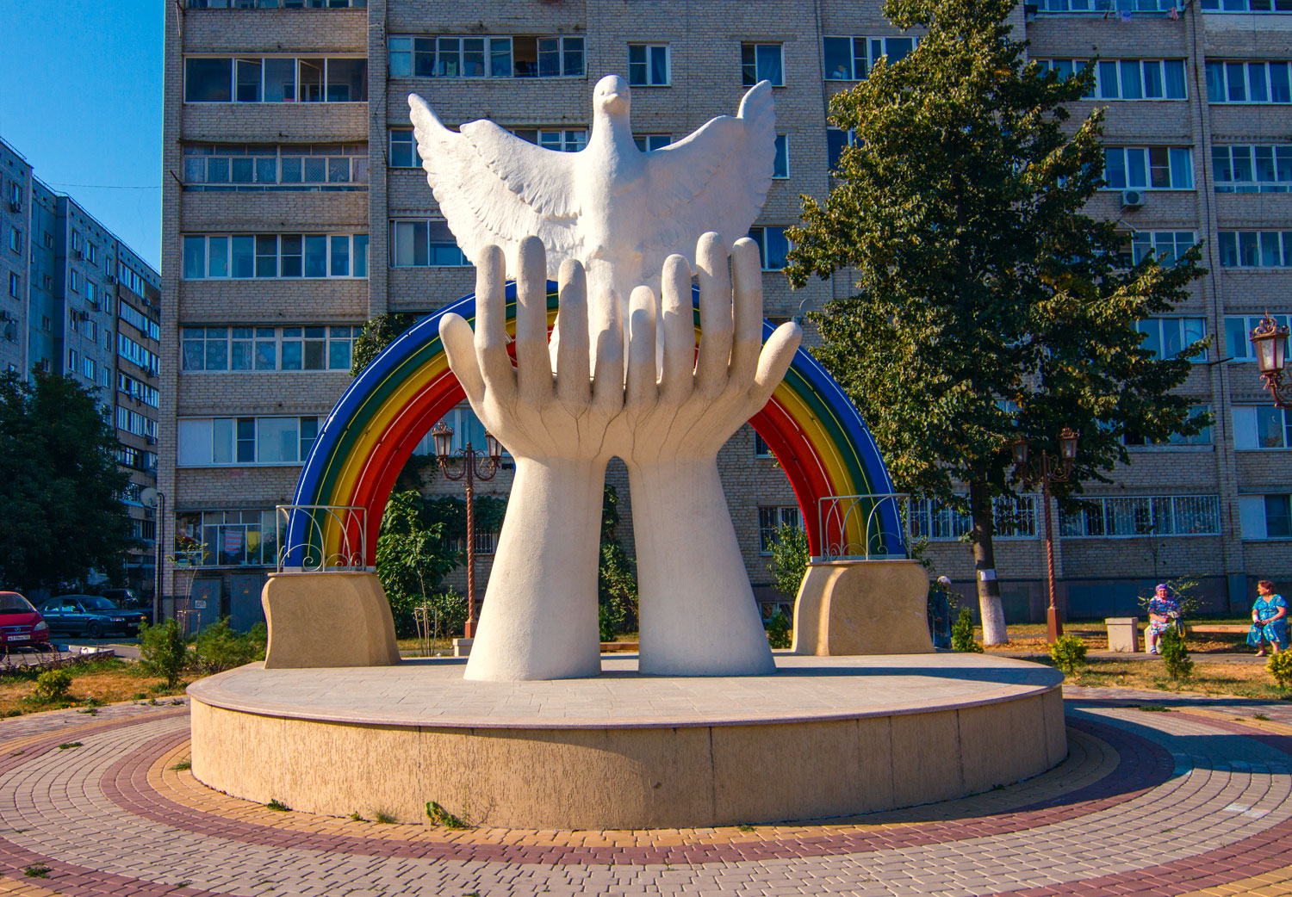

Slide 4
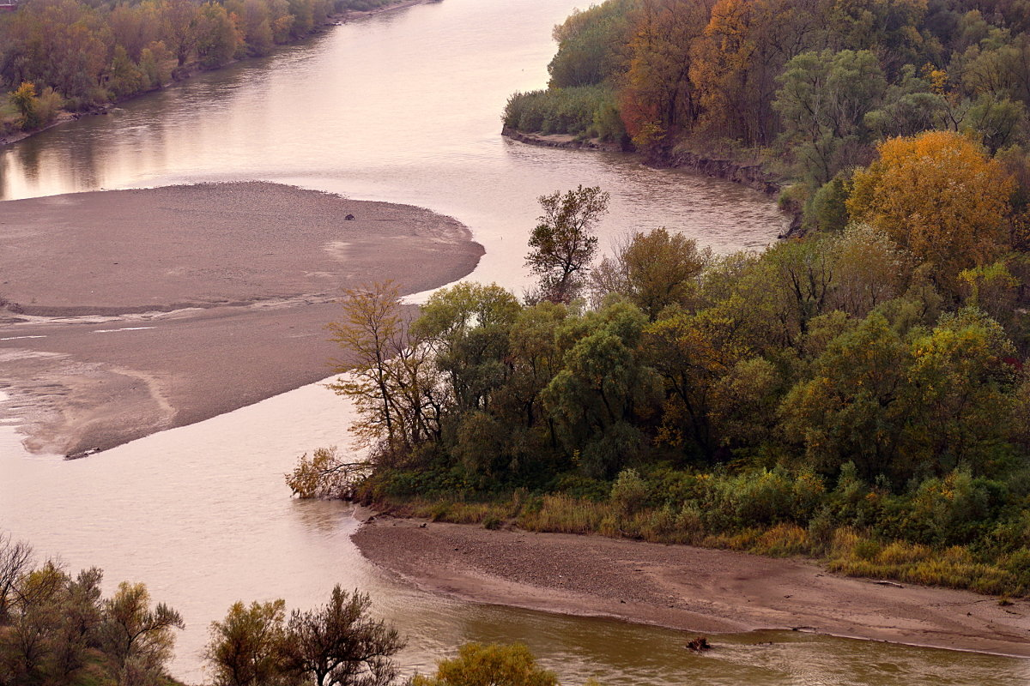
Geographically Armavir is located just in the middle
between the equator and the North Pole. But more exactly
the town lies in the North-East of Krasnodar region
in the steppe zone of Prikubanskaya lowland.
It spreads on the left bank of the Kuban not
far from the mouth of the Urup.

Slide 5
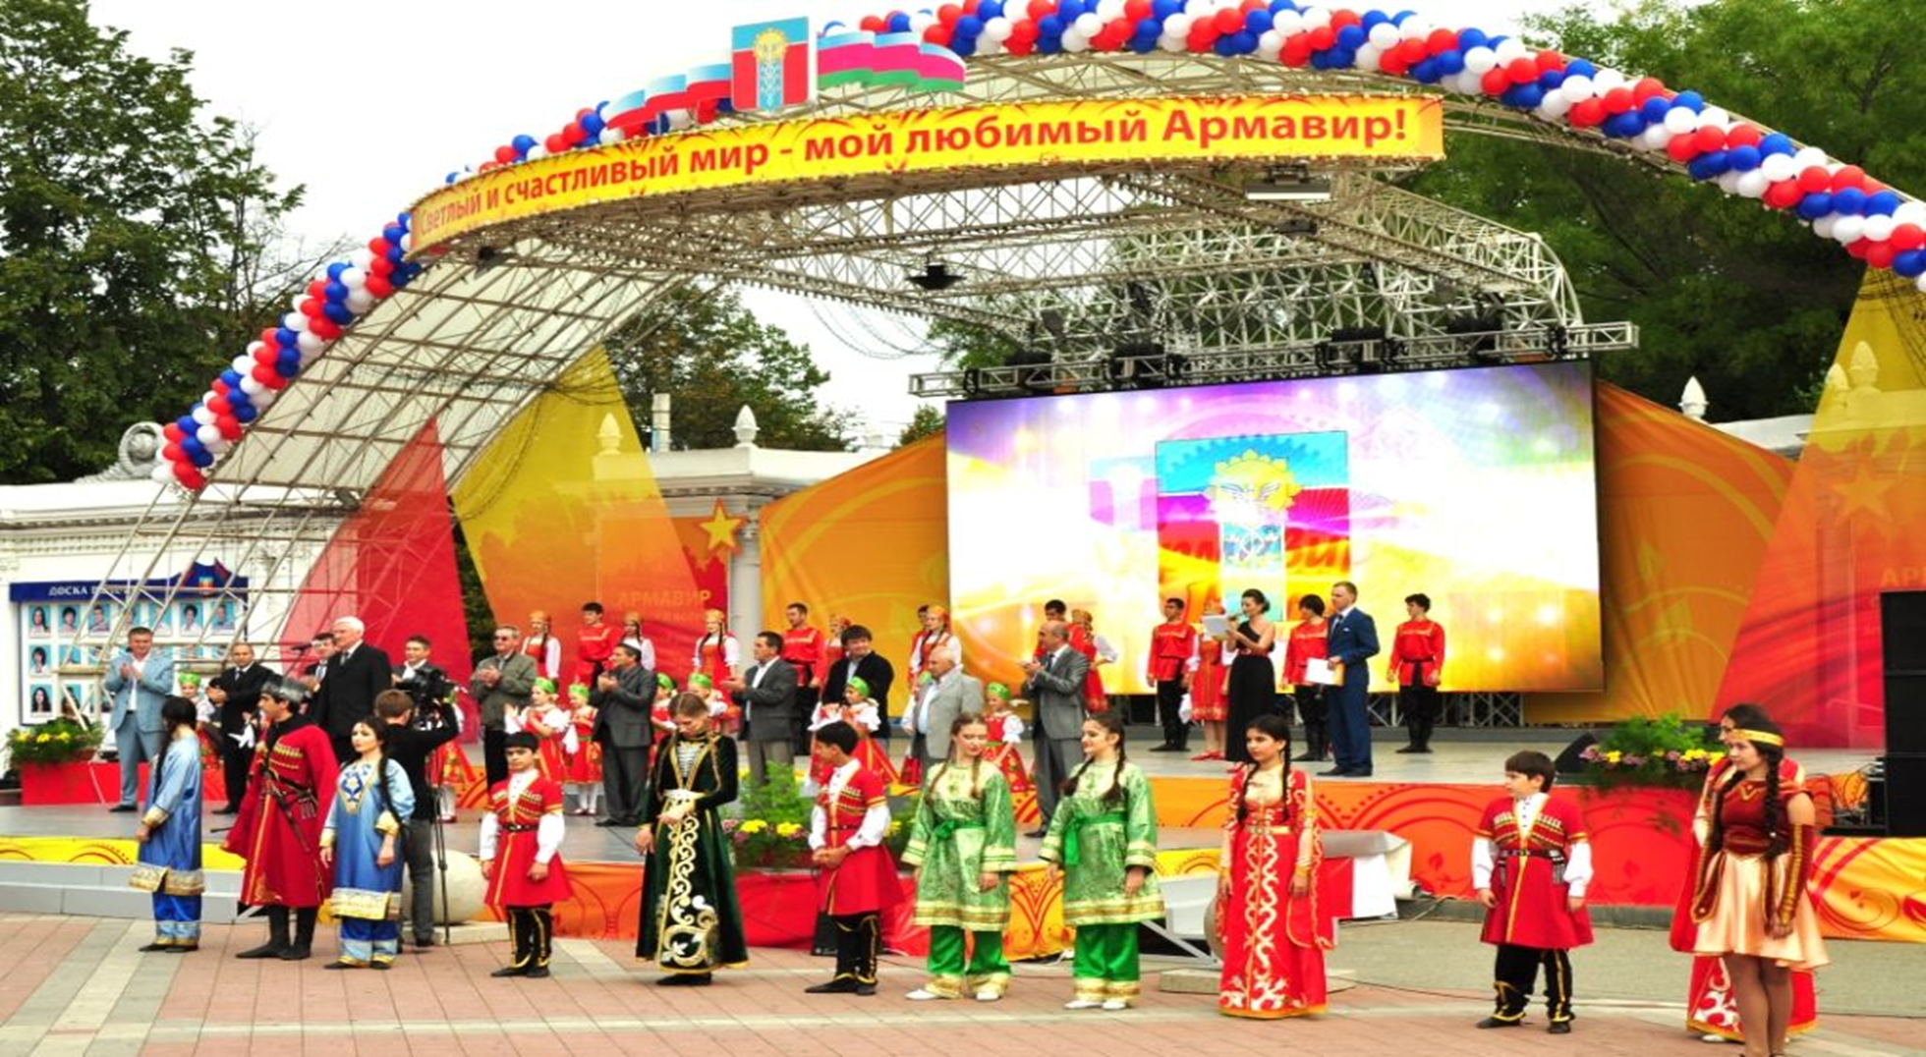
Due to its Caucasian neighbourhood,
many nationalities reside in Armavir.
For example, Armenians, Georgians,
Chechens, Circassians alnd even
Ukrainian Cossacks. I’m glad that
I live in a multinational city.
The atmosphere here is rather friendly and supportive. Many of my
friends are also of different nationalities and we get on well together. We get to learn about each other’s culture and traditions. And I should say it’s very exciting.

Slide 6
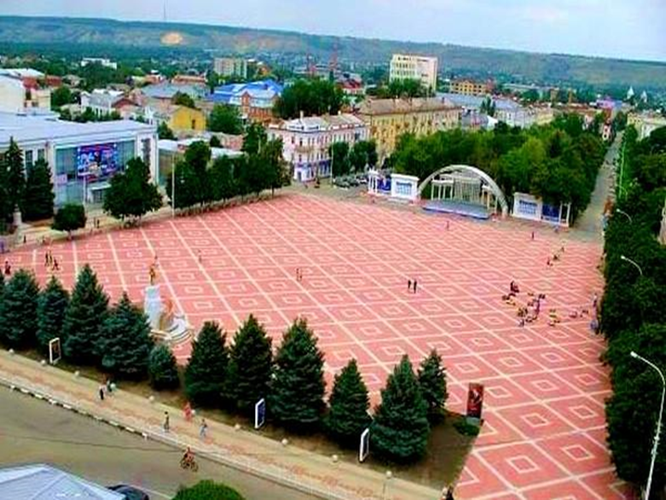
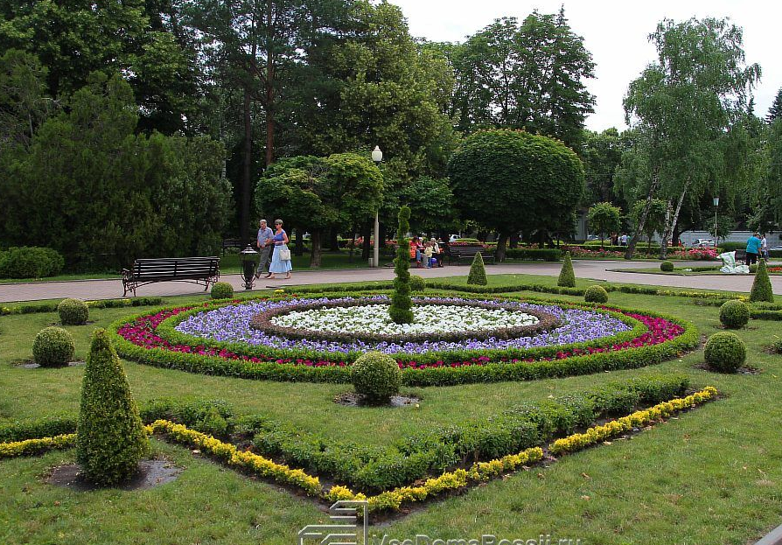
On the outer look Armavir is very green.
The city is full of parks and alleys.
In the center of the city there is the local Red Square.
All the important festivities are celebrated on this square.

Slide 7
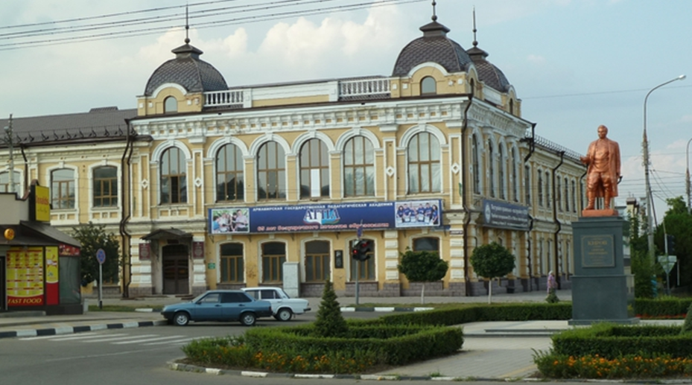
The streets are not long and usually cross each other, so it’s difficult to get lost.
Many young people from the nearby villages come to study and work in Armavir.
There are many good educational
institutions here.
Armavir Teachers’ Training University was
originally established as a rural college
1920, Later it was transformed into
an institute in 1954.

Slide 8
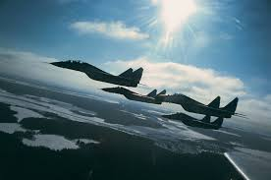
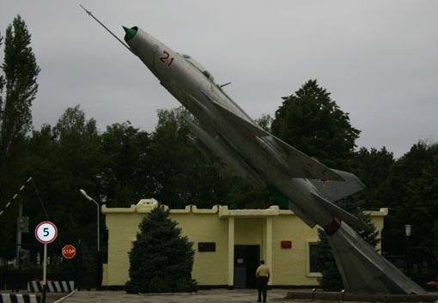
Armavir high flying school

Slide 9
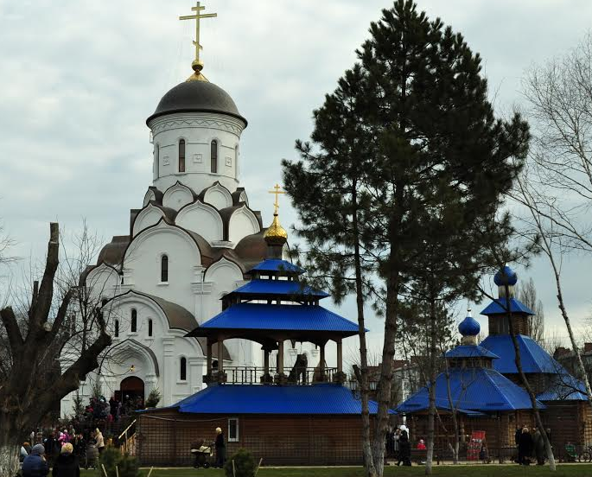
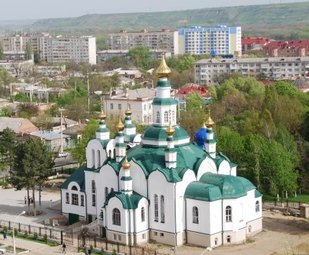
There are also many beautiful churches

Slide 10
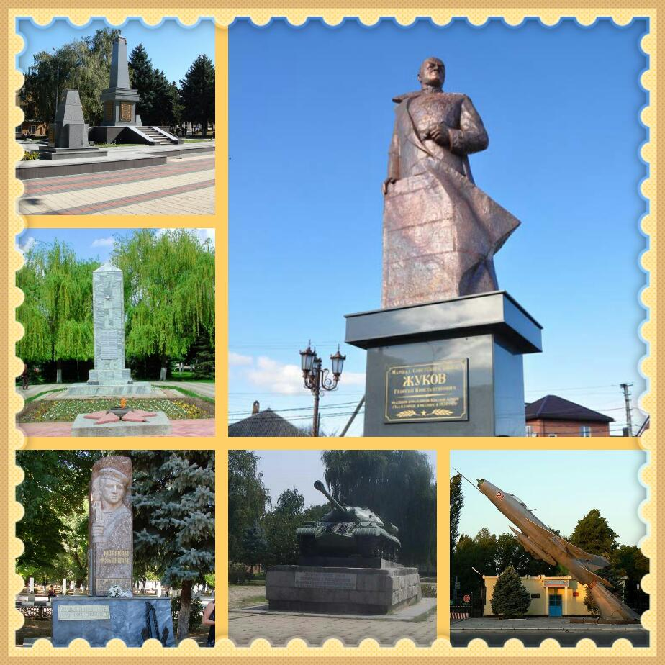
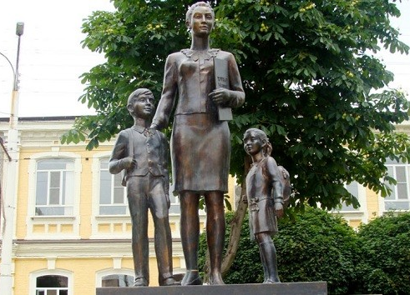
and monuments in Armavir.

Slide 11
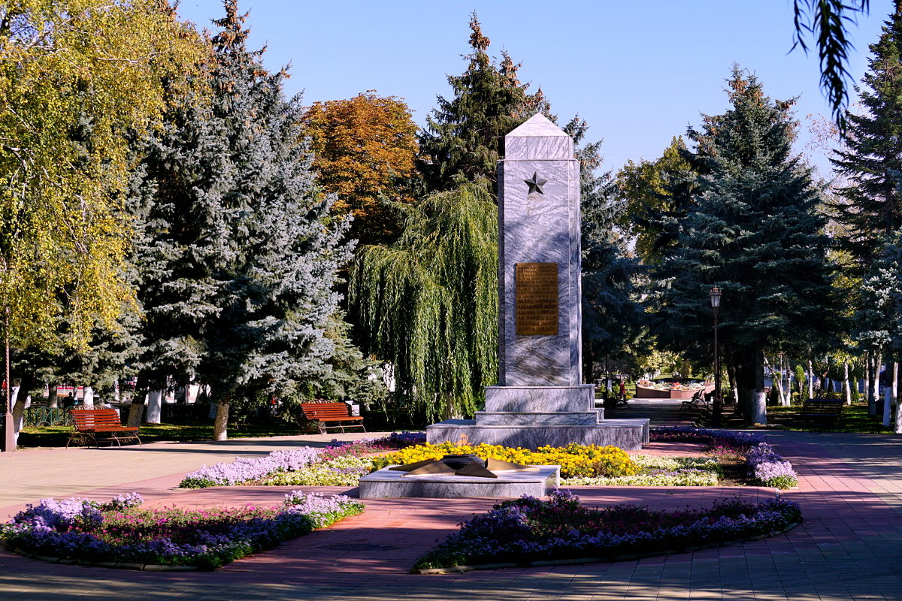
Armavir was a place of battle-field during the Great Patriotic War that is why one can find here numerous memorials to Motherland’s defenders.

Slide 12
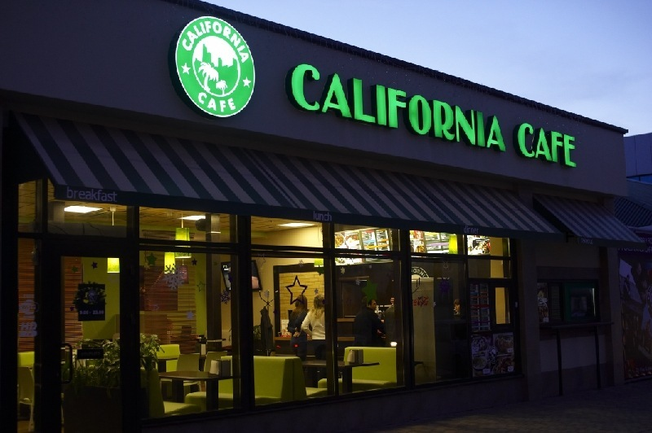
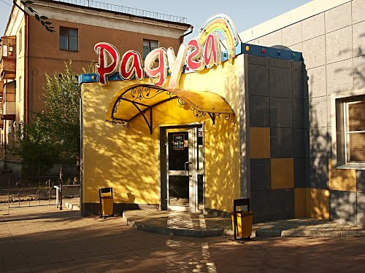
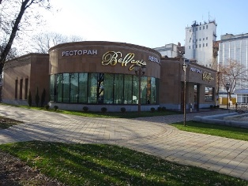
For fun lovers,
there are also several disco clubs,
posh restaurants and cute cafes.

Slide 13
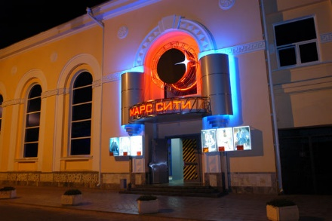
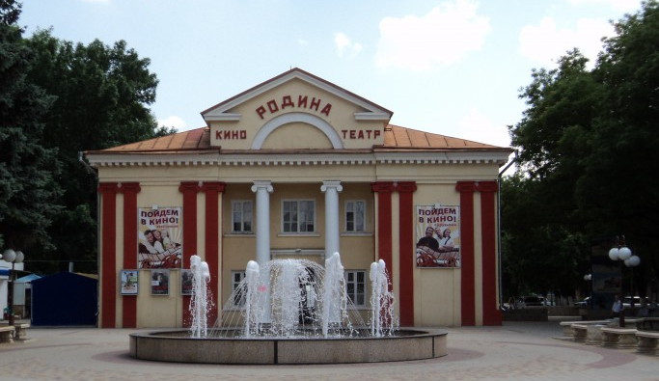
There are also two large and modern cinemas.
I often go there with my friends.

Slide 14
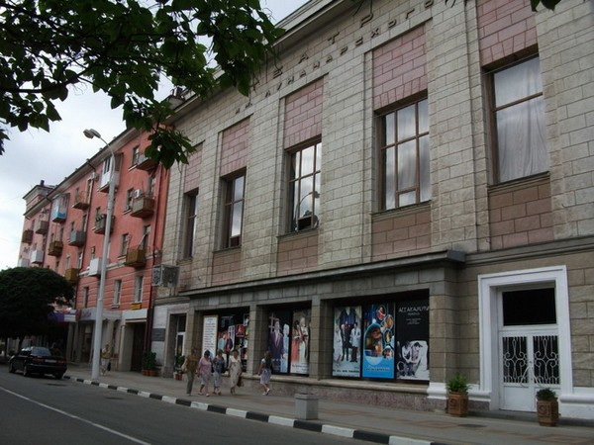
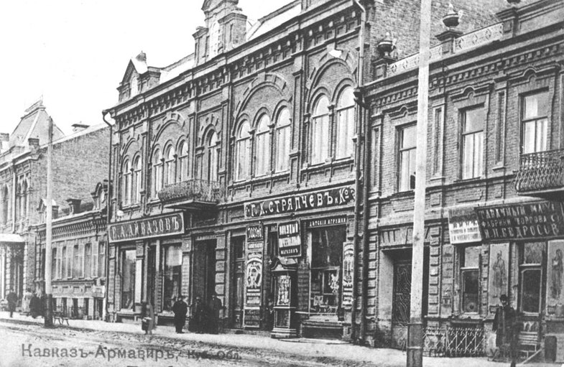
In 1920s great changes took place in cultural life of the town. The minister of education A.V.Lunacharsky visited it twice. And the local Drama theatre is called in his honors.

Slide 15
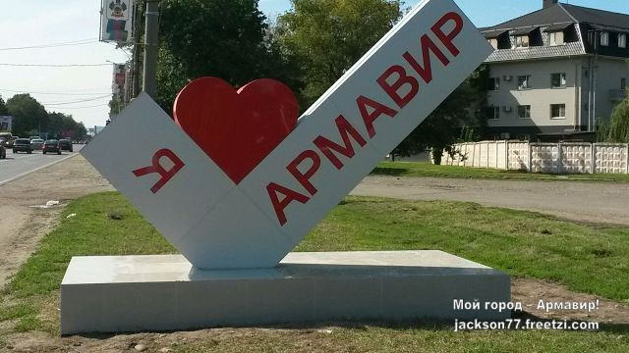
The weather in my town is mild and warm.
I love my city very much and I’m sure
that if you visit it and stay for a while,
you’ll love it too.

