Slide 1
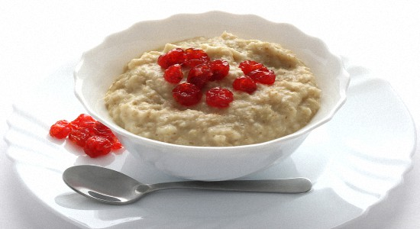
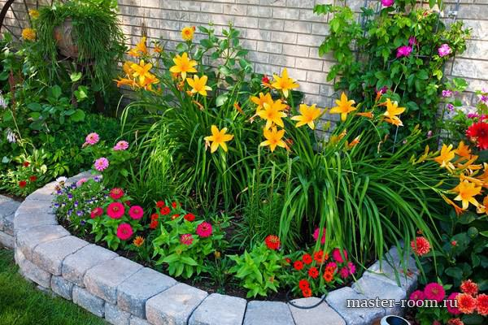
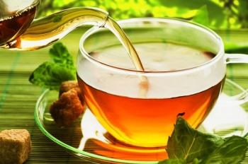

Slide 2
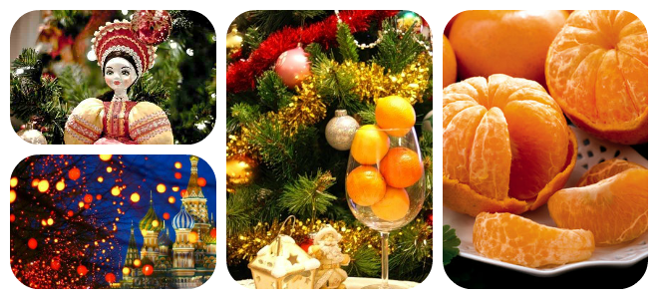
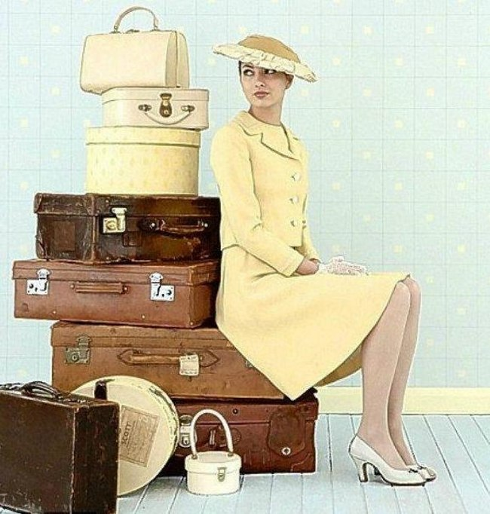
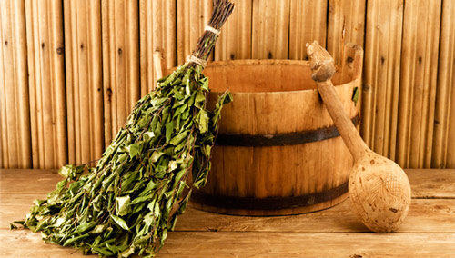

Slide 3
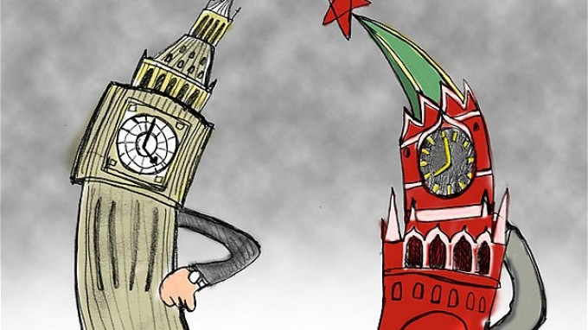
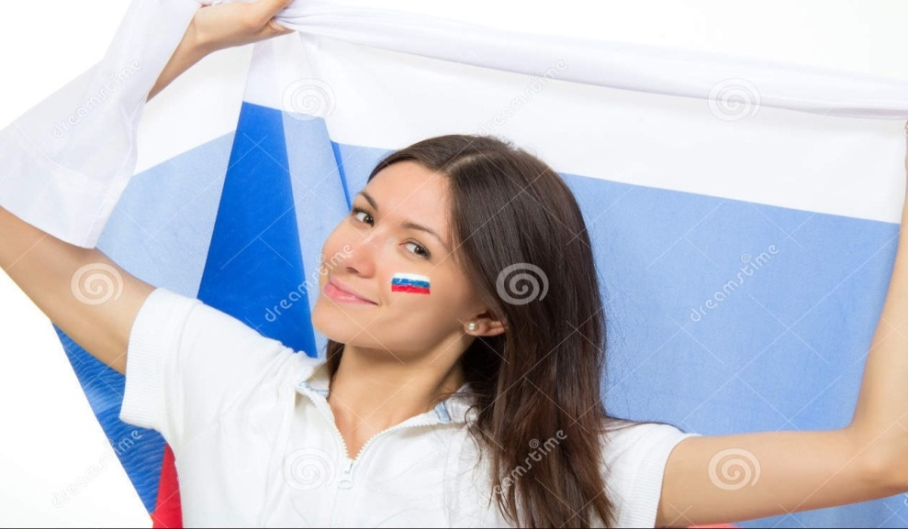
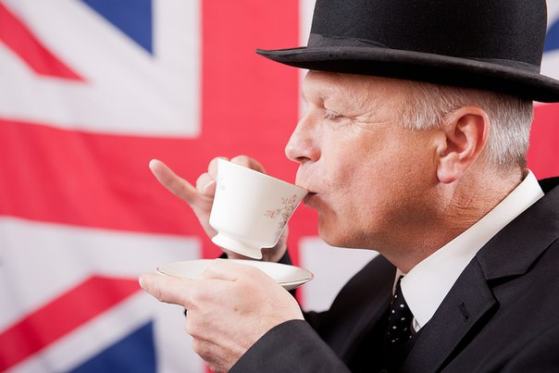

The habits of the English and Russian

Slide 4


Go to hot places for their holidays

Slide 5

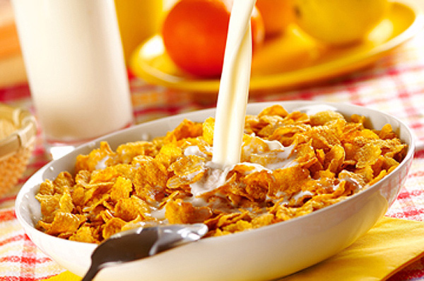
Often have cornflakes for breakfast

Slide 6

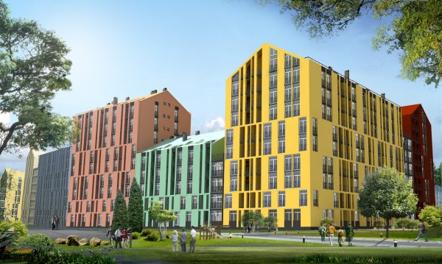

Don’t like living in flats

Slide 7

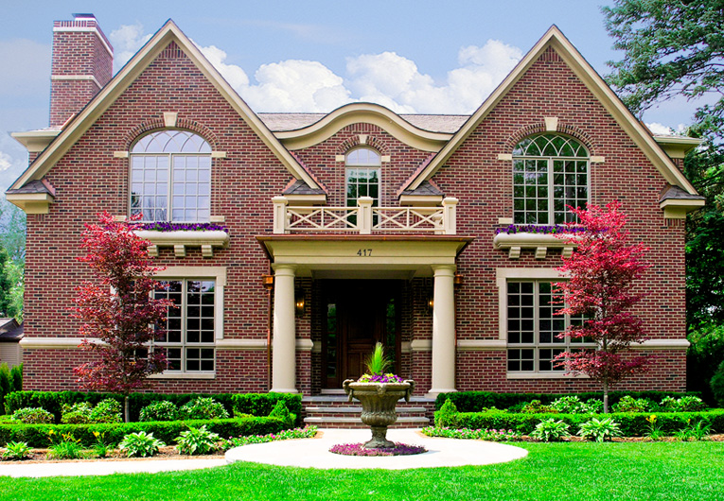
Love gardens and flowers

Slide 8

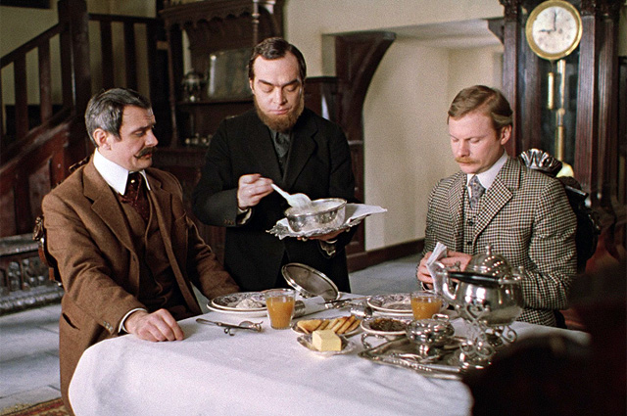
Often eat porridge for breakfast

Slide 9
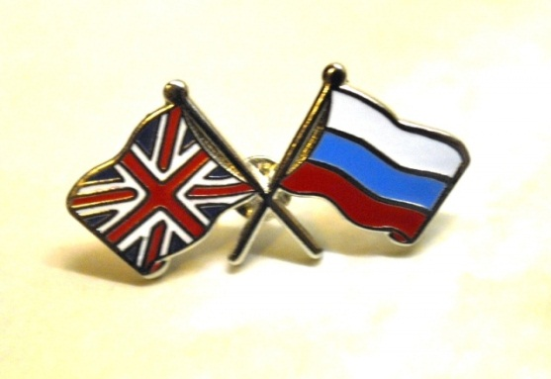

Love playing and watching football

Slide 10


Usually have two or three children in a family

Slide 11

Like having pets at home

Slide 12


Work on computers a lot

Slide 13

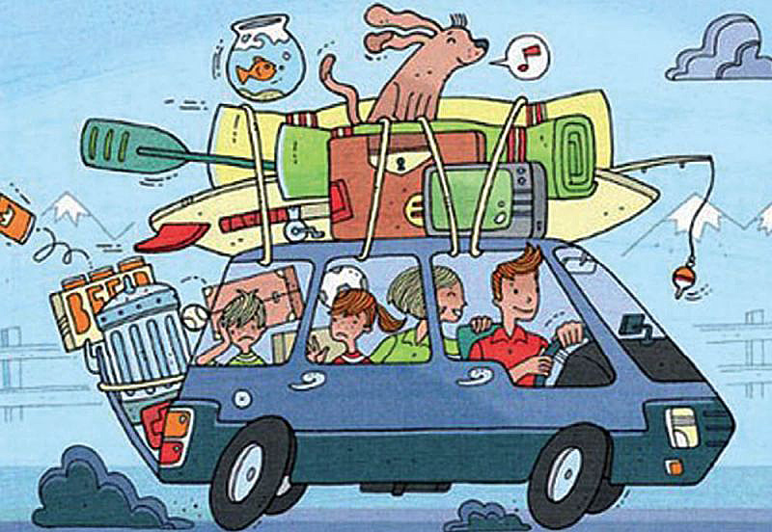
Travel by car a lot

Slide 14

Have school holidays in winter, spring and summer

Slide 15


don’t often speak Russian

Slide 16
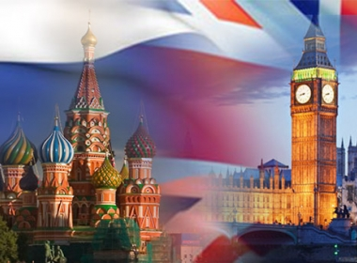
8-9

