Slide 1

Christmas and New Year in
English-speaking countries
Presented by Peil Uliya Vladimirovna, English teacher ,
Togliatti, Samara region

Slide 2
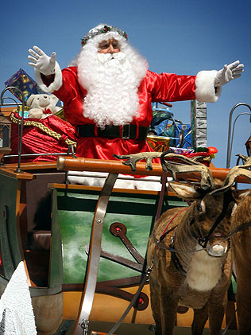
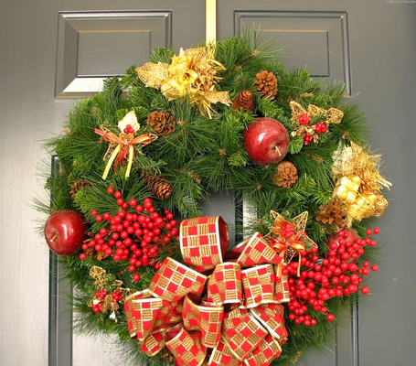
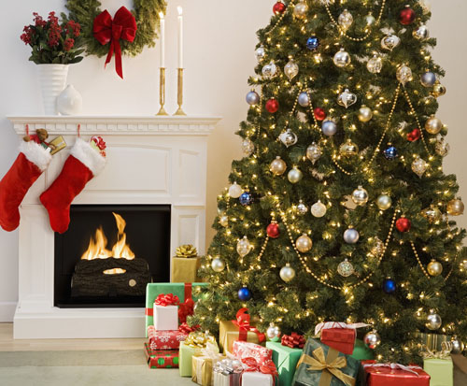
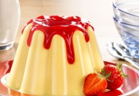
Marry Christmas
in
Grait Britain
Christmas omela
Father Christmas
Christmas pudding
Christmas Tree , fireplace and stoking

Slide 3
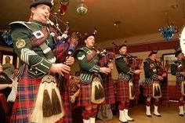
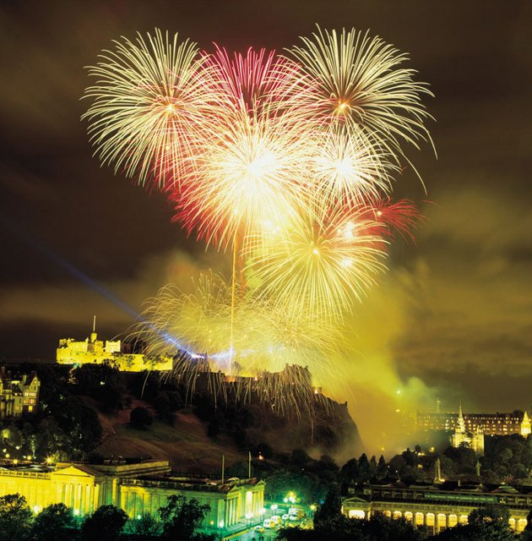
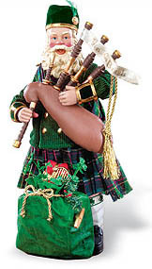
New Year and Christmas
IN
SCOTLAND
Hogmanay
EDINBURGH CASTLE FIREWORKS

Slide 4
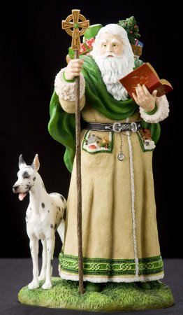

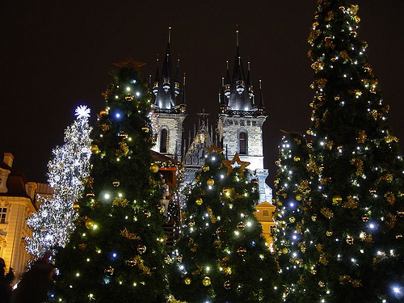
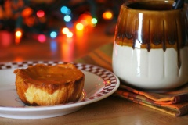
Christmas and New Year
in
Ireland
Father Christmas
Ireland bun and coffee
New Year in Dublin

Slide 5
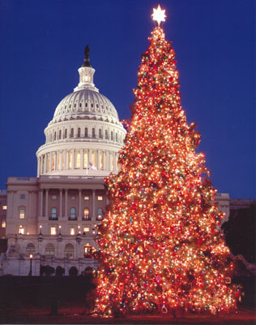
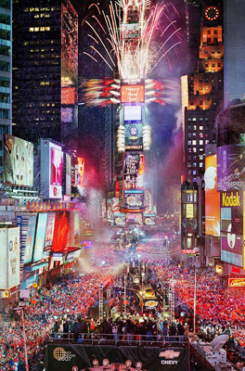
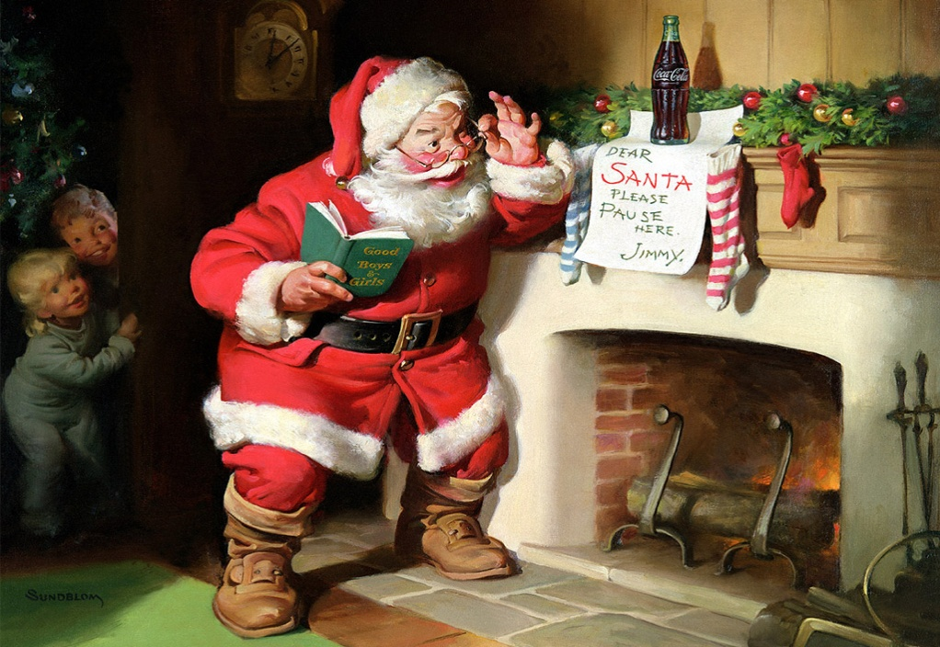
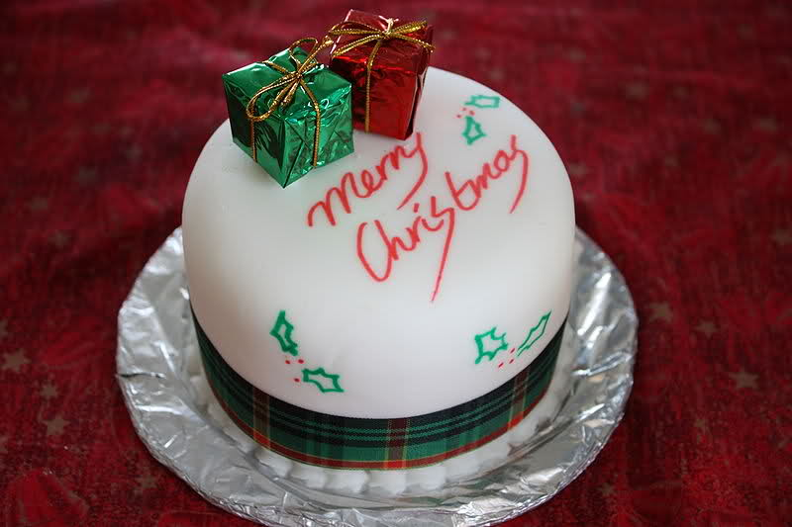
Christmas and New Year
in USA
Christmas Tree in Washington
Christmas cake
Santa Klaus

Slide 6
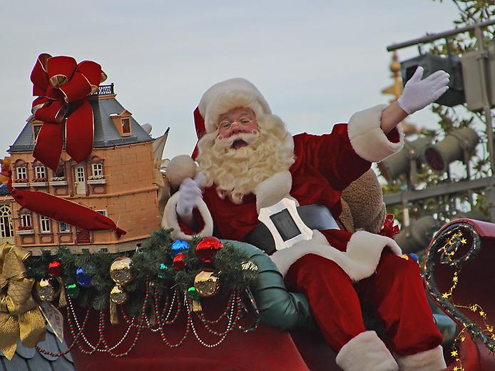
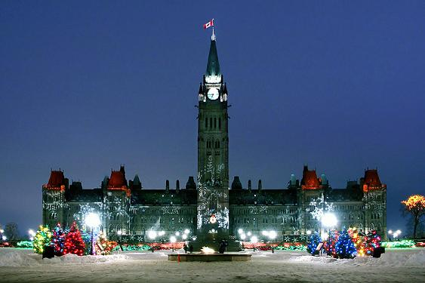
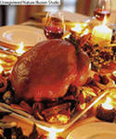
Christmas and New Year
in Canada
Ottawa at Christmas

Slide 7

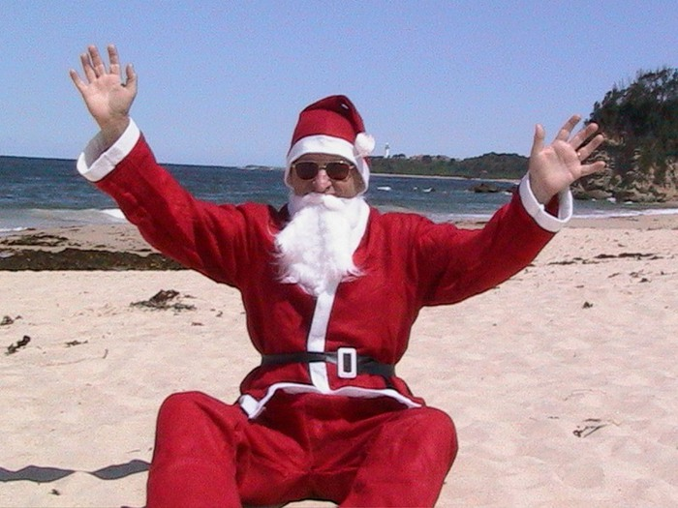
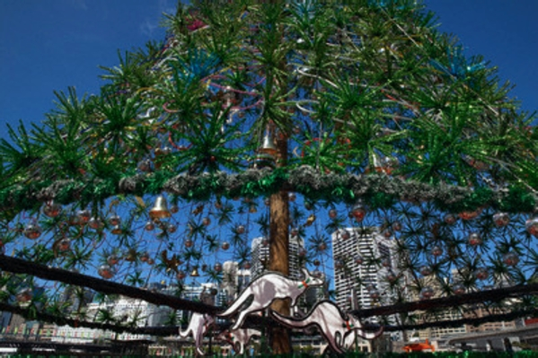

AUSTRALIA

Slide 8
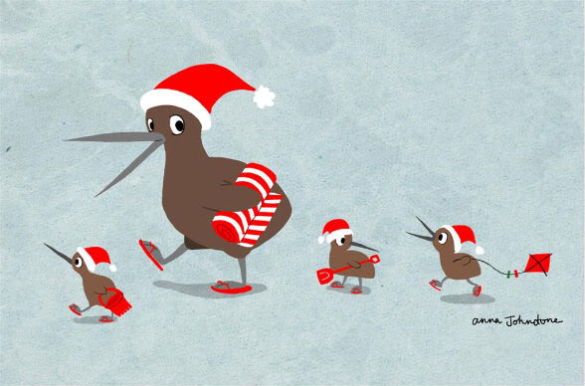

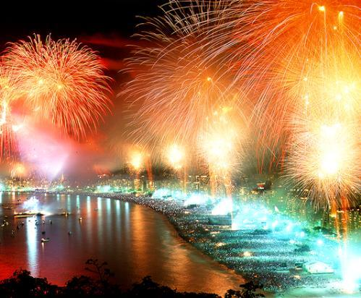
Christmas in
New Zealand
pohutukawa-flowers

