Slide 1

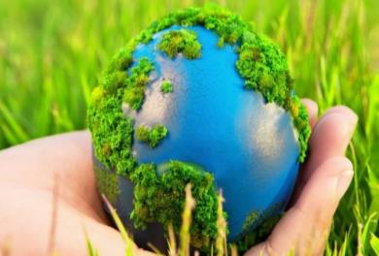
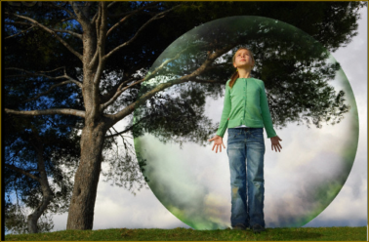
Unit 5
The ABC of Ecology
Презентация к уроку английского языка к УМК Rainbow English 7
Подготовила: учитель английского языка 1 категории, Троян Ольга Николаевна

Slide 2

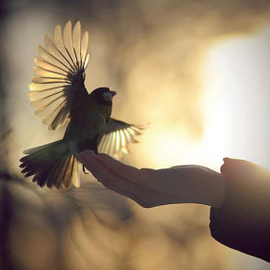
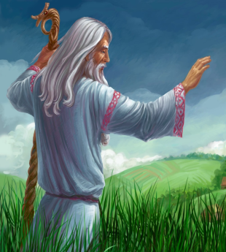
Step 1
Once there was a wise old man. He could answer any question in the world. Everybody knew about him. One day two boys said, “We are going to fool that old man. We’ll catch a bird, go to the old man and say, ‘We are holding something in our hands. Is it alive or is it dead?’ If he says, ‘Dead,’ we’ll let the bird fly, and if he says, ‘Alive’ we’ll kill it.”
They caught a bird and they carried it to the old man and they said, “We are holding something in our hands. Is it alive or dead?” And the wise old man looked at the young people and smile. “It is in your hands,” he said.

Slide 3
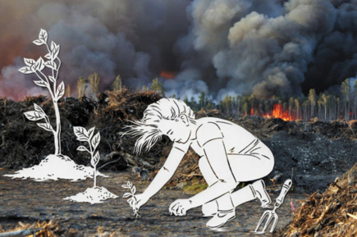
Answer the questions:
What is the connection between this story and the environment?
When we say the Earth is in danger, what is in danger exactly?

Slide 4
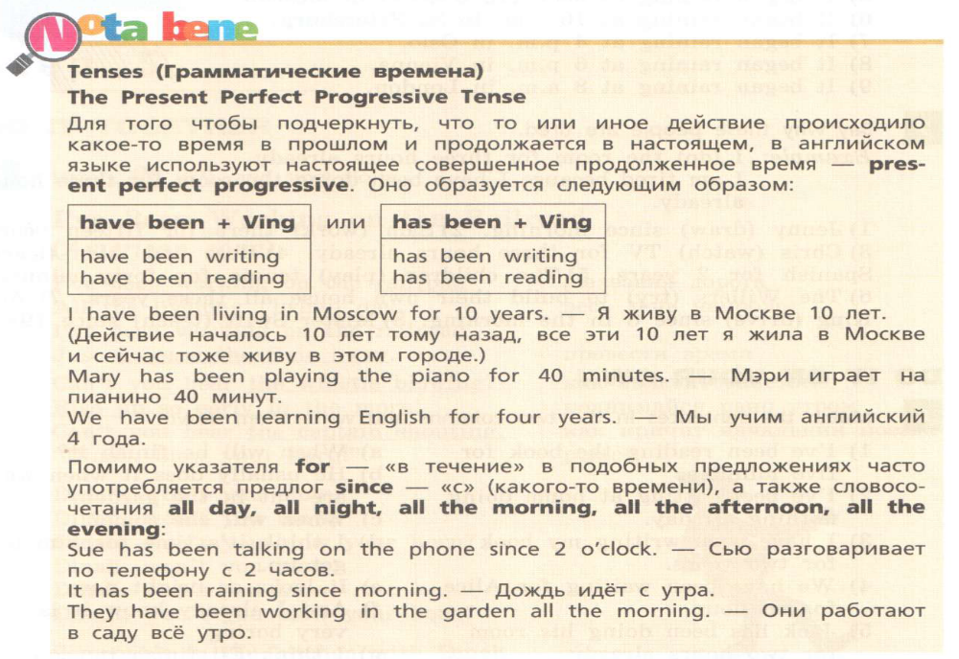
Remember!
Present Perfect & Present Perfect Progressive

Slide 5
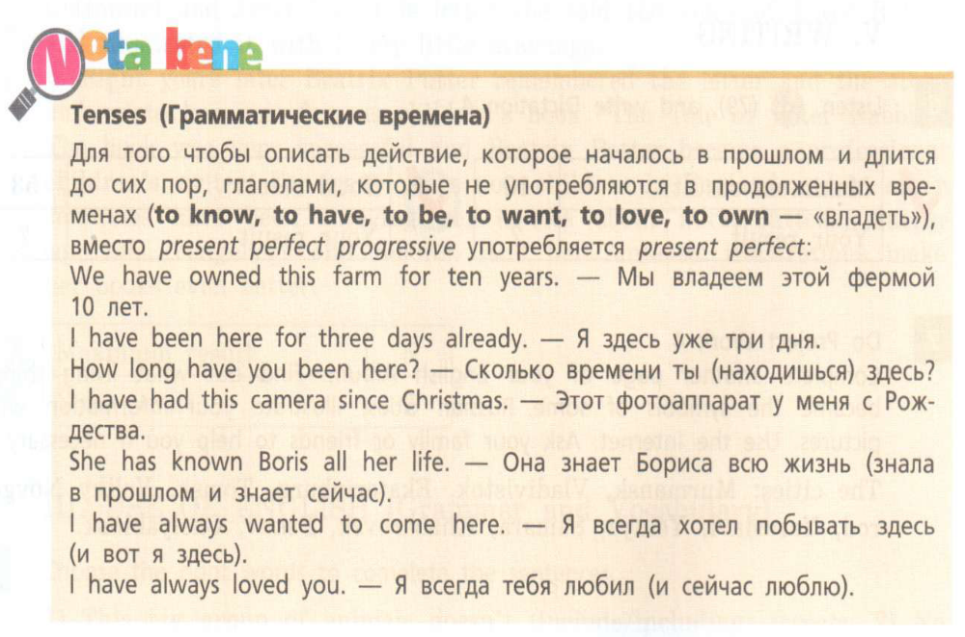
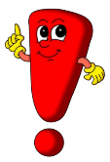

Slide 6
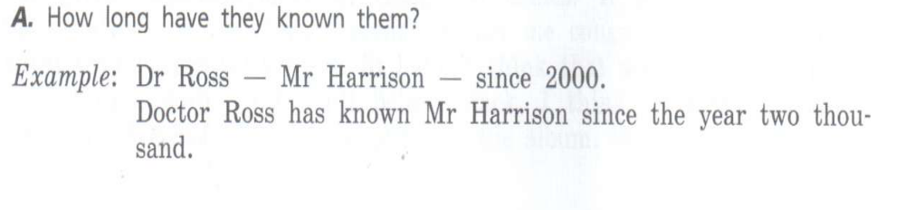
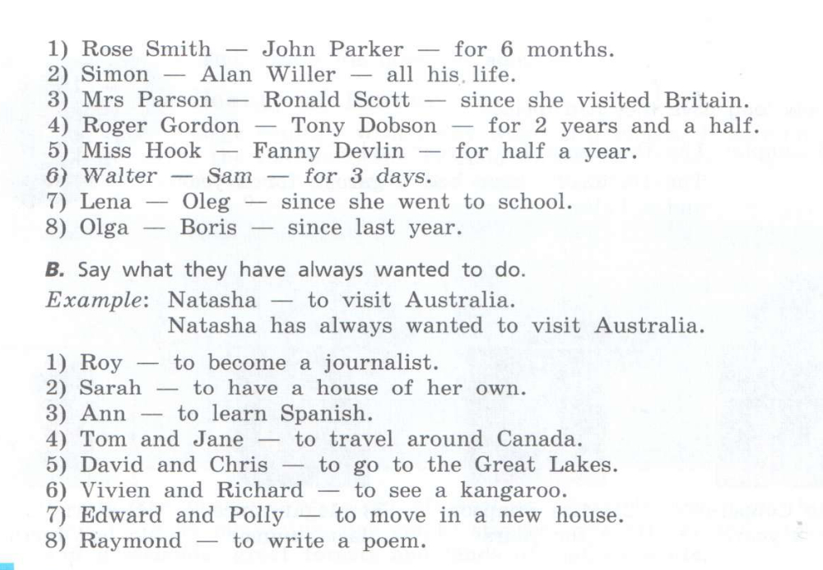


Slide 7
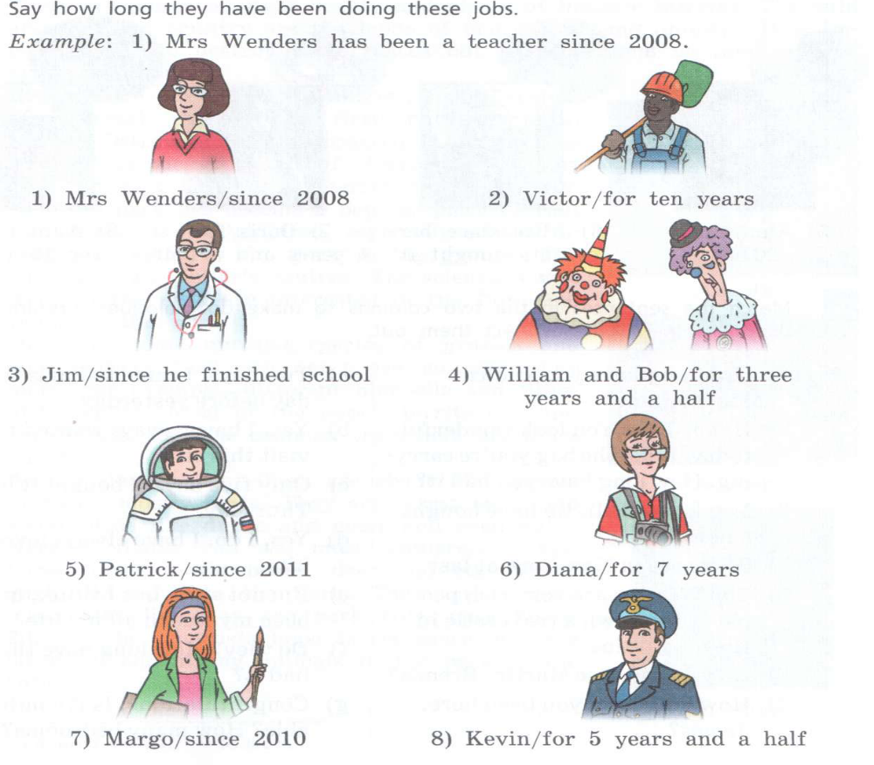

Slide 8
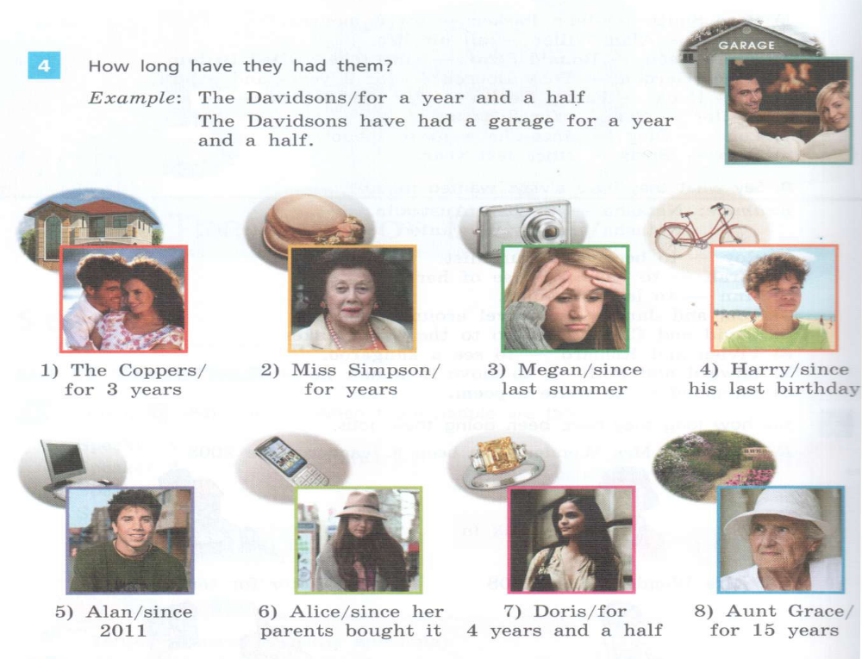


Slide 9
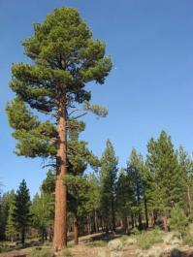
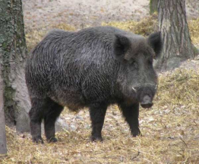
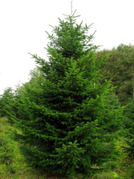
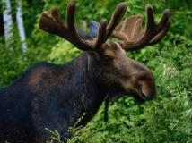
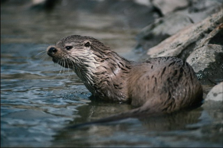
Next task: page 49 text Keep the Beauty of Russia
New words:
Empty- пустой
An area- область
A Pine- сосна
A Fir- пихта, ель
An Otter - выдра
An elk- лось
A boar- дикий кабан

Slide 10
Использованные материалы в презентации:
Яндекс картинки
УМК Английский язык. 7 кл.: в 2 ч. Ч.2: учебник /О.В. Афанасьева, И.В. Михеева, К.М. Баранова. – 3-е изд., пересмотр. - М.: Дрофа, 2015. – 152с.: - (Rainbow English)
http://pandia.ru/text/78/017/28144.php (текст притчи о мудреце и птице )

