Slide 1
I can
I can’t
Can you …?

Slide 2
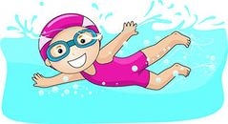
I can swim.
I can’t swim.
Can you
swim?

Slide 3
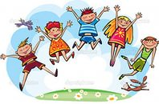
I can jump.
I can’t jump.
Can you jump?

Slide 4

I can hop.
I can’t hop.
Can you hop?

Slide 5

I can fly.
I can’t fly.
Can you fly?

Slide 6
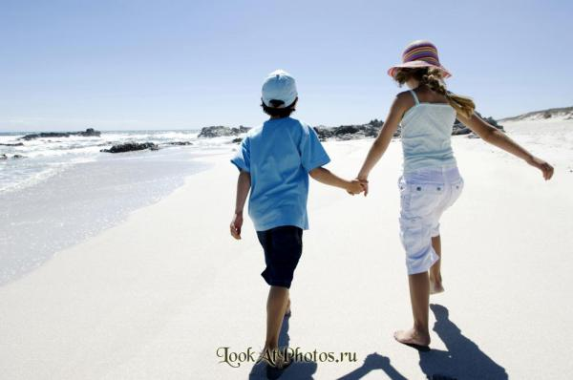
I can walk.
I can’t walk.
Can you walk?

Slide 7
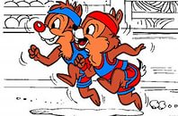
I can run.
I can’t run.
Can you run?

Slide 8
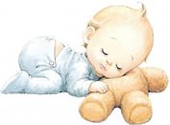
I can sleep.
I can’t sleep.
Can you sleep?

Slide 9
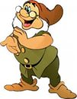
I can clap.
I can’t clap.
Can you clap?

Slide 10
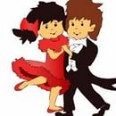
I can dance.
I can’t dance.
Can you dance?

Slide 11
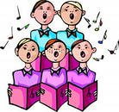
I can sing.
I can’t sing.
Can you sing?

Slide 12
Well done!!!

