Slide 1

Страны и национальности

Slide 2

Flags of English –speaking countries

Slide 3
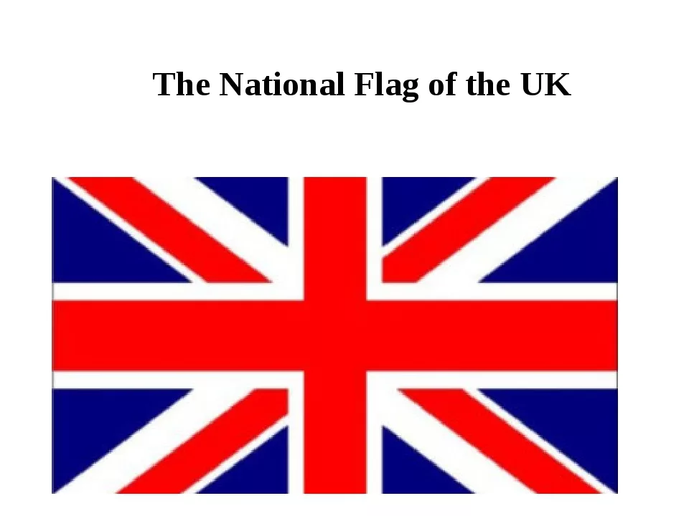

Slide 4

Australia

Slide 5
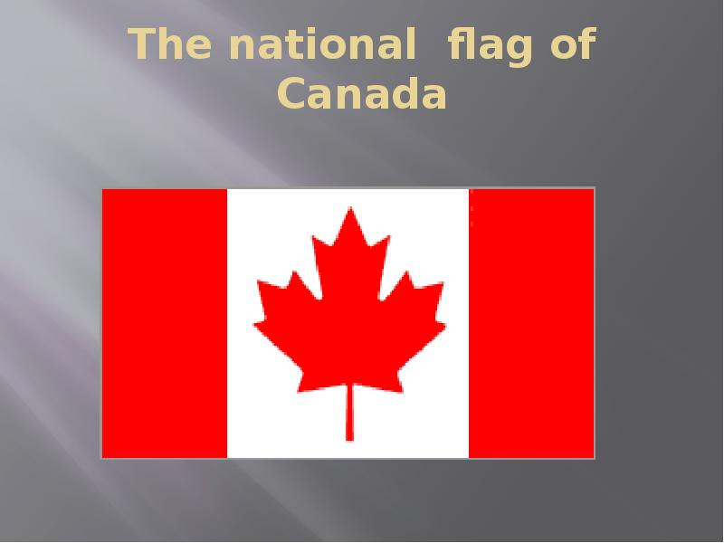

Slide 6

New Zealand

Slide 7

The USA

Slide 8

France

Slide 9

Japan

Slide 10
Countries | Nationalities
The UK | British
The USA | American
Canada | Canadian
Australia | Australian
New Zealand | New Zealander
France | French
Japan | Japanese

