Slide 1
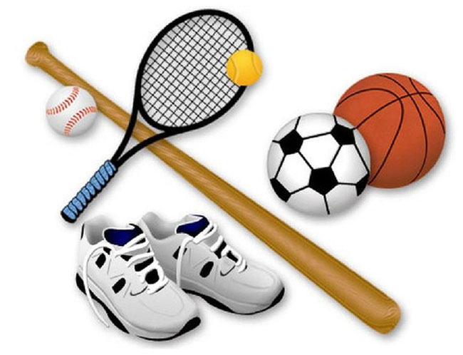
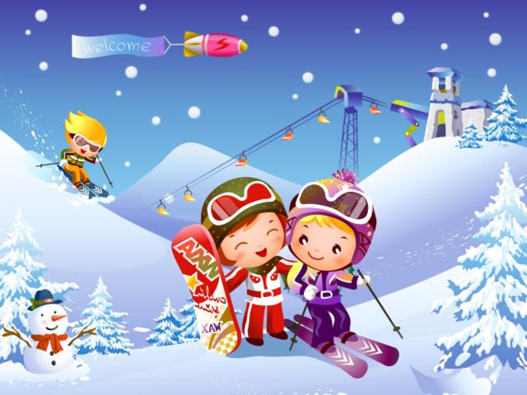
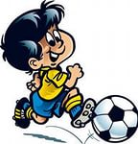
Look at the pictures and guess about the topic

Slide 2
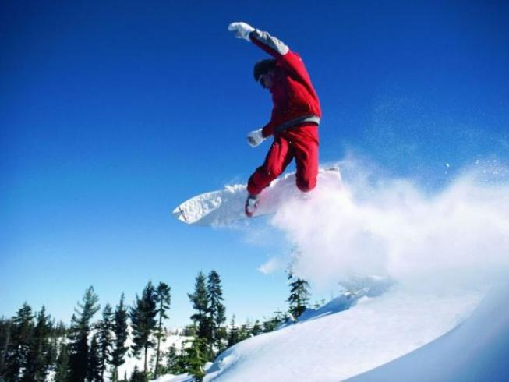
Topic of our lesson is
Sport is
fun.

Slide 3
Read the poem
Sport is fun for girls and boys
It’s much better than the toys.
You can sledge and ski and skate
And throw snowballs with Kate.
You can swim and play football,
Hockey, tennis, basketball.
You can jump and you can run,
You can have a lot of fun.

Slide 4
In sports and journeys men are known.
Люди познаются в спорте и в путешествиях.
A sound mind in a sound body.
В здоровом теле здоровый дух.

Slide 5
Kind of Sport
Tennis
Football
Badminton
Swimming
Surfing
Sailing
Skating
Boat racing

Slide 6

Where we can do sport?
Stadium
Swimming pool
River,Lake
Mountains
Sea
Street
Court
Gym
Field

Slide 7
Mathch the sports and the places
SPORTS | PLACES
swimming | stadium
ice hockey | skating rink
athletics | pool / lake
roller skating | river / sea
figure skating | mountains
cross country running (кросс) | fields
cycling / skiing | forest
riding | street
tennis | sport ground
water skiing (водные лыжи) | Court
surfing | gym
power lifting | sea

Slide 9
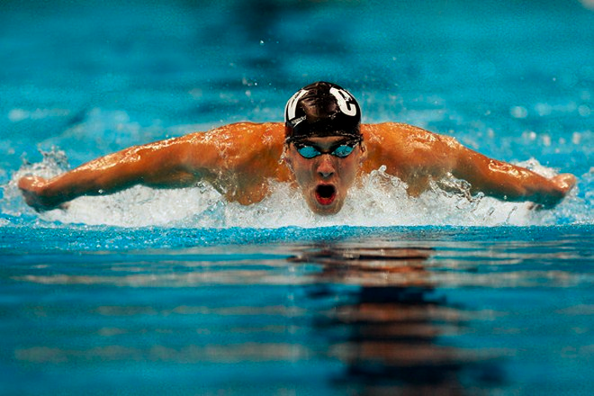
Show the action

Slide 10
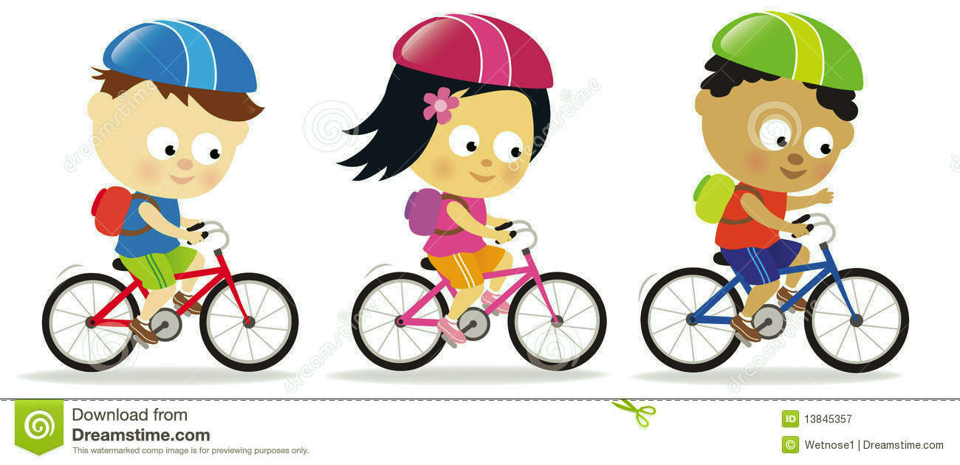

Slide 11

Show the action

Slide 12
True/ false
1.sport helps people to keep fit, be healthy and strong
2. People don’ t train themselves in sport clubs and sections
3. At Olympic Games people set many records and won medals

Slide 13
4. Another group of people don t prefer to watch sport competition on TV.
5. Some people listen to sport news and read sport newspapers.
6. Children don’t play valleyball and basketball at school.

Slide 14
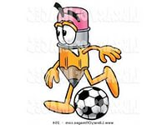
Advantages | Disadvantages

Slide 15

Now I can speak about sport
yes I can
50/50
No I can t

