Slide 1
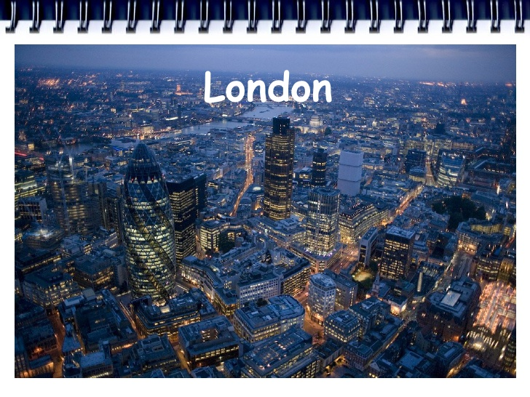
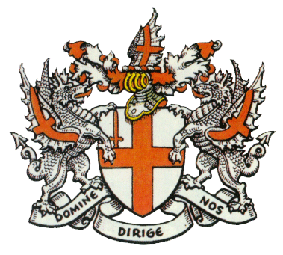

Slide 2
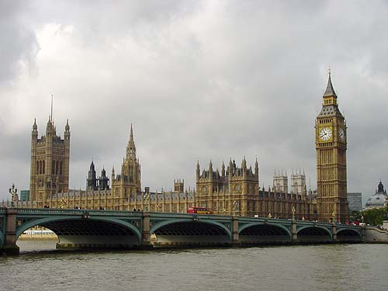
London is the capital of the United Kingdom, its economic, political and cultural center. It is one of the world's most important ports and one of the largest cities in the world. There are a lot of places of interest in London.

Slide 3
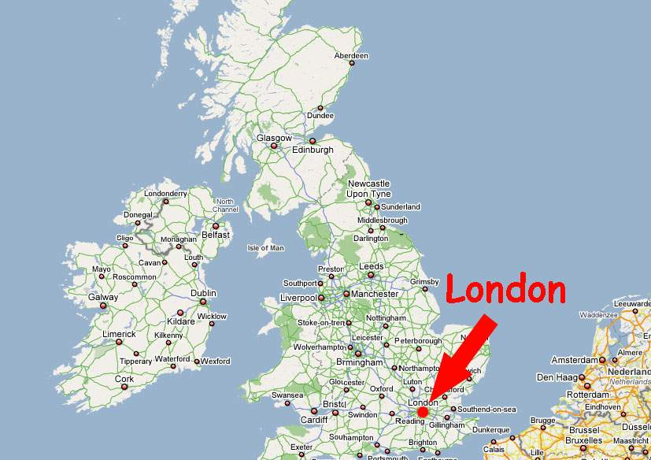
London is the British capital and
one of the biggest cities in the world.

Slide 4
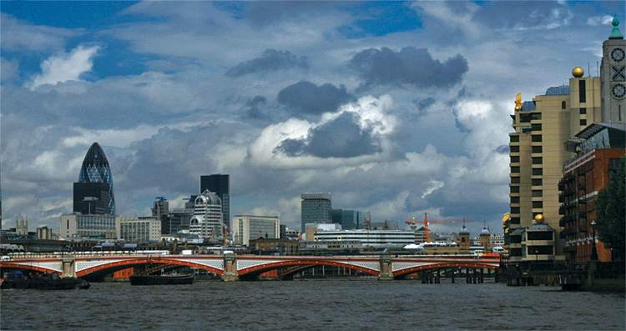
London is situated upon both banks of the
River Thames, it is the largest city in Britain..

Slide 5
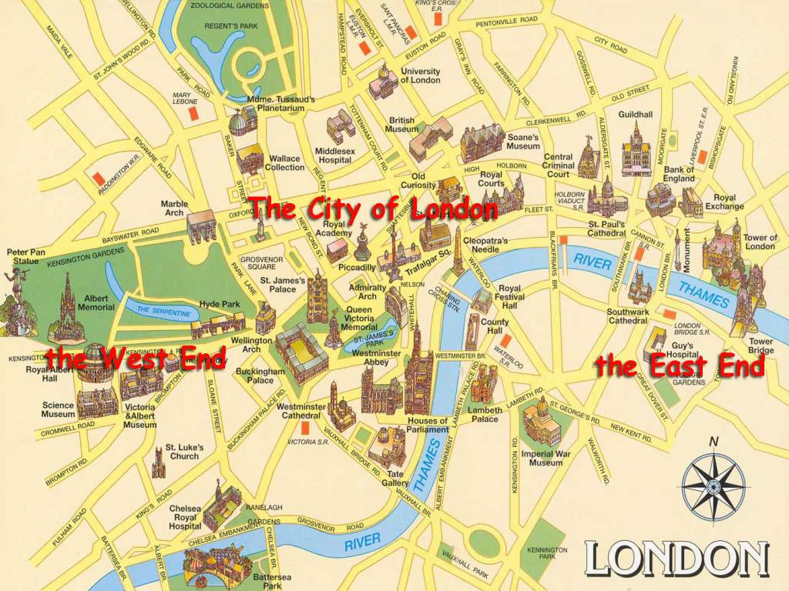

It consists of three parts: the City of London, the West End and the East End.

Slide 6
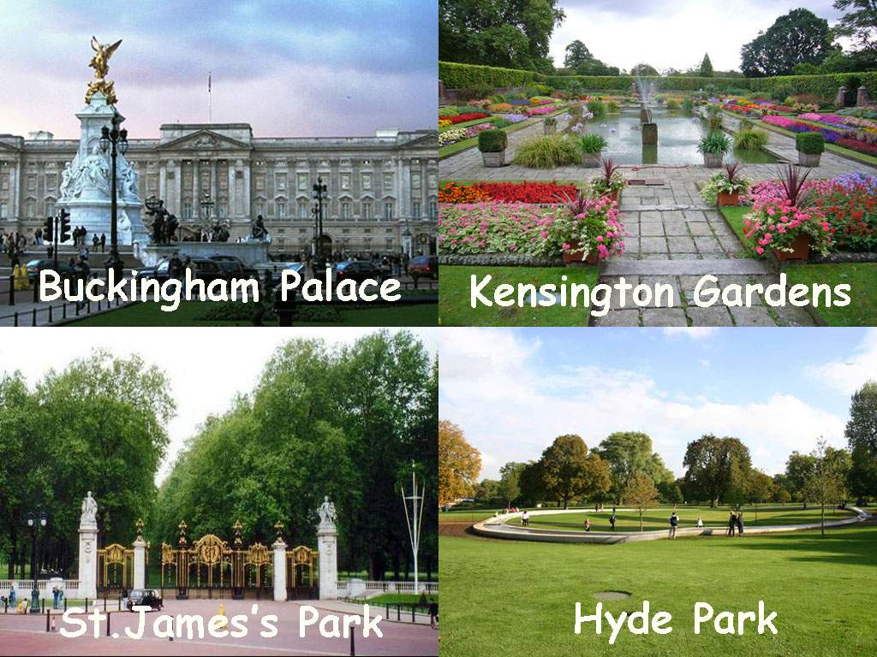

Slide 7
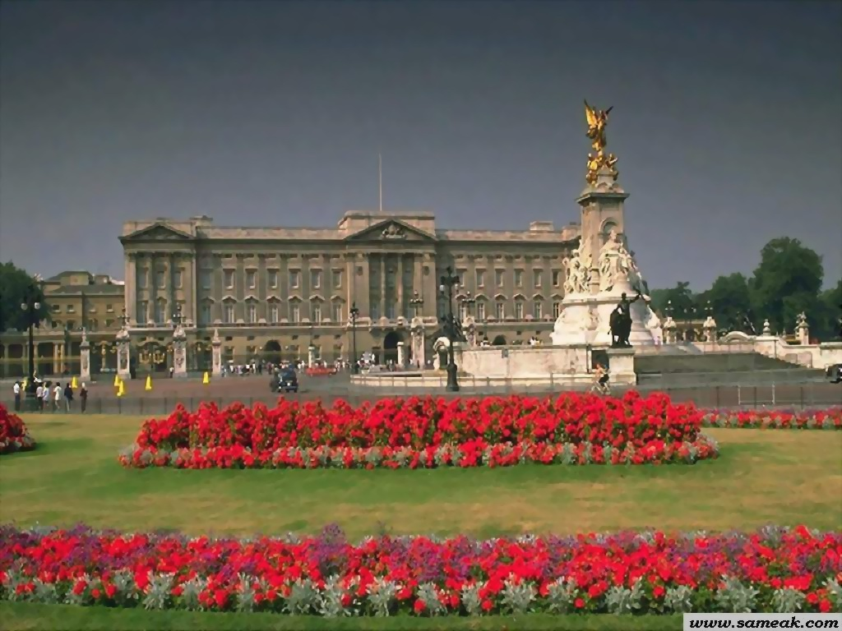
Buckingham Palace

Slide 8
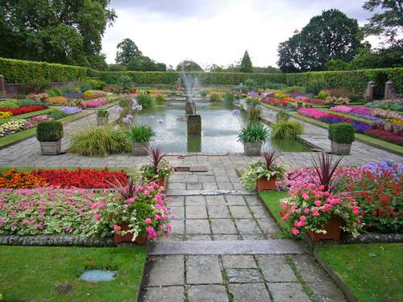
Kensington Gardens

Slide 9
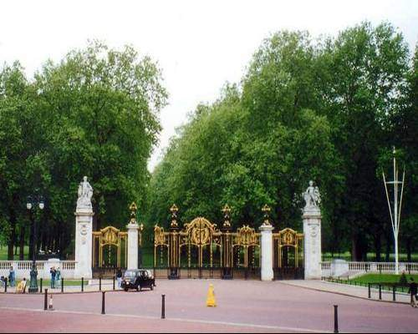
St.James's Park

Slide 10
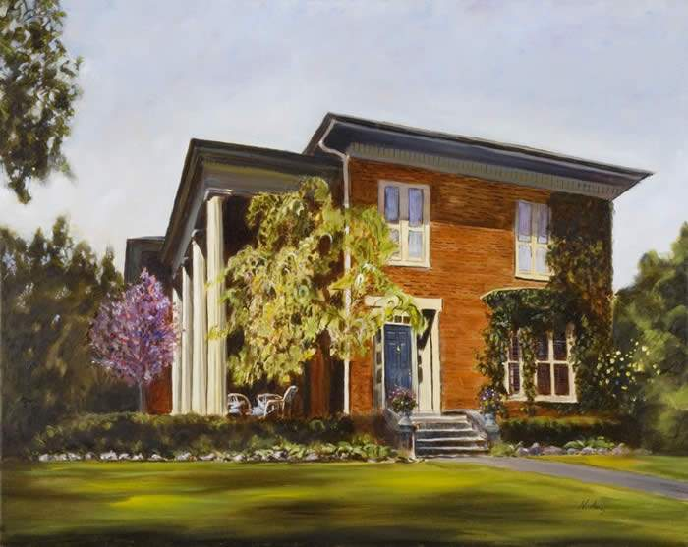
The Queen's Residence
The Queen's Residence was built in
1870 for Samuel Barnard, a vice president
of the Paper Company.

Slide 11
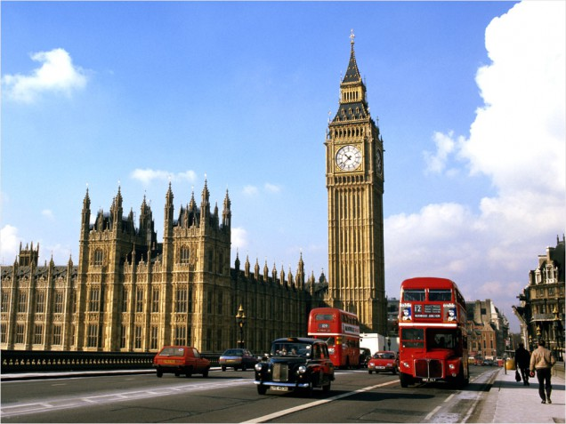
Westminster Palace and Big Ben

Slide 12
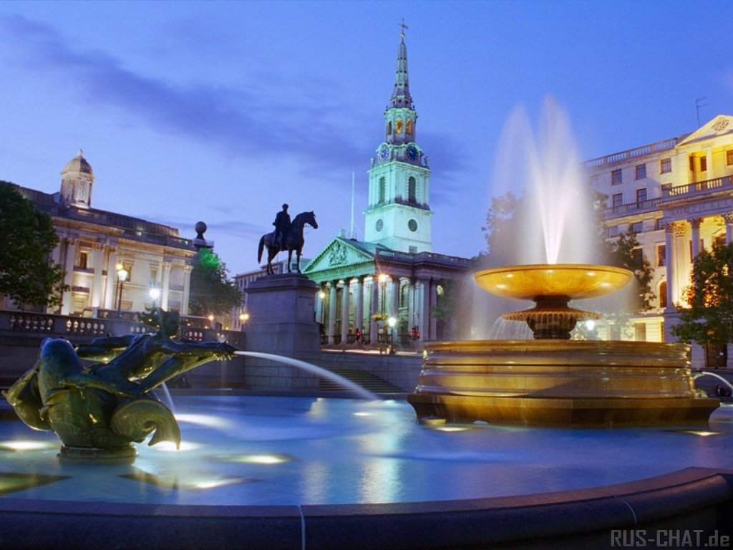
Trafalgar Square

Slide 13
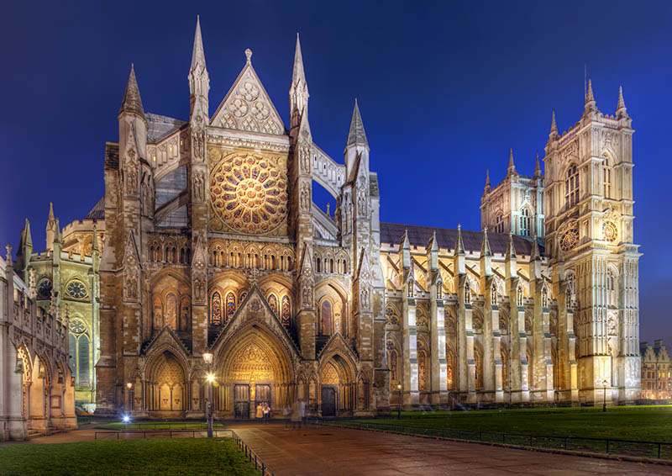
Westminster Abbey

Slide 14
