Slide 1


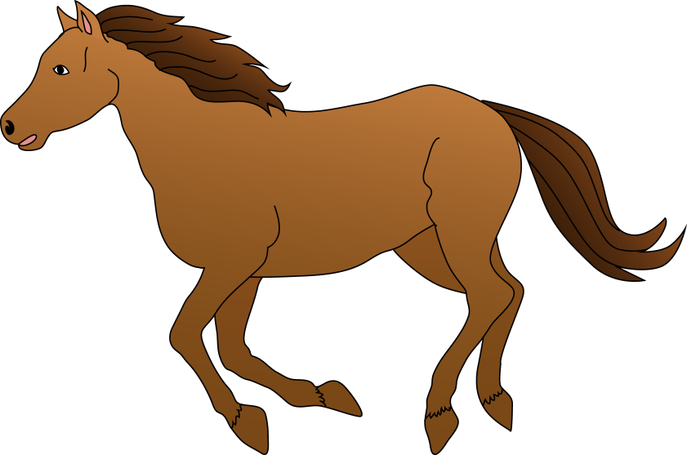



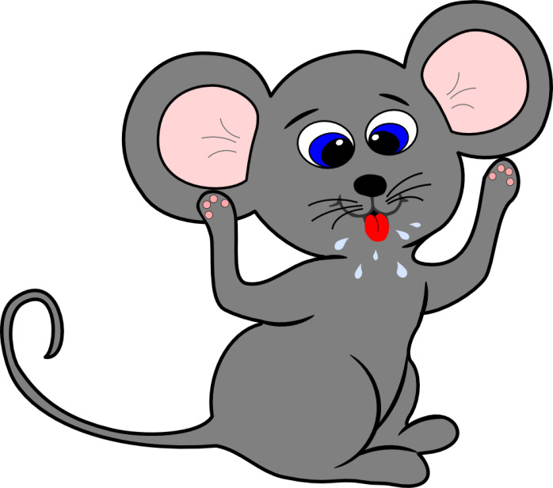

Pets

Slide 2

CAT

Slide 3

DOG

Slide 4
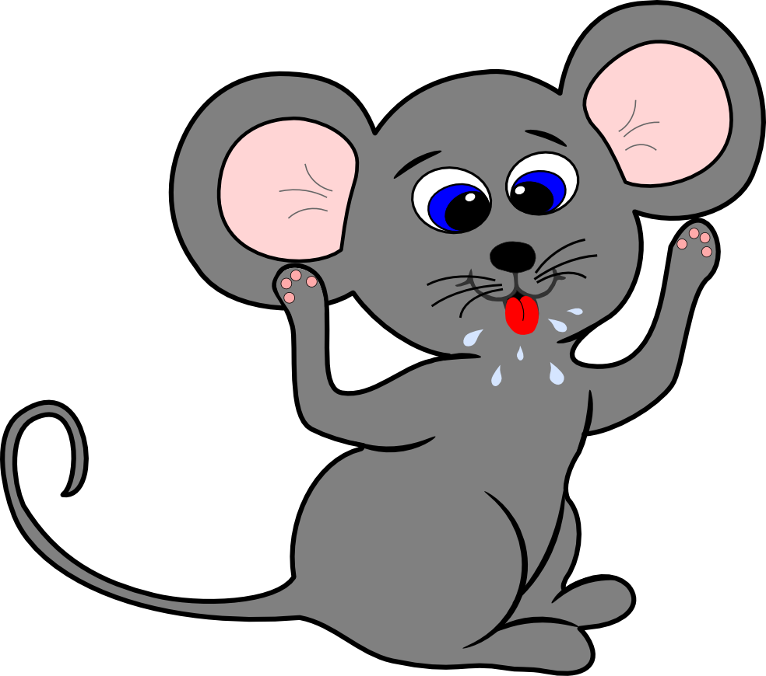
MOUSE

Slide 5
BIRD

Slide 6
RABBIT

Slide 7

FISH

Slide 8

HORSE

Slide 9

HAMSTER

