Slide 1
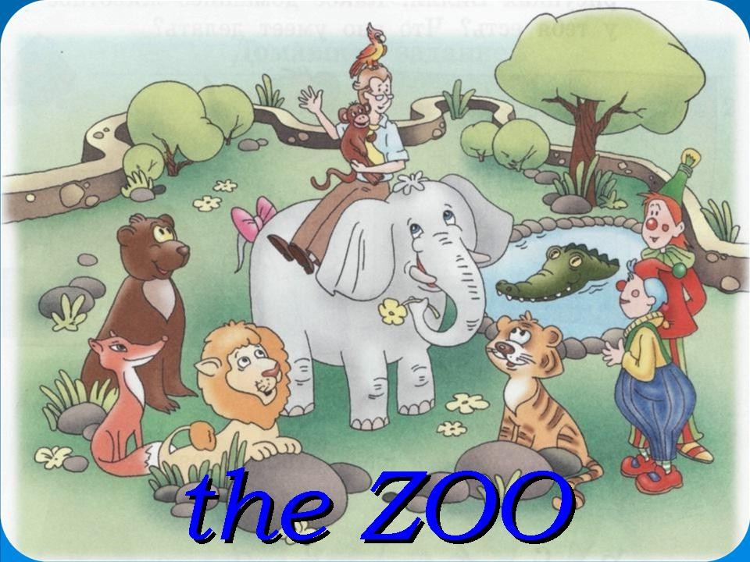

Slide 2
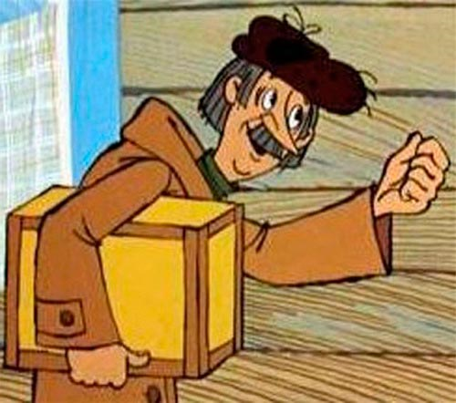
You have a letter…
FOR 4 «Б»

Slide 3


Dear friend,
My name is Little Saiga.
I live in Kalmykia. Kalmykia is beautiful.
We celebrate New Year in January. I have some presents for you. Please do some exercises and find them.
Bye,
Little Saiga.

Slide 4

CAN
-Hello, I’m a monkey.
-Hello, I’m a giraffe.
-Can monkeys fly?
-No, we can’t.
-What can you do?
-We can jump.
-What can giraffes do?
- We can walk.

Slide 5
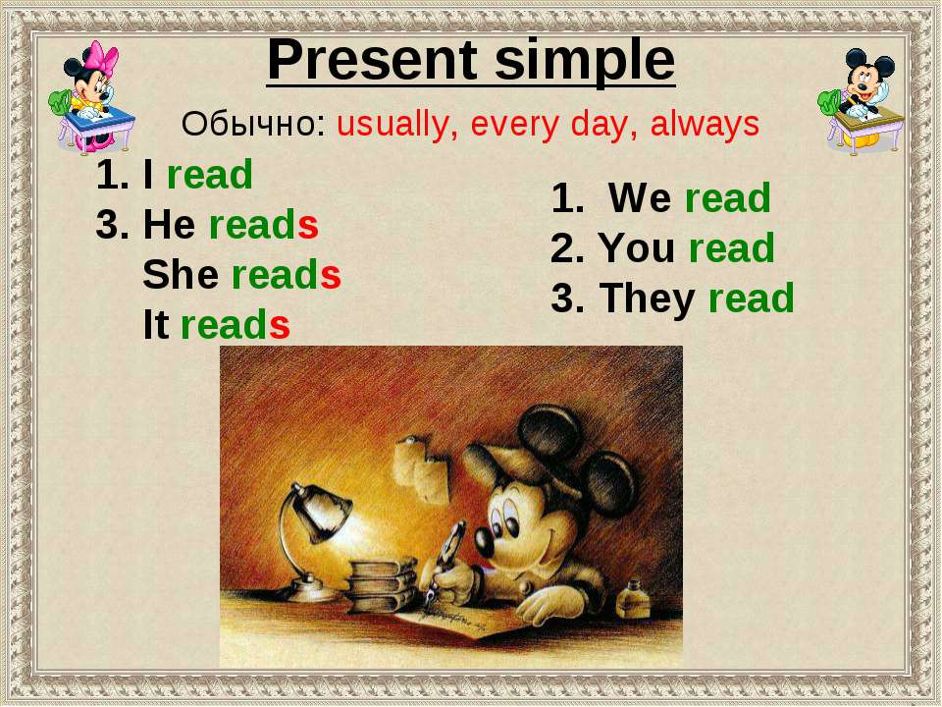

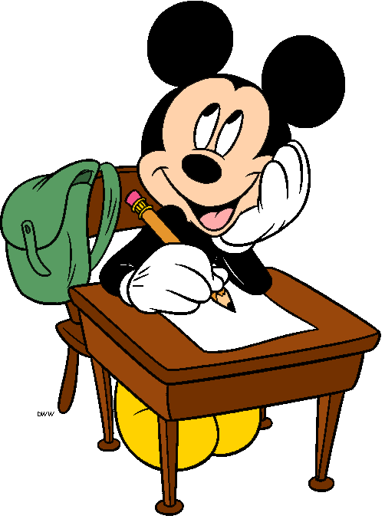
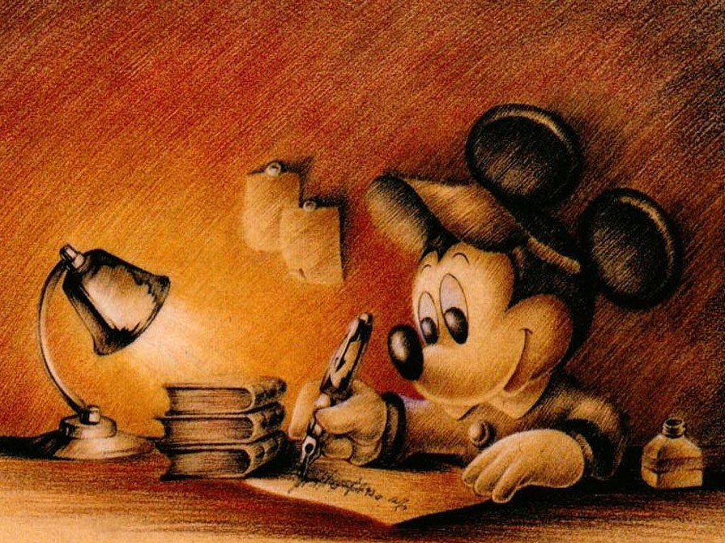
Present Simple
Usually, every day, always, often, sometimes
I read 5. She reads
We read 6. He reads
You read 7. It reads
They read

Slide 6
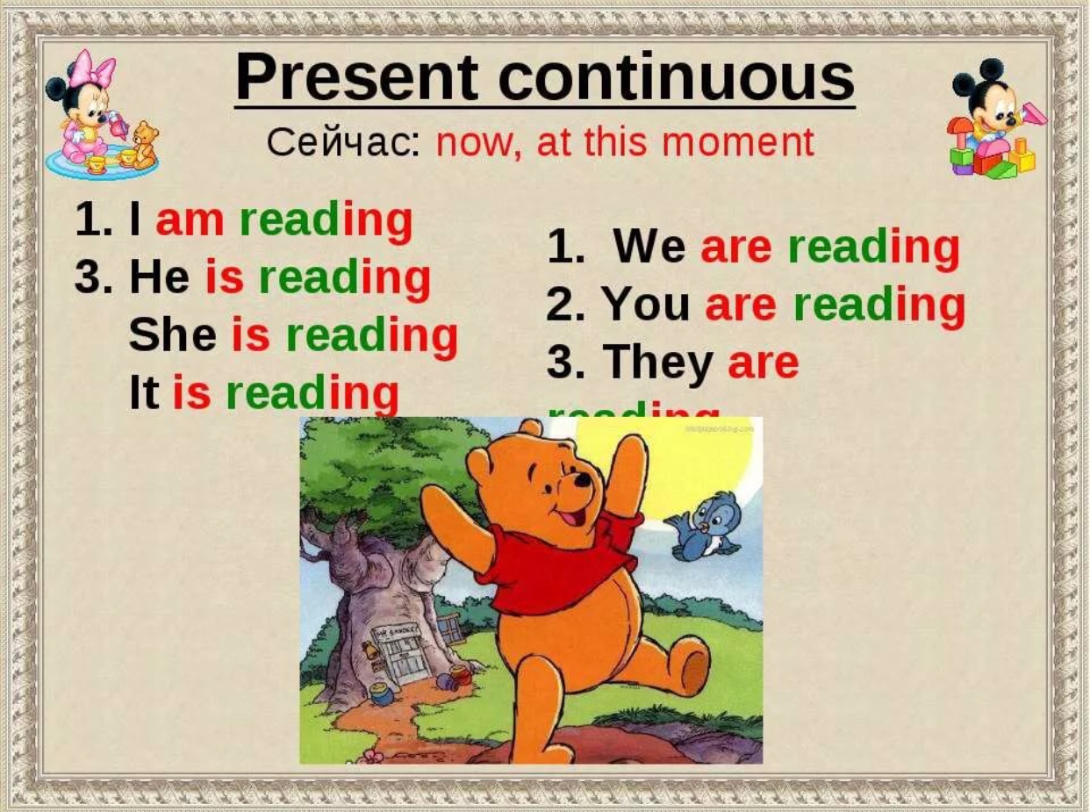
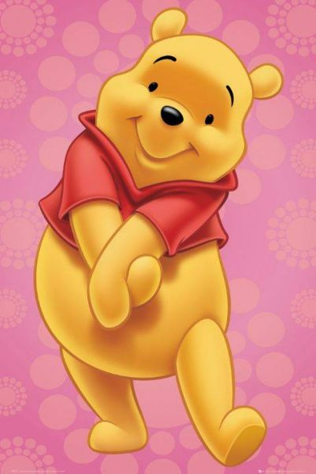
Present Continuous
Сейчас: now, at this moment
LOOK!
LISTEN!
1. I am reading 5. You are reading
2. He is reading 6. We are reading
3. She is reading 7. They are reading
4. It is reading

Slide 7

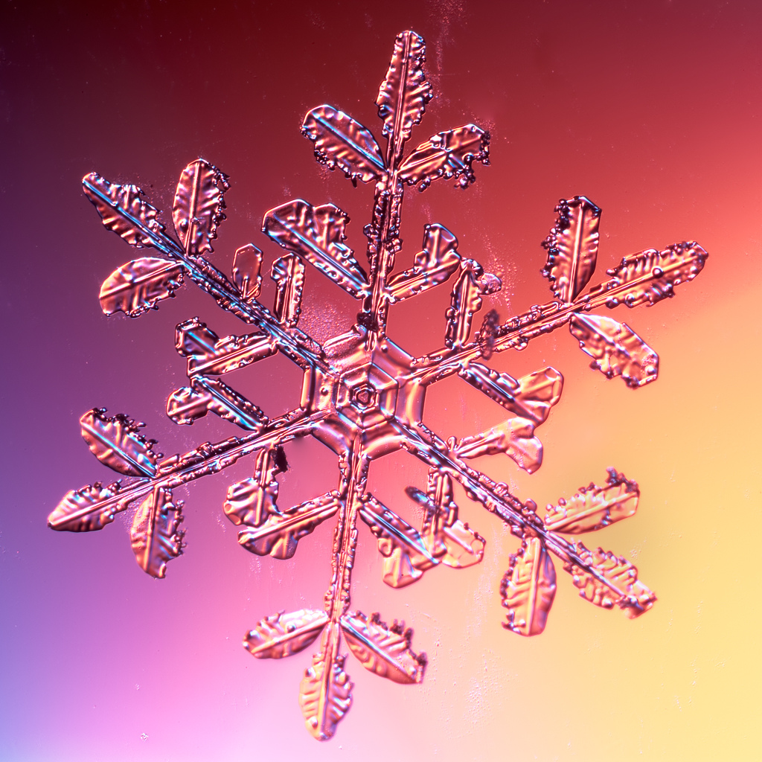
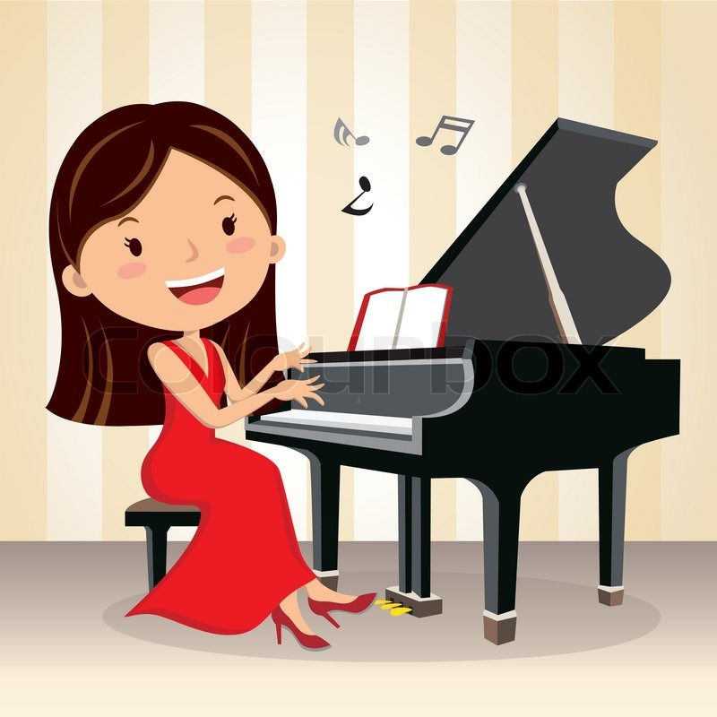


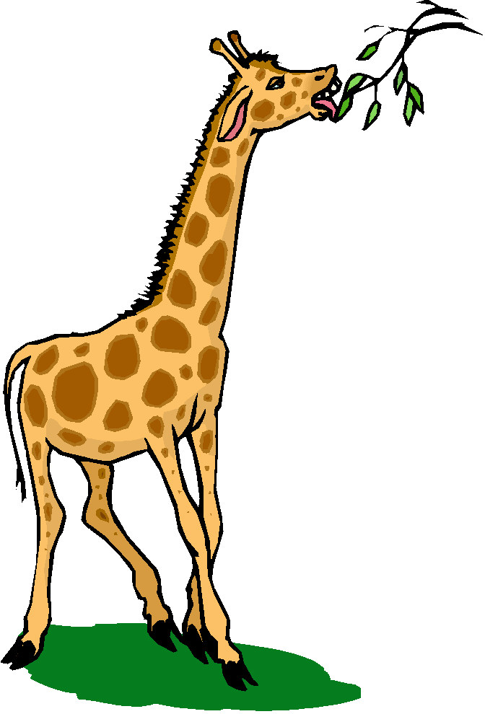
Play the piano Sing a song
Play with a ball Eat from a tree

Slide 8
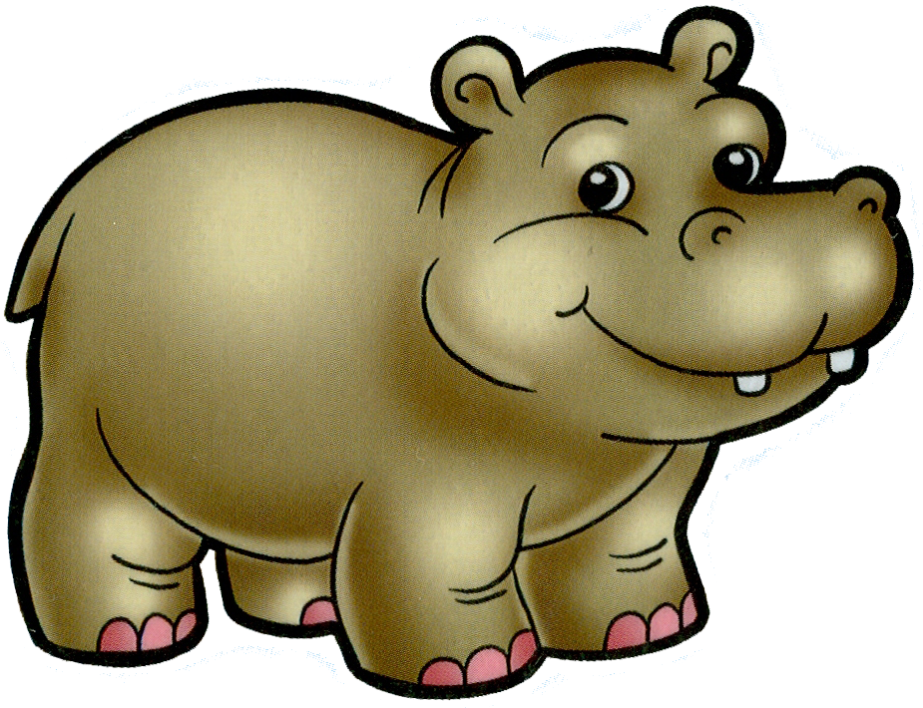

Прочитайте предложения, выберите подходящие ответы.
1) Mum always cleans / is cleaning the house
2) Seals swim / are swimming in the sea
3) The children are going / go to the park every week
4) Listen! They sing / are singing
Заполните анкету информацией из текста и запишите её в тетрадь.
Hippos are very big animals. They live in Africa.
They are very fat. They sleep most of the day
and eat at night. They eat grass and
live for about 40 years
Name: e.g. hippo
lives in : 1)___________________
eats : 2)______________________
lives for : 3) __________________
sleeps: 4) ____________________

Slide 9



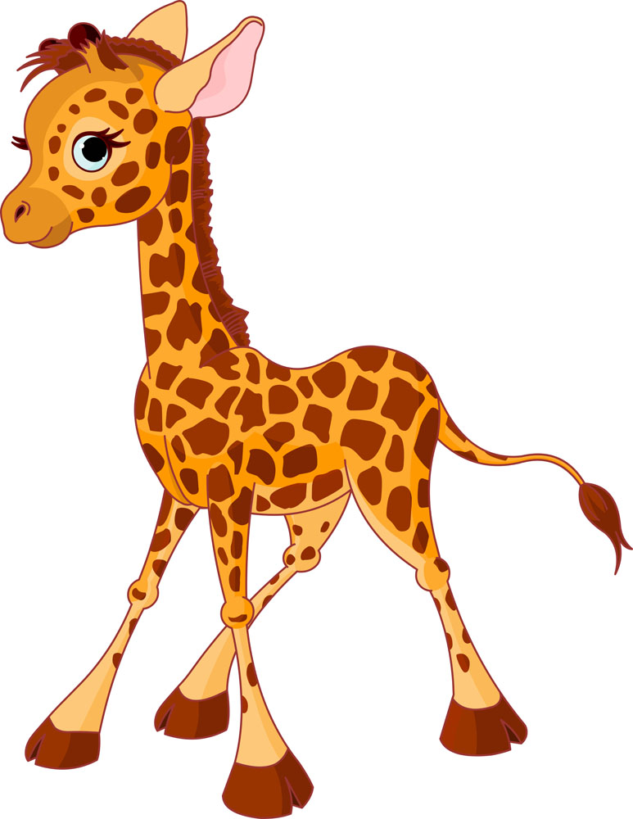



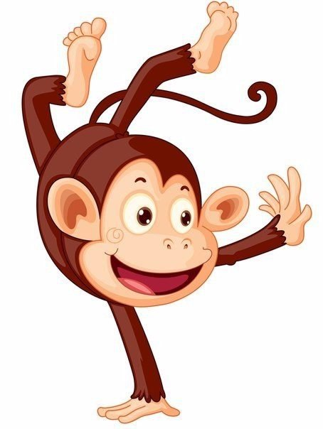
Seal
Lizard
Hippo
Dolphin
Crocodile
Whale
Monkey
Giraffe

Slide 10
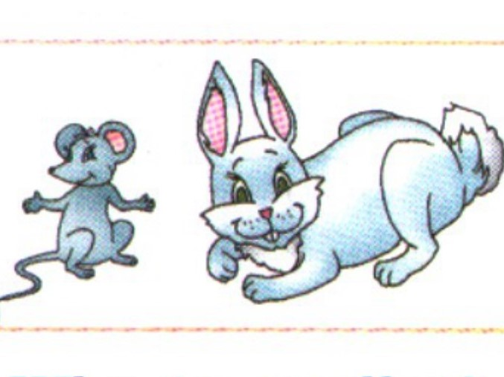
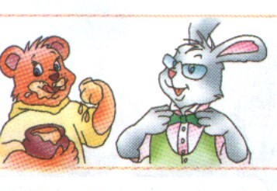
Who is smaller? Who is cleaner?

Slide 11
