Slide 1

All the world's a stage,
And all the men and women merely players;
They have their exits and their entrances;
And one man in his time plays many parts,
His acts being seven ages.

Slide 2

All the world`s a stage,
and all the men and women
merely players.

Slide 3
Write the words with these letters
sh, ch, a,
wh, th, w,

Slide 4

Try to guess
A soloist
A humourist
A linguist
A psychyatrist
An anarchist
A florist
A therapist

Slide 5
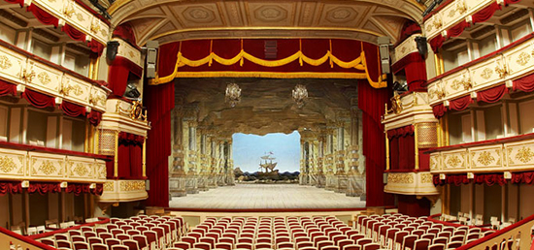

Slide 6

Match each person with one of the descriptions:
Acrobat, clown, conductor, juggler, understudy, ballerina, vocalist, director, stuntman
Someone who makes people laugh at the circus.
Someone who tells actors what to do.
Someone who sings.
Someone who entertains others by throwing and catching things.
Someone who entertains others by performing gymnastics.
Someone who takes an actor’s place in an emergency.
Someone who tells an orchestra what to do.
Someone who performs dangerous actions in place of an actor.
Someone who dances gracefully in a leading role.

Slide 7

Let`s watch
the video

Slide 8
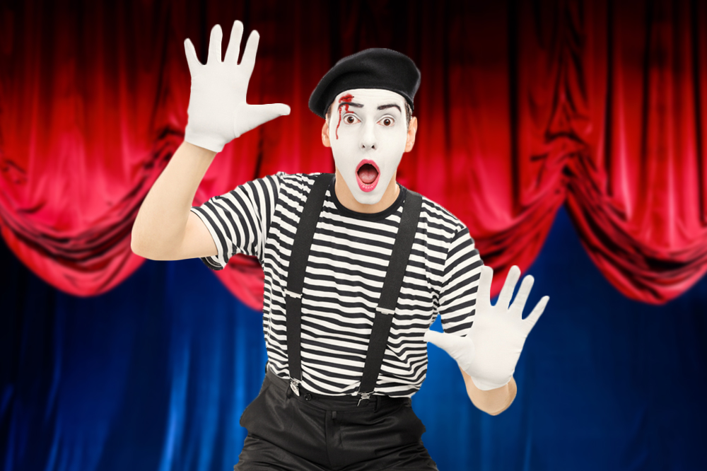
Pantomime

Slide 9

Fill in: on, out, up, on to
1. Sorry to hold you __: my train was late.
2. She held ___ me to stop herself falling down.
3. Mr. Brown is busy at the moment, hold ___ please.
4. He said his boss had held him ___ at the office.
5. The child was hold ____ the sleeve of my coat while we were walking along the road.
6. The man held ___ his identity card to the policeman.

Slide 10

Listening Task
His hobby
Her dreams comes true
Born to dance
The young film-maker

Slide 11
Complete the gaps in the text with these words
One day, who, in the end, which
“
Beauty and the Beast" was directed by Jean Cocteau. It is bases on the fairytale by Madame Le Prince de Beaumont and it stars Jean Marais as the Beast and Josette Day as Beauty.
Beauty is one of three daughters of a French merchant. Her sisters, Felicie and Adelaide, are mean and treat Beauty as a servant. (1)__________Beauty's father gets lost in the forest, but finds a strange castle, (2) __________ he enters, looking for help. The owner of the castle is a monster, half-man, half-beast, (3)__________ threatens the merchant – either one of his daughters replaces him as a prisoner in the castle or he will die. Beauty offers to replace her father and goes to live in the castle. (4) __________, she discovers the Beast is not as ugly and inhuman as he seems, but a handsome prince.

Slide 12
Match the names of arts with the names of people’s activities.
Someone who
plays a musical instrument is…
acts in plays or films is…
paints pictures is…
makes up songs and music is…
writes plays is…
plans buildings is…
makes statues is…
dances in ballet is…
writes poems is…
sings is…
a poet
a dramatist or a playwright
a ballet dancer
a musician
a singer
an architect
an actor or an actress
a composer
a sculptor
an artist

Slide 13

Reflection
Today we … What did you do? Why did you do it?
2. Today, I didn’t understand … What language was difficult?
Next time, I want to … How will you improve in the next lesson?
4. How well did you do? Circle a number | Communication 0 0 0 0 0 Co-operation 0 0 0 0 0 Collaboration 0 0 0 0 0

