Slide 1
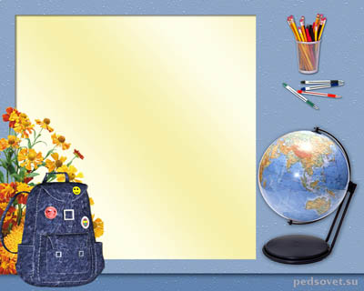
WELCOME
TO OUR
LESSON!

Slide 2

Pat’s black cat is in Pat’s black hat

Slide 3
?

Slide 4
A black cat sat on a mat and ate a fat rat

Slide 5
?

Slide 6
Why do you cry Willy?
Why do you cry?
Why, Willy? Why, Willy? Why, Willy? Why?

Slide 7
?

Slide 8
Father, mother, sister, brother,
Hand in hand with one another

Slide 9
?

Slide 10
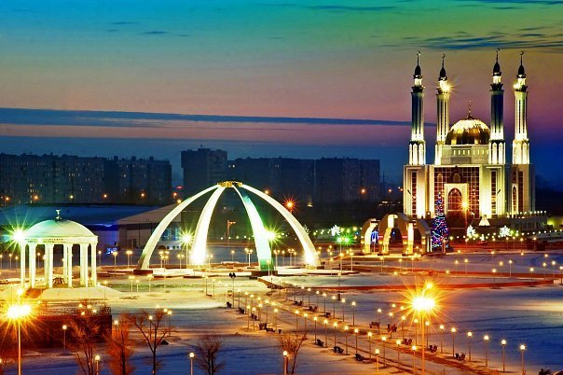
My Native Town

Slide 11
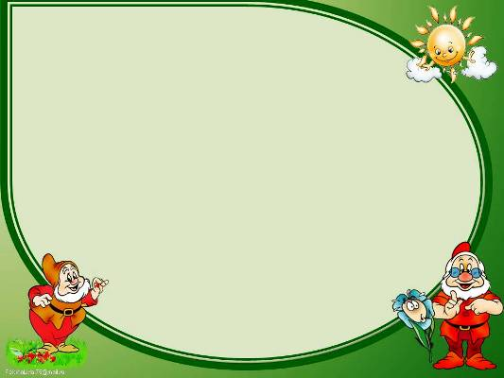
Actobe is…
… a big town
… situated in Kazakhstan
… my native town
… a beautiful town
…a green town

Slide 12
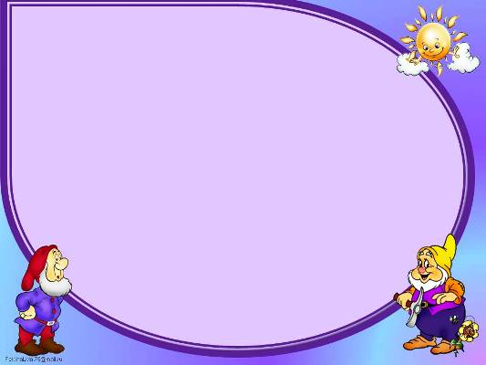
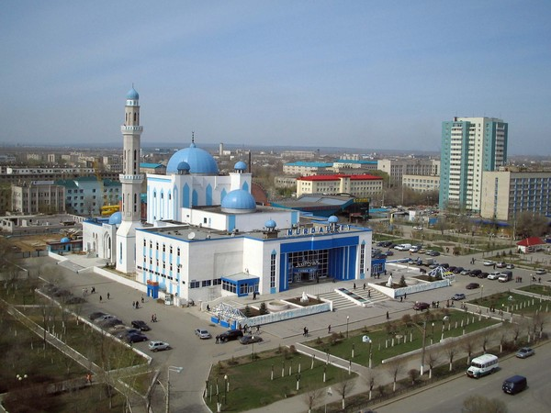
Actobe is a big and old city.
It is 146 years old. The name “Actobe” means “White Hill” .

Slide 13
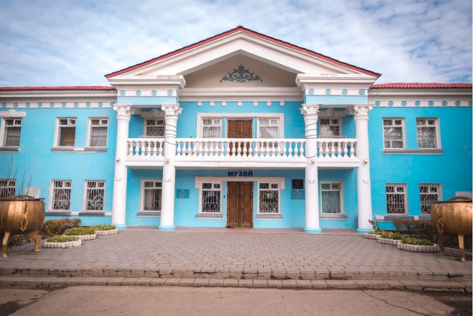
There are many beautiful places in Actobe. There is Local History Museum.

Slide 14
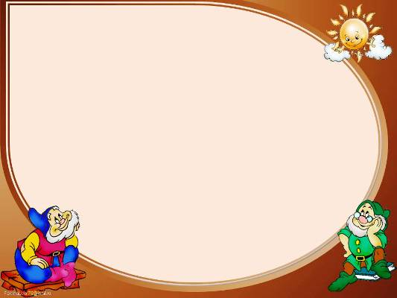
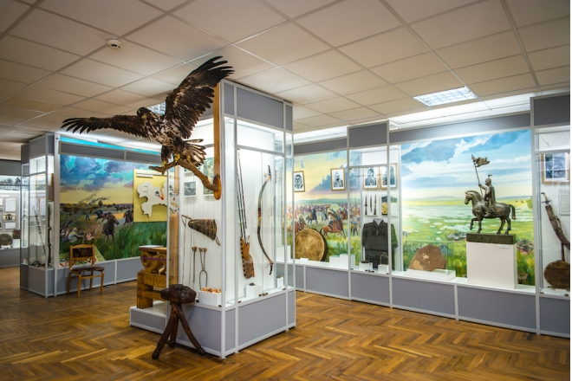
It has different interesting things and the sculptures of animals.

Slide 15
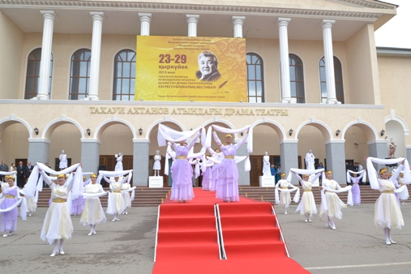
There is a big theatre. It is named afterKazakh writer
T. Akhtanov.

Slide 16
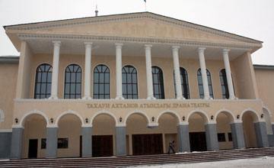
The theatre was opened in 1965.

Slide 17
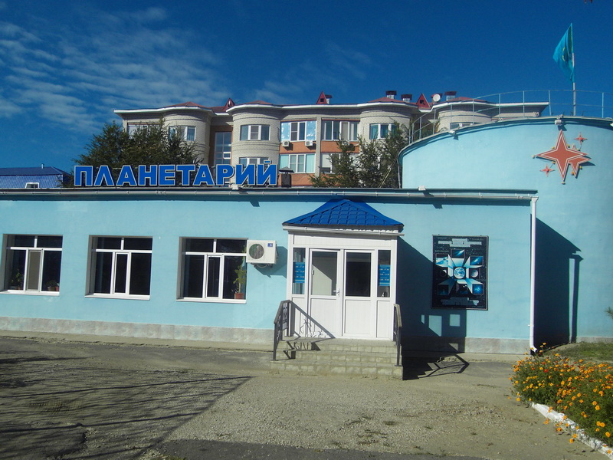
There is a planetarium in our town. It is the first and the only planetarium in Kazakhstan.

Slide 18
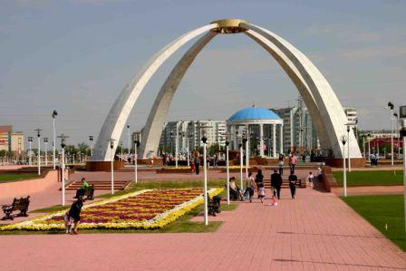
There is a big park after our president Nazarbaev.

Slide 19
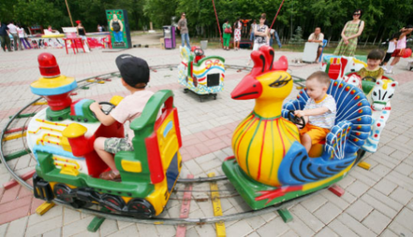
Children can walk and play there.

Slide 20
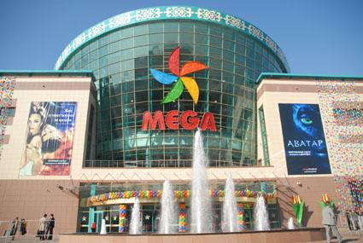
There is
a big trade
center Mega
Actobe.
You can play and buy different
things there.

Slide 21
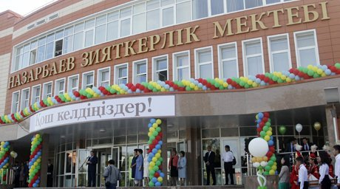
There are many schools, hospitals, shops and restaurants.

Slide 22
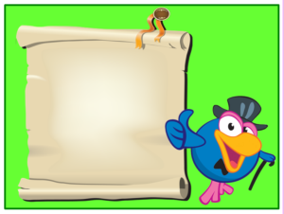
city /town – қала
museum – мұражай
park – саябақ
school – мектеп
shop – дүкен
hospital – аурухана
restaurant – мейрамхана
railway station – теміржол
вокзалы
playground – ойын алаңы
airport – әуежай

Slide 23
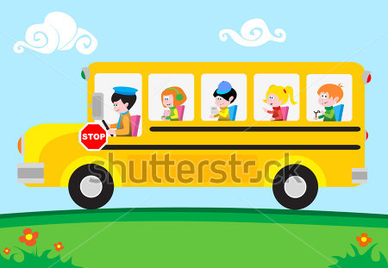
Bus stop №1
T.Akhtanov Theatre
Bus stop №2
Park after N.Nazarbaev
Bus stop №4
Abilkaiyr khan Avenue
Bus stop №3
Trade Center Mega Actobe
Bus stop №5
Airport Actobe

Slide 24
Bus stop №1
T.Akhtanov Theatre

Slide 25
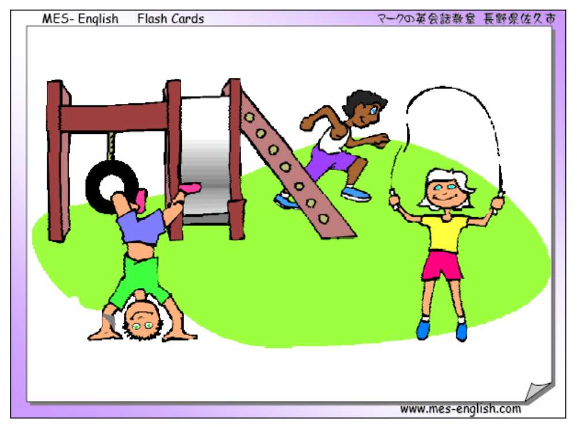
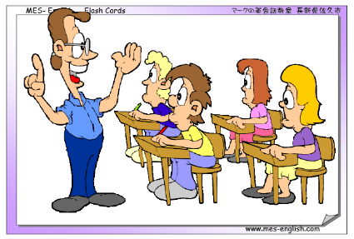
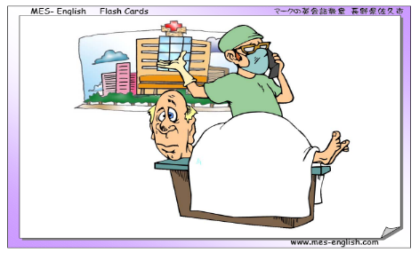
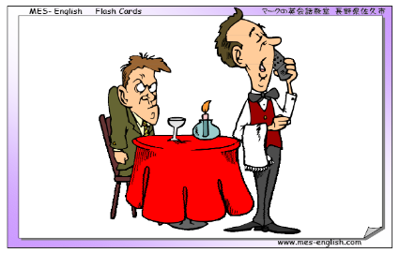
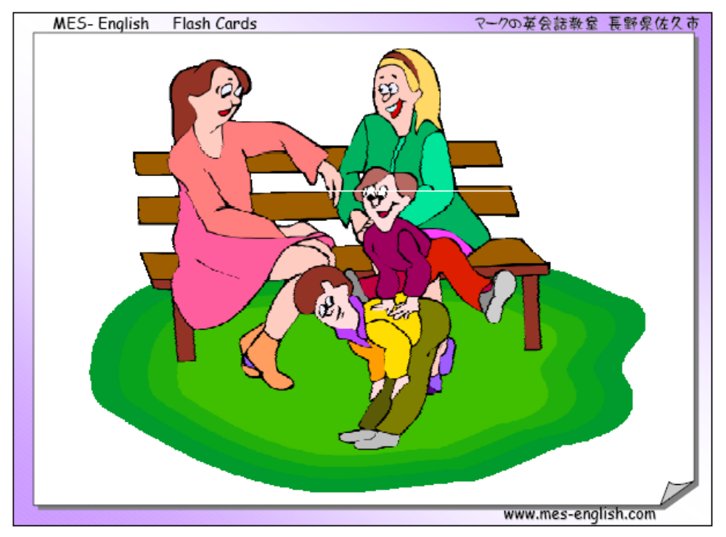
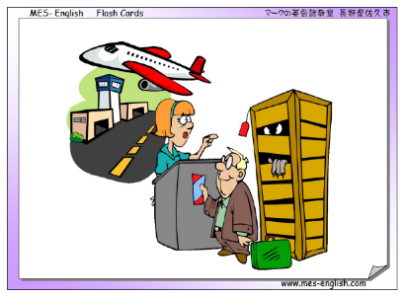
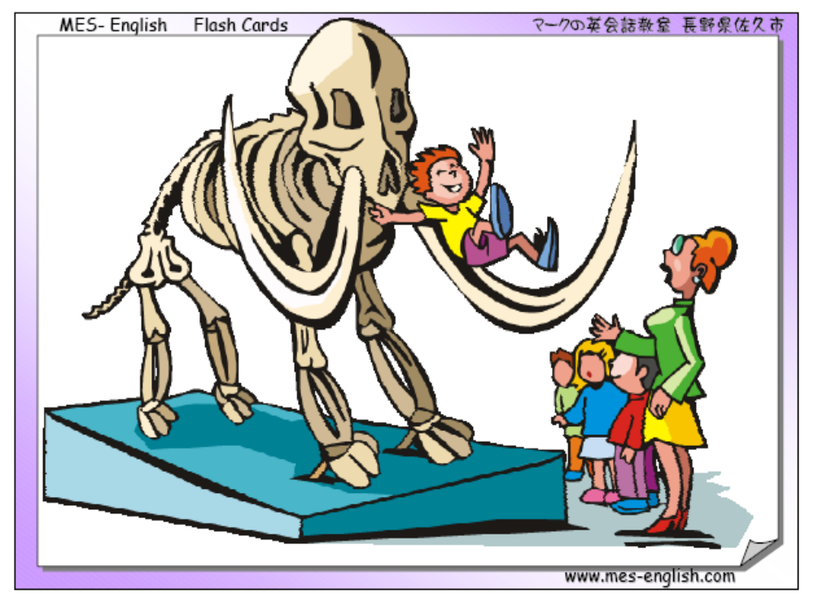
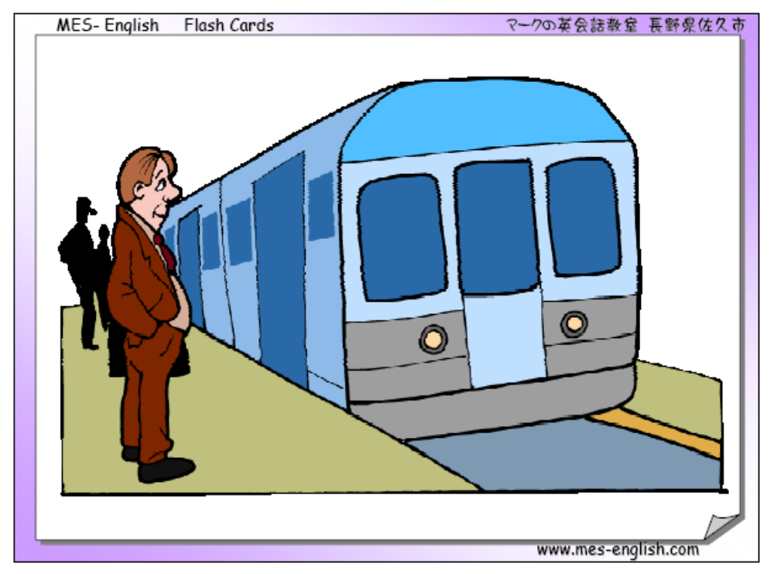
Task – 1
Match the pictures with the words:
e) railway
station
a) park
b)playground
f)airport
c)museum
g)restaurant
d)hospital
h)school

Slide 26
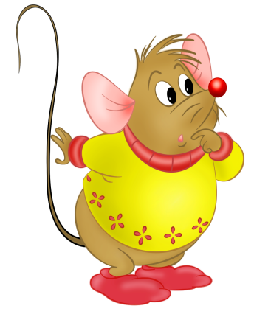
Task – 2. Match the explanations with the words:
1.we can eat different food there a)railway station
2.we can see a doctor there b)airport
3.we can see a train there c)museum
4.we can see a plane there d)restaurant
5.we can see old things there e)hospital

Slide 27
Task - 3. Complete the text. Do it in your copybooks.
My native town
I live in Actobe. There is a . We can see a_____
there. There is a . We can see a _____ there.
There is a . We can eat different _____there.
If we are ill, we can go to a . We can see a _____
there.

Slide 28
Task - 4. Find the words in the puzzle:
R | A | I | L | W | A | Y | S | T | A | T | I | O | N
M | R | E | S | U | P | E | R | M | A | R | K | E | T
U | H | O | S | P | I | T | A | L | R | I | E | N | S
S | E | V | C | W | T | I | S | U | P | T | R | T | O
E | W | S | H | O | P | T | Z | A | O | Y | L | O | Z
U | V | A | O | S | E | F | P | A | R | K | Z | W | M
M | C | Z | O | O | С | I | T | U | T | O | U | N | A
S | I | P | L | A | Y | G | R | O | U | N | D | S | G
H | N | M | U | S | U | P | E | P | L | A | N | E | A
O | R | E | S | T | A | U | R | A | N | T | A | R | Z
park, museum, railway station shop, zoo, restaurant, town,
playground, city, supermarket

Slide 29
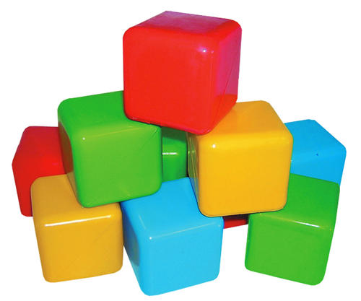
Task - 5. Play with the cube.
Name the word on the picture

Slide 30
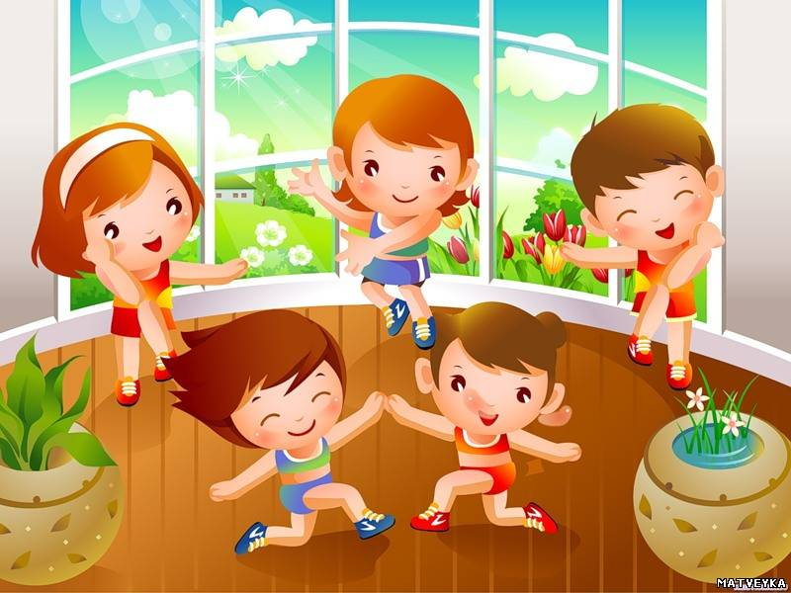
Warm -up

Slide 31
Bus stop №2
Park after N.Nazarbaev

Slide 32
Task - 1. Complete the sentences with is/are.
Do it in your copybooks.
1. There ___ an airport in my town.
2. There ___ many shops in my town.
3. There ___ a railway station in my town.
4. There ___ a planetarium in my town.
5. There ___ two museums in my town.

Slide 33

Task - 2. Make questions with the sentences from task - 1: my – your
Eg:
There is a park in my town. - Is there a park in your town?

Slide 34

Task - 3. Play with the ball.
Put questions to each other and try to answer according to the picture.
Eg:
Where are they? - They are at the shop.

Slide 35
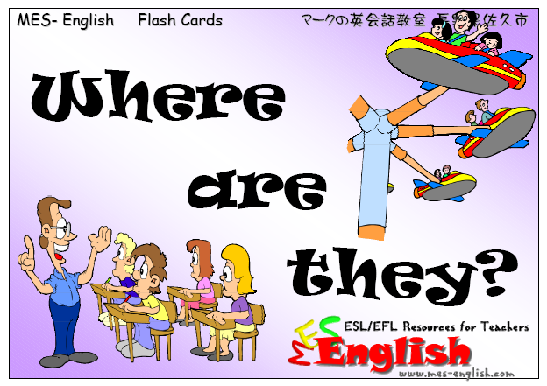

Slide 36
at the playground

Slide 37
at the park

Slide 38
at the museum

Slide 39
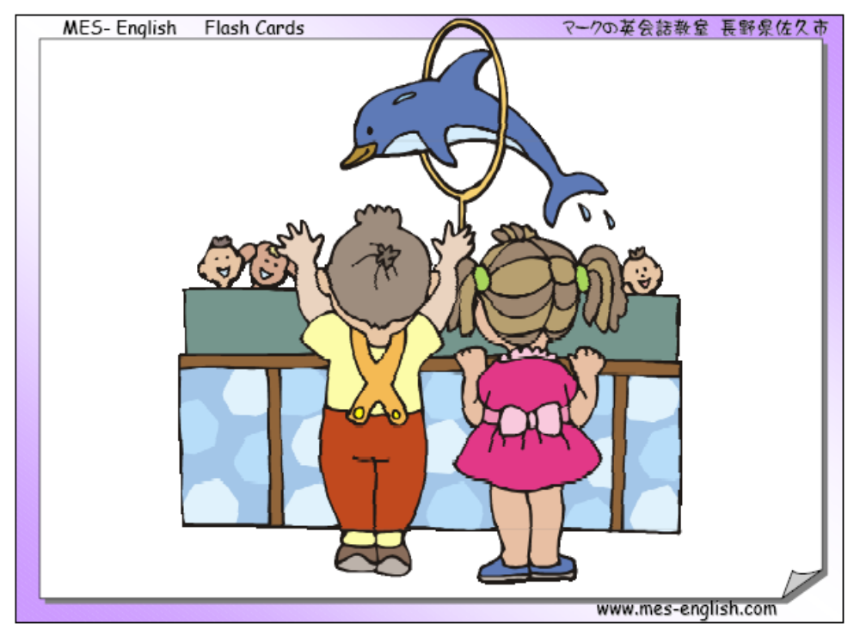
at the zoo

Slide 40
at the railway station

Slide 41
Bus stop №3
Trade Center Mega Actobe

Slide 42
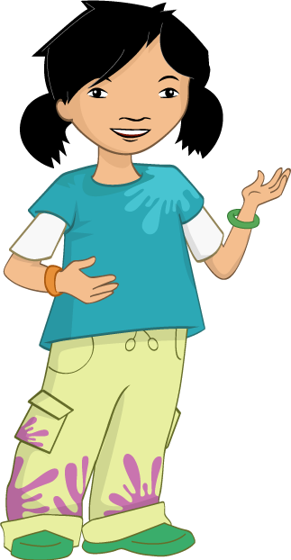
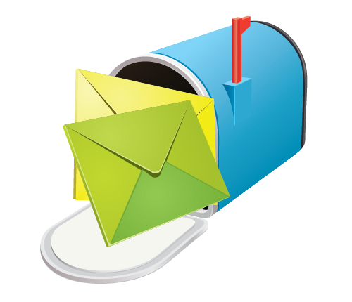
Here is a letter from Tom!

Slide 43
Bus stop №4
Abilkaiyr khan Avenue

Slide 44
Look, listen and remember!

Slide 45
Bus stop №5
Airport Actobe

Slide 46
Mission is completed!

