Slide 1
Welcome to Disneyland!

Slide 2
Have you ever heard about Disneyland?
Have you ever been to Disneyland?
Do you want to go there?

Slide 3
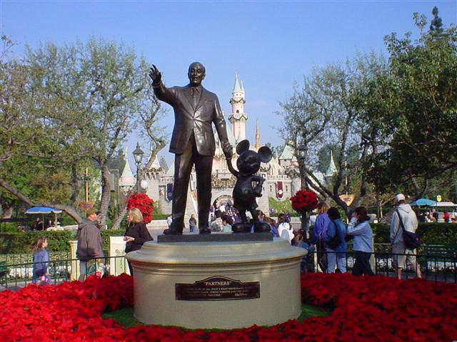
Dividing into groups:

Slide 4
Pronunciation check:
Park [ s ]
Ceremony [ k ]
Create [ a: ]
Magical [ ei ]
Acre [dз ]

Slide 5
Vocabulary work:
Ceremony - мейрам
Knowledge - білім
Create - жасау
Magical - сиқыр
Acre-акр (жердің өлшембірлігі)
Dusty - шаңды
Later - кейінірек

Slide 6
«To all who come to this happy place! Welcome. Disneyland is your land» Walt Disney said these words on July 17, 1955 at the opening ceremony of this park. Disneyland is a place where people find both happiness and knowledge.
Walt Disney told his friends a story about how, on Saturdays, he took his two daughters to parks and playgrounds. It was Walt Disney who created such a park. His «magical little park» twenty years later became the Magic Kingdom. He turned 160 acres of dusty orange place into the happiest place on the earth.

Slide 7

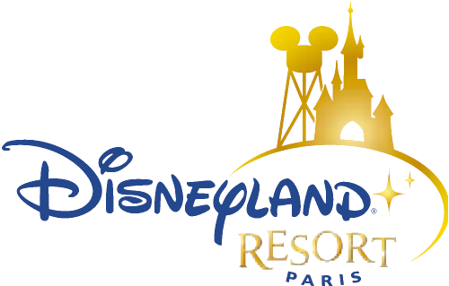
Comprehension check:
How old is Disneyland?
What kind of place is Disneyland?
Who created this park?
Whom did he take to parks and playgrounds?
Is it a big park?

Slide 8
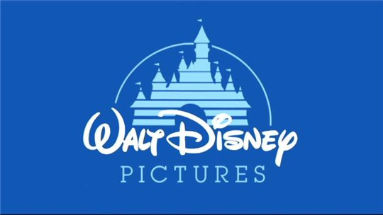
Working with a poster:

Slide 9
Grammar revision
There is …..
There are……

