Slide 1

Work
3b Speaking & Vocabulary

Slide 2
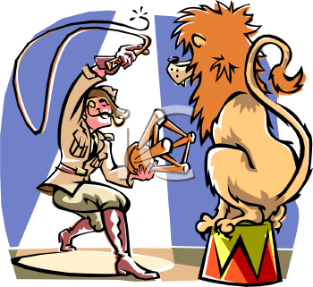
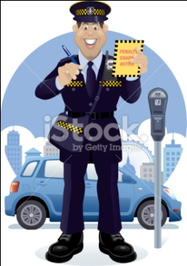
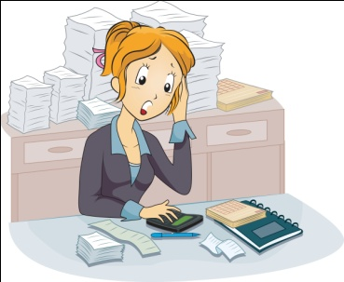


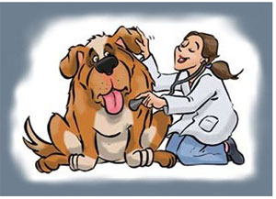
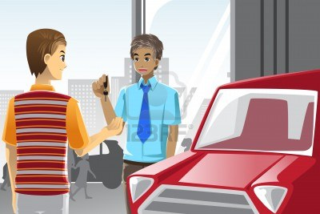
What do they do?
Sam
John
Author
Traffic warden
Vet
Artist
Lion tamer
Operator
Waiter
Air traffic controller
Architect
Graphic designer
Accountant
Cashier
Computer programmer
Pizza delivery boy
Car salesman
Sales assistant
Bank teller
Emily
Ben
David
Mark
Kim
might be ……..
I think ☺ is ……..

Slide 3
What field of science should
you study to become a (an) …..?
Natural
Science
Biology
Chemistry
Physics
Earth Science
Astronomy
Geography
Ecology
Social
Science
Psychology
Sociology
Education
Politics
History
Applied
Science
Computer Science
Health Science
Engineering
Management
Economics
Computer programmer
Accountant
Geologist
Teacher
Vet
You should study ….. to become a (an)….

Slide 4
Work dictionary
Freelancer – someone who works in his own company
Full-time – work all day and all week
Part-time – work half day or half week
Overtime – more work than usual
Shift – a period of work time when some people work during
the day and some work at night
Salary – amount of money from your job
Deadlines – specific time or date by which you have to do
something
Pay rise – amount of money for your job
p.44 Ex 2a

Slide 5
Lets talk about your parents job.
My mum has a ....... job as a (an) ........ She doesn’t have to wear a ........ at work. She recently got a .......
My dad is a (an) ......... He has a ..... job.
Use these words:
Freelancer
Full-time
Part-time
Overtime
Shift
Salary
Deadlines
Pay rise

Slide 6
Giving / reacting to news
your friend didn’t get a part-time job.
your friends mother got a promotion.
your friends father got a pay rise.
Giving good news
Giving bad news
Guess what! I've .....
I've got some good news. I .....
I've just ....
I'm going .... tomorrow.
I've just heard .....
I'm afraid .....
I'm sorry to say ....
I've got some bad news.
Reacting
That’s great. Well done!
Wow! That’s brilliant!
That’s fantastic.
Oh, no.
Really? What happened?
That’s too bad.
Really? ☺ must be very sad.

