Slide 1




English

Slide 2



Maths

Slide 3
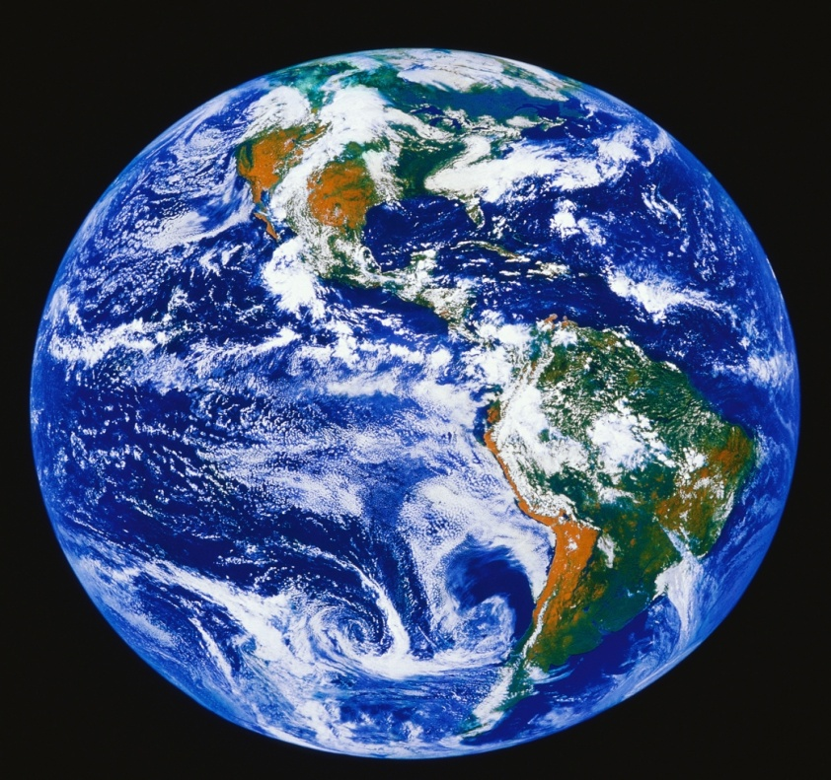

Geography

Slide 4
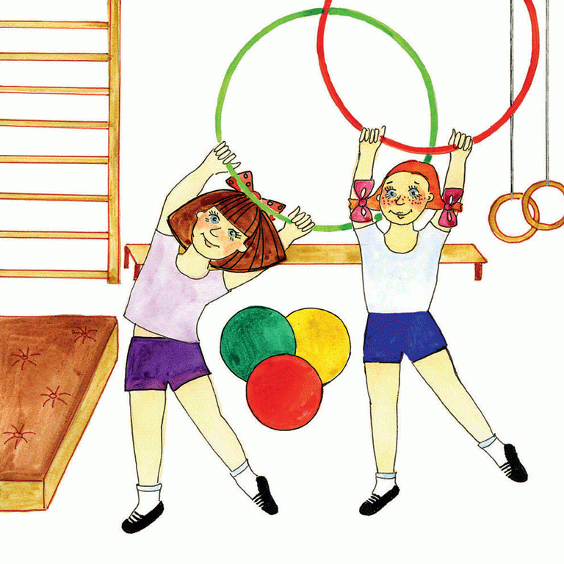


PE

Slide 5
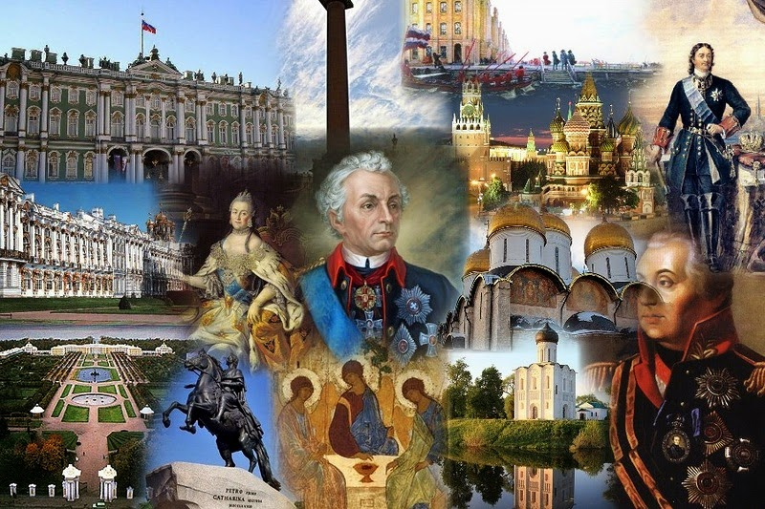
History

Slide 6




Science

Slide 7

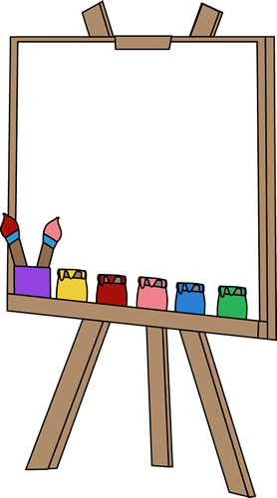

Art

Slide 8


Music

