Slide 1
SEE «Secondary school № 27»
«Mysterious Scotland:
Loch Ness monster – fact or fiction»
Students: D. Gusejnov
Form: 11 «A»
Teacher: E.V. Mordas

Slide 2
The problem:
whether there is Nessie?
The hypothesis:
we will suppose that Nessie really exists.
The subject of the research:
possibility of the existence of Nessie.
The object of the research:
information about Nessie.
The purpose:
to prove or disprove the existence of a monster in lake Loch Ness.

Slide 3
Tasks:
Studying of a special literature on this subject.
To define what is Nessie.
Clarify the possibility of the existence of Nessie in lake Loch Ness.

Slide 4
Methods:
Studying of a special literature and other sources
The analysis of the received information
Drawing up questioning and synthesizing the received data
Generalization

Slide 5
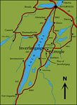
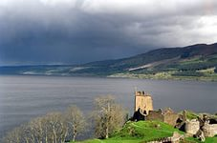
Geographical reference:
The territory of Scotland includes a northern third of the island Great Britain and adjacent islands - the Hebrides, the Orkneys and the Shetlands.
The lake Loch Ness is located in Scotland. Loch Ness is quite deep (230m) and big (65 sq. km). It is the lake of a glacial origin and it is located at a height of 16 meters above sea level. Loch Ness is famous for its Loch Ness monster, also known as Nessie.

Slide 6
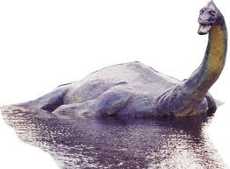
Nessie is a monster
What is Nessie?
According to different data the Loch Ness monster looks different. Someone thinks it is similar to a dinosaur, someone to a huge snake, someone to a huge lizard. Someone advances the idea that it is a huge crocodile. Those who believe in existence of the Loch Ness monster, consider that it is one of the survived plesiosaur.

Slide 7
In the footsteps of Nessie
People of nearby settlements are sure that at the foot of a hill, limiting the lake, there are enormous underground labyrinths. Sceptics, think that it is simply the legend. But, when the devices examined the bottom and shores of the lake, information was confirmed.
The operation «Deepscan» was also performed: Nessie was looked for with the help of sonars.
In 1979 American Jolly demonstrated very sensitive sonar designed by him, which tests were carried out in lake Loch Ness. This sonar noted schools of fish well, but it didn't find Nessie.
Grandiose attempts to reveal a secret of the well-known lake were made by the resident of London Adrian Shine. He organized the research of the lake by ten boats equipped with sonars. But because of the bad weather works were stopped.

Slide 8
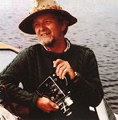
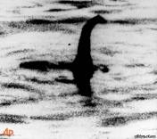
Proofs of the existence of Nessie
In 1960 even sceptics were convinced of the existence of "Nessie". During six days of perfectly organized search works the aviation engineer Tim Dinsdale was able to observe the animal, which floats on the surface of the lake.
Dinsdale photographed it on a 16-millimetric film. Records were subjected to a serious examination. All experts confirmed that the film is original.

Slide 9
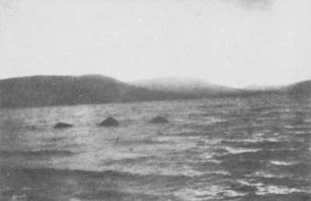
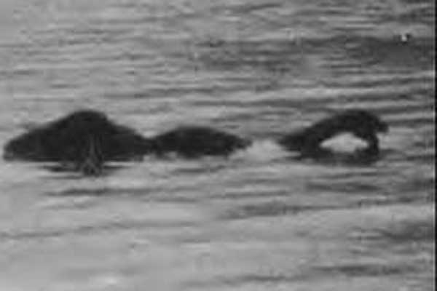
Photos that are made on a 16-millimetric film

Slide 10
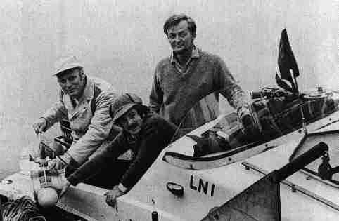
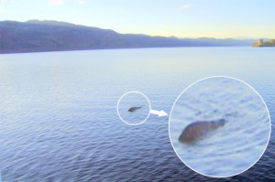
Dr. Robert Rines
In the 1970th years, doctor Robert Rines from Academy of Applied Science in Boston decided to use the sonar. He, together with his team, got pictures of what they called a "flipper, head and upper body" of the animal, which, in their opinion, can only be Nessie.

Slide 11
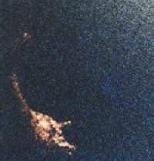
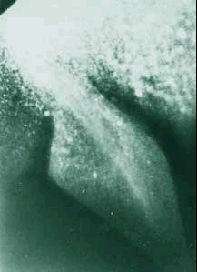
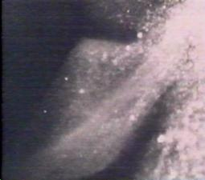
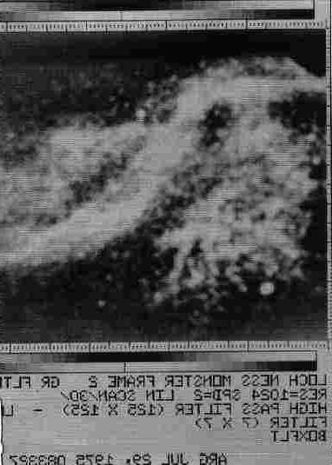
"flipper, head and upper body"
Robert Rines’ research work

Slide 12
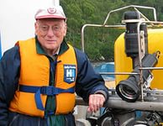
George Edwards
More than twenty years of his life George Edwards devoted to the search for the elusive Loch Ness Monster. He thinks that he achieved the dream. He even has a proof now – a great photo of a monster. He managed to take photo of a black spine from a board of his boat, which was shown several times on the surface of the lake. Its authenticity is confirmed by American military experts studying the Loch Ness monster, and the British expert on the observations of Nessie.

Slide 13
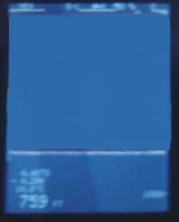
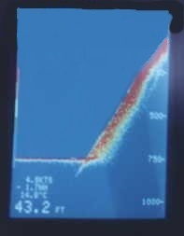
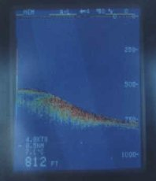
George Edwards
Loch Ness Monster Sonar Images

Slide 14
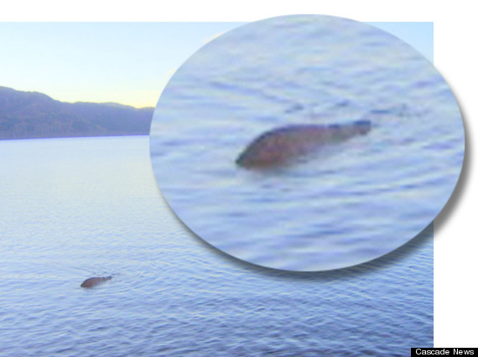
A mysterious dark hump moving in the water

Slide 15
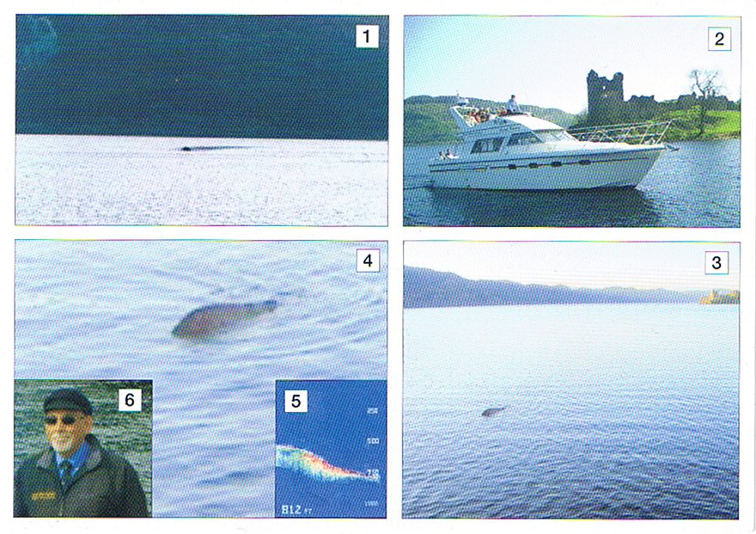

Slide 16
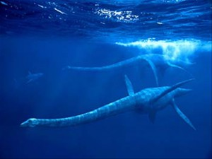
Historical prerequisites
The first mention of Nessie date back to the IV century BC. A first written mention of the mysterious creatures living in the waters of Loch Ness, refers to the 565 AD. In the description of the life of St. Columba an abbot Jonah talked about the victory over the holy "water beast" in the river Ness.

Slide 17
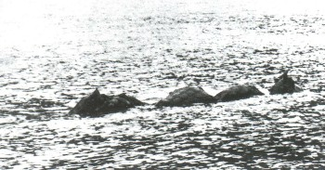
Some believe that the amateur photos in 1951 shows a giant creature with three humps on their backs

Slide 18
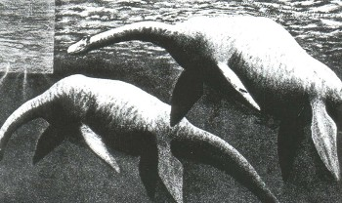
Perhaps "Nessie" is one of the most ancient creatures, related elazmozavram. Sea monster is still unexplained phenomenon

Slide 19
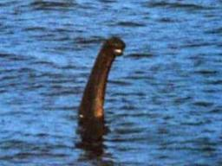
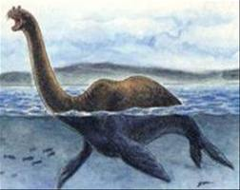
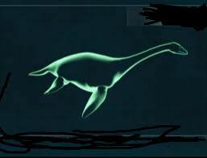
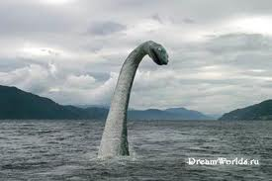

Slide 20
Counterarguments
In 2005, Neil Clark, the curator of paleontology at the Museum of the University of Glasgow, compared the first reliable data of the monster with the travel of the old circus on the road to Inverness. Clark believes that the first facts and photos of Nessie were taken from the elephants bathing and swimming in the lake. When the elephant swims, he takes the trunk on the surface. Also on the water surface two "humps" — the top of the head and the upper part of the back of an elephant are visible. The picture is very similar to descriptions and Nessie's photos.

Slide 21
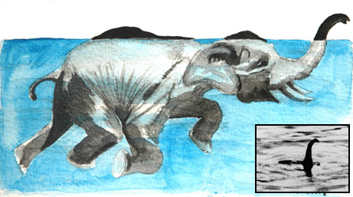
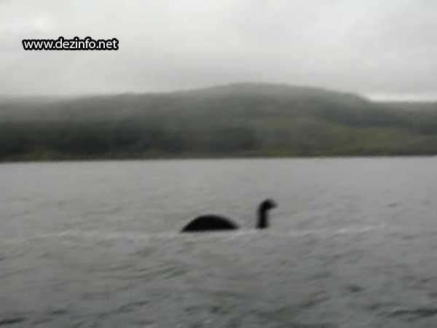

Slide 22
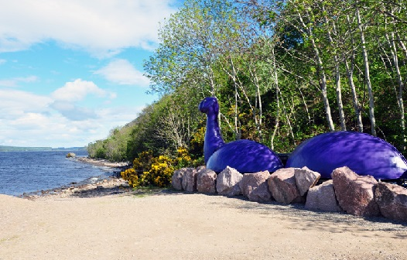
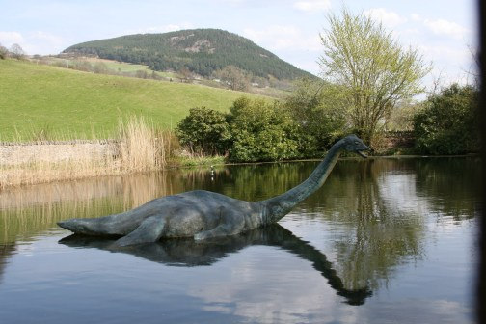
Counterarguments
Opponents of the theory of the existence of Nessie think that this legend is only successful use of the old fairy tale for advertising purposes and prosperity for tourism in these places.

Slide 23
Questioning
During the survey, the following results were received: 26% of respondents consider that Nessie exists to this day, 37% - that a monster existed earlier, 37% - doubt of its existence.
From the results of questionnaires, it is clearly that many people have heard of Nessie and believe that it could survive; some of them think that it is a legend, and thus some do not even know what Scotland is.

Slide 25
№ problem | A Yes | B No | C | D | respon- dents
1. Scotland is A) a part of the UK B) a part of France) a separate country | 76 | 14 | 10
2. Have you heard about Nessie? | 93 | 7
3. You think Loch Ness Monster is A) a dinosaur B) just a legend) fiction for tourists d) other | 12 | 34 | 25 | 29
4. What do you think Nessie could survive to the present day? | 50 | 50 |  |  | 100
5. Can it placed in lake Loch Ness? | 67 | 33
6. Do you think Nessie has its family? | 38 | 62
7. Is there any food for Nessie in the Loch Ness? | 76 | 24
8. May lake Loch Ness fall into the ocean? | 32 | 68
9. When was the first mention of the Loch Ness monster? | 45 | 15 | 40
10. You think Nessie A) exists B) existed) has never existed | 26 | 37 | 37

Slide 26
Conclusion
Using the information and the results of the questioning we found out that Nessie is likely to exist. The hypothesis made at the beginning of our work was confirmed. This is supported by the numerous eyewitness’s accounts, photographs, the authenticity of the last examination, the testimony of radar and sonar, geological features of the location of Loch Ness. These facts cannot be a conclusive evidence of the hypothesis but they confirmed it indirectly.

Slide 27
Thanks a lot for your attention!

