Slide 1

Travelling to English land

Slide 2

The plan of the competition:
- Station of lexics
- Station of grammar
- Station of Post office
- Station of tongue- twisters
- Station of Who am I?

Slide 3
Station of lexics
match these proverbs to their equivalents in Russian:
1. Без труда не вытащишь и рыбки из пруда
2. Друг познается в беде
3. Лучше синица в руках, чем журавль в небе
4. В здоровом теле здоровый дух
5. Не все золото что блестит
6. Нет дыма без огня
a) A sound mind in sound body
b) A cat in gloves catches no mice
c) There is no smoke without fire
d) A friend in need is a friend indeed
e) A bird in the hand is worth two in the bush
f) All is not gold that glitters

Slide 4
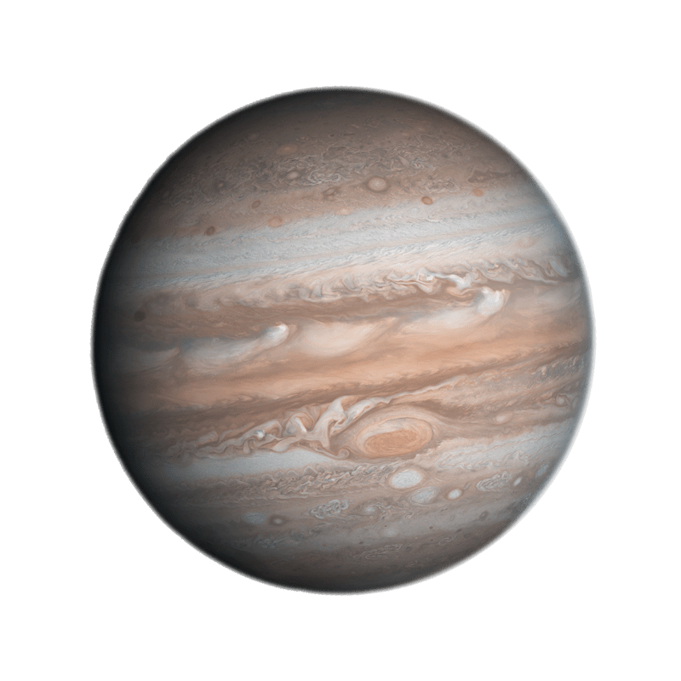

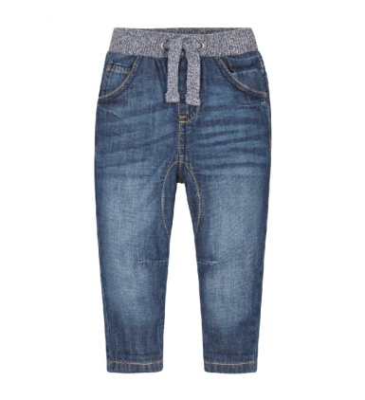
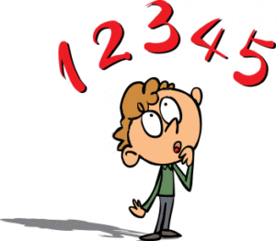
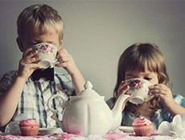
Station of grammar
Make sentences :
1) is, from , Zenna , a , different ,planet.
2) they ,to, do ,have , wear , uniform , a?
3) jeans, Nadia’s , bigger , mine, are ,than
4) the, difficult, subject, is , Maths , most , me, for .
5) you, drinking , now , are, tea ?

Slide 5
Station of Post office
find mistakes and tell the correct variant:
Deer Masha!
Thank you four your letter. I am so glad what you wrote to I! Everyone is phine with me. I am prepare for entrance examz to the university. I would love to invite you to came and watch me next weak . Please let me know if this is convenient four you. I hope to sea you soon.
Your Sarah.

Slide 6
Station of tongue –twisters
If you, Sandy, have two candies
Give one candy to Andy, Sandy
A cup of coffee from a copper coffee pot
A little pot is soon hot
Seven Santas sing silly songs
She sells sea shells on a sea shore

Slide 7



Station
Am I big? – No
Am I an animal? –Yes
Do I live at home ? – Yes

Slide 8


