Slide 1
Презентация по английскому языку для 8 класса к уроку “Writing dossier. A personal description.” Unit 9 “ Body and Soul”. Учебник Английский язык 8 класс, авторы Ю.А.Комарова, И.В.Ларионова, К.Макбет.
Кравцова Наталья Егоровна

Slide 2
A personal description
Writing dossier
Aim: To write a personal description from a photo, after reading a model and practising planning compositions.
Кравцова Наталья Егоровна

Slide 3
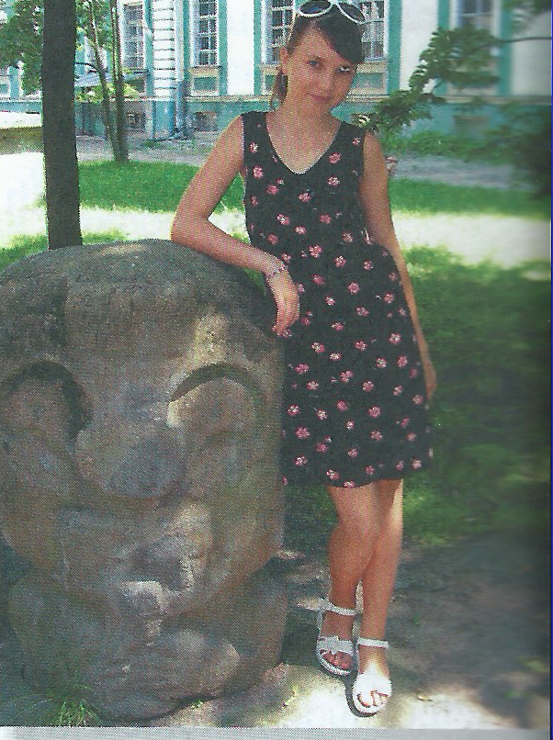
Where is the girl?
What is she doing?
What's she wearing?
How does she look?

Slide 4
Personal description
Plan
paragraph
2. paragraph
3. paragraph
When was the picture taken?
Where was it taken?
introduction
Who by?
What clothes is the girl wearing?
physical description
Is she wearing any jewellery?
Does she look happy? Why? Why not?
Does the picture reflect her personality?
character
Why has she kept
this picture?

Slide 5
Find the answers in the description
When was the picture taken?
Where was it taken?
Who by?
What clothes is she wearing?
Is she wearing any jewellery?
Does she look happy? Why / Why not?
Does the picture reflect her personality?
Why has she kept this picture?

Slide 6
This picture was taken last summer when I was 14 years old. I think the picture was taken by my mother. As you can see, I'm in the park behind the Kunstkamera museum. I was on holiday with my family in Saint Petersburg. In this photo I'm wearing a flowery dress. I'm also wearing a silver chain and silver earrings which were given to me by my best friend. I think they were made in Asia, in this picture I'm wearing a bracelet which I bought in a craft shop in Peterhof. I really like it. I think I look happy in this picture. I was on holiday so I was feeling very relaxed. This picture reflects my personality because I'm usually quite easy-going and I don't get stressed very often. I've kept the picture because it reminds me of being on holiday!
Divide the text into three paragraphs according the plan

Slide 7

1. This picture was taken last summer when I was 14 years old. I think the picture was taken by my mother. As you can see, I'm in the park behind the Kunstkamera museum. I was on holiday with my family in Saint Petersburg.
2. In this photo I'm wearing a flowery dress. I'm also wearing a silver chain and silver earrings which were given to me by my best friend. I think they were made in Asia. In this picture I'm wearing a bracelet which I bought in a craft shop in Peterhof. I really like it.
3. I think I look happy in this picture. I was on holiday so I was feeling very relaxed. This picture reflects my personality because I'm usually quite easy-going and I don't get stressed very often. I've kept the picture because it reminds me of being on holiday!

Slide 8
Planning your writing
Always plan your composition before you start writing. Follow these steps:
Decide how many paragraphs to use.
Make notes for each paragraph (you can use a plan to help organize your ideas).
Decide where you can include some vocabulary and grammar from the unit.

Slide 9
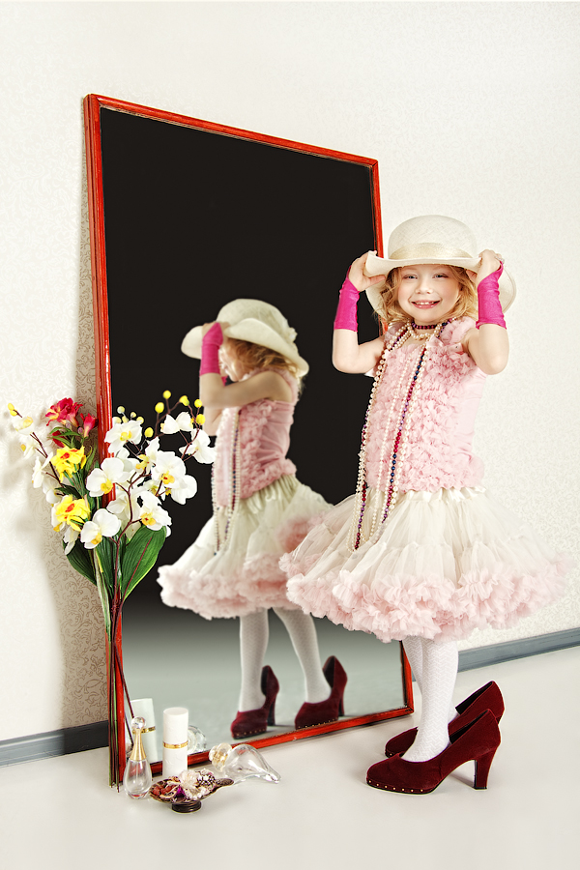
Describe the picture according the plan
1. This picture was taken when I was 6 years old. I think the picture was taken by my sister. We were alone at home. Our parents were out. As you can see, I am trying my mother`s clothes on.
2. In this photo I'm wearing a pink dress. I'm also wearing a white hat. I think It was made of straw. My mum bought it in Sochi. Mum`s shoes look ridiculous on my feet. in this picture I'm wearing red and white neckllaces. I like them.
3. I think I look happy in this picture. This picture reflects my personality because I am always in trend and like dressing up. I've kept the picture because it is full of positive emotions, and it makes me think of it reminds me happy moments of my life.

Slide 10
Homework
Write the description of your photo

