Slide 1
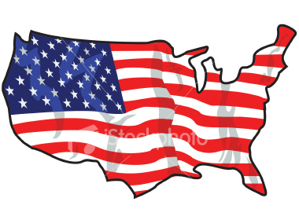
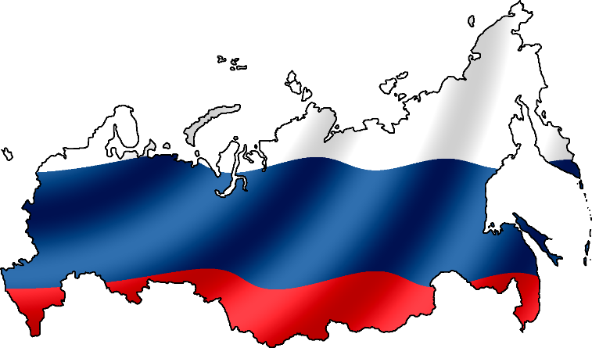
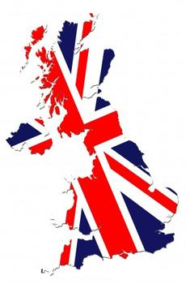
What countries will we say today on the lesson about?

Slide 2
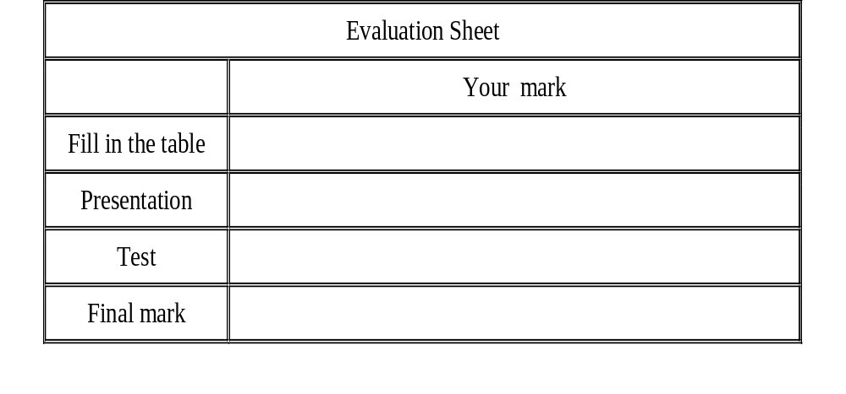
Your aim is honestly evaluate your work by the end of the lesson

Slide 3
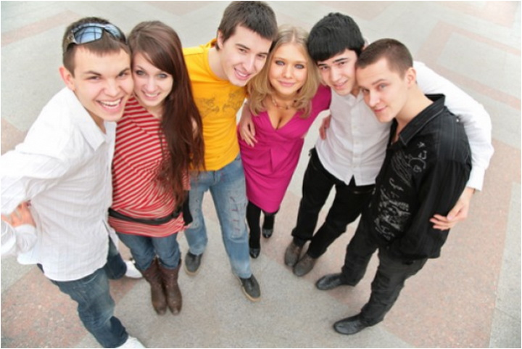
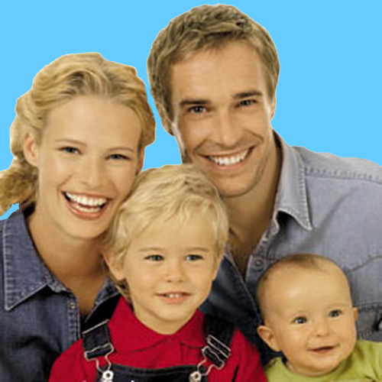

WHERE ARE YOU FROM?

Slide 4
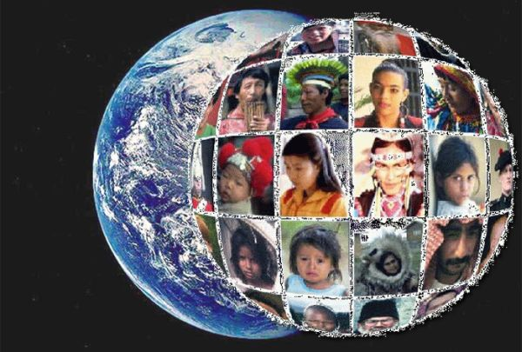
WE LIVE IN A GLOBAL VILLAGE.

Slide 5
GLOBALISATION
means that international trade, cultural exchange, and interdependence of countries increase rapidly

Slide 6
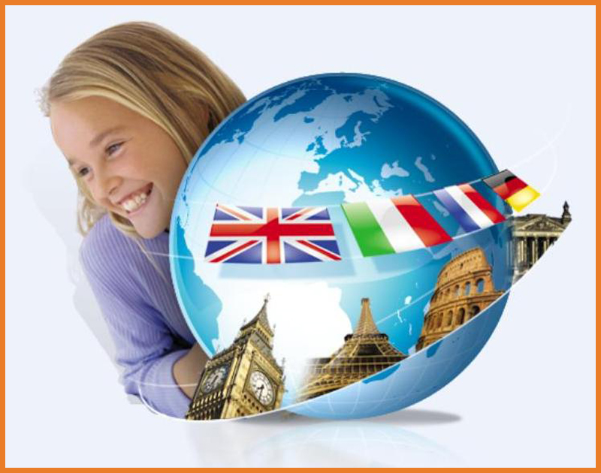
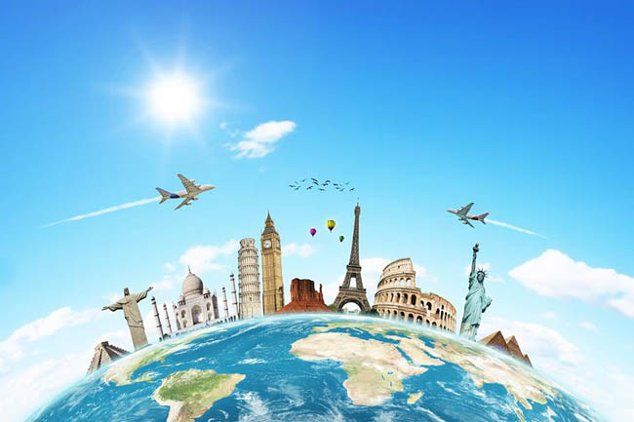
“Knowledge of other people is a key to mutual understanding.

Slide 7
FILL IN THE TABLE:
Name of the country
Official name of the country
Capital
Area
Official language
Form of government
Head of government
The largest and major cities
The famous sights of this country
Parts
Location
Boarders
Highest mountain
Longest river
Deepest lake

Slide 8
THE UK
Name of the country | Great Britain
Official name of the country | The United Kingdom of Great Britain and Northern Ireland
Capital | London
Area | 244 thousand sq. km.
Official language | English
Form of government | Constitutional monarchy
Head of government | Queen of the UK is Elizabeth II Prime Minister of the UK is David Cameron.
The largest and major cities | London, Cardiff, Edinburgh, Belfast, Birmingham, Glasgow
The famous sights of this country | The Houses of Parliament, Westminster abbey, Tower of London, Buckingham Palace, Trafalgar Square, Windsor castle, Stonehenge
Parts | Four historic parts: England, Scotland, Wales and Northern Ireland
Location | the north – west coast of Europe
Boarders | Ireland, France, the Netherlands, Belgium Scandinavian countries by sea
Highest mountain | Ben Nevis
Longest river | the Severn
Deepest lake | Lough Neigh

Slide 9
THE USA
Name of the country | America
Official name of the country | The United States of America
Capital | Washington D.C.
Area | 9 million sq. km.
Official language | English
Form of government | presidential republic
Head of government | the President of America is Barack Obama
The largest and major cities | New York, Atlanta, Boston, Houston, Chicago, Detroit, Philadelphia, Los Angelis, San Francisco, Baltimore
The famous sights of this country | The White House, The Capitol, Washington National Cathedral, The Statue of Liberty, Hollywood, Disneyland, Mount Rushmore,
Parts | 50 states and the District of Columbia
Location | the southern part of North America
Boarders | Canada (in the north), Mexico (in the south) and Russia by sea
Highest mountain | Mount McKinley, in Alaska, 6194 meters
Longest river | the Mississippi-Missouri, 6019 kilometers
Deepest lake | Superior

Slide 10
THE RF:
Name of the country | Russia
Official name of the country | The Russian Federation
Capital | Moscow
Area | 17 million sq. km.
Official language | Russian
Form of government | PRESIDENTAL REPUBLIC
Head of government | President is VLADIMIR VLADIMIROVICH PUTIN
The largest and major cities | St Petersburg, Nizhni-Novgorog, Rostov-on-Don, Samara, Tver, Volgograd, Omsk, Novosibirsk, Chelyabinsk, Perm
The famous sights of this country | The Kremlin and Red Square, St Basil’s Cathedral, the Pushkin Museum of Fine Arts, Tretyakova Gallery
Parts | 22 republic, 9 territories, 46 province, 4 autonomous areas, 1 autonomous region and 3 cities of federal importance
Location | the eastern part of Europe and the northern part of Asia
Boarders | China, Mongolia, Korea, Kazakhstan, Georgia, Azerbaijan, Norway, Finland, the Baltic States, Belorus, the Ukraine and USA by sea
Highest mountain | Mount Elbrus
Longest river | the Lena
Deepest lake | Lake Baikal

Slide 11
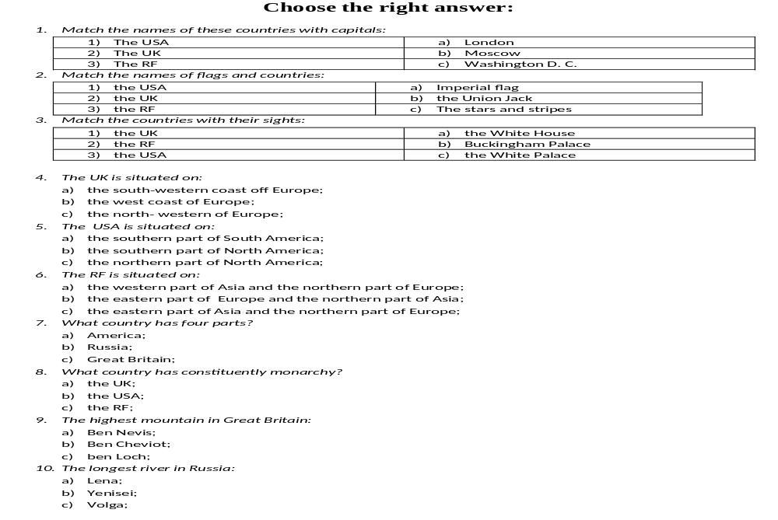
TEST

Slide 12
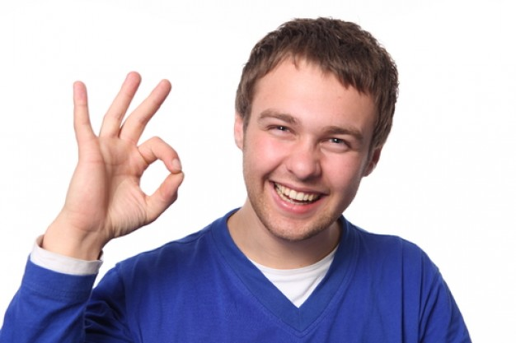
Check the answers of the test:
1c, 2a, 3b.
1c, 2b, 3a.
1b, 2c, 3a.
4c.
5c.
6b.
7c.
8a.
9a.
10a.

Slide 13

THANK YOU FOR HARD WORK!

