Slide 1
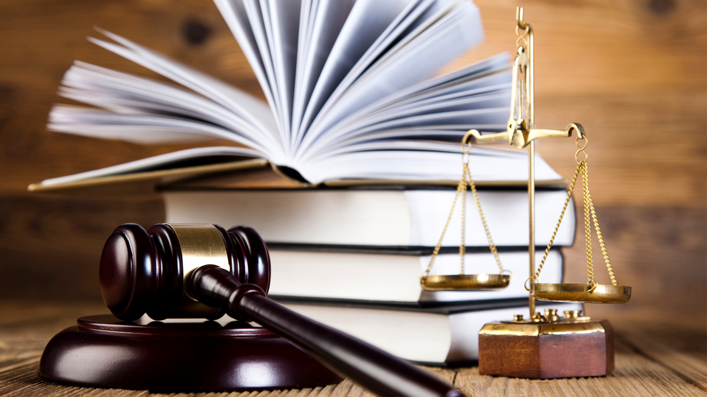

Slide 2
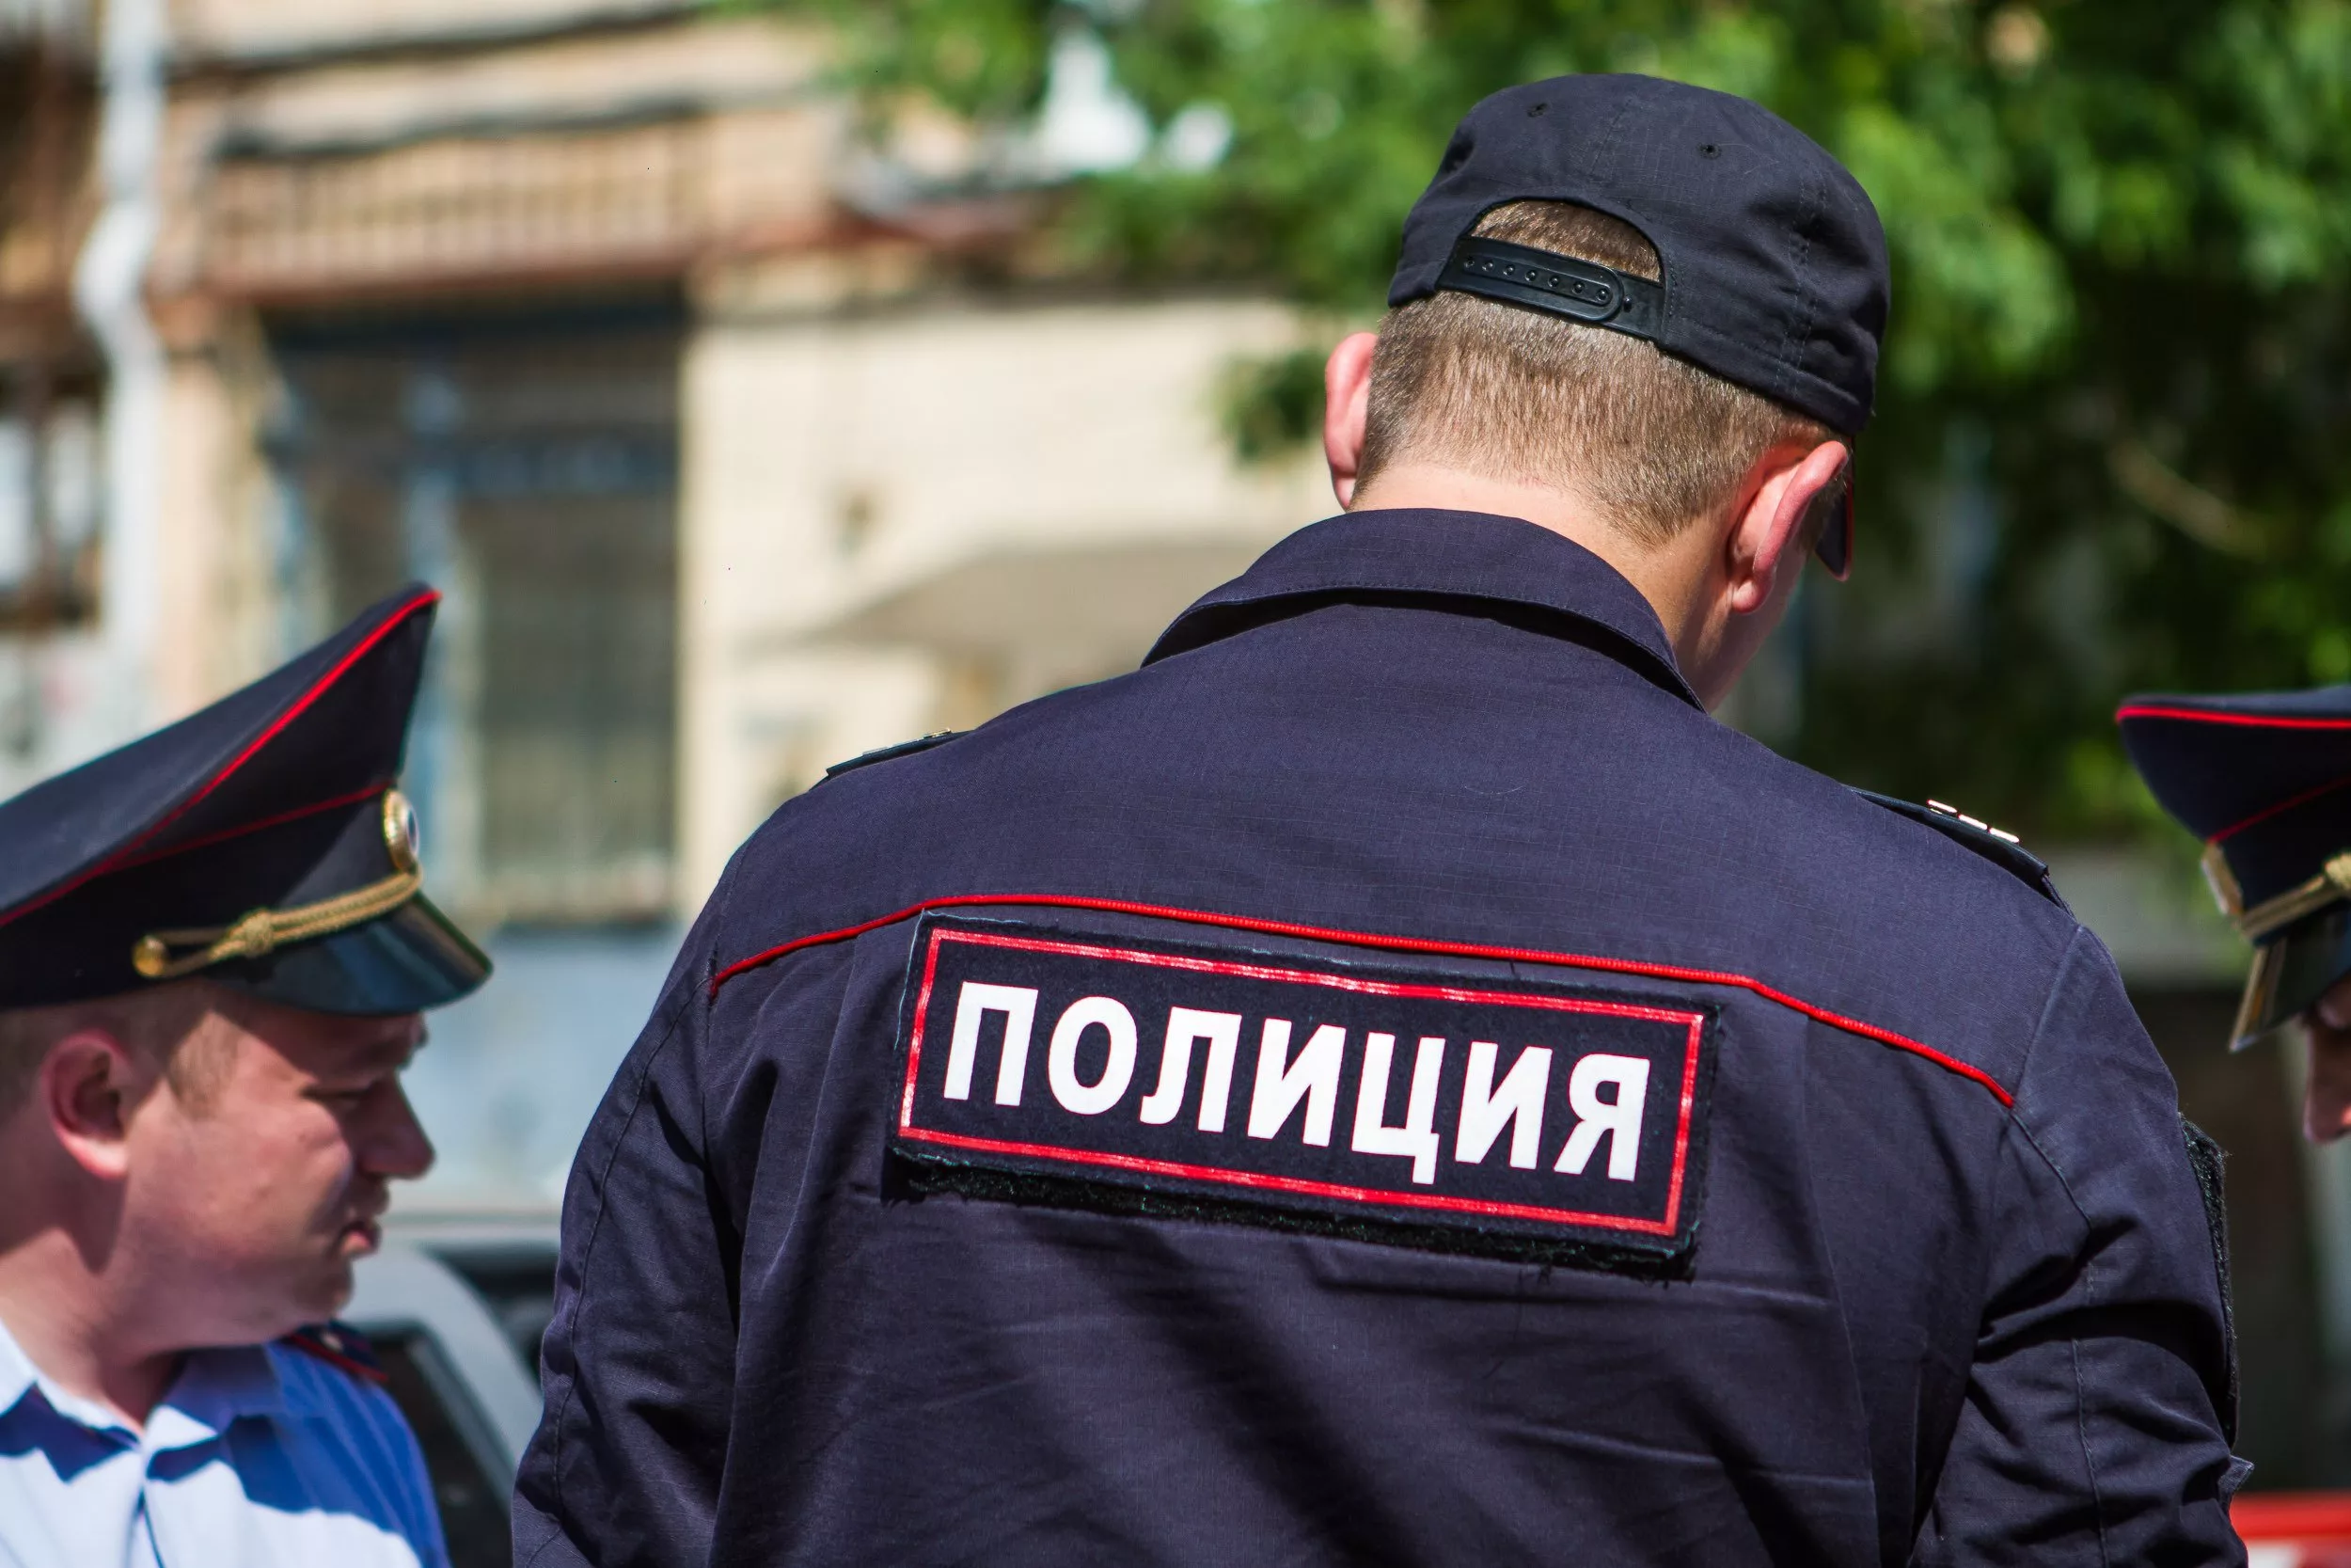
Policeman
Police – the chief guardian of public order. No big event is possible without the police. And in other days the police are on duty patrolling the streets of each city.

Slide 3
description of activity
A police officer ensures that the health and property of law-abiding citizens were safe. Those who violate the law, police is acting a little differently. While police accepts full responsibility for the offender and therefore can not inflict bodily injury (to use force is allowed only in extreme cases).
The officer also conducts lectures and talks in various organizations (including among children), examines incoming complaints.

Slide 4
THE RELEVANCE OF THE PROFESSION
Currently, the occupation of Police officer is considered to be very much in demand in the labour market. Many firms and many businesses need highly-qualified specialists in this field, because the industry is evolving quickly, and the specialists still get their education.

Slide 5
Attorney, Description of the profession of lawyer
The main aspects of the activities of the lawyer:
The study and application of the existing laws, acts, treaties.
Legal advice, provision of information, explaining the problem and some of its components.
The provision of legal protection of citizens of the state.
Proper preparation of applications, complaints and other documents of legal content.
Request references through legal advice, or other documents for the provision of professional legal assistance (Request made from public or government organizations, which are obliged to provide documents on demand).
Drafting of appeals on behalf of the client of the issues it addresses.
The collection of information in favor of the client through examinations, experiments, expert opinions, witness testimony.
Providing the client with information on the progress of the case, the answers to your questions and clarify details of the material.
Create appointments with the client in place of its finding to clarify issues mitigating his guilt.
Approval of measures on issues of interest to justify the client.
Continued support of human rights protection during investigation of the case.

Slide 6
Features of the profession of lawyer
What is special about the job and where he can apply his knowledge? To date, the lawyers have a choice: he can lead their activities individually, to open his own law office, and to unite with its partners in the Association, law firm.
The desire to protect, provide competent legal assistance in the shortest possible time, a daily desire to achieve justice – this is the primary mission of a professional lawyer. He is obliged to put his work to his competence and skill was never in doubt from its clients. Because to defend is always easier than to restrict.
Advocacy requires full storage of the information it receives from the client, because the opposite entails the loss of the title bar.

Slide 7
Requirements of the profession of lawyer
A successful lawyer must possess qualities such as:
Performance;
Reliability;
Logical thinking;
Friendliness;
Stealth;
Responsibility;
The flexibility of the mind;
Accuracy;
Initiative;
Mathematical ability;
Analytical thinking;
Deductive reasoning;
The ability to control emotions.
The profession of lawyer can be obtained after finishing law school, College or even courses.

Slide 8
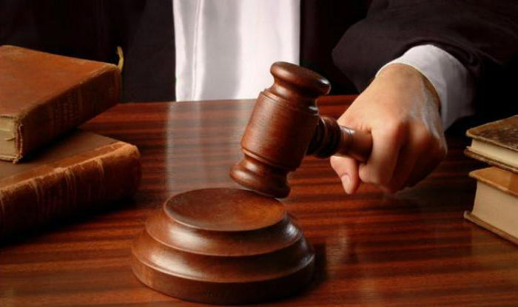
Judge
The judge called the person in making decisions and bearing responsibility for them in different disputable situations. His expertise can login as ordinary litigation between family and criminal cases. The judge must make impartial decisions. It should be based only on the Constitution and the laws of the state. This position is separate from the apparatus of the state.

Slide 9
Features
The features of professional judges rather peculiar. Consider them in detail:
State the nature of the activity.
The court addressed the rights of citizens and their interests, so the judge must fully comply with the norms of morality to be principled and objective.
In this profession it is extremely important independence and subordination only to the law.
The judge is solely responsible for decisions.
Judges hold public meetings, so their objectivity, independence and accuracy of decisions controlled by the public.

Slide 10
Military justice officer. Responsibilities
Military lawyers deal with various issues, including problems of international law.
The investigators are engaged in investigation of criminal cases, where suspects/accused are military personnel.
Military Prosecutor's office oversees the FSB, border troops, troops of the interior Ministry. Monitor compliance with legality in all organizations with military units.

Slide 11
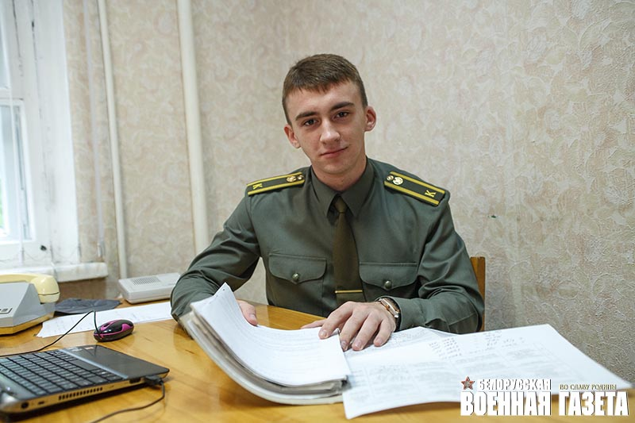
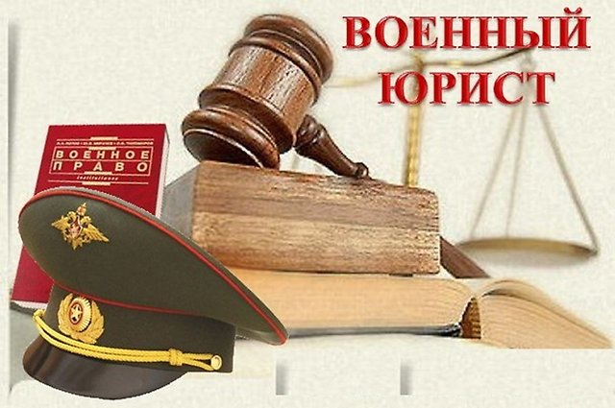
Important qualities
In the profession important qualities are: analytical mind, good memory, ability to build logical chains, persistence, confidence, communication skills.

Slide 12
