Slide 1
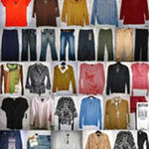
Clothes

Slide 2
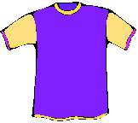

a T-shirt
a shirt

Slide 3
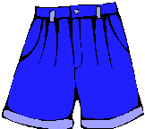

shorts
a coat

Slide 4
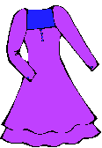
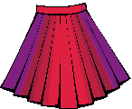
a skirt
a dress

Slide 5
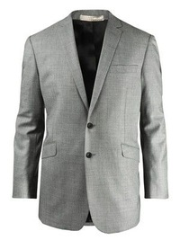
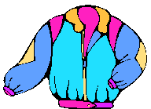
a jacket

Slide 6
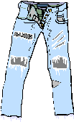
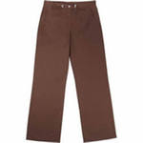
jeans
trousers

Slide 7
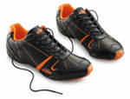

a hat
trainers

Slide 8
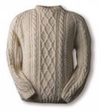
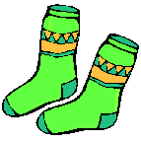
socks
a jumper

Slide 9
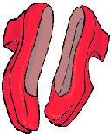
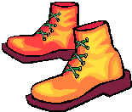
shoes
boots

Slide 10
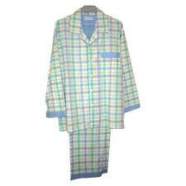
pyjamas

Slide 11
Fill in the letters:
T-sh…rt
s…orts
d…ess
sk…rt
je…ns
clo…hes
h…t
so…ks
b…ots
sh…es
…
i
t
h
a
r
c
i
o
a
o

Slide 12
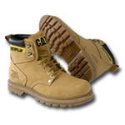
Complete the crossword:
 |  |  |  |  | c
 |  |  |  |  | l
 |  |  |  |  | o
 |  |  |  |  | t
 |  |  |  |  | h
 |  |  |  |  | e
 |  |  |  |  | s
1.
s
o
k
s
2.
b
o
t
s
3.
c
o
a
4.
a
t
5.
d
r
s
s
6.
t
r
o
u
e
r
s

Slide 13
What is it?
Match:
Example: 1. b)
1
2
3
a) a coat
b) shorts
c) jeans
d) a dress
e) a T-shirt
a hat
a jumper
h) a skirt
i) a jacket
boots
4
6
5
7
8
9
10

Slide 14
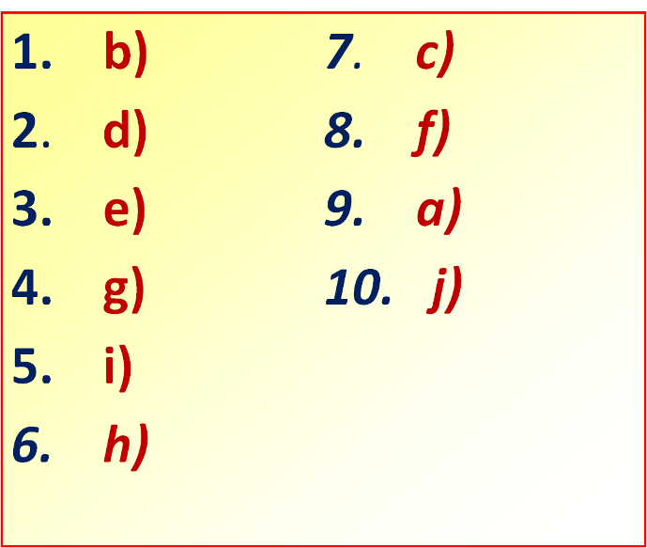
Check:

